Slide 1

SmartScrape
Sanjay Balan G

Slide 2

Introduction:
Project Objectives:
The objective of this project is to create a pipeline for scraping content from Wikipedia, processing it into vector embeddings, storing it in a Milvus vector database, and querying the data via a FastAPI interface. Google Generative AI embeddings are used for semantic understanding of the content.
Overview of Workings:
Input: A Wikipedia URL is provided by the user.
Scraping: The page content is scraped using BeautifulSoup (handled in scrap.py and web_scrap.py).
Embedding: The scraped content is embedded using Google Generative AI.
Storage: The embeddings are stored in Milvus (handled in app.py).
Querying: Users can ask questions about the stored content via FastAPI, which searches Milvus and generates answers based on the embedded data.

Slide 3
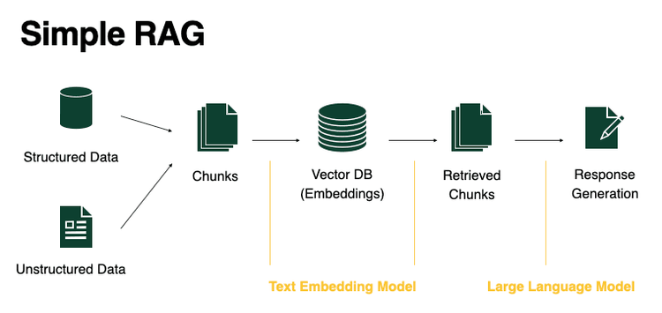
Data Processing and Workflow Architecture :

Slide 4
Detailed Overview – Step-by-Step Process :
Step 1: Scraping Wikipedia
File: scrap.py
Purpose: Scrapes the main content (paragraphs and headings) from Wikipedia using requests and BeautifulSoup.
Output: Cleaned text ready for embedding.
Step 2: Embedding and Storing in Milvus
1.Chunk Splitting:
Purpose: After scraping the text, it is split into manageable chunks using RecursiveCharacterTextSplitter.
2. Embedding:
The text chunks are processed into embeddings using Google Generative AI models.
3. Storing in Milvus:
The embeddings are then stored in Milvus, a vector database that supports efficient similarity searches for later querying.

Slide 5
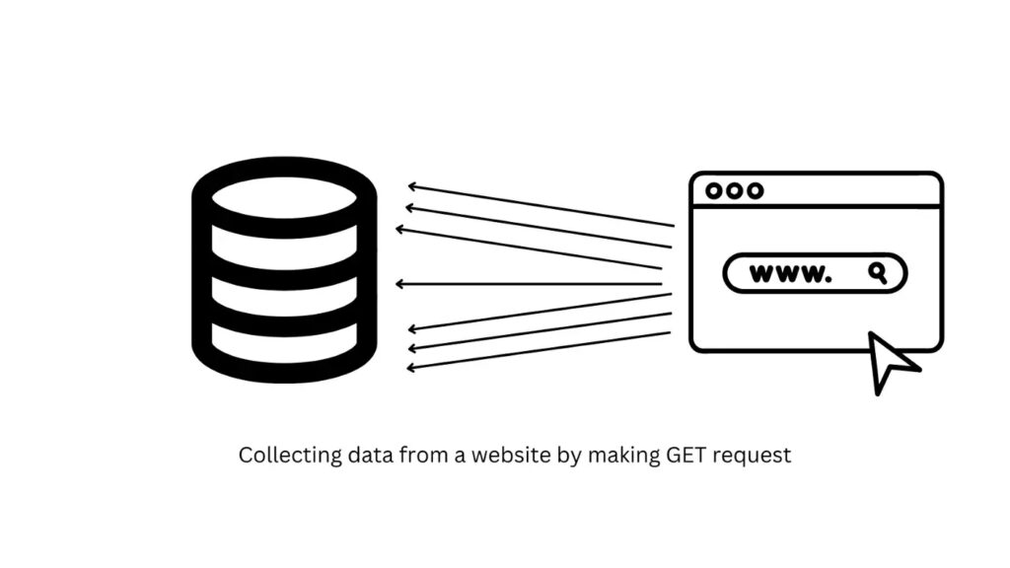
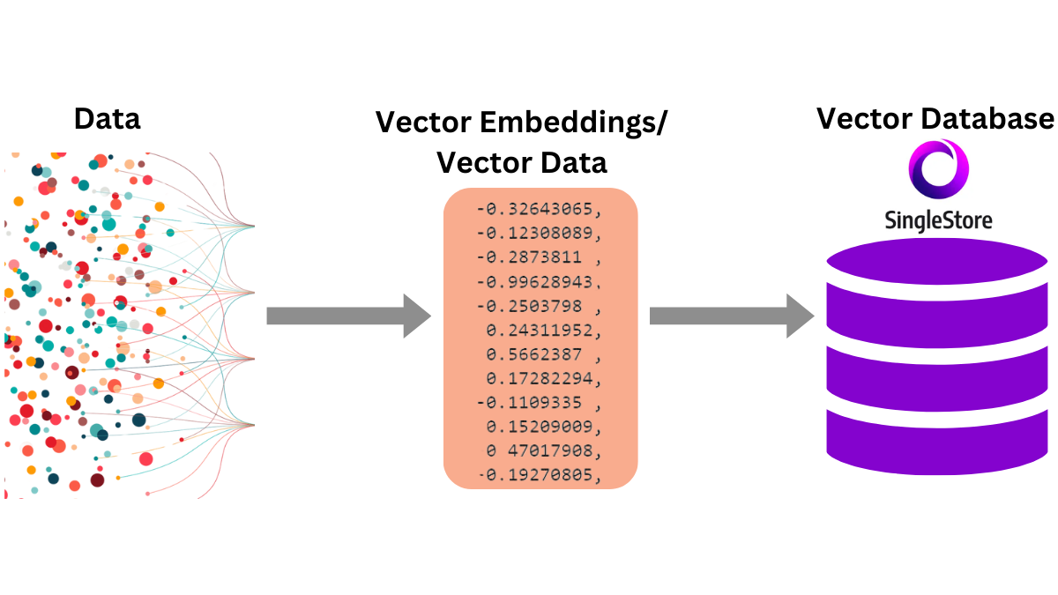
Data Processing and Workflow Architecture :
Web Scraping
Vector Embedding

Slide 6
Step 3: Conversational Chain Based on Prompts:
Prompt Usage:
Commanding the AI: The prompt template is designed to instruct the AI to only respond with answers from the provided context. If the answer is not found in the content, the AI is instructed to respond with "the answer is not available in the context". This ensures accuracy and prevents the AI from giving irrelevant or misleading information.
Step 4: Querying the Content:
Endpoints:
/scrape (POST): Scrapes a Wikipedia page, processes, and stores it in Milvus.
/ask (GET): Allows users to query the stored embeddings and receive detailed responses.

Slide 7
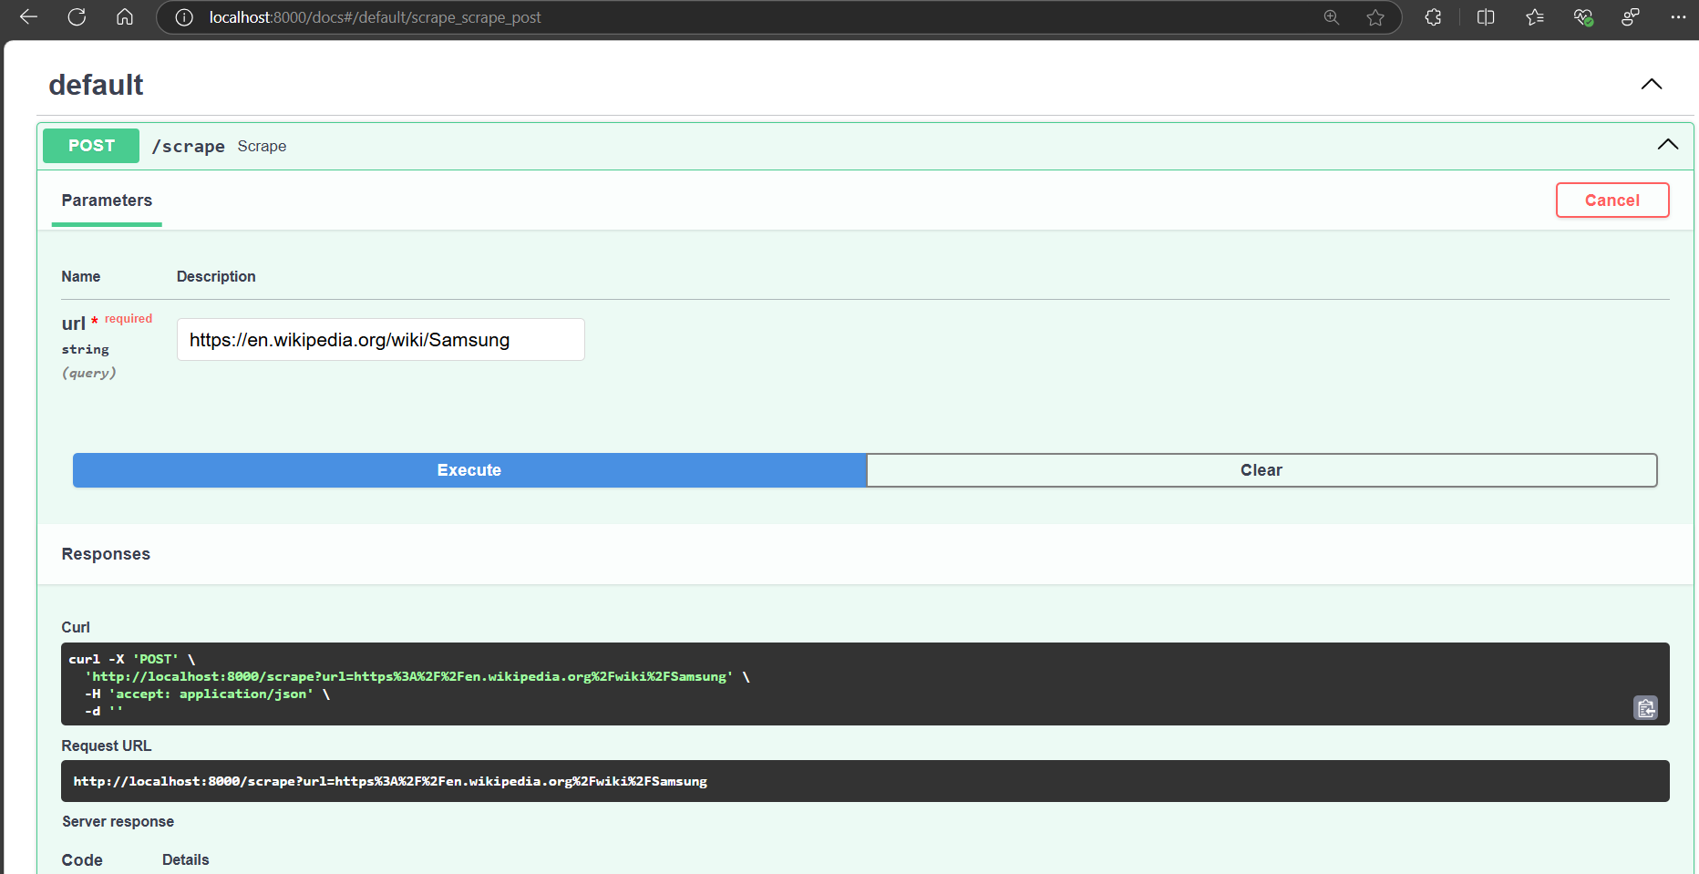
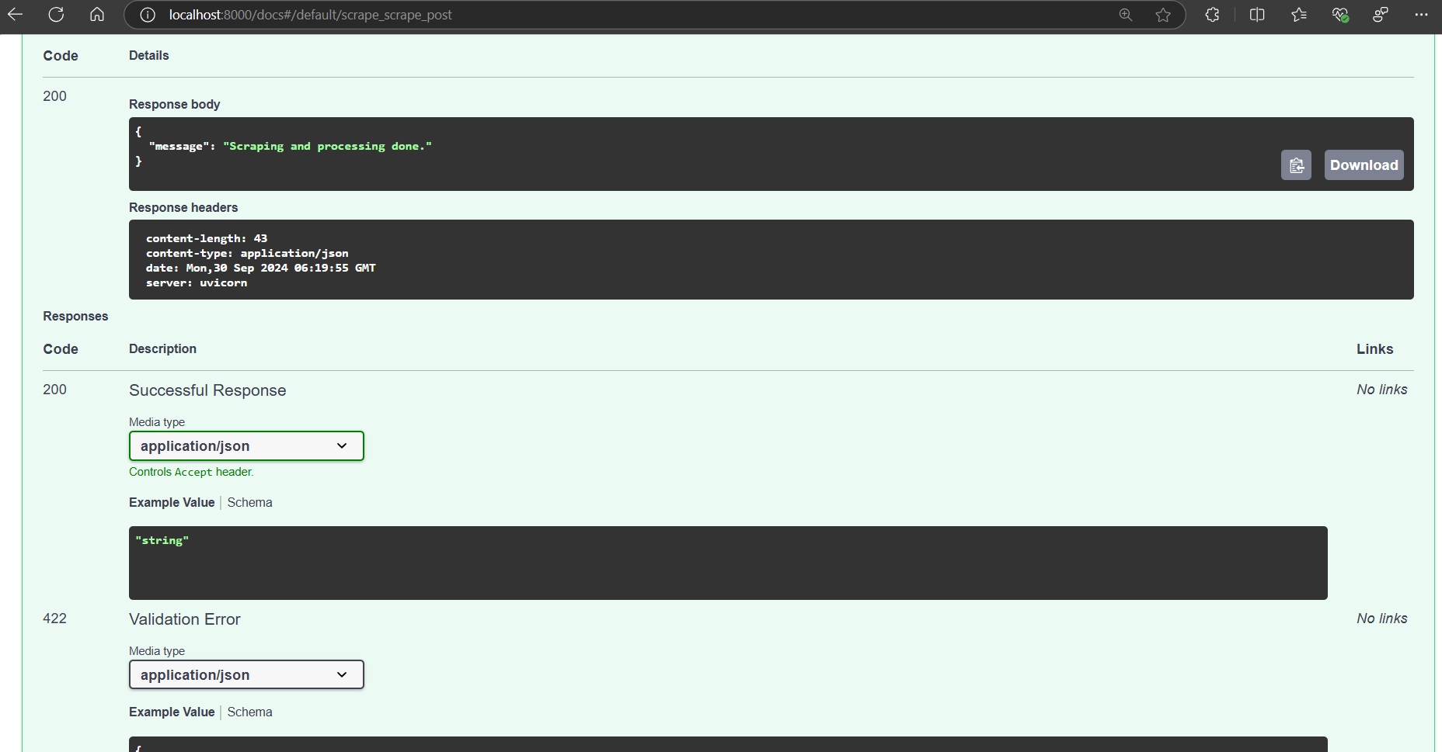
Output:
This screenshot displays the list of input URLs that were targeted for scraping. Each URL indicates a specific webpage from which content will be extracted. The message "successfully scraped" confirms that the content from these URLs was retrieved without any issues. This is a crucial step in ensuring that the data collection process is working as intended.

Slide 8
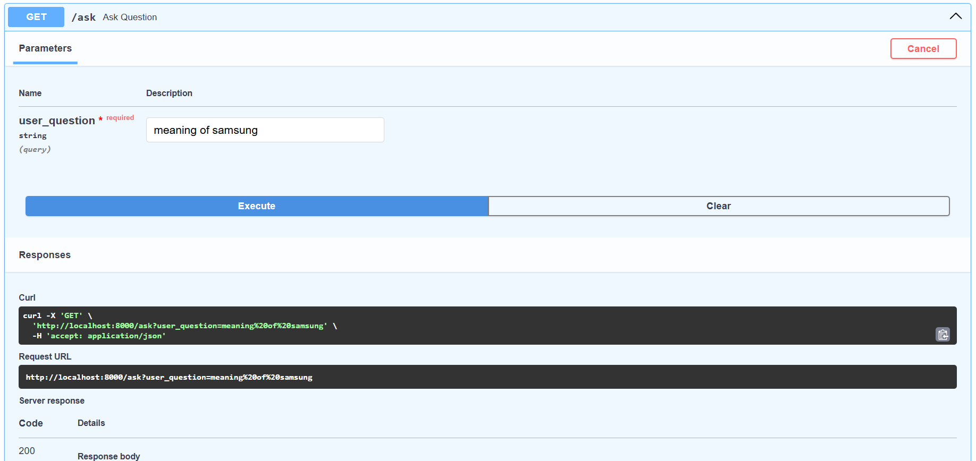
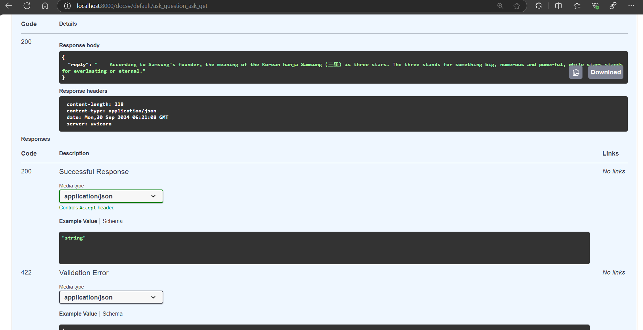
Output:
In this screenshot, the system is demonstrating its capability to process a query against the scraped content. By entering a specific question related to the information gathered, the application can intelligently analyze the content and provide a relevant answer

Slide 9
Real Time Applications:
1. Knowledge Management Systems:
Companies or organizations can scrape internal documentation, store it as embeddings, and enable employees to query for specific information. This system would ensure accurate responses derived only from authorized and available content.
2. Academic Research Assistance:
Researchers can scrape academic papers, books, or journal content and store them in a vector database. They could then ask specific research-related questions, receiving detailed answers based on embedded content, making it easier to find relevant research material.
3. Customer Support Systems:
This system can be used for automatically answering FAQs by scraping product manuals or customer support content. When customers ask a question, the AI will provide accurate responses based on available documentation.

Slide 10
Thank You

