Slide 1
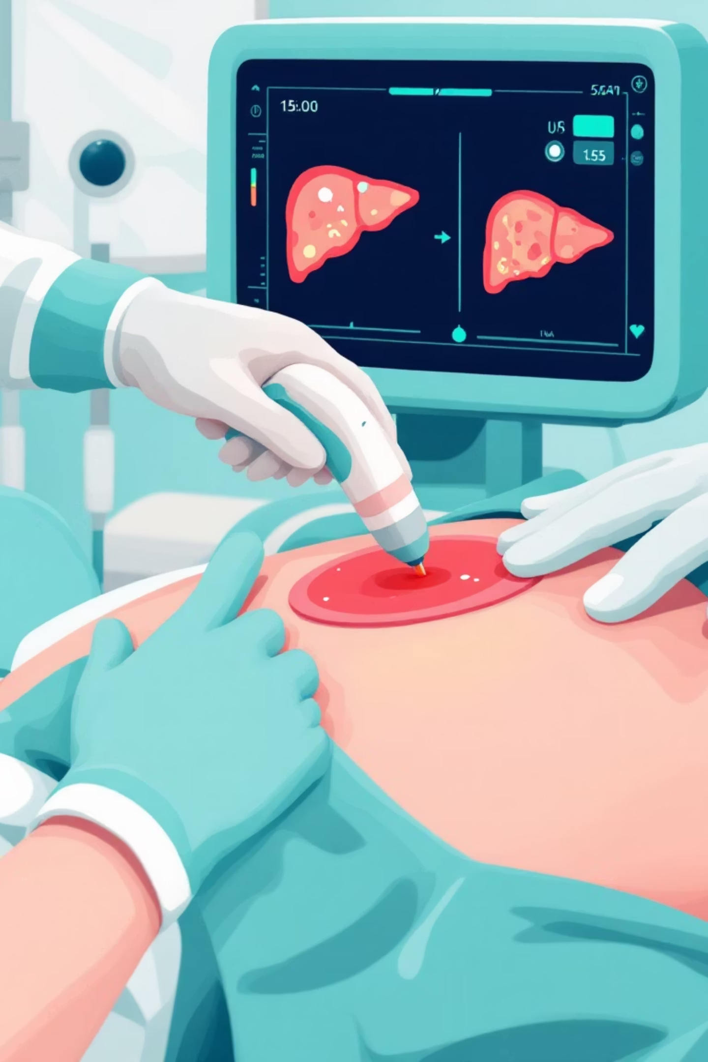
Automated Multi-Class Segmentation of Hepatic Lesions in Ultrasound Imagery
A Deep Learning Approach using Attention U-Net and Compound Loss Strategies
Presented by: [Your Name]
Department/Affiliation: [Your University/Dept]

Slide 2

The Problem: Why Ultrasound?
Context: Ultrasound is the primary screening tool for liver disease (accessible, radiation-free).
The Challenge:
Speckle Noise
Low Contrast
Operator Dependence
Grainy interference patterns that make boundaries fuzzy.
The liver tissue and lesions often have very similar intensity values.
Diagnosis relies heavily on the radiologist's subjective experience.
Objective:
Develop an automated system to segment the Liver (Organ) and Masses (Lesions) to assist doctors.
Ultrasound is great, but it's noisy. Unlike CT or MRI, ultrasound images suffer from 'speckle noise'—that grainy texture you see. This makes it incredibly hard to tell where the liver ends and a tumor begins. Our goal was to build an AI that can see through this noise.

Slide 3

The Dataset & Data Journey
Source: Annotated Ultrasound Liver Images Dataset (Kaggle)
Raw Data Format
Preprocessing Challenge
Input: Ultrasound Scans (JPG)
Deep learning models cannot read JSON coordinates directly; they need "Mask Images."
Annotations: Coordinate Polygons stored in JSON files
We started with raw ultrasound scans and their corresponding annotations, which were provided as JSON files containing coordinate points—essentially connect-the-dots for the liver shapes. We couldn't feed this directly into a neural network.

Slide 4

Data Engineering: JSON to Mask Conversion
The Process:
1
Parsing
2
Rasterization
3
Handling Overlap (Critical Step)
Extracted (x, y) coordinates for "Liver" and "Mass" classes from JSON.
Used Computer Vision (OpenCV) to "fill" these polygons into pixel maps.
Issue: A Mass is inside the Liver.
Solution: Implemented a priority layering system. We draw the Liver mask first (Class 1), and then overlay the Mass mask (Class 2) on top of it to ensure distinct class boundaries.
Final Output: 3-Class Mask
0: Background, 1: Liver, 2: Mass
This was a crucial engineering step. We wrote a script to convert those JSON coordinates into image masks. A key challenge was overlap: since tumors are inside the liver, we had to layer our masks carefully—drawing the liver first, then superimposing the tumor on top—to ensure the model learned the relationship between the organ and the lesion.

Slide 5
Model Architecture: Why Attention U-Net?
Baseline: Standard U-Net
The Solution: Attention Gates
Encoder-Decoder structure.
Integrated Attention Gates into the skip connections
The Flaw
Mechanism: The model learns to assign "weights" to different regions
Standard U-Net treats all pixels equally, leading to false positives in the dark background areas of ultrasound.
Result: It actively suppresses the irrelevant background and speckle noise, forcing the network to focus only on the organ structures
We initially tried a standard U-Net, but it struggled with the noisy background. We upgraded to an Attention U-Net. Think of 'Attention Gates' as a spotlight. Instead of processing the whole image equally, the model learns to dim the lights on irrelevant background noise and shine a spotlight specifically on the liver tissue. This significantly reduced false positives.

Slide 6
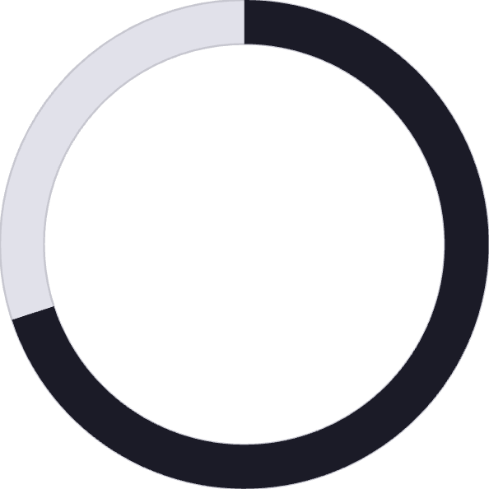
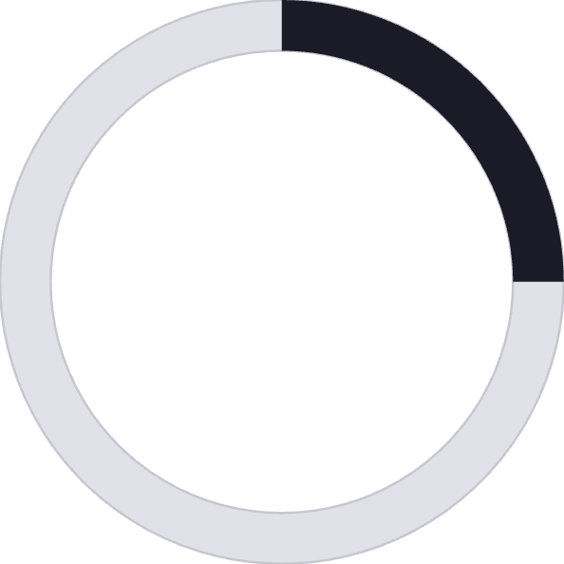


The Loss Function Strategy
The Challenge: Class Imbalance
70%
25%
5%
Background
Liver
Mass (Very small!)
Solution: Compound Loss Function
Cross Entropy
Dice Loss
Good for overall pixel-level classification accuracy.
Directly optimizes the IoU (Intersection over Union), ensuring the model doesn't ignore the small "Mass" class.
A major issue in medical AI is that tumors are tiny compared to the rest of the image. If a model just guessed 'Background' for everything, it would still be 95% accurate but useless. We used a 'Compound Loss' combining Cross Entropy and Dice Loss. Dice Loss specifically penalizes the model heavily if it misses the shape of those small tumors, forcing it to learn them.

Slide 7

Experimental Results
Training Setup:
Epochs: 100
Augmentation: Albumentations (Rotation, Flip) to simulate different probe angles
Quantitative Metrics:
0.7286
0.8340
0.6231
Average Foreground Dice Score
Liver Segmentation Dice
Mass Segmentation Dice
High accuracy
Strong baseline for ultrasound
Our results were promising. We achieved a Dice score of 0.83 for the liver, meaning the model captures the organ shape almost perfectly. For masses, which are notoriously difficult, we achieved 0.62. This proves the model can differentiate diseased tissue from healthy tissue despite the noise.

Slide 8
Visual Validation
Observation:
Row 1: Excellent delineation of the liver boundary
Row 2: Successful detection of the internal mass (white region)
Analysis:
The model successfully learned to ignore the cone-shaped shadowing artifacts typical of ultrasound probes.
Here you can see the model in action. In the predicted mask column, notice how clean the boundaries are. The model successfully ignores the dark shadows at the corners of the ultrasound cone and identifies the bright white tumor mass inside the liver.

Slide 9
Conclusion & Future Work
Summary:
Successfully automated the parsing of JSON annotations to training masks.
Attention mechanism effectively handled ultrasound speckle noise.
Compound loss stabilized training for the small "Mass" class.
Future Scope:
Testing on 3D Volumetric Ultrasound
Integrating the model into a real-time clinical dashboard for live assistance
To conclude, we successfully built an end-to-end pipeline from raw JSON data to a functioning diagnostic model. The move to Attention U-Net was the turning point for handling noise. Future work will focus on deploying this into real-time systems for clinical use.

Slide 10

Q&A
Thank you for listening.
Open for questions.

