Slide 1
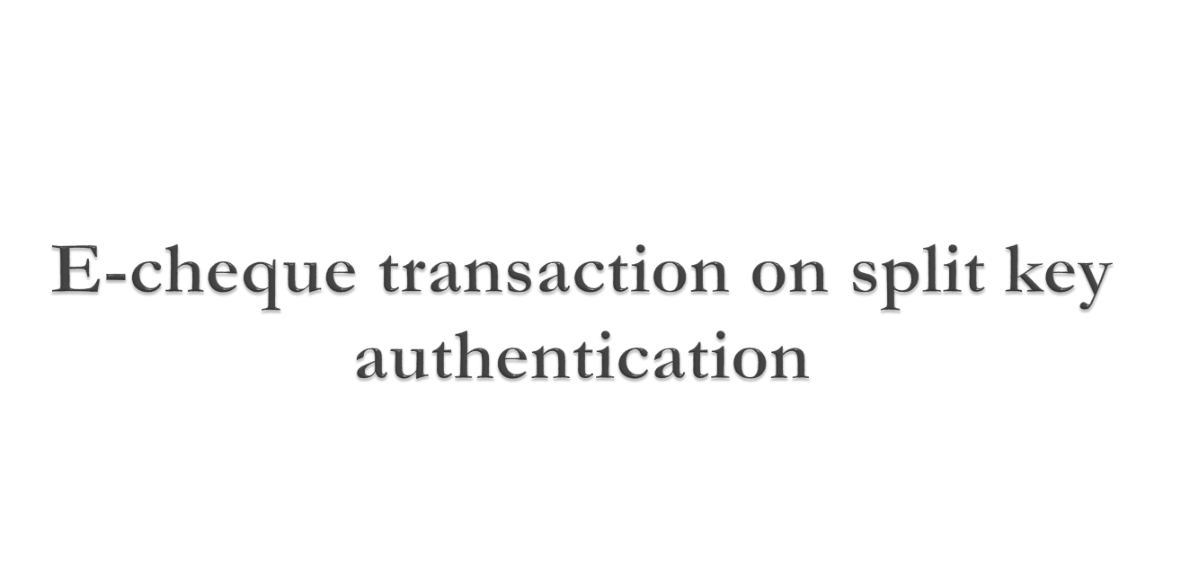

Slide 2


Allowing new banks to come up for small payments, embracing technology into play is advantageous.
Whenever a cheque is issued, a copy is also sent to the bank. When the recipient deposits that cheque, bank verifies with the copy already sent by the issuer and then clears for payment.
The split key Authentication for Electronics Transactions proposed in this Project will facilitate this procedure.

Slide 3

Existing electronic transactions are offset by the absence of adequate details needed by the recipients for a satisfactory book-keeping as they need to be extracted from other communication sources and entered manually.
Online payments are not convenient for routine payments in business since account keeping has to be done separately.

Slide 4

Payments should be effected by instructions based from the authorized source, in place of the instrument based system.
The fundamental double entry journal system should be followed for electronic payments with tri-party transactions involving payer, payee and the bank.
A built in security feature should ensure safer transfer of money.
Accounting entry with Dr. & Cr. passed on to the respective receivers with authorized signatures, is a valid proof initiated by the payer to complete the payment cycle.

Slide 5

HARDWARE SPECIFICATIONS :
Processor Type : Core i3
Speed : 2.4GHZ
Ram : 2 GB RAM
Hard disk : 200 GB HD

Slide 6

Operating System : Win 7/8
Programming Package : PHP
Tools : XAMPP server 5.0.
Back End : Mysql

Slide 7

Member User Creation
User Login
ECheque Transaction
Split Key Authentication
Debit and Credit Voucher
EBanker

Slide 8
Member User Creation
It will work as a web application developed from PHP with Mysql. It is developed mainly to administrate E-bankers to account holders. Here admin is E-Banker. It controls all users account , E-cheque transaction, Credit Voucher, Debit Voucher , Ledger and balance maintenance with secure.

Slide 9
Member User Creation
It will work as a web application developed from PHP with Mysql. It is developed mainly to administrate E-bankers to account holders. Here admin is E-Banker. It controls all users account , E-cheque transaction, Credit Voucher, Debit Voucher , Ledger and balance maintenance with secure.

Slide 10
User Login
When User login first time from their website, the username and password were splitted with key1 and key2 by the split key technique . Its only for security.

Slide 11
E-Cheque Transaction
The customer can transfer the money through E-Cheque to another account in online from their savings account or from their current account. The transaction is done by Split Key Authentication and in full security. If the users have the low balance they not allow transferring the money.

Slide 12

When a payment instruction is sent simultaneously to the Bank and to the receiver, who in turn forwards to the bank for clearing, the bank needs to authorize the transactions received from both the sources simultaneously.
Since the second receiver (payee) forwards the same to the first receiver (bank) who will be acting as a common entity for both, needs authentication. The generated security code is not stored anywhere and known only at the time of authentication when matched.
.

Slide 13

The Debit voucher received by the payee is forwarded to the Bank. The Credit voucher already sent is available with the Bank. Both the Dr and Cr vouchers are re-shuffled using the respective assembled Keys.
The payment instruction should be in pair, one for the bank (Cr entry) and the other for the payee (Dr entry) both linked with a security code, other than the transaction level encryption that is being normally used for sending digital data. .

Slide 14

E-Banker
The Bank which is having both the credit and debit entries simply accepts them after normal limit checking and security validation. The electronic acknowledgements are sent to the concerned parties. For recording a transaction as a double entry both debit and credit entries are required and they are readily available to the bank acting as the mediator, sent by the respective parties.
.

Slide 15


