Slide 1


Slide 2

Online cheque transaction.
Whenever a cheque is issued, a copy is also sent to the bank. When the recipient deposits that cheque, bank verifies with the copy already sent by the issuer and then clears for payment.
The split key Authentication for Electronics Transactions proposed in this Project will facilitate this procedure.

Slide 3
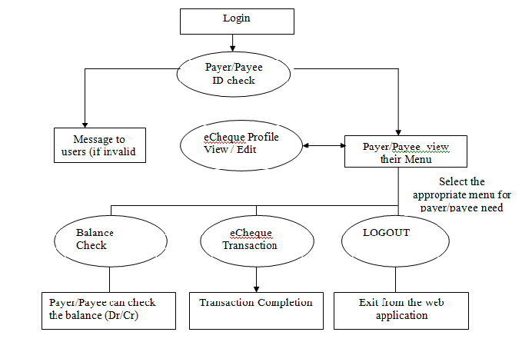

Slide 4

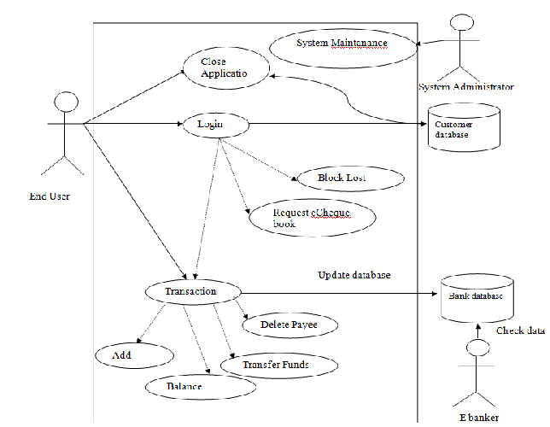

Slide 5


Slide 6
Index.php
<!DOCTYPE html PUBLIC "-//W3C//DTD XHTML 1.0 Transitional//EN" "http://www.w3.org/TR/xhtml1/DTD/xhtml1-transitional.dtd">
<html xmlns="http://www.w3.org/1999/xhtml">
<head>
<meta http-equiv="Content-Type" content="text/html; charset=utf-8" />
<title>DDKAL - by U P PRAKASHAM (+91 98400 33881)</title>
<!---------- CSS ------------>
<link rel="stylesheet" type="text/css" href="./css/style.css">
<SCRIPT TYPE="text/javascript">
function disableselect(e){
return false
}

Slide 7
function reEnable(){
return true
}
//if IE4+
document.onselectstart=new Function ("return false")
//if NS6
if (window.sidebar){
document.onmousedown=disableselect
document.onclick=reEnable
}
</SCRIPT>
</head>
<body oncontextmenu="return false">

Slide 8
<!--BEGIN #signup-form -->
<div id="signup-form">
<!--BEGIN #subscribe-inner -->
<div id="signup-inner">
<div class="clearfix" id="header">
<img id="signup-icon" src="./images/signup.png" alt="" />
<h1>Design of Distributed Key Authentication Algorithm for Electronic Transactions <br/> by U P Prakasham</h1>
</div>
<table>
<tr>
<td width="600px">
<p style="font:Verdana, Arial, Helvetica, sans-serif; color:#0000FF"><u>Login Form</u></p>
<form id="send" action="memauth.php" method="post">

Slide 9
<label for="memid">Member ID <font color="red">*</font></label>
<input id="memid" type="text" name="memid" value="" />
</p>
<p>
<label for="pwd">Password <font color="red">*</font></label>
<input id="pwd" type="password" name="pwd" value="" />
</p>
<p>
<button id="submit" type="submit">Enter</button>
</p>
</form>
</td>
<td width="400px">

Slide 10
<p style="font:Verdana, Arial, Helvetica, sans-serif; color:#0000FF"><u>New Member Creation</u></p>
<form id="send" action="insertmem.php" method="post">
<p>
<label for="memname">Member Name<font color="red">*</font></label>
<input id="memname" type="text" name="memname" value="" />
</p>
<p>
<label for="pnum">Phone Number <font color="red">*</font></label>
<input id="pnum" type="text" name="pnum" value="" />
</p>
<p>

Slide 11
<label for="pass">Password <font color="red">*</font></label>
<input id="pass" type="password" name="pass" value="" />
</p>
<!--
<p>
<label for="pname">Address *</label>
<input id="pname" type="text" name="pname" value="" />
</p>
<p>
<label for="Amount">Amount (In Figure) *</label>
<input id="amount" type="text" name="amount" value="" />
</p>

Slide 12

UNIT TESTING :
Unit testing involves the design of test cases that validate that the internal program logic is functioning properly, and that program inputs produce valid outputs.
All decision branches and internal code flow should be validated. It is the testing of individual software units of the application .
It is done after the completion of an individual unit before integration.
INTEGRATION TESTING :
Integration tests are designed to test integrated software components to determine if they actually run as one program.
Testing is event driven and is more concerned with the basic outcome of screens or fields.
Integration testing is specifically aimed at exposing the problems that arise from the combination of components.

Slide 13
FUNCTIONAL TESTING :
Functional tests provide systematic demonstrations that functions tested are available as specified by the business and technical requirements, system documentation, and user manuals.
Functional testing is centered on the following items:
Valid Input : Identified classes of valid input must be accepted.
Invalid Input : Identified classes of invalid input must be rejected.
Functions : Identified functions must be exercised.
Output : Identified classes of application outputs must be exercised.
Systems/Procedures : Interfacing systems or procedures must be invoked.
SYSTEM TESTING :
System testing ensures that the entire integrated software system meets requirements. It tests a configuration to ensure known and predictable results.
System testing is based on process descriptions and flows, emphasizing pre-driven process links and integration points.

Slide 14
WHITE BOX TESTING :
White Box Testing is a testing in which in which the software tester has knowledge of the inner workings, structure and language of the software, or at least its purpose.
It is used to test areas that cannot be reached from a black box level.
BLACK BOX TEXTING :
Black Box Testing is testing the software without any knowledge of the inner workings, structure or language of the module being tested.
You cannot “see” into it. The test provides inputs and responds to outputs without considering how the software works.

Slide 15
Field testing will be performed manually and functional tests will be written in detail.
Test objectives:
All field entries must work properly.
Pages must be activated from the identified link.
The entry screen, messages and responses must not be delayed.
Features to be tested:
Verify that the entries are of the correct format
No duplicate entries should be allowed
All links should take the user to the correct page.

