Slide 1

GOVERNMENT ENGINEERING COLLEGE, CHALLAKERE
(Affiliated to VTU Belagavi, Recognized by AICTE, New Delhi and Approved by Government of Karnataka)
AI-DRIVEN REAL TIME ANALYSIS OF AMNIOTIC FLUID INDEX(AFI) FOR FETUS HEALTH MANAGEMENT
UNDER THE GUIDENCE OF :
Asst. Prof. POORNIMA S P M.Tech, Ph.d
Dept of CSE
GEC, Challakere
PRESENTED BY :
PAVAN G S - 4EG22AI029
SANJAY H R - 4EG22AI037
SUNIL T R - 4EG22AI045
YASHAVANTHA N - 4EG22AI051

Slide 2
CONTENTS
Abstract
Introduction
Problem statement
Project objects
Project Challenges
Literature review
System Architecture
Patients Dashboard
Doctors Dashboard
Requriments
Methodology
Results
Conclusion
Reference
Future scope

Slide 3
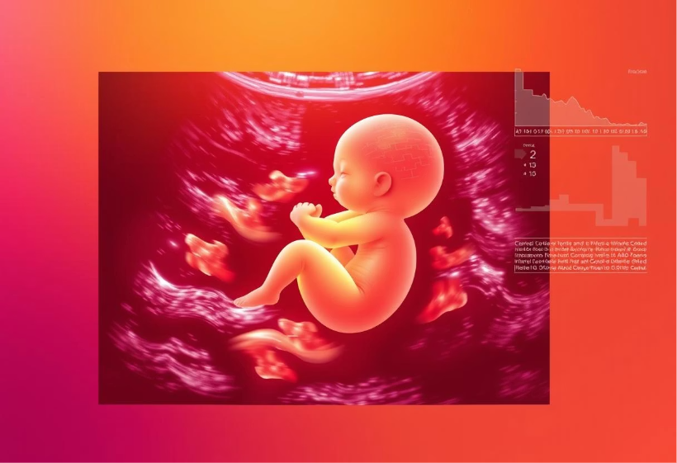
ABSTRACT
The Amniotic Fluid Index (AFI) helps measure the amount of fluid around the baby to check fetal wellbeing and detect any pregnancy risks.
Oligohydramnios means low amniotic fluid, Which can limit the baby's movement and cause issues like growth restriction or stress.
Polyhydramnios measure too much amniotic fluid, which may cause discomfort, early labor, complications like cord prolapse, needing proper care and management.

Slide 4
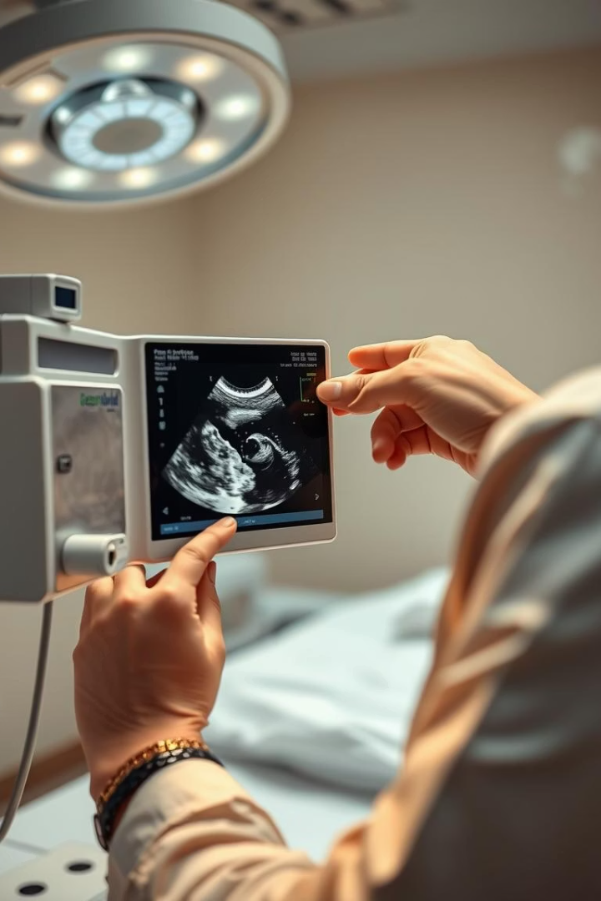
INTRODUCTION
What is AFI
Amniotic fluid is the protective liquid that surrounds the baby (fetus) inside the mother’s womb during pregnancy.
It is present inside the amniotic sac and starts forming soon after conception.
It is mainly composed of water, electrolytes, nutrients, hormones, proteins, and later fetal urine.
Why is it important
Abnormal levels (too low/high) indicate potential complications like fetal growth restriction, preterm birth.
Challenges with Current Method:
  Manual ultrasound measurement.
  Operator-dependent and variable.
  Not real-time or continuous.
  Inaccessible in areas with few skilled sonographers.

Slide 5
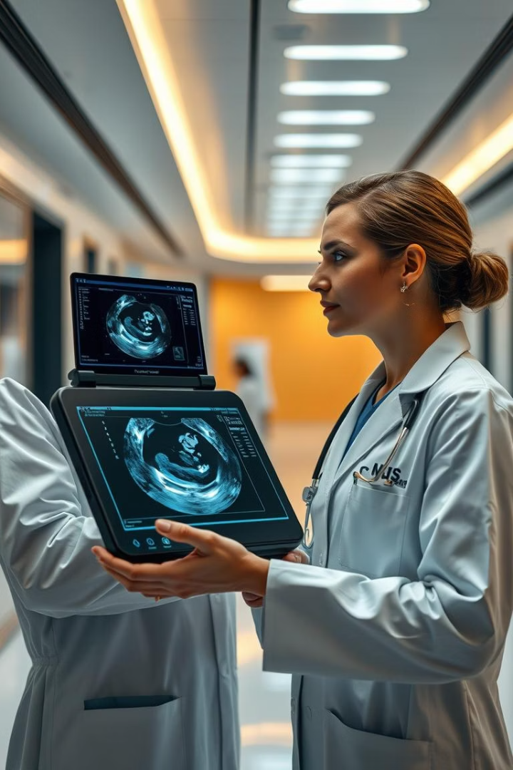
PROBLEM STATEMENT
Traditional AFI assessment using ultrasound is manual, time-consuming, and prone to inter-observer variability, leading to inconsistent diagnosis of oligohydramnios or polyhydramnios.
Lack of real-time, automated monitoring of amniotic fluid levels limits early detection of fetal distress, delaying timely clinical intervention.
There is a need for an AI-powered system that can automatically segment amniotic fluid pockets and compute AFI accurately and continuously, supporting clinicians in making faster and more reliable pregnancy-related decisions.
Proposed Solution: An AI-powered, web-based system for automated, accurate, and real-time AFI classification.

Slide 6
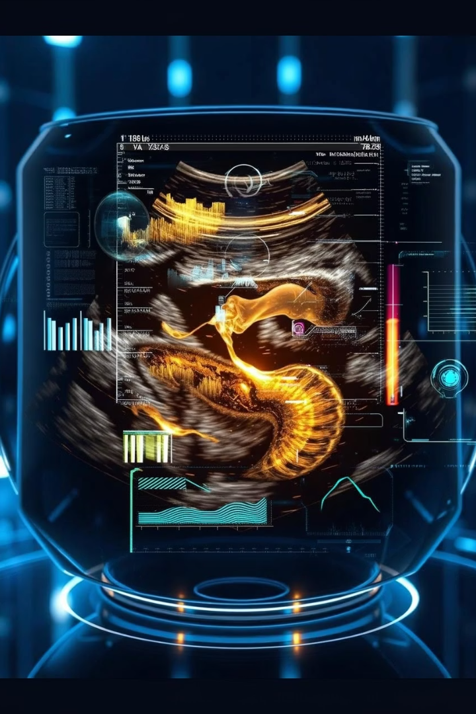
PROJECT OBJECTIVES
1
Automate Fluid Detection
Use U-Net deep learning to segment amniotic fluid regions.
2
Calculate AFI Accurately
Measure pocket depths and sum for total AFI in centimeters.
3
Classify Clinical Categories
Diagnose oligohydramnios, normal, or polyhydramnios levels.
4
Enable Real-Time Web Access
User-friendly platform for immediate image upload and feedback.

Slide 7
CHALLENGES
Manual AFI Measurement Limitations
Time-consuming and subjective, varies by sonographer skill.
Human Error and Variability
Prone to inconsistent results and misdiagnosis risk.
Accessibility Issues
Low-resource settings often lack skilled personnel for AFI assessment.
Need for Automation
AI system aims to standardize, speed, and enhance prenatal diagnostics.

Slide 8
SUMMARY OF LITERATURE REVIEW
SL NO
TITLE
YEAR
AUTHORS
KEY FINDINGS
1
Automated Ultrasound Assessment of AFI
2021
Hyun Chao
This study introduces a deep-learning-based method for automatic AFI evaluation from ultrasound images.
2
Deep Learning-Based Classification of AF Levels
2022
Almalki
Utilizing transfer learning models like Xception and MobileNet, this paper classifies AF levels as normal or abnormal using ultrasound images. The MobileNet model achieved an accuracy of 94%, highlighting the potential of AI in aiding sonographers.
3
End-to-End Automation of Fetal Biometry and AF
2023
Horgan
The study developed and prospectively assessed deep learning models for automated fetal biometry and amniotic fluid volume measurements, demonstrating human-level performance in various fetal ultrasound tasks.
4
U-Net Hyperparameter Tuning for AF Segmentation
2022
Ayu Pradipta
This paper analyzes the impact of hyperparameter tuning on the performance of the U-Net model for segmenting amniotic fluid in ultrasound images, aiming to optimize segmentation accuracy.

Slide 9
5
AI Challenges in AF Classification
2022
Nida Aslam
This review discusses the challenges and advancements in AI-based techniques for amniotic fluid classification, emphasizing the need for standardized datasets and evaluation metrics.
6
Pixel-Based AF Segmentation
2021
Sri Hartati
The study proposes a pixel classification model based on window sampling for amniotic fluid segmentation in B-mode ultrasonography images, enhancing segmentation precision.
7
AFNet for Automatic AF Segmentation
2020
Alejo Costanzo
This paper introduces AFNet, a novel convolutional neural network model for segmenting amniotic fluid .
8
Deep Learning Based Model for AF Segmentation in 2D Image
2025
Putu Desian
The study applies a CNN-based semantic segmentation approach to detect and classify amniotic fluid echogenicity types.

Slide 10
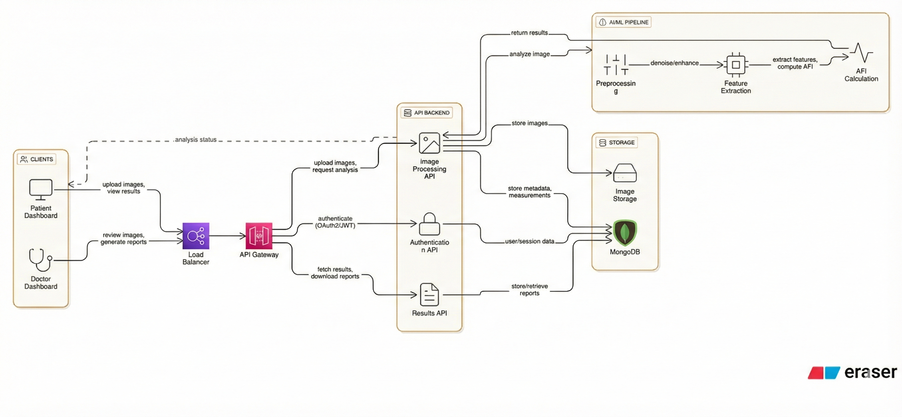
SYSTEM ARCHITECTURE

Slide 11
1. Clients
Patients upload ultrasound images and view analysis results.
Doctors review images and generate medical reports through a dashboard.
2. Load Balancer
Distributes incoming requests across backend services.
Ensures smooth performance and high availability
3. API Gateway
Central entry point for all client requests.
Handles routing, security, rate-limiting, and authentication.
4. API Backend
Authentication API
  Uses OAuth2/JWT for secure user access.
Image Processing API
  Receives images and triggers analysis in AI/ML pipeline.
Results API
  Provides processed results and report downloads.
5. AI/ML Pipeline
Preprocessing: Denoising, enhancement, image cleaning.
Feature Extraction: Identifies fluid pockets and features.
AFI Calculation: Computes the Amniotic Fluid Index and generates results.
Returns analyzed results to backend.
6. Storage Layer
Image Storage: Stores raw and processed ultrasound images.
MongoDB: Stores metadata, AFI measurements, user sessions, and reports.
7. Data Flow Summary
Images uploaded → Sent to backend → Processed by AI → Results stored → Users view/ download results.

Slide 12
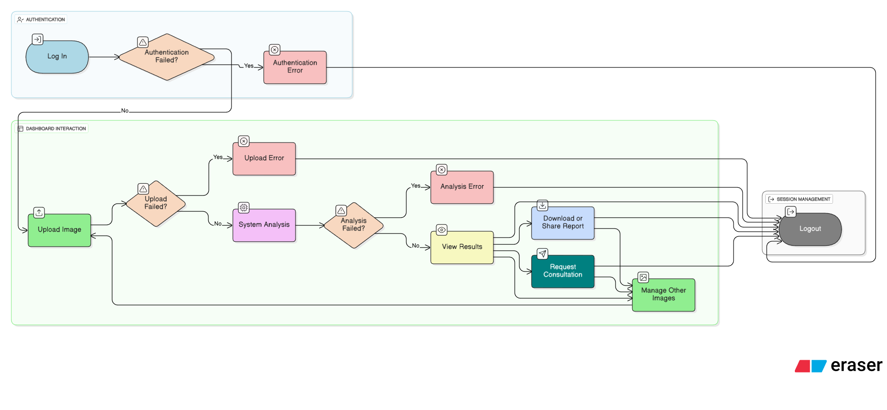
PATIENTS DASHBOARD

Slide 13
1. Authentication Process
User logs into the system.
Login is validated through authentication checks.
If authentication fails → user is shown an Authentication Error.
If successful → user proceeds to dashboard.
2. Image Upload Process
User uploads an ultrasound image for analysis.
System checks for upload issues.
If upload fails → Upload Error is displayed.
If upload succeeds → image proceeds to system analysis.
3. System Analysis Process
Uploaded image is processed by the backend/AI system.
System checks if analysis is successful.
If analysis fails → Analysis Error is shown.
4. Viewing & Using Results
If analysis is successful:
  User can view results.
  User can request consultation with a doctor.
  User can manage other images (upload/view/delete).
5. Session Management
At any point, user can log out from the session.
Logout ensures session closure and data protection.

Slide 14
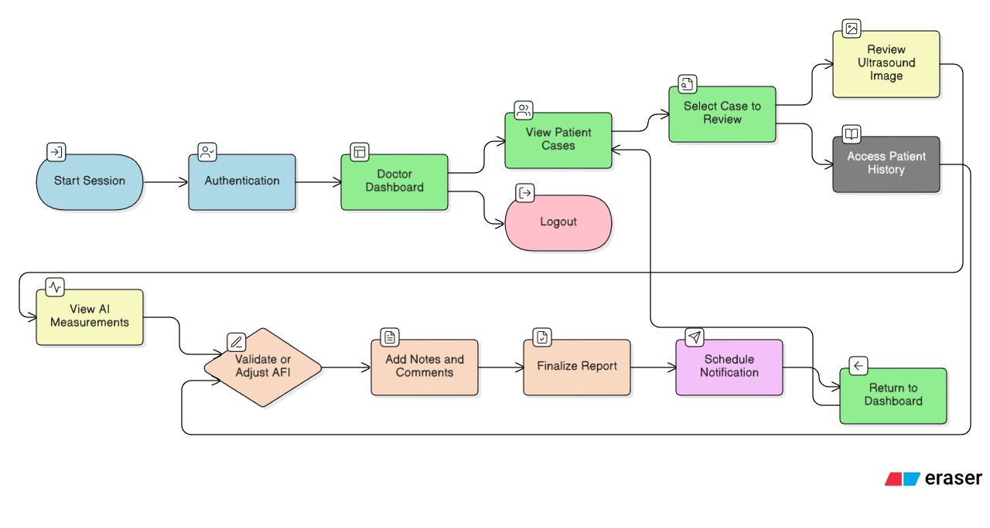
DOCTORS DASHBOARD

Slide 15
1. Session Start & Authentication
Doctor starts a new session.
System verifies login credentials.
After authentication, doctor is taken to the main dashboard.
2. Accessing Patient Cases
Doctor views the list of patient cases.
Selects a specific case to review.
Can also log out anytime from the dashboard.
3. Reviewing Case Details
Doctor reviews the ultrasound image.
Accesses patient history and previous reports for context.
4. AI Measurement Evaluation
Doctor views AI-generated AFI measurements.
Validates or manually adjusts AFI values if needed.
5. Report Preparation
Adds clinical notes and comments.
Finalizes the AFI report.
Schedules a notification or follow-up if necessary.
6. Return & Logout
Doctor returns to the dashboard after completing the case.
Can log out to end the session securely.

Slide 16
SOFTWARE REQUIREMENT
1 Frontend Requirements:
Language: JavaScript (ES6+)
Framework: React.js
Libraries: Material-UI (MUI) for responsive design and icons
HTTP Client: Axios for REST API communication
Visualization: Charts, progress bars, and confidence meters for AFI insights
Styling: CSS3 with gradient themes and glass morphism effects
Testing: React Testing Library
2 Backend Requirements
Framework: FastAPI (Python 3.10+)
Server: Uvicorn ASGI Server
Libraries:
  Motor (async MongoDB driver)
  Python-Jose for JWT Authentication
  Passlib for password hashing
  Python-Multipart for file uploads
  TensorFlow/Keras for deep learning inference
  Pydantic for used to create request and response to model(email)
  Scikit-learn is used for preprocessing, normalization, basic ML utilities and train-test split

Slide 17
3.Database Requirements:
Database: MongoDB (Atlas / Local Instance)
Driver: Motor (async)
Collections:
  Users (for login, roles)
  Predictions (for AFI results)
  Appointments (for scheduling)
Backup and SSL: certifi added for secure TLS communication.
4 Machine Learning Stack:
Framework: TensorFlow / Keras
Dataset: Ultrasound image dataset organized into class folders
Classes: Low, Normal, High AFI
Activation function: Rectified Linear Unit (ReLU)
Output: Softmax probabilities with confidence score
Model Type: CNN-based classification model (trained offline and deployed in backend)

Slide 18
OTHER REQUIREMENTS
Functional Requirements:
  User Registration & Login (JWT Auth).
  Role-Based Access (Patient/Doctor Dashboards).
  Image Upload & AI-Based AFI Prediction.
  Report Generation & Appointment Booking.
  Health Record Management.
Non-Functional Requirements:
  Performance: Response time < 3 seconds.
  Security: JWT tokens, hashed passwords (HIPAA-compliant principles).
  Usability: Responsive, WCAG-compliant UI (Material-UI).
  Scalability: Stateless backend for horizontal scaling.
  Reliability: 99% uptime target, automatic retries.

Slide 19
METHODOLOGY
Approach: Hybrid Agile + Prototyping.
Development Workflow:
  Requirement Analysis: Studied medical standards and defined core features.
  Architectural Planning: Designed U-Net architecture system and API endpoints.
  Model Development: Built and trained a CNN model on labeled ultrasound data.
  Backend Development: Implemented FastAPI server with auth and MongoDB integration.
  Frontend Development: Built responsive React dashboards for patients and doctors.
  System Integration & Testing: Connected all layers and performed unit/integration tests.
Implementation Layers:
  User Interaction (React)
  Application Logic (FastAPI)
  AI Engine (TensorFlow)
  Data Management (MongoDB)

Slide 20
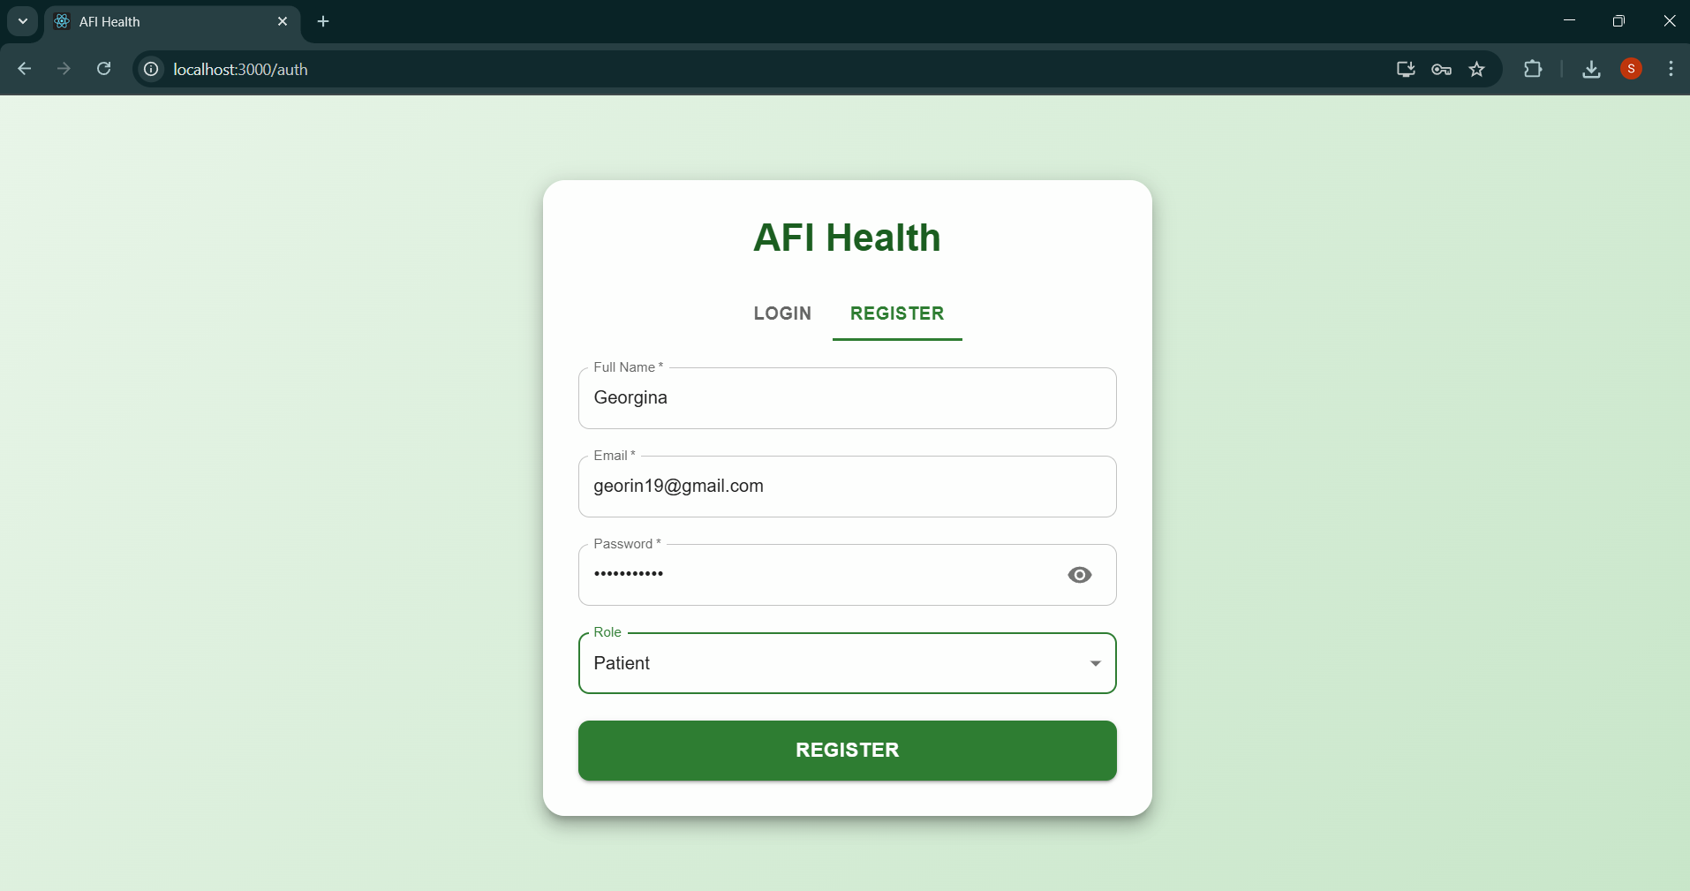
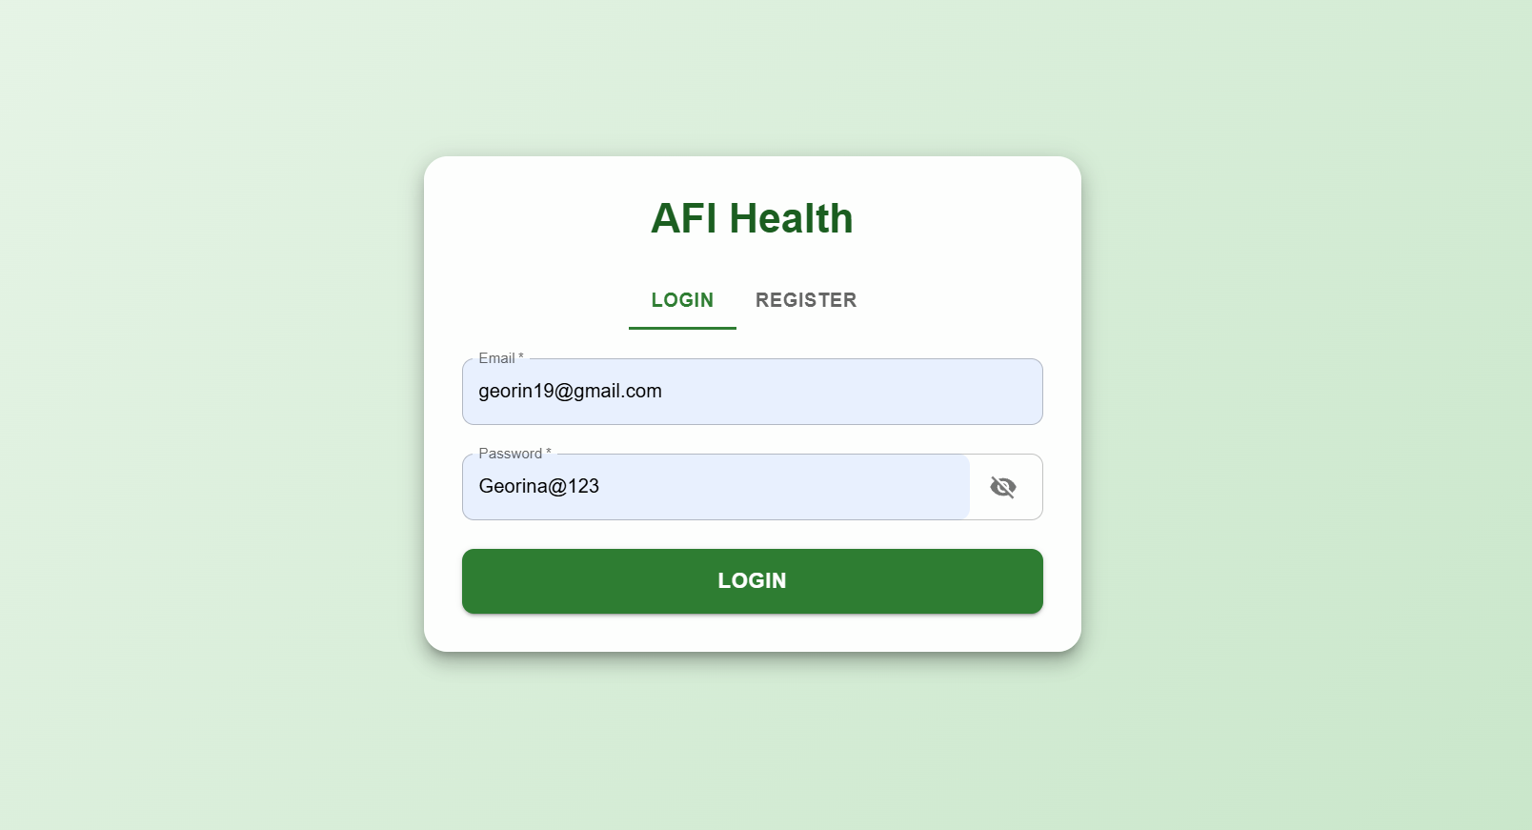
RESULTS

Slide 21
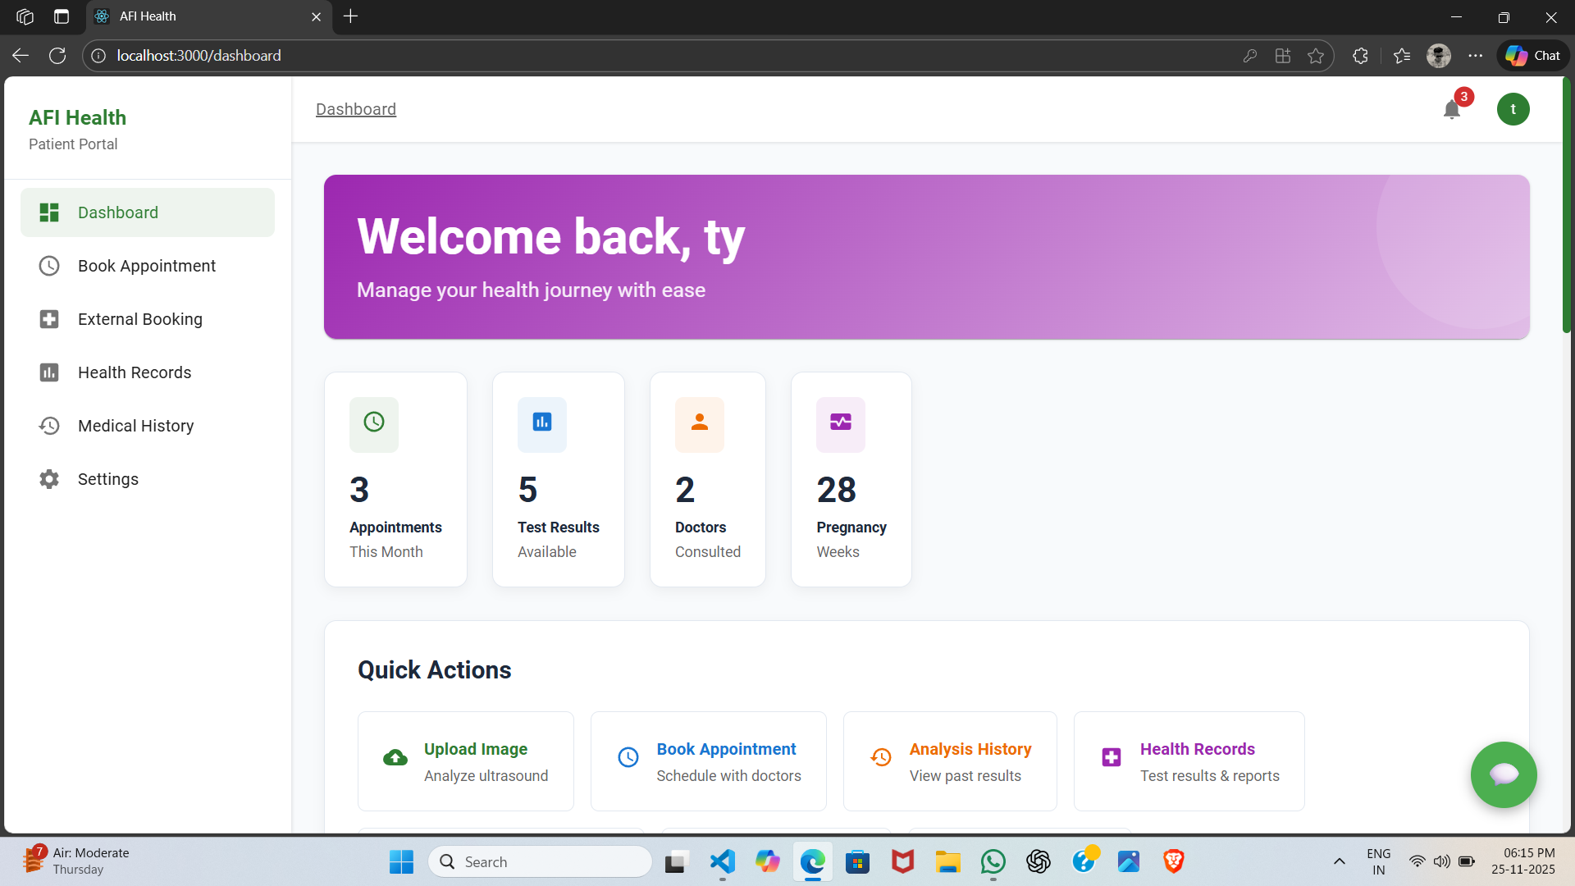
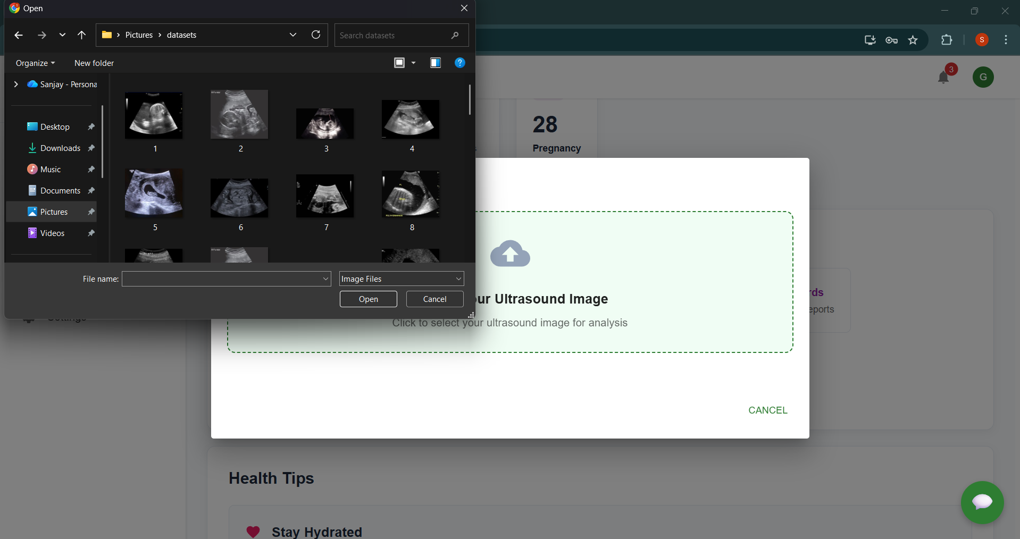
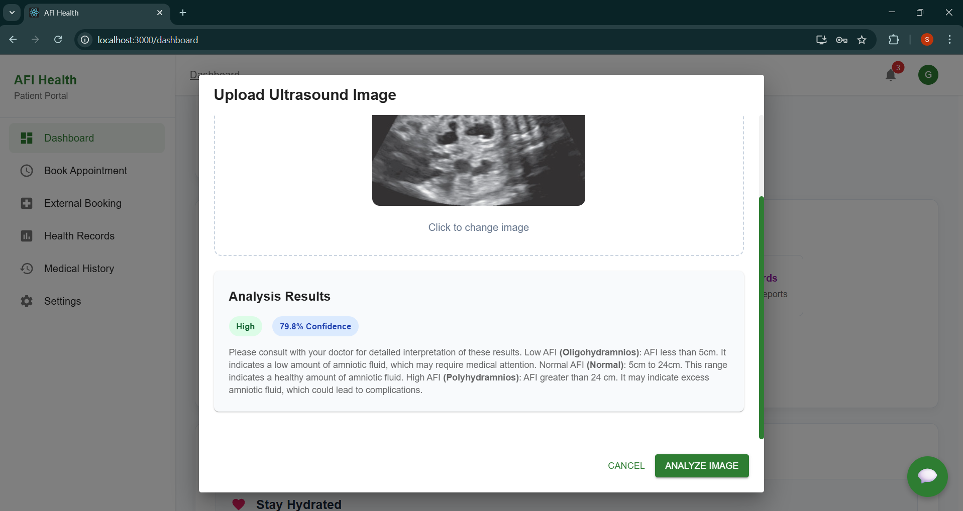
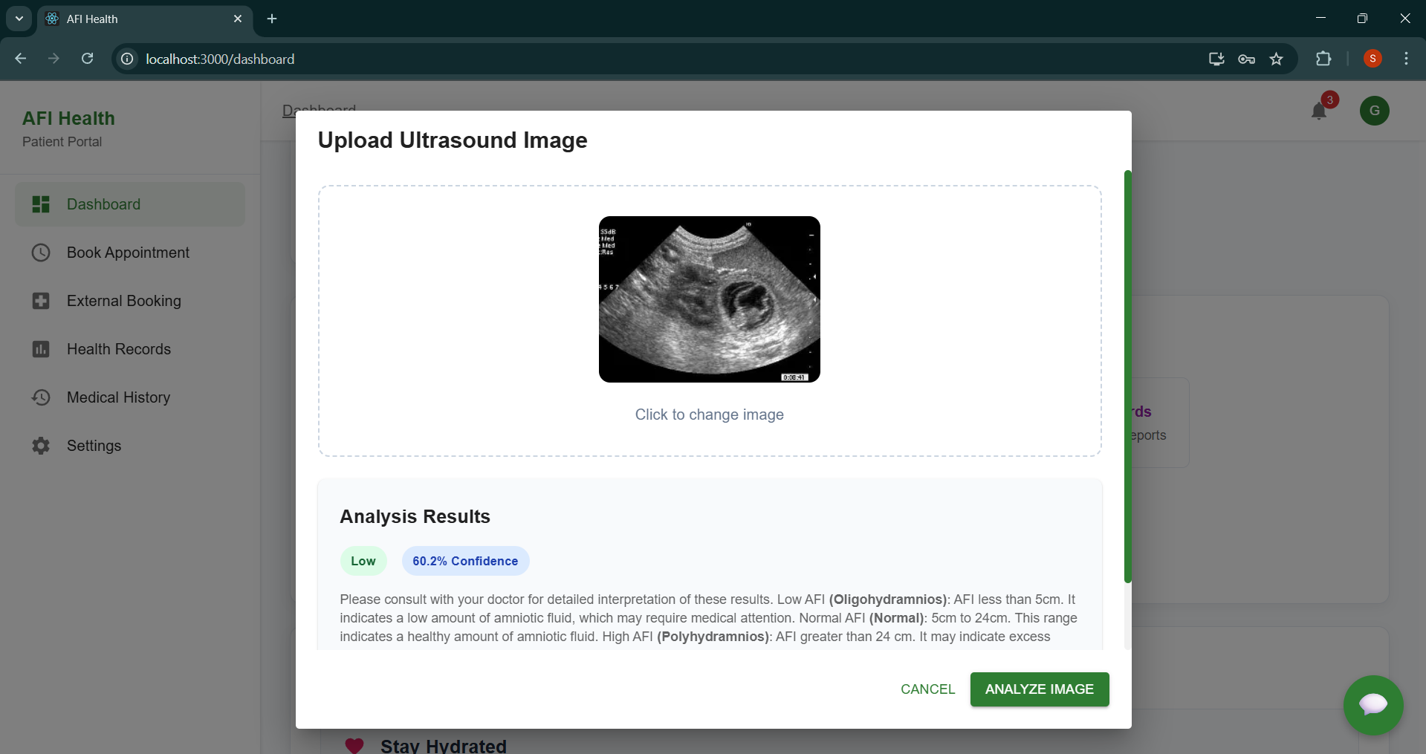

Slide 22
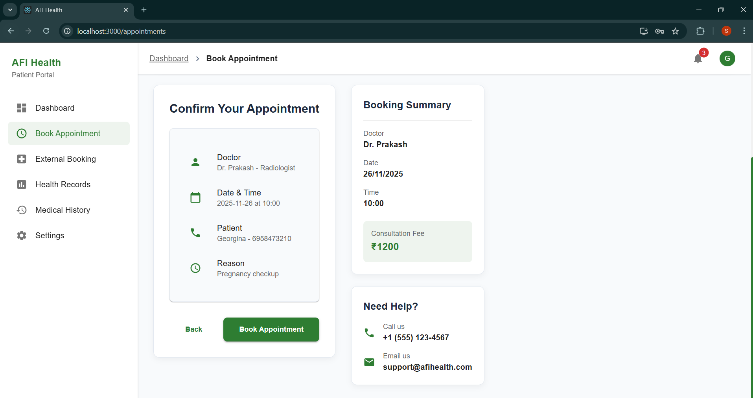
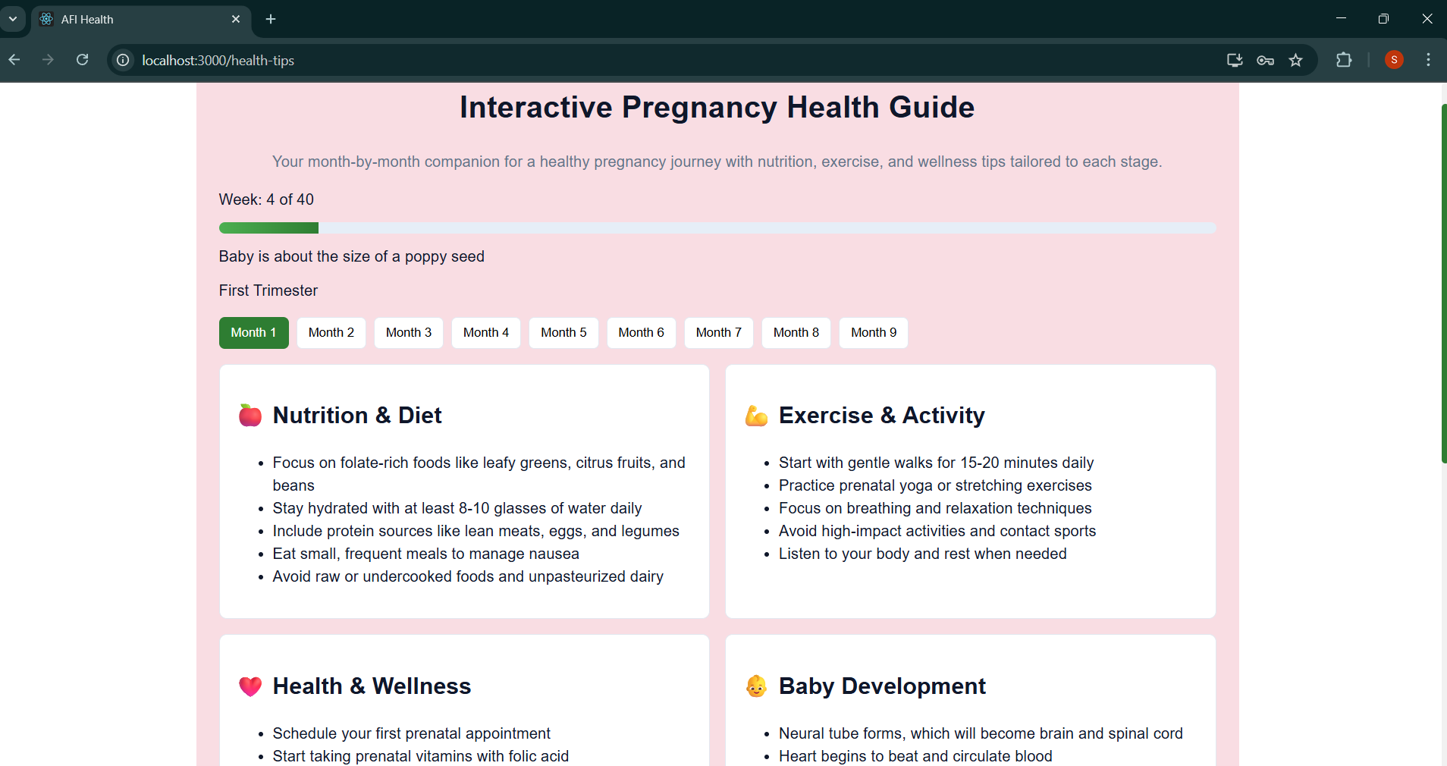
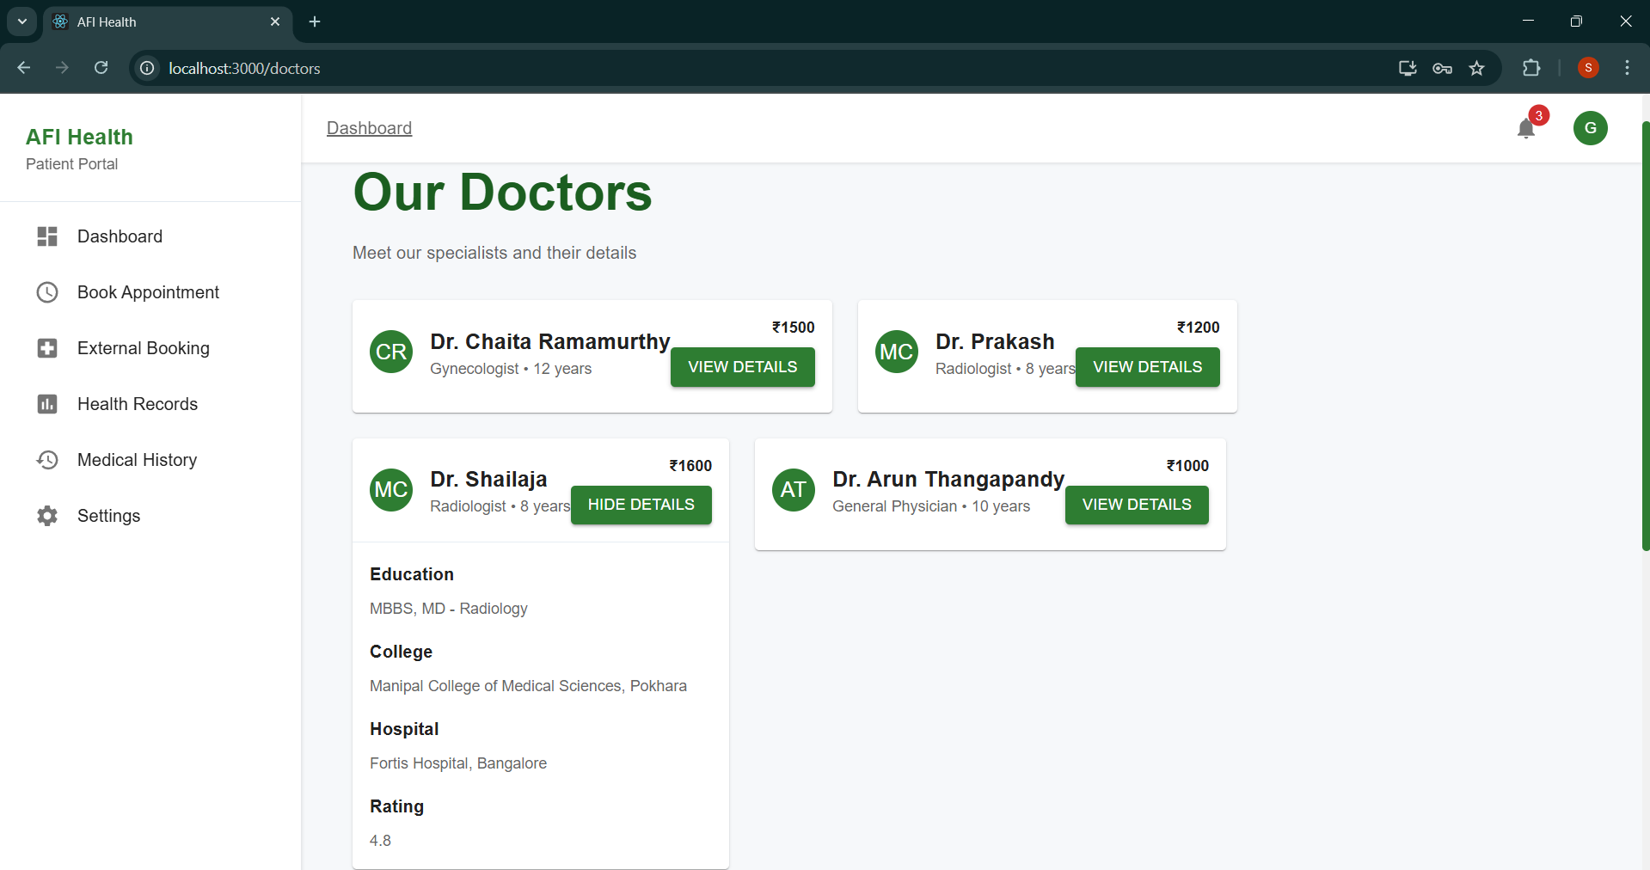
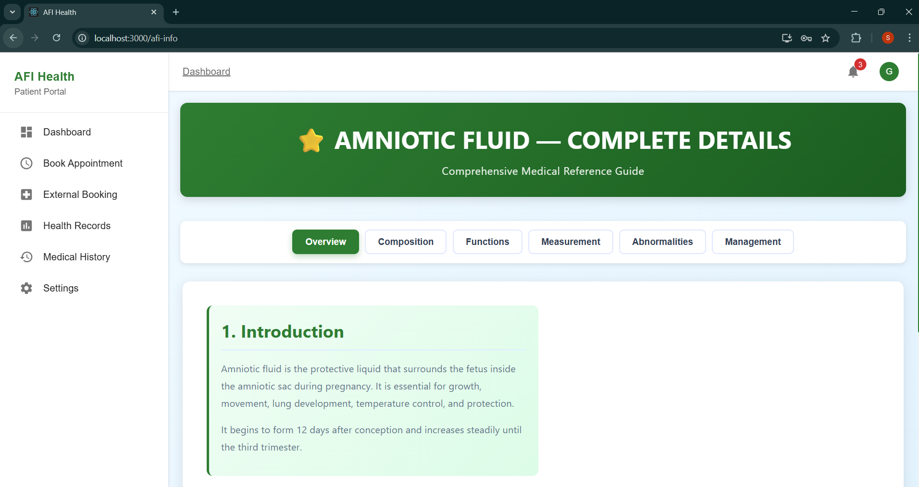

Slide 23
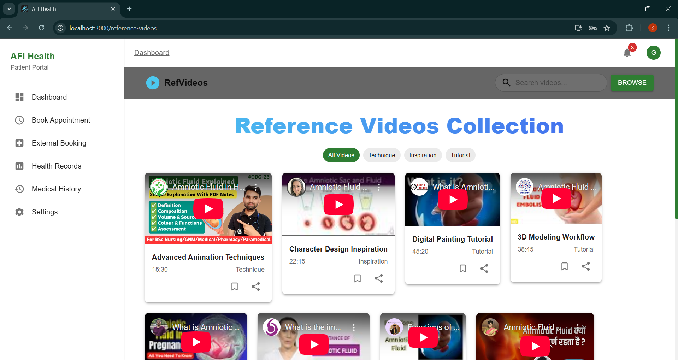

Slide 24
CONCLUSION
This AI-based system proves real-time automated AFI measurement is feasible and effective.
Integration enhances clinical workflow, reduces errors, and supports prompt fetal health interventions.
Offers scalable deployment potential for low-resource and remote healthcare settings.

Slide 25
FUTURE SCOPE
Automated AFI Measurement using segmentation models.
Doppler ultrasound feature integration for better diagnosis.
CTG analysis added for comprehensive fetal monitoring.
Doctor–patient communication module for consultations.
Optimized lightweight models for mobile and offline use.
Integration with Hospital Information Systems (HIS).
Multi-language support for wider accessibility.
Explainable AI using Grad-CAM visualizations.
Real-time patient monitoring dashboard.
Cloud deployment on AWS/Azure/GCP for scalability.

Slide 26
REFERENCES
Automated ultrasound assessment of amniotic fluid index using deep learning - PubMed
Deep Learning-Based Computer-Aided Classification of Amniotic Fluid Using Ultrasound Images from Saudi Arabia
Fetal biometry and amniotic fluid volume assessment end-to-end automation using Deep Learning | Nature Communications
U-Net Tuning Hyperparameter for Segmentation in Amniotic Fluid Ultrasonography Image | Semantic Scholar
Amniotic Fluid Classification and Artificial Intelligence: Challenges and Opportunities - PMC
Amniotic fluid segmentation based on pixel classification using local window information and distance angle pixel - ScienceDirect
AFNet Algorithm for Automatic Amniotic Fluid Segmentation from Fetal MRI
(PDF) Deep Learning Based Detection and Classification of Amniotic Fluid Echogenicity Type for Enhanced Prenatal Diagnosis

Slide 27


