Slide 1
Digital fabrication
By Group No.29
1.P.Rashmitha CS19BTECH11019
2.M.Sayeed CS19BTECH11004
3.A.Sanjay CS19BTECH11013
“3D printing has digitalized the entire manufacturing process.”
-Peter Diamandis

Slide 2
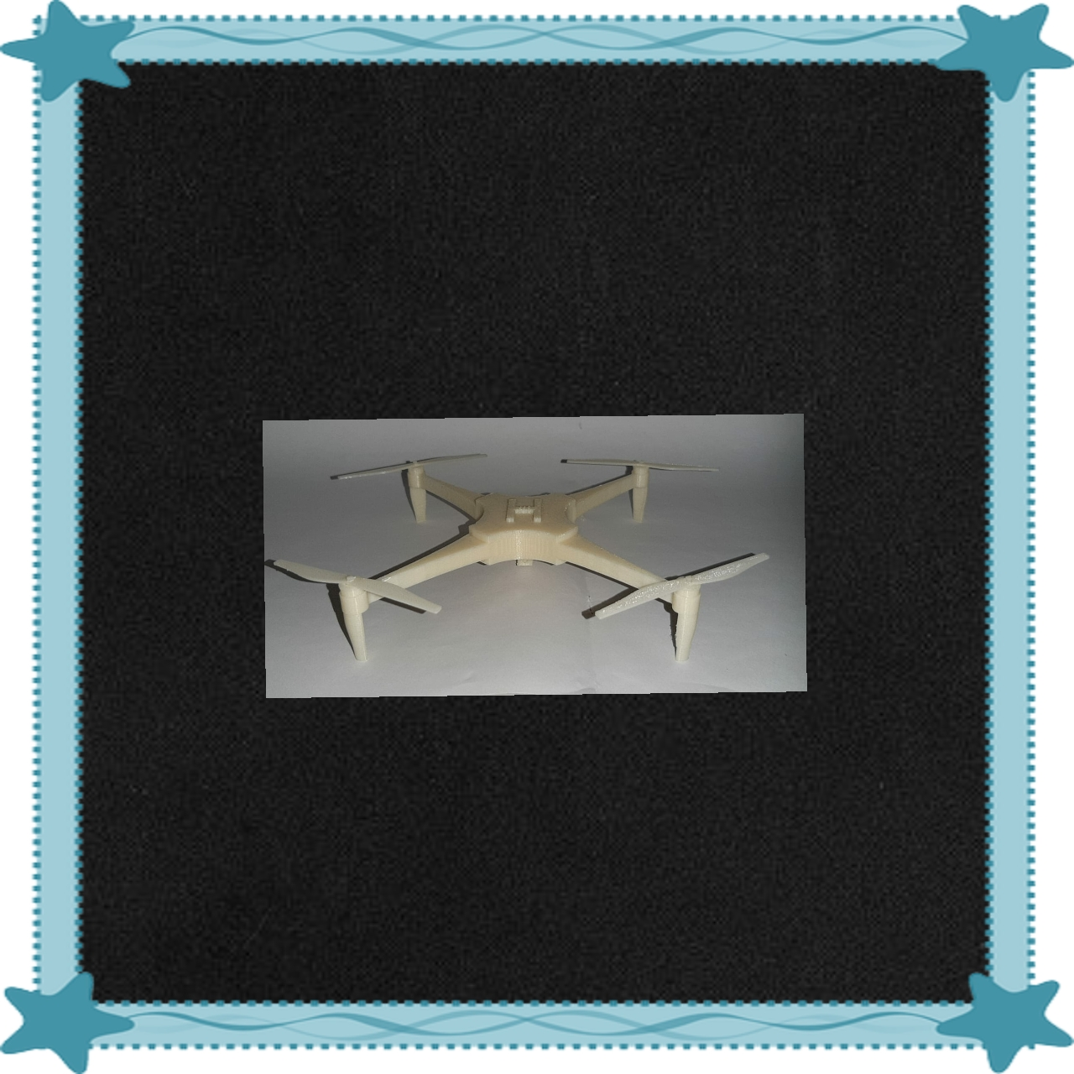
PROJECT WORK : DRONE WITH ROTATABLE BLADES.
*Our project is to make a drone having a camera with rotatable blades.
*While working on this project , we faced many challenges . Firstly , after getting the idea of a drone , visualizing part has become most crucial .
*Designing the drone by visualizing it’s each part ,one after the other is the first challenge .
*Drawing free hand curves for the layout of the design ,is also a determining task.

Slide 3
*Our second challenge is to make the drone with rotatable blades.
*For that , we printed the base part and it’s blades separately.
*After once our model get printed, assembling the base part and it’s blades , by making sure that the drone will have rotatable blades ,is a great challenge for us.
LEARNINGS :
*Many orientations were possible , but only few were effective considering time factor . Then , We came to know that orientation of our design model plays a major role in estimation of time for 3D printing.
Uses :
*Farmers use drones to monitor livestock on vast spreads of land.
*Fire departments can use drones to track and map wild fires.

