Slide 1

Capstone Project Sports Analytics
Presented by - Sanjay Kumar

Slide 2
Introduction
Welcome to this insightful presentation on the historical analysis of the olympic games. Our mission is to uncover valuable insights by delving into diverse dimensions such as games, sports, participants, and medals. By meticulously exploring interconnected tables, we aim to unveil trends, patterns, and noteworthy revelations from various olympic editions. This endeavor seeks to offer A comprehensive glimpse into the Olympics' evolution, driving us to recommend enhancements for future events. Our ultimate goal is to present A comprehensive report that illuminates the rich history of the olympics, fostering A deeper understanding of its significance.

Slide 3
Objective
The objective of this analysis is to conduct a comprehensive exploration of historical Olympic Games data across multiple dimensions, including sports, events, participants, medals, and regional representation. By delving into the intricate relationships between these tables, the analysis aims to uncover trends, patterns, and valuable insights that illuminate the evolution of the Games over time. Through the examination of sports diversity, regional representation, and athlete performance, the goal is to generate actionable recommendations to optimize future Olympics' organization, enhance sports selection, and foster inclusivity across regions. The final outcome will be a detailed report and presentation highlighting the significant findings and historical significance of the Olympic Games, contributing to a deeper understanding of its global impact and evolution.

Slide 4
Table Explanations
This table contains A comprehensive list of all sports names ,id featured in the olympics, covering
Both the summer and winter editions
The event table offers detailed information about the various events held within each sport.It contain
id , sports_id ,event_name.
This table provides an extensive list of cities from around the world that have hosted or participated
In the olympic games over the years.
The games table records every instance of the olympic games since its inception in 1896. It includes
Essential details such as the year in which the games were held, game name , id,season.
A small table listing the different types of medals awarded at the Olympics, including Gold, Silver,
Bronze, and N/A (indicating no medal).
Sports Table
Events
city
Games
Medal

Slide 5
This joining table establishes the relationship between the games and city tables , its contain two
column games id , city id
The person table records information about individuals who have competed in the olympics. It
Includes their names, gender, height, and weight, with height and weight
This joining table establishes connections between individuals and the countries they represented.
While competing in the olympics.It contain person id and region id.
This table consists of noc codes, representing national olympic committees, and their
Corresponding countries
This table serves as a joining table, linking individuals to specific olympic games, showcasing the
Participants and their involvement in each event.
This table represents the largest one, providing crucial details about the combination of
Competitors, the events they participated in, and the medals they received, if any.
Games_city
Person
Person_regions
Noc_region
Games competitor
Competitor event

Slide 6
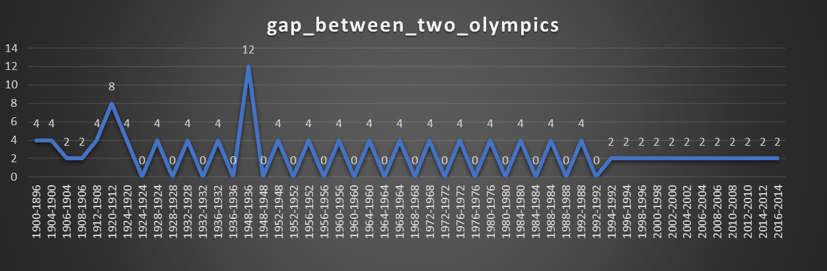
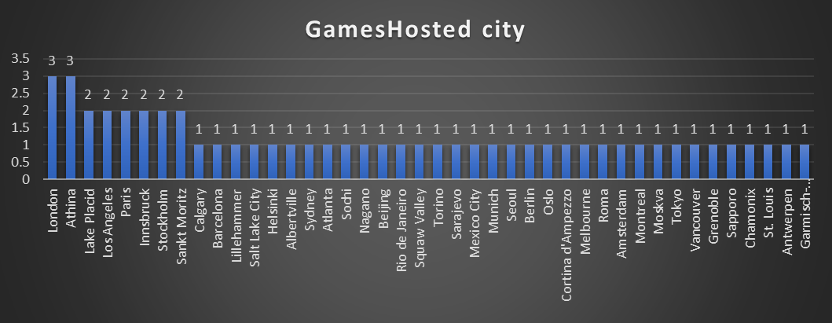
Findings and Analysis
Q-1 Are there any trends or patterns in the frequency of hosting Olympic games?
I analyzed the trend using games hosted by city & difference between the two Olympics games ,below graph show that most of the game hosted by city London and Athena and there are 5 cities which has hosted the games twice ,rest of the city hosted the game only one time.2nd graph show that most of the games held on the interval of 4 year ,but in 1948 games held after 12 years it was a very long durations.

Slide 7
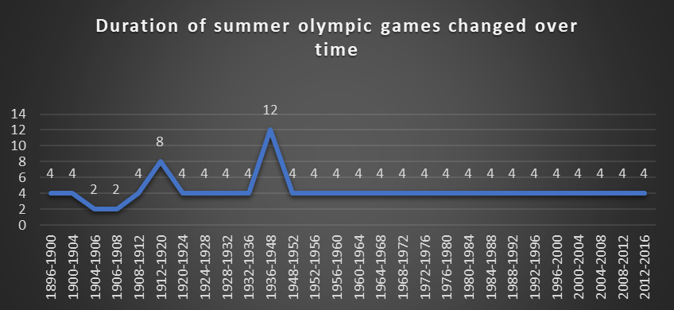
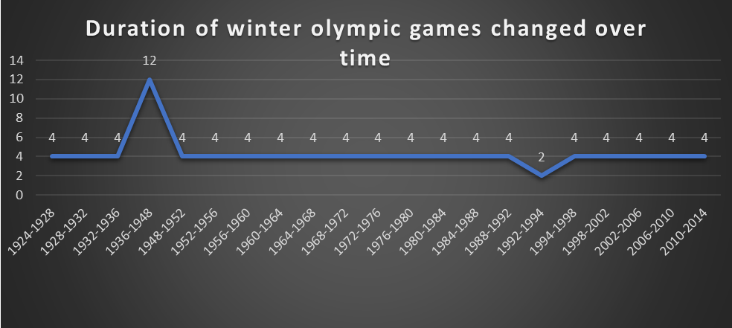
Q-2 how has the duration of Olympic games changed over time?
The duration of the Olympic games has evolved over time. Initially, there were gaps of 2 to 4 years between games. From 1912 to 1920, the gap widened to 8 years due to world war I , and again From 1936 to 1948 , the gap widened to 12 years Subsequently, the duration settled into a pattern of 4-year gaps. This consistent interval persisted until the present day, reflecting a balanced approach to hosting and preparation.

Slide 8
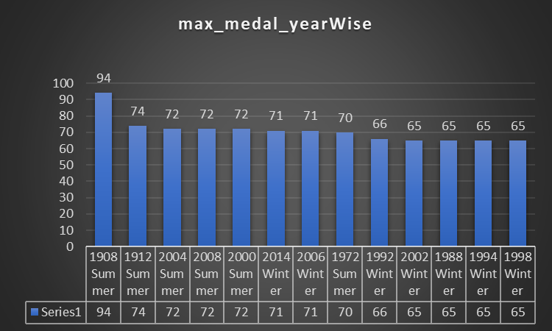
Q-3 are there any notable events or occurrences associated with specific Olympic games?
First of all I joined multiple table to get insight and I got total medal in each Olympics games .highest number of medal was distributed in summer Olympics game 1908.total 94 medal was distributed it is one of the notable event

Slide 9
Q-4 are there any emerging sports that have been recently added to the Olympics?
From given data I joined multiple table in MySQL then I got below result there was two sports that added recently in 2016 Olympics these two sports have never played before . So I can say that these two sports are emerging and recently added in Olympics.

Slide 10
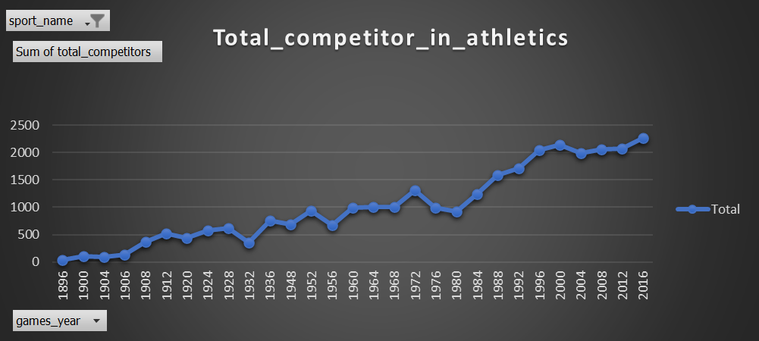
Q-5 how has the popularity of certain sports changed over the years?
After analysand the given data I got this result it show that no. Of competitor are increasing in athletics .In 1896 only 34 person participated and in 2016 total no. Of competitor is 2268 and also maximum events held in athletics that is 47.In This way I can say that most popular sports is athletics.

Slide 11
Q-7 are there any sports that have a higher number of events for one gender compared to others?
I joined multiple table in MySQL to get desirable result finally I got these are the 44 sports that have a higher number of events for one gender compared to others . there is huge different between male and female for sport shooting .in shooting 76 events for male and only 12 events for female.

Slide 12
Q-8 are there any new events that have been introduced in recent editions of the Olympics?
First I joined multiple table MySQL After executing the SQL query i got this result .It is showing only that event which involved in olympics 2016 , these events never held previously.

Slide 13
Q-9 Are there any events that have been discontinued or removed from the olympics?
This is the list of event that were not played in 2016.from given data i saw olympics games start in 1896 and many events were held in 1896 and few events were not held in next any olympics might be that events have discontinued. Some events started in olympics 1900 and then played that year only.

Slide 14
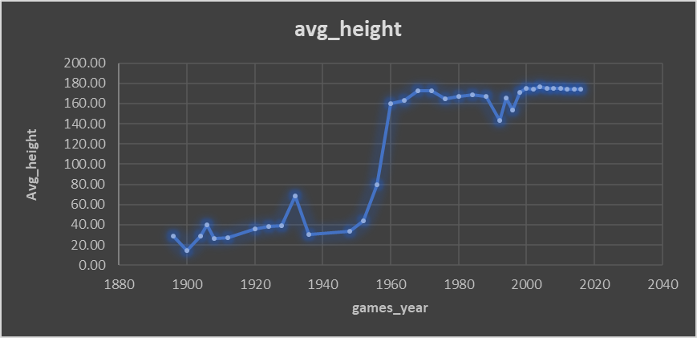
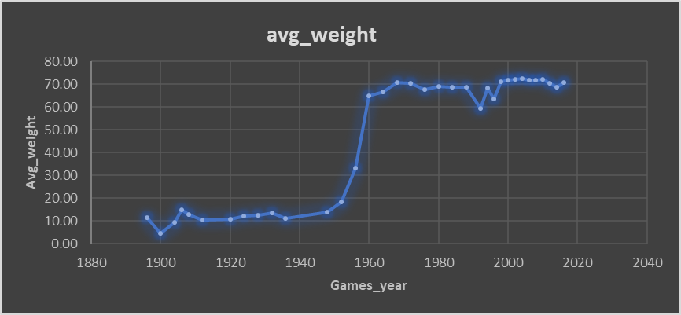
Q-10 Are there any notable trends in the height and weight of participants over time?
Below chart shows that average weight and average height of participants are increasing with increasing with the years .Yes , weight and height are not increasing continuously for few year its decreasing also compare to previous year.

Slide 15
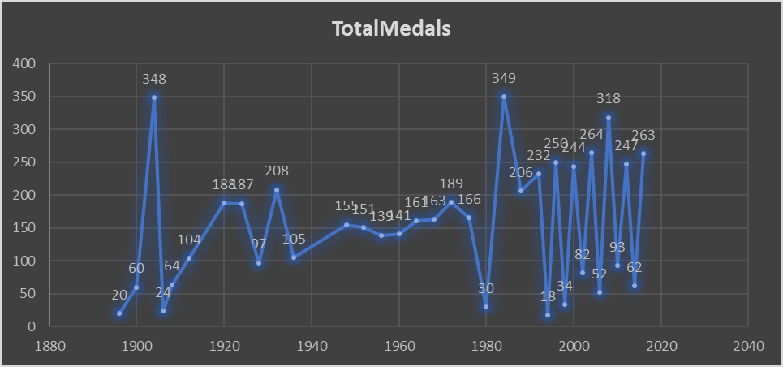
Q-13 Are there any countries that consistently perform well in multiple Olympic editions?
After analysing data I got USA is performing well in multiple olympics editions then soviet and Germany . but highest medal 496 earned by soviet in 1980

Slide 16
Q-14 are there any sports or events that have a higher number of medalists from a specific region?
Ice Hockey Men's Ice Hockey - Sweden has the highest number of medalists with 386, followed by the USA with 376 and Canada with 368.
Hockey Men's Hockey - India has the highest number of medalists with 307, followed by the UK with 303.
Art Competitions Mixed Painting, Unknown Event - USA has the highest number of medalists with 296.
Water Polo Men's Water Polo - Hungary has the highest number of medalists with 253, followed by the USA with 247.
Football Men's Football - Italy has the highest number of medalists with 239, followed by Brazil with 204 and the USA with 198.

Slide 17
Q-16 Are there any regions that have experienced significant growth or decline in Olympic participation?
I after analysing the data I got Bulgaria regions has experienced significant decline in Olympics in 1956 ,total 2243 people participated after few year only 3 people participated and in Egypt regions number of participants are more compare to other regions .

Slide 18
Q-18 Are there any regions that have had a notable impact on the overall medal tally?
1.Top 20 country medal wise
2.Top 20 country medal wise
Table 1 clearly show that USA has owned maximum medal and table 2 show that north Borneo and newfoundland have owned only 2 medal . These 3 regions can be note for max and min medal

Slide 19
Power BI
Questions :
1.How many Olympic Games have been held in each season (Summer vs. Winter)?
2.What is the distribution of games across different decades?
3.Which cities have hosted the most Olympic Games?
4.What is the distribution of sports between Summer and Winter Olympics?
5.Which sports have the highest number of events in the Olympics?
6.How has the participation in each sport evolved over time?

Slide 20
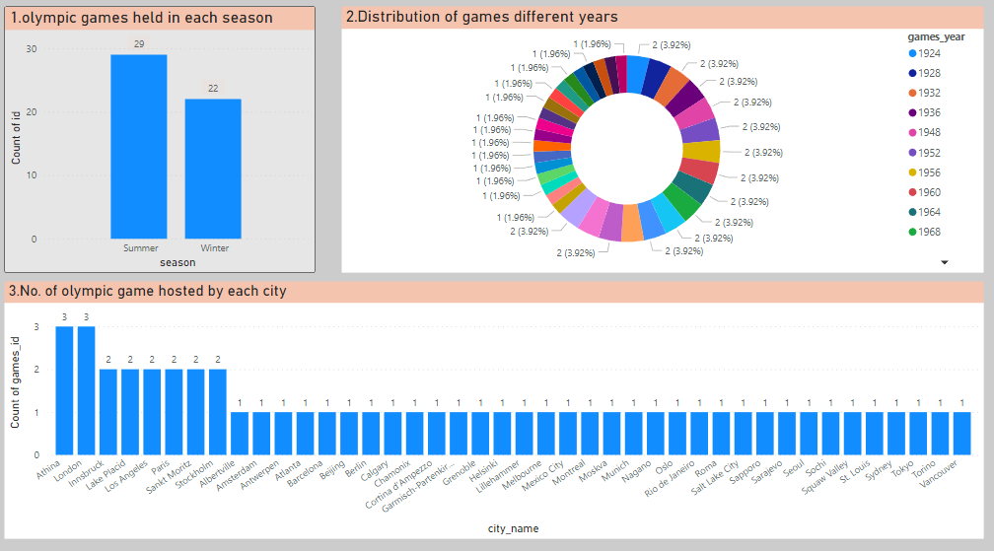

Slide 21
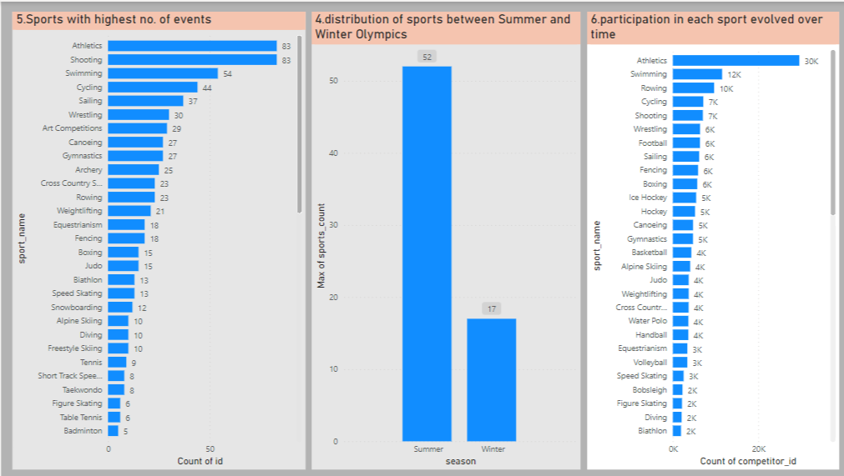

Slide 22
Question :
7.How many events are there in each sport?
8.What is the distribution of events by gender (Men, Women, Mixed)?
9.How has the number of events changed over time?
10.What is the distribution of participants by gender?
11.Which countries have the highest number of participants in the Olympics?
12.How does the age distribution of participants vary across different games?

Slide 23
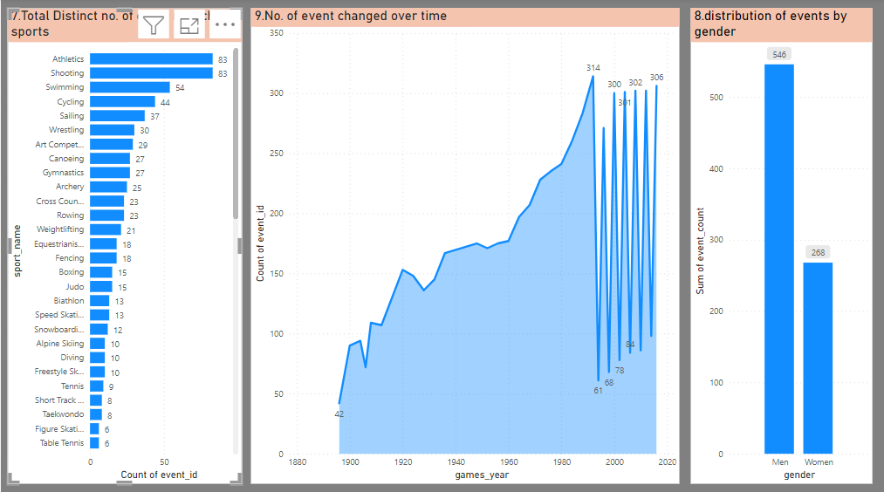

Slide 24
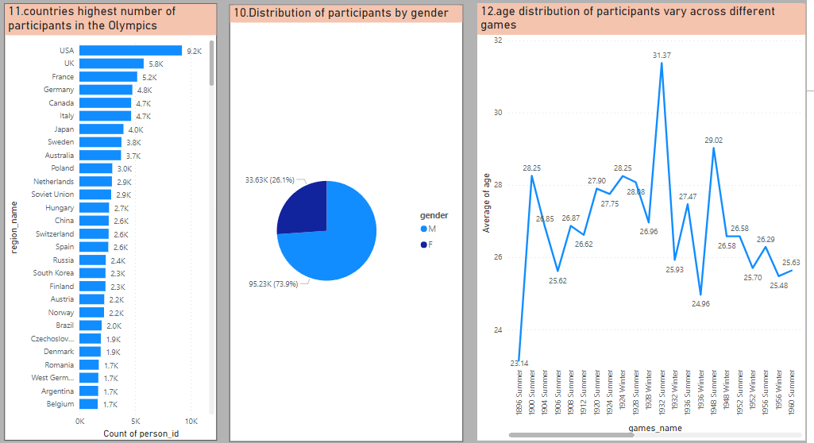

Slide 25
Question :
13.How many medals have been awarded in each Olympics?
14.Which countries have the highest number of gold medals?
15.How does the medal distribution vary across different sports?
16.How many regions or NOCs participate in each Olympic Games?
17.Which regions have the highest number of participants in the Olympics?
18.What is the distribution of medals among different regions?

Slide 26
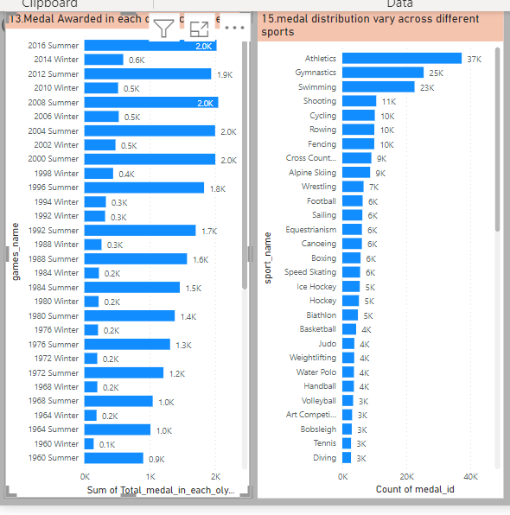

Slide 27
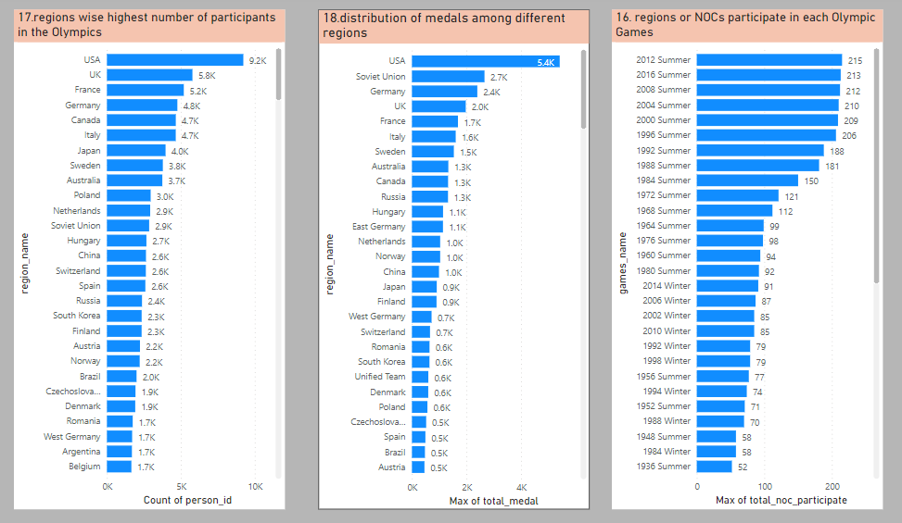

Slide 28
Conclusion
In conclusion, the analysis of the historical data of the Olympic Games has provided us with a wealth of insights that span across various dimensions, shedding light on the evolution and significance of this prestigious international sporting event. Through a thorough examination of the dataset, we've uncovered trends, patterns, and significant information that offer valuable takeaways for enhancing future Olympic Games' organization, sports selection, and representation.

