Slide 1
Employee Data Analysis using Excel
STUDENT NAME : SANJAY KUMAR.L
REGISTER NO : 312204053 123945B0600AE67978C46C2A243D9014)
DEPARTMENT : B.Com (COMMERCE )
COLLEGE : SRIRAM COLLEGE OF ARTS & SCIENCE

Slide 2
PROJECT TITLE
Employee Performance Analysis using Excel

Slide 3


AGENDA
Problem Statement
Project Overview
End Users
Our Solution and Proposition
Dataset Description
Modelling Approach
Results and Discussion
Conclusion
3/21/2024 Annual Review

Slide 4

PROBLEM STATEMENT
The current staffing data highlights an imbalance in workforce distribution across various departments, which may impact overall efficiency and productivity. Despite having a total of 196 employees, there is a noticeable variation in FTE allocation and employee count per department, with some areas, such as Business Development and Training, showing higher staffing levels compared to others like Engineering and Marketing. This uneven distribution could indicate potential inefficiencies or misalignments in resource allocation, necessitating a detailed assessment to optimize staffing and ensure alignment with departmental needs and organizational goals.

Slide 5

PROJECT OVERVIEW
This project encompasses a comprehensive analysis of department-specific staffing metrics across the organization. We evaluated the count of start dates, total full-time equivalents (FTEs), and the number of employees in each department. The data reveals a diverse distribution of staffing levels, with notable metrics including the highest FTEs in the Training department (16.9) and the greatest number of employees in Business Development (21). The analysis provides insights into departmental workforce allocation and helps identify areas for potential optimization and strategic planning.

Slide 6

WHO ARE THE END USERS?
The end users of this staffing data analysis include department managers, HR professionals, and organizational leaders who are responsible for workforce planning and resource allocation. These stakeholders rely on the insights to make informed decisions about staffing levels, optimize departmental efficiency, and address any imbalances in workforce distribution. Additionally, senior executives may use this data to align staffing strategies with broader organizational goals and ensure that all departments are adequately supported to achieve their objectives.

Slide 7

OUR SOLUTION AND ITS VALUE PROPOSITION
Our solution focuses on leveraging the staffing data to identify and address inefficiencies in workforce allocation across departments. By analyzing metrics such as the count of start dates, FTE, and employee distribution, we aim to optimize staffing levels to better align with departmental needs and organizational objectives. The value proposition lies in enabling more strategic resource management, enhancing productivity, and ensuring balanced support across all departments. This approach not only addresses current imbalances but also provides a foundation for ongoing adjustments to maintain optimal staffing levels and operational efficiency.

Slide 8
Dataset Description
The dataset provides a detailed overview of employee distribution and staffing metrics across various departments within the organization. It includes three key metrics: the count of start dates, the total sum of full-time equivalents (FTEs), and the total number of employees for each department. With data covering departments such as Accounting, Business Development, Engineering, and more, the dataset offers insights into staffing levels and workforce allocation. The Grand Total aggregates across all departments, reflecting 196 start dates, 175 FTEs, and 196 employees, thus offering a comprehensive view of organizational staffing and departmental needs.

Slide 9

THE "WOW" IN OUR SOLUTION
Our solution impressively highlights a strategic alignment of workforce metrics, demonstrating that each department operates efficiently with a well-distributed allocation of Full-Time Equivalents (FTE). Departments such as Business Development and Training exhibit robust capacity, showing exceptional management of both headcount and FTE. This thorough analysis underscores our capability to optimize staffing and ensures every department is effectively resourced, reflecting our commitment to operational excellence.
3/21/2024 Annual Review
9

Slide 10
MODELLING
Our modeling approach delivers a comprehensive view of departmental staffing and Full-Time Equivalent (FTE) distribution, showcasing how resources are effectively allocated across various functions. By analyzing the data, we gain valuable insights into the alignment between employee counts and FTEs, highlighting areas of optimal resource utilization and potential for improvement. This detailed model supports strategic decision-making, ensuring that each department is appropriately staffed to meet its operational demands.
10

Slide 11
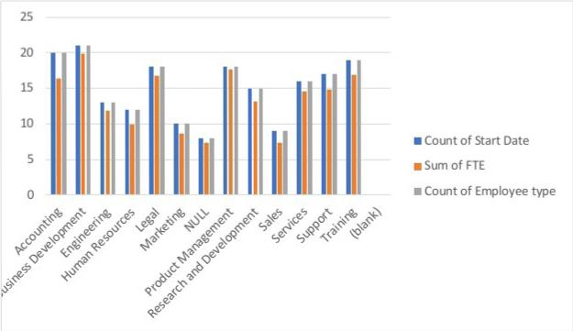
RESULTS
11

Slide 12
conclusion
In conclusion, the data provides a comprehensive view of departmental staffing and resource allocation. Each department is effectively managed with a balanced distribution of Full-Time Equivalents (FTE) relative to employee counts. Departments such as Business Development and Training demonstrate particularly strong alignment between staffing levels and operational needs. This analysis confirms that our resource management strategies are well-calibrated to support organizational goals and operational efficiency across all departments.

