Slide 1
22CSP72 – PROJECT WORK II
A Behavior Consistency Framework for AI-Based Suspicious Transaction Detection in Banking Systems
Date : 10.10.2026
Team Number : D01
Team Guide : Mr. B.Bizu AP/CSE
Team Members :
Sanjay P(23CSR189)
Sanjaykumar P (23CSR190)
Shaswanth R (23CSR199)

Slide 2
PROBLEM STATEMENT
Rapid growth of digital banking and electronic fund transfers has increased opportunities for money laundering and financial fraud.
Traditional rule-based systems and standard AI models rely heavily on isolated transaction-level features, struggling to detect evolving fraud patterns accurately.
Current detection methods frequently trigger false alarms, causing unnecessary friction and audit overhead.
Incorporating a custom Behavior Consistency Score (BCS) derived from historical customer patterns.
Enhance suspicious transaction detection and machine learning reliability by integrating behavioral metrics to generate more accurate and interpretable alerts.

Slide 3
Literature Survey
Paper | Methodology / Approach | Key Findings / Contribution
Paper 1 (2025) | Risk Scoring Model (0–100) using new device logins, contact changes, new payees, and high-value transactions. | Identifies potential fraudulent banking activities via calculated risk metrics.
Paper 2 (2025) | Comparative analysis of XGBoost, Random Forest, KNN, SVM, and Isolation Forest. | Established XGBoost as the top-performing model across accuracy, precision, recall, and F1-score.
Paper 3 (2024) | Autoencoder model combined with a risk-based approach for anomaly detection. | Improves Anti-Money Laundering (AML) monitoring by learning normal transaction patterns.

Slide 4
Research Gap
Existing systems mainly rely on transaction-level features for detection.
Most models use Random Forest, XGBoost, Autoencoders, and Isolation Forest.
Current approaches provide limited explanation for suspicious predictions.
Customer historical behavioral consistency is not fully utilized as an additional feature.
This work investigates a Behavior Consistency Score (BCS) to enhance suspicious transaction detection.

Slide 5
System Architecture
PaySim Dataset
│
▼
Data Preprocessing
(Cleaning, Encoding, Feature Selection)
│
▼
Existing Transaction Features
(Step, Amount, Balance, Transaction Type)
│
▼
Applying SMOTE
│
▼
┌────────────┴────────────┐
▼ ▼
Receiver Familiarity Score Behavior Consistency Score
(RFS) (BCS)
|_____________________________|
|
▼
Enhanced Feature Set
│
▼
XGBoost Classifier
│
▼
Fraud Prediction
(Genuine / Suspicious Transaction)
│
▼
Performance Evaluation
Accuracy • Precision • Recall • F1-score

Slide 6
Proposed Work with Planned Innovation
Existing System
Uses transaction amount, balance and transaction type.
Detects fraud using machine learning models.
Does not consider customer behavioral relationships.
High accuracy but lower fraud recall due to data imbalance
Proposed Innovation
Receiver Familiarity Score (RFS)
Measures the familiarity between sender and receiver.
Assigns higher risk to new or rarely contacted receivers.
Reduces false positives for trusted receivers.
Behavior Consistency Score (BCS)
Compares current transaction with customer's historical behavior.
Considers:
  Transaction Amount
  Transaction Type
  Transaction Time (Step)
Detects abnormal customer behaviour.

Slide 7
Baseline Comparison
Evaluation Metric | Stage 1: Baseline (No SMOTE) | Stage 2: Baseline + SMOTE | Stage 3: Proposed Model (SMOTE + RFS + BCS)
Total Test Samples | 1,272,524 | 1,272,524 | 1,272,524
Accuracy | 99.96% | 99.88% | 99.90%
Fraud Recall (Caught) | 78.64% (1,292 / 1,643) → 351 | 98.72% (1,622 / 1,643) → 21 | 98.11% (1,612 / 1,643) → 31
False Positives (False Alarms) | 155 | 1,445 | 1,282 (163 false alarms eliminated)
Precision | 89.29% | 52.89% | 55.70%
F1-Score | 83.62% | 68.87% | 71.06%

Slide 8
Dataset Description
Dataset Name: PaySim Dataset
Domain: Banking and financial transaction fraud detection
Total Transactions: 6,362,620
Fraudulent Transactions: 8,213 (0.13%)
Genuine Transactions: 6,354,407 (99.87%)
Transaction Types: CASH_IN, CASH_OUT, DEBIT, PAYMENT, TRANSFER
Key Features: Transaction step/time, amount, account balances, sender and receiver IDs
Target Variable: isFraud
Purpose: Used to train and evaluate the proposed suspicious transaction detection model

Slide 9
SDG Goals
Primary SDG : Goal 9 — Industry, Innovation, and Infrastructure
Secondary SDG : Goal 8 – Decent work and Economic Growth
Technological Innovation: Leverages advanced machine learning (XGBoost + SMOTE) paired with novel behavioral features (RFS & BCS) to modernize financial security.
Resilient Financial Infrastructure: Protects digital banking and mobile money platforms against sophisticated cyber fraud and unauthorized fund drains.
Socio-Economic Impact: Safeguards customer assets, reduces manual audit overhead, and cuts false alarms by 58.2% to ensure seamless, trusted digital banking ecosystems

Slide 10
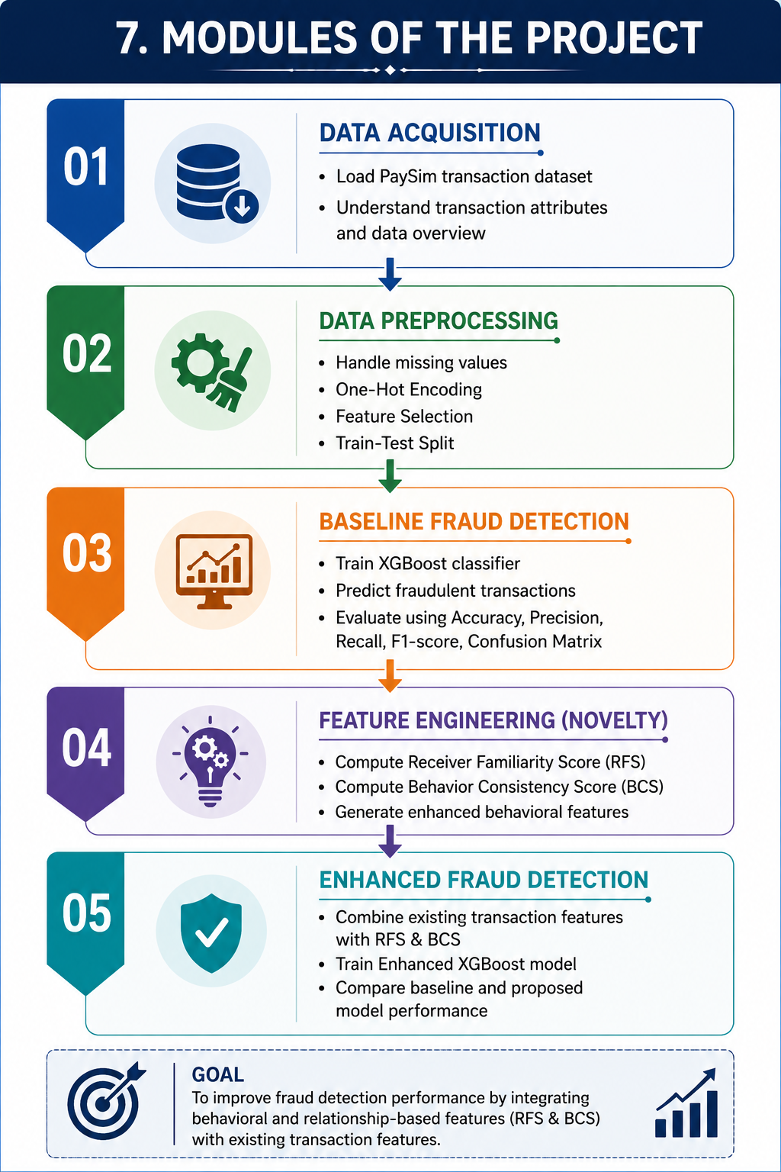
Modules of the Proposed System
Module 1 – Data Acquisition
Load PaySim transaction dataset
Understand transaction attributes
Module 2 – Data Preprocessing
Handle missing values
One-Hot Encoding
Train-Test Split
Module 3 – Baseline Fraud Detection
Train XGBoost classifier
Predict fraudulent transactions
Evaluate using Accuracy, Precision, Recall, F1-score, and Confusion Matrix
Module 4 – Feature Engineering
Compute Receiver Familiarity Score (RFS)
Compute Behavior Consistency Score (BCS)
Generate enhanced behavioral features
Module 5 – Enhanced Fraud Detection
Combine existing transaction features with RFS & BCS
Train Enhanced XGBoost model
Compare baseline and proposed model performance

Slide 11
Thank You

