Slide 1
22CSP72 – PROJECT WORK II PHASE I
A Behavior Consistency Framework for AI-Based Suspicious Transaction Detection in Banking
Date : 25.06.2026
Team Number : D01
Team Guide : Mr. B.Bizu AP/CSE
Team Members :
Sanjay P(23CSR189)
Sanjaykumar P (23CSR190)
Shaswanth R (23CSR199)

Slide 2
PROBLEM STATEMENT
The rapid growth of digital banking, online payments, and electronic fund transfers has significantly increased the number of financial transactions, creating greater opportunities for money laundering and suspicious financial activities. Traditional rule-based monitoring systems and many existing AI-based approaches primarily rely on transaction-level features, making it difficult to detect evolving fraud patterns accurately and often resulting in high false-positive rates.
This project proposes to enhance suspicious transaction detection by incorporating a Behavior Consistency Score (BCS) derived from a customer's historical transaction behavior. By comparing current transactions with normal behavioral patterns and integrating BCS as an additional feature in machine learning models, the proposed system aims to improve detection performance while providing more reliable and interpretable suspicious transaction alerts.

Slide 3
Literature Survey
Paper 1: AI-Driven Fraud Detection: A Risk Scoring Model for Enhanced Security in Banking
Develops a Risk Scoring Model (0–100) to identify potentially fraudulent banking activities.
Uses indicators such as new device logins, contact information changes, new payees, and high-value transactions to calculate risk.
Paper 2: Comparative analysis of machine learning algorithms for money laundering detection
Compares multiple machine learning algorithms (XGBoost, Random Forest, KNN, SVM, Isolation Forest) for detecting money laundering transactions.
Finds XGBoost as the best-performing model, achieving the highest accuracy, precision, recall, and F1-score among the evaluated algorithms.
Paper 3: A Suspicious Financial Transaction Detection Model Using Autoencoder and Risk-Based Approach
Uses an Autoencoder model to learn normal transaction patterns and identify anomalous (suspicious) financial transactions.
Combines anomaly detection with a risk-based approach to improve Anti-Money Laundering (AML) monitoring and suspicious transaction detection.

Slide 4
Research Gap
Existing systems mainly rely on transaction-level features for detection.
Most models use Random Forest, XGBoost, Autoencoders, and Isolation Forest.
Current approaches provide limited explanation for suspicious predictions.
Customer historical behavioral consistency is not fully utilized as an additional feature.
This work investigates a Behavior Consistency Score (BCS) to enhance suspicious transaction detection.

Slide 5
Objectives
Aims of the Proposed Work
To develop an AI-driven suspicious transaction detection for identifying potential money laundering and fraudulent banking transactions.
To analyze customer historical transaction patterns and construct a Behavior Consistency Score (BCS) to measure transaction consistency.
To integrate the BCS as an additional input feature along with transaction attributes in Machine Learning models for enhanced detection.
To evaluate whether the proposed BCS improves detection performance by reducing false positives and improving prediction accuracy.

Slide 6
Novelty
Behavior Consistency Score (BCS): Introduces a behavioral score by comparing the current transaction with the customer's historical transaction patterns.
BCS as an Additional ML Feature: Integrates the Behavior Consistency Score along with existing transaction attributes to improve machine learning-based prediction.
Reduced False Positives: Investigates whether incorporating BCS can reduce false positives and improve overall detection performance compared to traditional transaction-level models

Slide 7
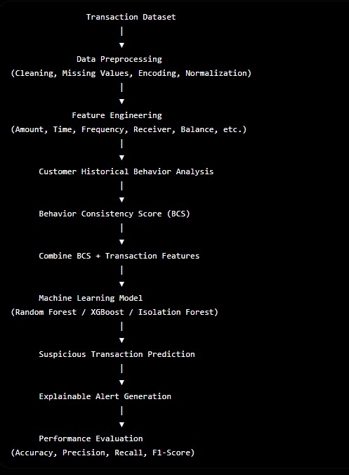
Proposed Methodology

Slide 8
Thank You

