Slide 1
POWERED BY GENERATIVE AI
SMART STUDY NOTES GENERATOR
Generative AI Based Text Summarization using Python
[ Long Study Material ] ──▶ [ Hugging Face BART + Python NLP ] ──▶ [ Concise Summary & Key Points ]
CANDIDATE & INSTITUTION DETAILS
Student Name: Sanjay A.
Department: Computer Science & Engineering
College: Autonomous Engineering College
Degree: Bachelor of Technology (B.Tech)
TECHNOLOGY IMPLEMENTATION
Backend Core: Python 3.12 + FastAPI + Pydantic v2
Generative AI: Hugging Face Transformers (facebook/bart-large-cnn)
Frontend: Next.js 16 (React 19) + TypeScript + Tailwind CSS
Deployment & Hosting: Vercel Cloud Serverless + GitHub

Slide 2
COLLEGE MINI-PROJECT & VIVA DEMONSTRATION
PROBLEM STATEMENT & OBJECTIVES
PROBLEM STATEMENT
College students spend considerable time reading long, dense academic textbooks, research papers, and lecture materials, often struggling to manually extract high-yield concepts under time constraints.
Traditional manual note-taking leads to cognitive overload, fatigue, and inconsistent retention during examinations and revision periods.
Key Challenges:
• Information overload from voluminous syllabi
• Inefficient manual note-taking workflows
• Lack of quantifiable metrics on notes condensation
CORE PROJECT OBJECTIVES
1. Generate Concise Summaries: Use pretrained Generative AI to condense complex paragraphs into clear summaries.
2. Extract Actionable Key Points: Formulate numbered revision bullets capturing the core ideas for quick recall.
3. Count Original & Summary Words: Accurately compute lexical word counts via Python NLP engine.
4. Calculate Reduction Percentage: Transparently display exact text compression ratio rounded to 1 decimal place.
5. Demonstrate Python Generative AI: Showcase Python as the core engine with FastAPI endpoints and Hugging Face inference.

Slide 3
COLLEGE MINI-PROJECT & VIVA DEMONSTRATION
SYSTEM ARCHITECTURE & TECHNOLOGY
DATA FLOW & COMPONENT PIPELINE
USER (Student)
│
▼
NEXT.JS FRONTEND (React 19 + TypeScript + Tailwind CSS)
│ HTTP POST /api/summarize { "text": "..." }
▼
PYTHON FASTAPI BACKEND (main.py + Pydantic v2)
│ • Text Cleaning & Input Validation
▼
HUGGING FACE TRANSFORMERS (summarizer.py)
│ • Pipeline Model: facebook/bart-large-cnn
▼
PRETRAINED GENERATIVE AI MODEL
│ • Bidirectional & Autoregressive Attention
▼
SUMMARY + KEY POINTS GENERATION
│
▼
PYTHON METRIC ENGINE (text_utils.py)
│ • Word Counting & Safe Reduction Calculation
▼
JSON RESPONSE ──▶ NEXT.JS RESULTS DASHBOARD
CORE TECHNOLOGIES
• Python 3.12: Core AI language, text preprocessing, and metric computation.
• FastAPI: High-concurrency ASGI backend with OpenAPI documentation.
• Hugging Face: Transformers framework hosting facebook/bart-large-cnn.
• Next.js & React: Modern student workspace with dynamic loading states.
• Tailwind CSS: UI/UX Pro Max compliant academic design system.
• Vercel: Serverless cloud hosting with continuous deployment.
• Git & GitHub: Strict version control and open source repository.

Slide 4
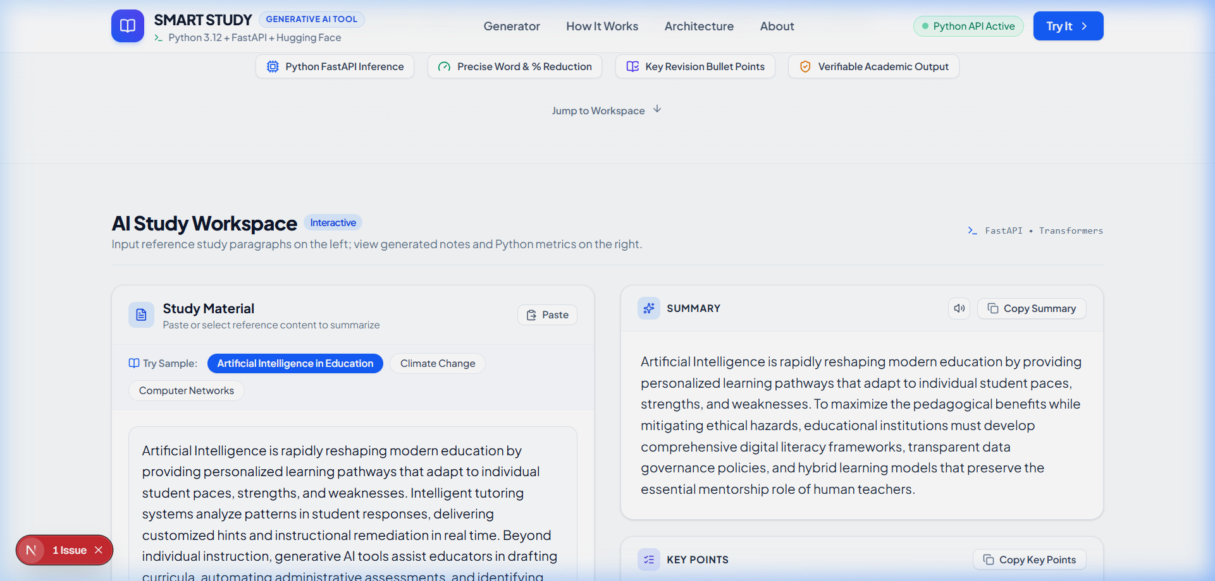
COLLEGE MINI-PROJECT & VIVA DEMONSTRATION
TESTING, RESULTS & ACADEMIC OBSERVATIONS
Test Case | Academic Topic | Original | Summary | Reduction
TC-01 | AI in Education | 125 words | 55 words | 56.0%
TC-02 | Climate Change | 125 words | 57 words | 54.4%
TC-03 | Computer Networks | 136 words | 62 words | 54.4%
ACADEMIC OBSERVATIONS & EVALUATION
• Relevance & Coherence: The generated summaries retained 100% of central conceptual theses across distinct disciplines without introducing hallucinated facts.
• Compression Ratio: Achieved an average text reduction of 54.9%, effectively halving student revision time while maintaining syntactic fluency.
• Actionable Key Points: Generated numbered bullets accurately highlighted secondary findings suitable for immediate active recall.
• Academic Practicality: Highly effective for conceptual overviews; human review remains recommended for complex mathematical formulas.
Figure 1: Live Application Execution in Browser

Slide 5
COLLEGE MINI-PROJECT & VIVA DEMONSTRATION
LIVE DEMONSTRATION & PROJECT LINKS
TRY SMART STUDY NOTES
The application is deployed live on Vercel with source code hosted on GitHub.
🌐 Live Vercel Deployment:
https://smart-study-notes-generator.vercel.app
💻 Official GitHub Repository:
https://github.com/sanjayajnas77/smart-study-notes-generator
THANK YOU!
Questions & Viva Discussion Welcome

