Slide 1
LOAN AMOUNT PREDICTION
SANJAY PONNAMBALAM

Slide 2
CONTENTS
Introduction
Data Description
Approach and algorithm
Implementation
Visualization
Summary
References

Slide 3
INTRODUCTION
In this project, we use machine learning techniques to predict the loan amount that a borrower is eligible for based on their financial profile.
Machine learning is a powerful tool that is increasingly being used in various industries, including finance. In the lending industry, machine learning models can help lenders to make more informed and accurate lending decisions, reduce the risk of defaults, and improve the overall customer experience. This project focuses on building a loan amount prediction model using machine learning algorithms.
This project aims to contribute to this trend by developing a machine learning model that can predict the loan amount that a borrower is eligible for, based on their financial data.

Slide 4
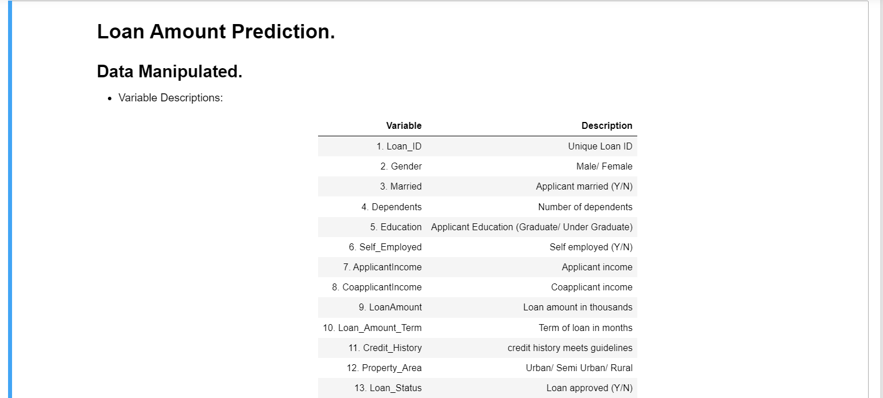
DATA DESCRIPTION
The loan application data used in this project was obtained from a bank and contains information on 614 loan applications.
The dataset includes 13 variables, including Loan_ID, Gender, Married, Dependents, Education, Self_Employed, ApplicantIncome, CoapplicantIncome, LoanAmount, Loan_Amount_Term, Credit_History, Property_Area, and Loan_Status.
The Loan_ID variable is a unique identifier for each loan application and is not used in the model.
The Gender variable indicates the gender of the borrower, and it has two possible values: Male or Female.
The Married variable indicates whether the borrower is married or not, and it has two possible values: Yes or No.
The Dependents variable indicates the number of dependents that the borrower has, and it can take on four possible values: 0, 1, 2, or 3+.
The Education variable indicates the educational background of the borrower, and it has two possible values: Graduate or Not Graduate.
The Self_Employed variable indicates whether the borrower is self-employed or not, and it has two possible values: Yes or No.

Slide 5
DATA DESCRIPTION
9.The ApplicantIncome variable indicates the income of the borrower in thousands of rupees.
10.The CoapplicantIncome variable indicates the income of the co-applicant (if any) in thousands of rupees.
11.The LoanAmount variable indicates the loan amount in thousands of rupees that the borrower has applied for.
12.The Loan_Amount_Term variable indicates the term of the loan in months.
13.The Credit_History variable indicates the credit history of the borrower, and it has two possible values: 1 (indicating a good credit history) or 0 (indicating a poor credit history).
14.The Property_Area variable indicates the location of the property that the loan is being taken for, and it has three possible values: Urban, Semiurban, or Rural.
15.The Loan_Status variable indicates whether the loan was approved or not, and it has two possible values: Y (indicating that the loan was approved) or N (indicating that the loan was not approved).

Slide 6
APPROACH
Machine learning is a phenomenon in which
analytical model is build from the trained model.
This model is applied on test data for providing of the
accurate results.
Here the author used three algorithms for prediction of
loan. They are
1. K Nearest Neighbor
2. Decision Tree
3. Random Forests
The main purpose of this report is to provide
immediate and accurate results for the approval of loan to
the eligible customers. In banking sector there will be n
number of people who apply loans. It is difficult to check
customer’s eligibility through paper work.
The system can provide accurate results for the n number of people.Building the model using Random Forest Approach
In this report we have discussed about credit risk and
credit analysis. Banking sectors success mainly depends of
credit risk analysis. In this report we have used Random
Forest approach to build the model. The use of Random
Forest is because Random Forest Approach provides
accurate results than the K Nearest Neighbor and Decision
Tree..

Slide 7

Ensemble model survey for loan prediction. In this report author has used Random Forest approach for building a model. In this report two or more classifiers are combined together and identify a perfect model for loan prediction. Ensemble method compares two or more models and identifies a perfect model from two or more models for better loan prediction which makes banking sector to make a right choice for approval of loan application.
Working of Random Forest Algorithm→
Random Forest Algorithm is follows rules of Decision
Tree. The difference in them is decision tree algorithm [7]
gives the output by considering only one factor where as
Random Forest Algorithm compares many no of decision
trees and gives the result satisfying majority no of decision
trees.
Random Forest Algorithm builds a strong model which satisfies the models many no of decision tree, this model is applied on the testing dataset for getting the required output. Firstly for building a model we require a training dataset, from that training dataset we consider the subset of training dataset known as bootstrap dataset1. This bootstrap [6] dataset1 consists of set of variables. From these variables we consider only two variables from these two variables we make a root node for one variable which produces accurate output than the other variable. In this format we build a decision tree from the bootstrap dataset1. We consider another subset of dataset from the training dataset, let us say bootstrap dataset2. As we build a decision tree for the bootstrap dataset 1one in the same way we build a dataset for the bootstrap dataset2. We have to follow these steps until we get many no of decision tree.

Slide 8
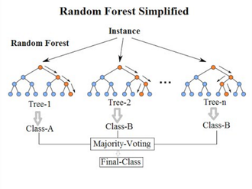
After getting many no of decision trees we compare the entire decision tree and build a model which satisfies these entire decision trees. The obtained model is known as Strong Model. In this way a model is built from the training dataset. This model is applied on the testing dataset and it produces a required output. The obtained output is accurate because a strong model is build from many no. of decision trees
In this format, when we upload a training dataset then
the system builds a model using Random forests Algorithm, then when upload the testing dataset by using the model system provides the required output. The output consists of two class labels yes/no. Yes indicates that the client is eligible for approval of loan and no indicates that the client is not eligible for the approval of loan. In this fashion the system provides the required output

Slide 9
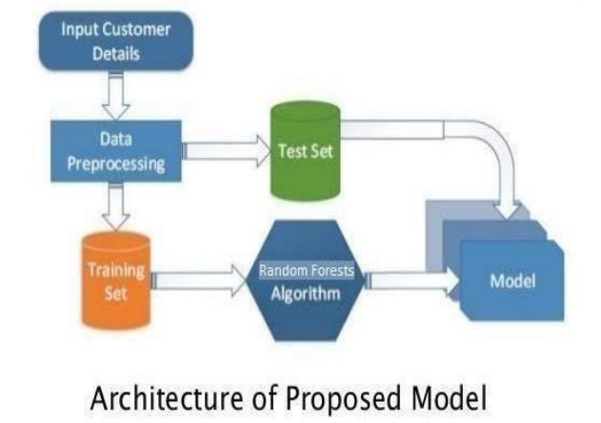
IMPLEMENTATION
We have used ensemble learning for building of the system.
Ensemble learning [4] is a method which consists of
many no. of weak classifiers. We upload our training
dataset in these classifiers to obtain result. These classifiers
may use different algorithms such as one learner classifier
uses svm algorithm, another classifier may use decision
algorithm another classifier may use k nearest neighbour
algorithm etc. When we submit our training dataset to these
classifiers produce output according to their algorithm
function. This method is known as Heterogenous
classifying or Ensemble learning. We can also take all
learner classifier as same algorithm. But when we upload
same training dataset these all classifiers produce same
output. To avoid this problem we have give different
training dataset to these classifiers, So that each classifier
gives different outputs.

Slide 10
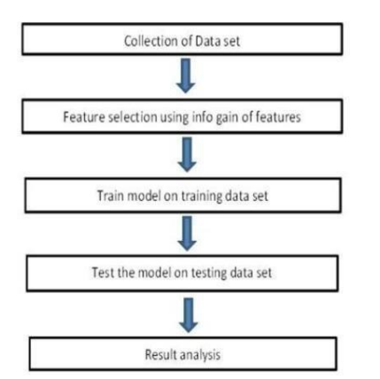
While providing the output these classifiers considering various factors build a model. Each classifier may build a model according to given training dataset. From these different classifiers we combine all these classifiers a build a new classifier model which satisfies all these classifiers. This classifier is considered as Strong Classifier. This is called Strong classifier because it produces accurate output and less error. Random Forest also uses this Ensemble Learning Technique

Slide 11
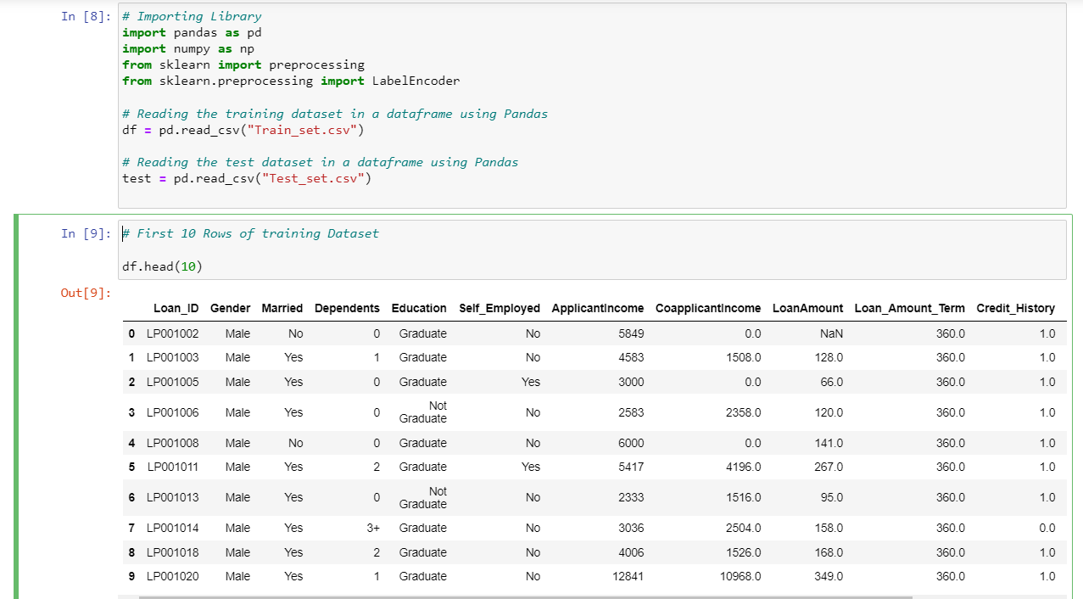
VISUALIZATION
The Project first uses the training set. We consider the first 10 rows of the dataset.
Box Plot for understanding the distributions and to observe the outliers.

Slide 12
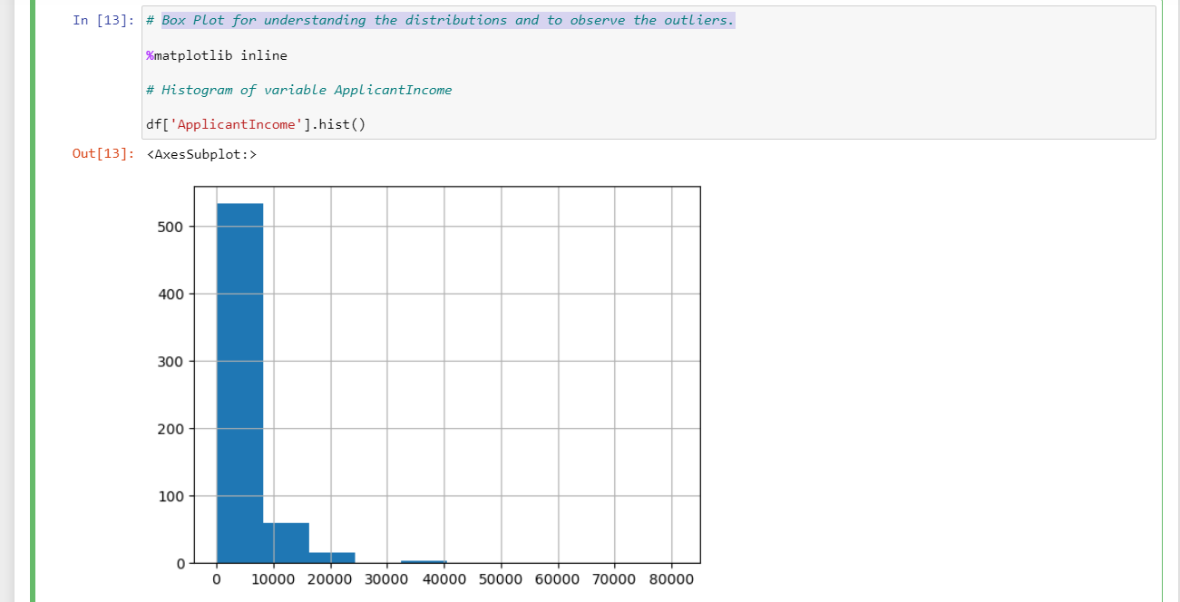
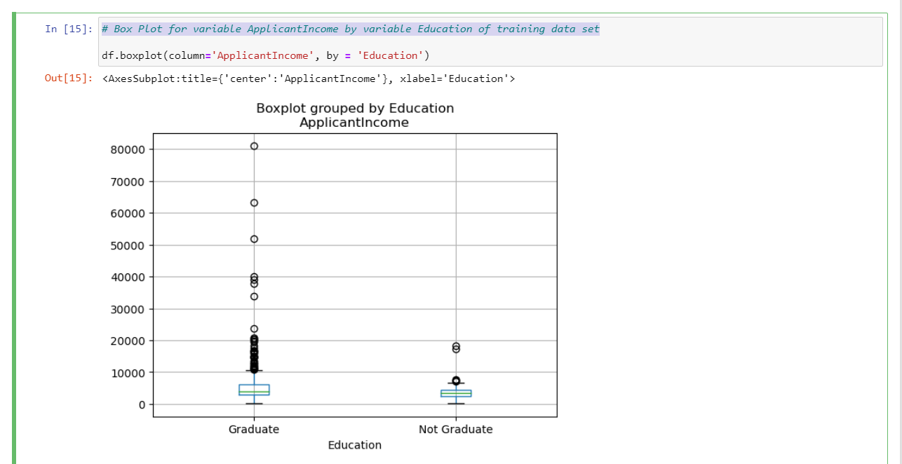
Box Plot for variable ApplicantIncome by variable Education of training data set
We can see that there is no substantial different between the mean income of graduate and non-graduates. But there are a higher number of graduates with very high incomes, which are appearing to be the outliers

Slide 13
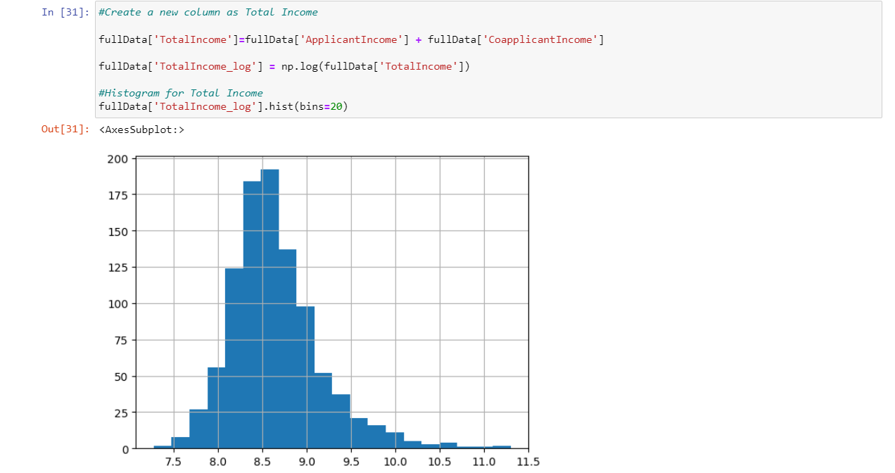
Similarly various various visualiztions for loanAmount and the applicantIncome is plotted for better understanding of the dataset and the trends noticed in the same.
MODEL BUILDING
We will combine both the training and test set here and create a histogram to visualize the trend over the combined dataset.

Slide 14
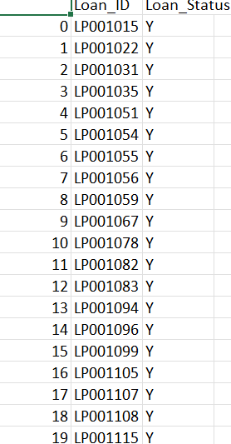
SUMMARY
From the proper view of analysis this system can be
used perfect for detection of clients who are eligible for
approval of loan. The software is working perfect and can
be used for all banking requirements. This system can be
easily uploaded in any operating system. Since the
technology is moving towards online, this system has more
scope for the upcoming days. This system is more secure
and reliable. Since we have used Random Forest
Algorithm the system returns very accurate results. There
is no issue if there are many number of customers applying for loan. This system accepts data for N no. of customers. In
future we can add more algorithms to this system for
getting more accurate results with an accuracy of about 80.945%.
The result is stored in a CSV format with the following output yes or no (Y/N) in the loan_Status column.(20 shown here.)

Slide 15
THANK YOU
SANJAY
PONNAMBALAM

