Slide 1


SIH 2020
CODE ATTORNEY
Court Case Management Software

Slide 2

TEAM DETAILS
1. Sanjay S - 111718104082
2. Sathish M - 111718104083
3. Sathya S - 111718104085
4. Srutikaa A - 111718104093
5. Sujitha Sree A -111718104096
6. Thyagaraj T - 111718104101

Slide 3
Organization: Dr. B R Ambedkar
Institute of Technology
Category : Software
PS Number : DS159
Domain Bucket: Software – Web
App Development

Slide 4
PROBLEM STATEMENT
DESCRIPTION:
Repository of departmental court cases design and prepare a court case management software that has facility to record information like adding a case ,adding lawyers (have facility select from existing list of lawyers) , add invoice for each hearing and for different heads under which lawyers change the clients. In short the system should provide end to end management of court case from client perspective and should be easy to use.

Slide 5

IDEA:
Our web-based case management software provides solutions to the challenges faced in organizing, streamlining, and effectively utilizing the dynamic information that advocates and law firms handle each day.
We have used front stack development to create page and accessed third party API’s to implement some features like message, calendar alert, receipt generator and so on,.
Our aim is to provide an eco-friendly solution and it must be accessible on any internet-enabled device.

Slide 6
Our web app’s invoice management simplifies and adds structure to the client invoicing process.
The aim is to provide you the best possible experience. The legal software saves you time and effort, enables you to manage cases in a more organized manner, and collaborate more efficiently, for positive contributions to revenue and brand image.

Slide 7
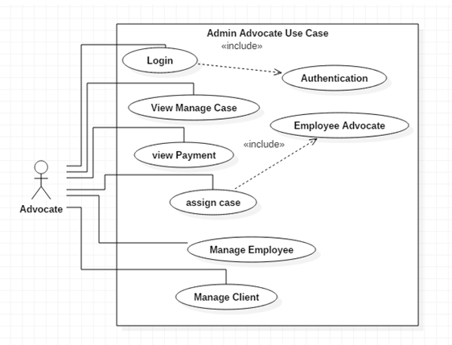

Slide 8
Requirement of case information management system
Improve Security:
This system has multilevel profiles. The lower profile should not view upper
profiles. System security should be ensured in this system.

Slide 9
Support Multi User:
Nowadays, every system work in an environment of multi user. As per requirement of our system, the system is developed in multi user’s environment.
Fast:
Every module should be compatible with other modules.

Slide 10
There should not be any lag or delay in processing the data.
Available 24/7:
Case Management System should be available to clients 24X7. The user can access the system whenever they need to access, wherever they want to access provided having an internet connection and device to access.

Slide 11


TECHNOLOGY STACK
FRONT END
1.HTML:
Hypertext Markup Language (HTML) is the standard markup language for documents designed to be displayed in a web browser. It can be assisted by technologies such as Cascading Styling Sheets(CSS) and scripting languages such as JavaScript
2.JQUERY:
jQuery is a JavaScript library designed to simplify HTML DOM tree traversal and manipulation, as well as event handling, CSS animation, and Ajax. It is free, open-source software using the permissive MIT License.

Slide 12


3.CSS:
Cascading Style Sheets (CSS) is a style sheet language used for describing the presentation of a document written in a markup language like HTML. CSS is a cornerstone technology of the World Wide Web, alongside HTML and JavaScript. CSS is designed to enable the separation of presentation and content, including layout, colors, and fonts. This separation can improve content accessibility, provide more flexibility and control in the specification of presentation characteristics, enable multiple web pages to share formatting by specifying the relevant CSS in a separate.
4.JS:
JavaScript often abbreviated as JS, is a high-level, just-in-time compiled, multi-paradigm programming language that conforms to the ECMAScript specification. JavaScript has curly-bracket syntax, dynamic typing, prototype-based object-orientation, and first-class functions. JavaScript enables interactive web pages and is an essential part of web applications. The vast majority of websites use it, and major web browsers have a dedicated JavaScript engine to execute it.

Slide 13


5.BOOTSTRAP:
Bootstrap is a free and open-source CSS framework directed at responsive, mobile-first front-end web development. It contains CSS and (optionally) JavaScript-based design templates for typography, forms, buttons, navigation and other interface components. Bootstrap is a web framework that focuses on simplifying the development of informative web pages (as opposed to web apps).
6.DJANGO(python framework):
Django is a Python-based free and open-source web framework, which follows the model-template-view (MTV) architectural pattern. Django's primary goal is to ease the creation of complex, database-driven websites. The framework emphasizes reusability and "pluggability" of components, less code, low coupling, rapid development, and the principle of don't repeat yourself

Slide 14


BACK END
1.MYSQL:
MySQL is an open-source relational database management system (RDBMS).MySQL is free and open-source software under the terms of the GNU General Public License, and is also available under a variety of proprietary licenses.
2.PHP:
PHP is a general-purpose programming language originally designed for web development. PHP is a recursive acronym for "PHP: Hypertext Preprocessor". PHP is a server side scripting language that is embedded in HTML.

Slide 15

FEATURES:
1.DOCUMENTS MANAGEMENT:
.
Upload and download several documents at a time.
Filter documents by case, title, time,
uploader and type.
Get a top-level view of all uploaded
documents on a single screen.
Choose to keep documents private
or grant access as needed.
View documents by title, size, type, time of upload
and the name of team member who uploaded it.

Slide 16
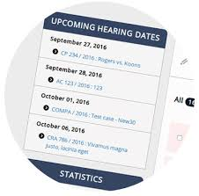
2.HEARING DATES MANAGEMENT:
you can keep track of hearing dates with exceptional efficiency.
Once you input the basic details such as case
type, number and year, the web app pulls
publicly available data from the
Supreme Court, High Court or
District Court website.
It filters the hearing dates pertaining
to your case only and automatically creates
a calendar entry.
This helps to never miss your court date.

Slide 17
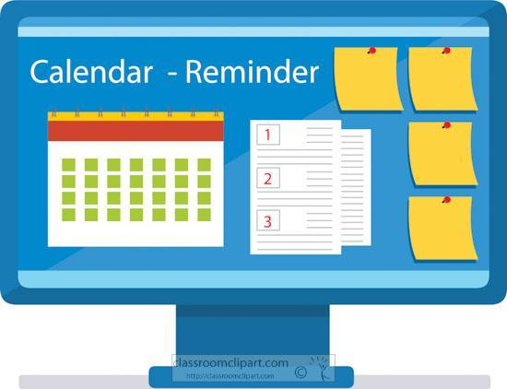
3.GCalendar:
This web app allows calendar functionality to enable the daily, weekly and monthly tracking of
to-dos and hearing dates.
You can filter your search by to-dos or
hearing dates to view exactly what you want.
If the task is critical, set an
additional reminder to ensure
that recipients don’t skip the
deadline.
The ability to view court schedules for various cases on a single platform will help advocates plan their availability and communicate their inability to attend a hearing well in advance.

Slide 18
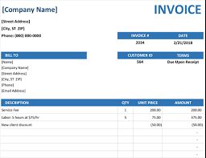
4.BILL/INVOICE:
Our web app’s invoice management simplifies and adds structure to the client invoicing process.
You can view invoices by each client, and get details such as total invoiced amount, total paid amount, balance due and invoice by type as well as each invoice for the particular client, with date of issue, total amount and balance due.
Sendgrid API can be used to send invoices as emails for easy interaction between clients and admins.

Slide 19

5.SECURITY:
Every time you login, an SMS informing that a login has occurred from your account is sent to you.
(API: Nexmo)
Each time you log in, a one-time password (OTP) valid for one login session is automatically generated and sent via SMS and email.
Only upon entering the OTP, which is valid for some time, is log in possible. This authentication ensures that logins are secure and performed by the user only.

Slide 20
USE CASES:
This web app can be very useful for lawyers and clients. There are many special features included in this website for easy interaction with user. The software interface has a clean design, is easy to follow and all the information you need is available on a single platform. This feature also allows judges to use the platform and they are considered as super-users.
It is possible to manage the hearing dates, generate invoices, provide calendar and reminders and so on. This new, modern mindset will encourage innovative businesses to facilitate technological change that the judicial ecosystem aims to achieve.

Slide 21
THANK YOU
Thank You

