Slide 1
TDMA Schedule Planner & Optimizer
S0
S1
S2
S3
S4
S5
Distance-2 graph colouring for collision-free TDMA, enforced in an EMANE emulation
S6
S7
S8
Sanjay Suresh · Vaan Megam Networks, Wireless Protocol Development internship task · October 2026
9 slots
0 collisions
99.88 %
proven optimal for the PDF's 16-node sample grid
independent verifier, simulator and EMANE agree
EMANE delivery on scheduled links (0 % off-links)
Notes:
Opening: the task is a centralised TDMA scheduler (Part 1, mandatory) plus EMANE enforcement (Part 2, bonus). Three headline numbers: 9 slots, proven minimal, for the sample grid; zero collisions confirmed three independent ways; and in EMANE the schedule is enforced, 99.96 % delivery on links and 0 % off-links.

Slide 2
Radios share one channel by taking turns
Time is a repeating frame of slots; each radio transmits only in its own slot.
Direct link (1 hop): A and B cannot both talk; each would miss the other.
Hidden terminal (2 hops): A and C cannot hear each other, but collide at B.
More than 2 hops apart: the same slot is safe. That is spatial reuse.
Distance-1: direct link
A
B
different slots required
Distance-2: hidden terminal
A
B
C
Goal: give every radio a slot so that no receiver ever hears two transmitters at once, using as few slots as possible.
A and C collide at B
500 m radio range: radios within 500 m are linked
Notes:
These are the two collision mechanisms from the problem statement. Distance-2 colouring means two nodes that are adjacent, or share a neighbour, get different slots. Everything further apart may reuse a slot.

Slide 3
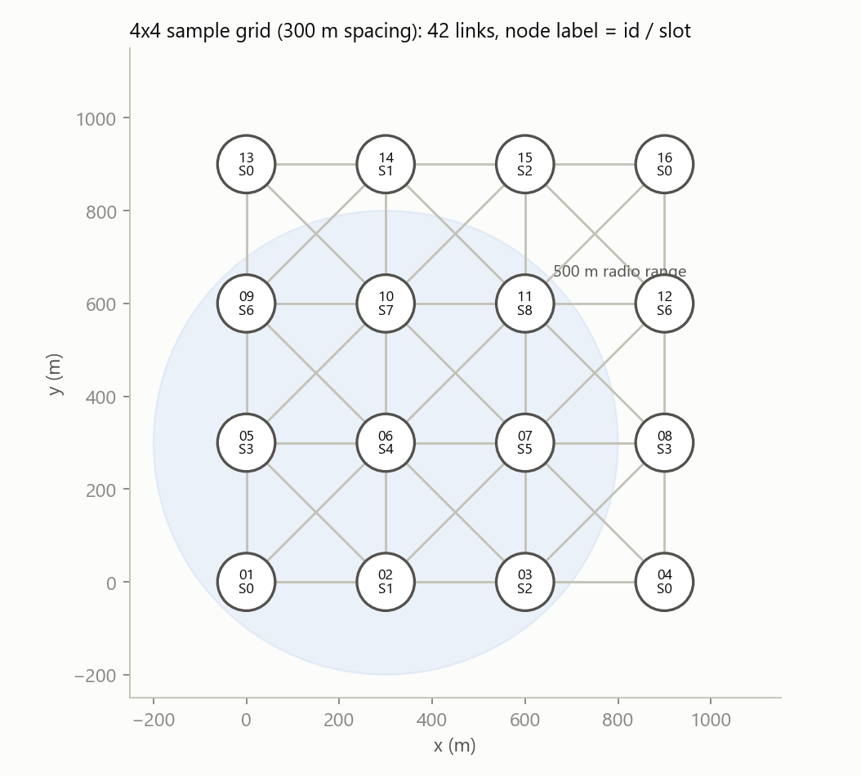
The model: colour the square of the radio graph
1
G: link if distance ≤ 500 m
networkx graph; squared distances, inclusive boundary
2
H = G²: join nodes ≤ 2 hops apart
1-hop and 2-hop conflicts in one conflict graph
3
Slot = colour
any proper colouring of H is a collision-free schedule
4
Minimise colours = χ(G²), NP-hard
lower bound ω(G²): a clique of H needs distinct slots
Sample grid: 42 links (300 m and 424 m), each node hears up to 8 others
Notes:
Reduction: distance-2 colouring of G equals ordinary colouring of the square graph, so all classical colouring algorithms apply. The clique lower bound is what lets me prove optimality later.

Slide 4
The sample output is infeasible: 9 slots is minimal
21
9
two-hop conflicts in the PDF's 5-slot sample assignment, checked against its own 4×4 grid input
slots: provably the minimum. Any 3×3 block of nodes is pairwise within 2 hops, a 9-clique of G²
Example: the sample gives Node_01 and Node_03 the same slot, yet both hear Node_02 (hidden terminal).
The colouring 3·(i mod 3) + (j mod 3) reaches 9, and this tool finds a 9-slot schedule in 1.4 ms.
I follow the sample's format exactly (--sample-format is byte-for-byte), not its numbers.
Notes:
This is the first thing a careful reader notices: the PDF's sample output is a format template. Verified by an automated test and by the independent reviewer's ILP. Copying 5 slots would fail the collision criterion.

Slide 5
Heuristics first, then a proof
Lower bound
1
Portfolio
2
Iterated greedy
3
TabuCol
4
Exact B&B
5
ω(G²) by exact max clique (Bron-Kerbosch)
DSATUR, RLF, largest-first, smallest-last, BFS, sweep, 64 random orders
recolour by classes; can never use more slots
local search: try K−1, K−2, …
DSATUR branch-and-bound proves the optimum
Every step runs only while K exceeds the lower bound: on the sample grid DSATUR hits 9 = ω and the pipeline stops after the portfolio (1.4 ms).
Independent verifier: a separate implementation (no networkx) recomputes links from the raw coordinates and checks every same-slot pair of the printed matrix. Exit code 0 only if it passes.
Notes:
Why a portfolio: no single colouring heuristic wins everywhere (the benchmark shows the winner changes). Why the exact step: heuristics cannot tell you they are optimal; at N = 16 the proof costs milliseconds. Exact optimum cross-checked against a scipy/HiGHS ILP on 120 random instances.

Slide 6
Output: the required report, verified
================================================================
TDMA TOPOLOGY OPTIMIZATION REPORT
================================================================
Total Nodes Processed : 16
Configured Radio Range : 500.0 meters
Optimized Frame Length : 9 unique timeslots (Lower is better)
Theoretical Lower Bound: 9 timeslots (largest 2-hop clique) -> PROVEN OPTIMAL (frame length = lower bound)
Spatial Reuse Factor : 1.78 transmitters/slot (16 nodes in 9 slots; one-node-per-slot TDMA would need 16)
Selected Heuristic : DSATUR (portfolio of 7 runs, 1.4 ms)
-----------------------------------------------------------------
NODE -> SLOT ASSIGNMENTS:
Node_01: Slot 0
Node_02: Slot 1
...
STRUCTURAL TDMA SCHEDULE MATRIX (Slot x Node Boolean Matrix):
Slot \ Node | 01 | 02 | 03 | 04 | 05 | 06 | 07 | 08 | 09 | 10 | 11 | 12 | 13 | 14 | 15 | 16
-------------------------------------------------------------------------------------------
Slot 00 | 1 | 0 | 0 | 1 | 0 | 0 | 0 | 0 | 0 | 0 | 0 | 0 | 1 | 0 | 0 | 1
Slot 01 | 0 | 1 | 0 | 0 | 0 | 0 | 0 | 0 | 0 | 0 | 0 | 0 | 0 | 1 | 0 | 0
Slot 02 | 0 | 0 | 1 | 0 | 0 | 0 | 0 | 0 | 0 | 0 | 0 | 0 | 0 | 0 | 1 | 0
...
Independent verification: 10 same-slot pairs checked, 0 conflicts (1-hop and 2-hop)
Execution finalized cleanly. Schedule verified conflict-free.
1
Sample layout
2
Proof printed
3
Verified, not claimed
4
Robust input
same sections and labels; --sample-format is byte-exact
lower bound and optimality status in the header
independent check; exit code 0 / 1 / 2 / 3
JSON string, @file, --file, stdin; PowerShell quote repair
Notes:
Run live: python tdma_scheduler.py --file inputs/grid_4x4.json. Options: --verbose, --max-reuse, --simulate 100, --json-out.

Slide 7
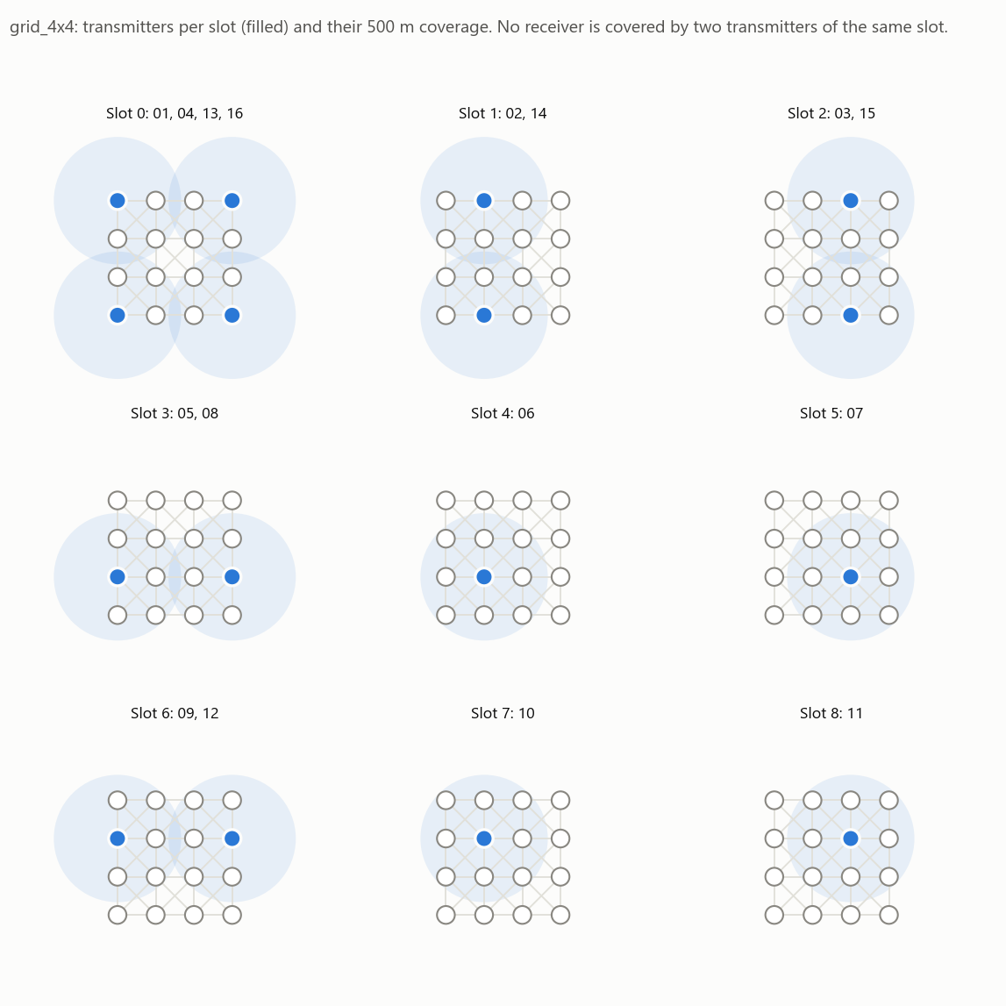
Spatial reuse: 16 radios in 9 slots
1.78×
throughput of one-node-per-slot TDMA: 9.33 vs 5.25 successful receptions per slot (slot-level simulator)
Corners share slot 0; edge nodes 900 m apart share slots 1, 2, 3 and 6.
No receiver lies inside two coverage discs of the same slot.
--max-reuse adds extra non-conflicting slots in the same frame (random_16: 16 → 26 transmissions per frame).
Notes:
Each panel is one slot: filled nodes transmit, the wash is their 500 m coverage. The inner four nodes each need their own slot because every one of them is within 2 hops of almost everyone.

Slide 8
638 of 638 networks solved optimally, with proof
638/638
networks (N = 13-200) solved optimally with a proof
19 of 28
rings where the optimum exceeds the clique bound: only the exact search can prove them
≤ 43 ms
at N = 200 (mean 1.28 ms at N = 16)
Notes:
Every single heuristic misses the optimum somewhere; networkx independent-set misses on all 20 networks at N = 200. Honest note: on random unit-disk graphs the best of all seven networkx strategies together is usually optimal too; the pipeline's value is that it reaches the optimum every time and proves it.

Slide 9
Why the 2-hop rule matters
0
receptions lost by this tool's schedules on 638 benchmark networks
54-70 %
of receptions lost by a distance-1 colouring (hidden terminals)
×10.7
throughput vs round-robin at 200 nodes (95.2 vs 8.9 per slot)
Notes:
Round-robin is collision-free but wastes the channel; a 1-hop-only colouring uses fewer slots but loses half its packets to hidden terminals. Distance-2 colouring gets both: no losses and spatial reuse.

Slide 10
Trust: verified independently, three ways
91
0
83.9 vs 84.36 %
automated tests
collisions found by an independent reviewer
simulator vs EMANE
G² vs networkx (500 graphs) · verifier vs brute force (1 500) · exact B&B vs ILP (120) · printed report re-parsed and re-verified · identical output under 3 hash seeds
fresh AI reviewer, no access to my reasoning: 320 fuzzed CLI runs with its own checker and ILP. Found 8 input/output robustness defects; all 8 fixed with regression tests
two independent models predict and measure the same hidden-terminal losses on a deliberately wrong schedule
Notes:
The verification is layered so that no single bug can produce a false 'conflict-free'. The reviewer's defects were all at the input/output boundary (encoding, overflow, exit codes, a sub-micrometre tolerance); none affected collisions.

Slide 11
Part 2: the EMANE engine
Does a real TDMA emulator carry and drop packets exactly as the Brain planned?
Notes:
EMANE 1.5.3 on one Linux machine (WSL2 Ubuntu 24.04), 16 emulated radios.

Slide 12
From matrix to EMANE in one bridge
schedule.xml
full TDMA schedule (XML route)
Brain JSON
schedule_to_emane.py
EMANE 1.5.3
--json-out: nodes, NEM ids, Slot × Node matrix, 500 m links
validated against EMANE's own XSD; round-trip checked
TDMAScheduleEvent
ProtoBuf, one event per NEM
16 NEMs, each in its own unprivileged network namespace
16 NEMs, each in its own unprivileged network namespace
pathloss 90 / 200 dB
EMANE's channel = the 500 m graph
16 × platform XML
virtual transport → TDMA MAC → PHY
1
Rootless install
no Docker, no sudo: the official .debs are extracted into a user sysroot (install_rootless.sh); a Dockerfile is provided but not built here
2
Testbed
hub bridge for OTA and event multicast; Poisson UDP broadcast probes; statistics read from every NEM's control port
Notes:
Both requested formats are implemented and tested: the XML route (what emaneevent-tdmaschedule does) and the ProtoBuf route (TDMAScheduleEvent built directly). Precomputed pathloss makes EMANE's connectivity identical to the Brain's 500 m graph.

Slide 13
TDMA profile: 1 ms slots, 9-slot frame
1000 µs
9 ms
2.4 GHz
1350 B
slot (100 µs guard ≫ 1.7 µs propagation over 500 m)
frame = 9 slots, 1 frame per multiframe
carrier · 10 MHz bandwidth · 30 dBm
per slot at 12 Mbit/s (12·10⁶ × 900 µs / 8)
<emane-tdma-schedule>
<structure frames="1" slots="9" slotoverhead="100"
slotduration="1000" bandwidth="10M"/>
<multiframe frequency="2.4G" power="30" class="0" datarate="12M">
<frame index="0">
<slot index="0" nodes="1,4,13,16"/>
<slot index="1" nodes="2,14"/>
...
<slot index="8" nodes="11"/>
</frame>
</multiframe>
</emane-tdma-schedule>
Defined slot = TX for the listed NEMs; every other slot defaults to RX (half-duplex TDMA)
Link budget: 30 − 90 = −60 dBm vs −100 dBm noise → SNR 40 dB, always decoded
Two equal signals: SINR ≈ 0 dB, below the 12 Mbit/s curve's 3 dB floor → collision
Notes:
The schedule XML is generated from the matrix: one slot element per row. The PCR curve for 12 Mbit/s gives 0 % reception at SINR <= 3 dB and 100 % at >= 9 dB, so overlap is fatal and a clean link is perfect.

Slide 14
EMANE carries and drops packets as planned
Experiment | Slots | Delivery on 500 m links | Non-links | Frames heard in sender's slot | Collision drops
E1 Brain schedule (XML route) | 9 | 99.88 % | 0 % | 99.89 % | 0
E1b same, ProtoBuf route | 9 | 99.93 % | 0 % | 99.93 % | 0
E2 Node_06's slot removed | 9 | others 99.99 %; Node_06 0 % | 0 % | 99.98 %; Node_06 sent 0 frames | 0 (532 queue drops)
E3 wrong (distance-1) schedule | 4 | 84.36 % | 0 % | 99.58 % | 532 kB (SINR)
E4 E1 at 400 pkt/s per node | 9 | 96.63 % | 0 % | 96.78 % | 0 kB
1
Permitted where planned
every scheduled link delivers; no frame ever crosses a non-link; latency = half a frame + one slot, as TDMA theory predicts
2
Dropped where the schedule says
a node without a TX slot puts 0 frames on the air (its queue overflows); a schedule that breaks the 2-hop rule collides
Notes:
All 16 NEMs accepted every schedule (0 rejects); traffic starts only after that is confirmed. E1 residual loss (0.12 %) is host timing: EMANE missed 76 of 47703 TX slots because realtime priority needs root. Mean latency 5.73 ms.

Slide 15
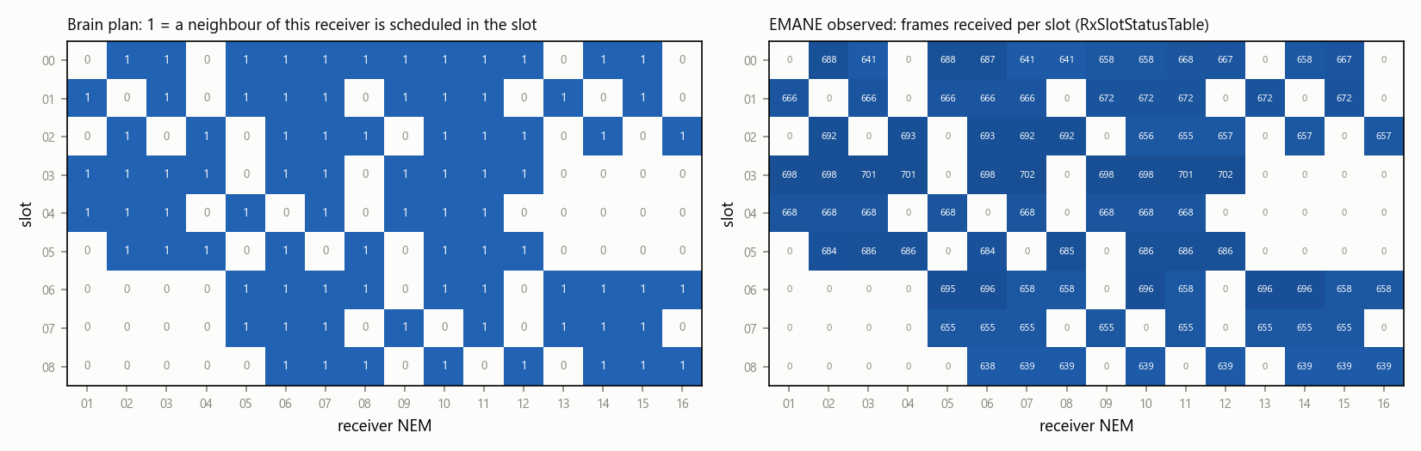
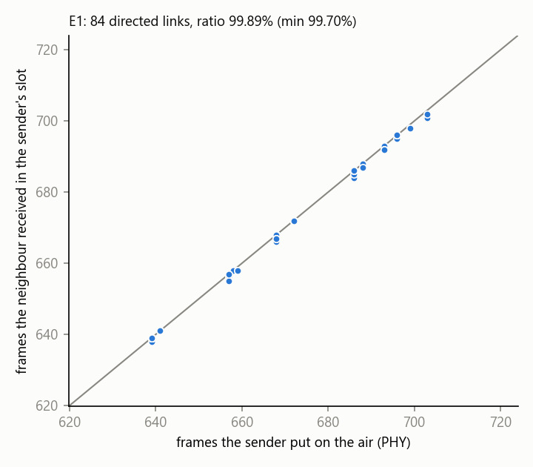
Each sender is heard only in its planned slot
99.89 %
0
0
of each sender's over-the-air frames were received by its neighbours in exactly its planned slot (84 links, min 99.7 %)
frames received in any slot where the receiver has no scheduled neighbour
frames transmitted by Node_06 once its slot was removed (E2)
Notes:
This evidence uses physical events at both ends: frames the sender put on the air (EMANE PHY) and frames the receiver got in each slot (EMANE RxSlotStatusTable). It does not rely on EMANE's installed-schedule tables, which an independent reviewer correctly pointed out would only compare the schedule with itself.

Slide 16
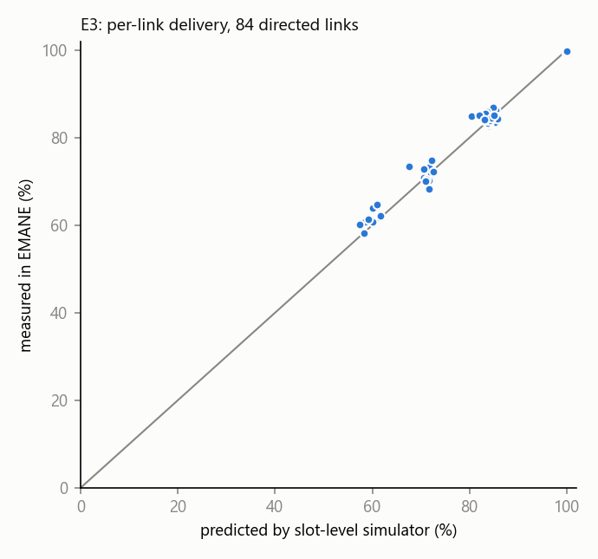
Predicted = measured, and repeatable
Schedule | Delivery on links, 5 traffic seeds | Mean ± 95 % CI | Expected
E1 Brain (9 slots) | 99.87, 99.98, 99.87, 99.93, 99.90 | 99.91 ± 0.06 % | 100 %
E3 distance-1 (4 slots) | 84.8, 84.8, 84.7, 85.0, 84.7 | 84.8 ± 0.1 % | 83.9 % (simulator)
Two independent implementations agree: links with two hidden interferers deliver about 60 %, links with one about 85 %, links with none 100 %, in both the simulator and EMANE's PHY/MAC.
Latency follows TDMA theory: half a frame + one slot. Measured 5.73 ms (9-slot frame) and 3.24 ms (4-slot frame).
E3 (wrong schedule): my slot-level simulator vs EMANE, per link (83.9 % vs 84.36 % overall)
Notes:
Replication answers the 'single run' objection: five different Poisson traffic seeds per schedule, mean and 95 % confidence interval (Student t, 4 degrees of freedom).

Slide 17
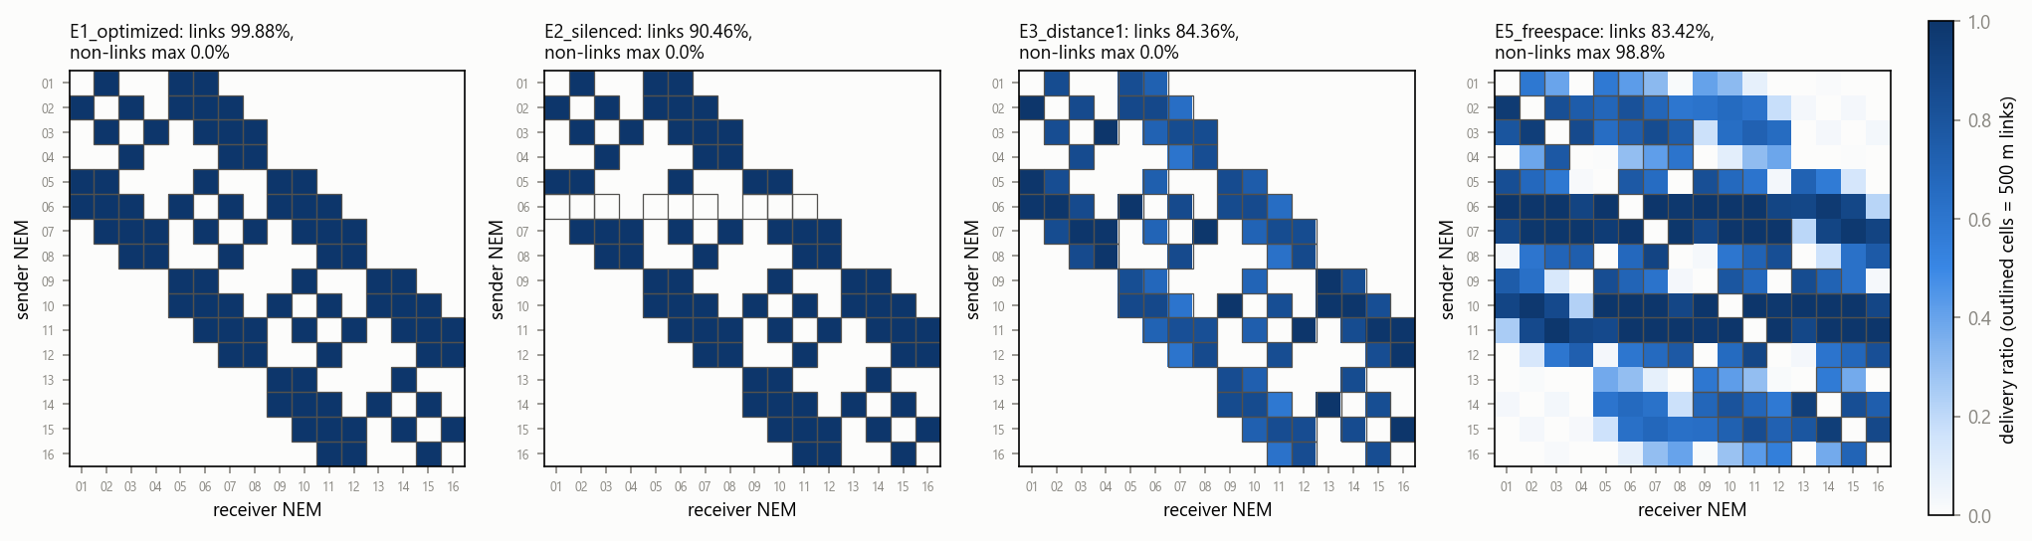
Stress tests: 10× load, and a physical channel
E4: 400 packets/s per node
96.63 % delivered on links. Several packets are aggregated into one 1 ms slot (1350 B), so the 9-slot schedule carries 10× the load; the remaining loss is slot-timing jitter on the rootless host (0 collisions, 0 queue drops).
E5: free-space path loss for every pair
No 500 m cut-off (power set so the 100 % decode edge is about 500 m). Links 83.42 %, and 98.83 % reaches some non-neighbours: physics has no hard edge.
Notes:
E5 deliberately breaks the task's unit-disk assumption. Free space has a long tail: co-slot transmitters 900 m apart are only about 6.5 dB weaker than a 424 m link, below the 9 dB the 12 Mbit/s curve needs. The remedy stays inside the Brain: plan with an interference radius (--range) larger than the decode range, add power margin, or use a terrain path-loss model.

Slide 18
Limitations, stated plainly
1
Interference model = unit disk (500 m), as the task defines
E5 quantifies the gap: with free-space propagation the interference range exceeds 2 hops; plan with a larger --range
2
EMANE ran rootless on WSL2 without realtime priority
0.16 % of TX slots missed (host timing); a real-root run can enable -r (VMN_EMANE_REALTIME=1)
3
Dockerfile provided but not built
Docker is not installed on the development machine; the native rootless path was executed
4
Broadcast traffic, static topology
node-based broadcast scheduling as specified; unicast/ARP and mobility not exercised
5
NP-hard at scale
if the exact search hits its limit, the tool reports 'optimum in [LB, K]'; never happened up to N = 200
Notes:
Every limitation is also in the documentation PDF with its evidence.

Slide 19
Summary
Correct by construction, optimal with proof, enforced in EMANE
Correct
Optimal
Enforced
distance-2 colouring of the 500 m graph; independently verified, 0 collisions
9 slots for the sample grid, proven; 638/638 benchmark networks optimal with proof
EMANE: each sender heard only in its planned slot; 99.88 % on links, 0 % off-links
Demo: python tdma_scheduler.py --file inputs/grid_4x4.json · bash emane/runner/run_experiments.sh 20 40
Questions welcome
Notes:
Close with the three words: correct, optimal, enforced. Then demo the CLI and show emane/results/summary.md.

