Slide 1
Sanjay M
Nmid:A02173E2397AF698B51416BCFB7D4E1C
Madras Institute of Technology campus, Anna University
Final Project
Customer churn prediction

Slide 2
PROJECT TITLE
Customer Churn Prediction using (IBM Customer Churn Dataset)
3/21/2024 Annual Review

Slide 3


AGENDA
The agenda of the project is to Clean, pre process, and engineer features from historical customer data.
Develop and deploy machine learning models to predict customer churn based on the prepared data.
3/21/2024 Annual Review

Slide 4
PROBLEM STATEMENT
The project aims to develop a machine learning system capable of accurately predicting customer churn for a business based on historical customer data, empowering proactive retention strategies and reducing revenue loss.
3/21/2024 Annual Review

Slide 5
PROJECT OVERVIEW
This project focuses on leveraging machine learning techniques to predict customer churn using historical data, enabling businesses to anticipate and mitigate customer attrition. By analyzing customer behavior and characteristics, the system aims to provide actionable insights for improving retention strategies and preserving revenue streams.
3/21/2024 Annual Review

Slide 6

WHO ARE THE END USERS?
1. Marketing Teams: Utilize predictions for targeted retention campaigns.
2. Customer Service Teams: Prioritize support for at-risk customers.
3. Product Development Teams: Enhance products based on churn insights.
4. Executive Management: Make strategic decisions for retention initiatives.
5. Sales Teams: Identify upselling opportunities for at-risk customers.
3/21/2024 Annual Review

Slide 7
YOUR SOLUTION AND ITS VALUE PROPOSITION
Proposed Model Accuracy:
0.8170
1. Data Analysis and Preprocessing: Analyze historical customer data to identify relevant features and preprocess the data to handle missing values and outliers.
2. Feature Engineering: Create new features or transform existing ones to capture patterns indicative of potential churn behavior, such as frequency of interactions, recency of purchases, and customer demographics.
3. Model Selection and Training: Experiment with various machine learning algorithms such as logistic regression, decision trees, and ensemble methods to identify the best-performing model. Train the selected model on the preprocessed data.
4. Model Evaluation and Optimization: Evaluate the model's performance using appropriate metrics like accuracy, precision, recall, and ROC-AUC. Fine-tune hyperparameters and consider techniques like cross-validation to optimize the model.
3/21/2024 Annual Review

Slide 8
THE WOW IN YOUR SOLUTION
1. Holistic Insight: Our solution not only predicts churn but also provides actionable insights for various departments, enabling a comprehensive approach to retention strategies.
2. Scalability and Adaptability: Designed to scale with the business and adaptable to evolving customer behavior, ensuring long-term effectiveness in reducing churn.
3. Continuous Improvement: Incorporates mechanisms for ongoing model monitoring and optimization, ensuring that the system remains accurate and relevant over time.
3/21/2024 Annual Review

Slide 9
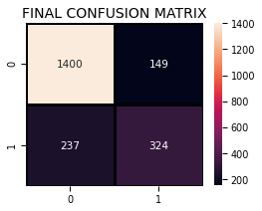
MODELLING
Working out all the model (KNN,SVC,RandomForest,LogisticRegression,Decision Tree Classifier
AdaBoost Classifier,Gradient Boosting Classifier,Voting Classifier)
3/21/2024 Annual Review

Slide 10
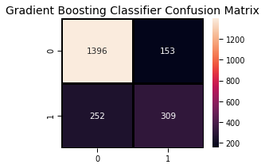
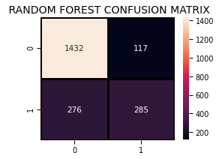
RESULTS
Highest Obtained Model Accuracy:
0.8170
Demo video link
https://drive.google.com/file/d/1DCe2oPP_-73U4dj5HPk4OmSqRuToKhit/view?usp=sharing
3/21/2024 Annual Review

Slide 11
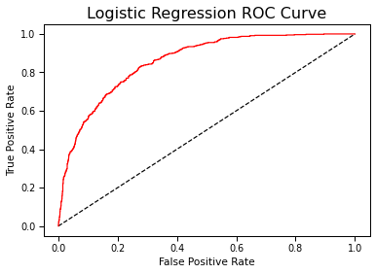
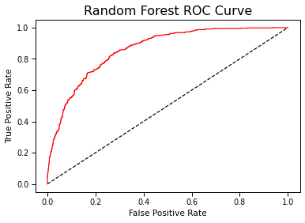
Accuracy of the model
KNN accuracy: 0.7758293838862559
SVM accuracy is : 0.8075829383886256
Random Forest:
0.8137440758293839
Logistic Regression accuracy is : 0.8090047393364929
Decision Tree accuracy is : 0.7298578199052133
AdaBoost Classifier accuracy
0.8075829383886256
Gradient Boosting Classifier 0.8075829383886256
Final Accuracy Score 0.8170616113744076

