Slide 1
RESIDENCY PROJECT • DAY 2
♡
Can we make the heart disease
model safer for real clinic use?
Model Optimization, Real-World Impact, and Ethical Evaluation
Tuning, threshold selection and subgroup checks on the Day 1 models
0.918
90.2%
37 of 41
best cross-validation ROC-AUC
final model recall
disease cases caught
University of the Cumberlands | PhDAI-733: Residency Project Day 2
Damaries Ongole | Iman Parwaiz Sayeda | Sanjeev Koushik Sennam Setty | Instructor: Najam Hassan

Slide 2
HEALTHCARE / AI ANALYTICS
02 / 09
Where Day 1 left off
Same data, same split, so Day 2 results compare cleanly with Day 1.
The dataset
DAY 2 QUESTION
302 cleaned records, 13 patient features, 164 with disease and 138 without.
Can tuning and a better decision threshold catch more cases, without flagging too many healthy patients?
The split
226 records to train, 76 held out for testing, chosen on Day 1 and not changed.
The baselines
Logistic Regression: 80.3% accuracy, 87.8% recall. Random Forest: 75.0% accuracy, 82.9% recall.
Priority metric: RECALL
Key point:
Day 2 changes only two things: the model settings and the decision threshold. Everything else stays fixed.
UCI Heart Disease (Cleveland) • Residency Project Day 2

Slide 3
HEALTHCARE / AI ANALYTICS
03 / 09
Hyperparameter tuning
Five-fold stratified cross-validation on the 226 training records only, scored by ROC-AUC.
MODEL
SETTINGS SEARCHED
BEST SETTINGS
CV ROC-AUC
Logistic Regression
12 combinations of C and penalty
C = 0.3, L2 penalty
0.912
Random Forest
48 combinations of trees, depth, leaf and split size
100 trees, depth 10, 3 per leaf, 2 per split
0.918
The test set was never used to pick the model. The Random Forest was selected on cross-validation alone, before any test results were seen.
Key point:
The two tuned models were nearly tied in cross-validation (.912 vs .918), so tuning alone was not the big win.
UCI Heart Disease (Cleveland) • Residency Project Day 2

Slide 4
HEALTHCARE / AI ANALYTICS
04 / 09
Choosing the decision threshold
Thresholds were compared on cross-validated predictions from the training data, not the test set.
THRESHOLD
CV RECALL
CV PRECISION
WHY 0.40
0.50 (default)
86.2%
87.6%
A missed case costs more than a false alarm, so recall leads. At 0.40 the model still keeps precision near 79% in cross-validation.
0.45
90.2%
84.7%
0.40 (chosen)
91.9%
78.5%
0.35
94.3%
76.8%
0.30
95.9%
72.8%
Key point:
Lowering the threshold trades precision for recall. 0.40 is the balance point we chose, and it was fixed before testing.
UCI Heart Disease (Cleveland) • Residency Project Day 2

Slide 5
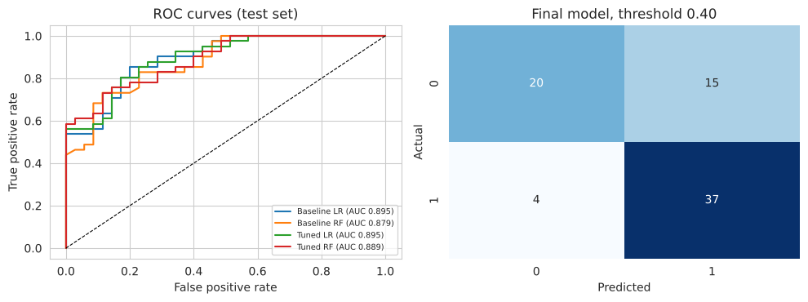
HEALTHCARE / AI ANALYTICS
05 / 09
Final model evaluation
Held-out test set: 76 patients, 41 with heart disease. Final model: tuned Random Forest at threshold 0.40.
MODEL
ACCURACY
RECALL
F1
ROC-AUC
Baseline Logistic Regression
80.3%
87.8%
82.8%
0.895
Baseline Random Forest
75.0%
82.9%
78.2%
0.879
Tuned Logistic Regression
81.6%
87.8%
83.7%
0.895
Tuned Random Forest (0.50)
76.3%
85.4%
79.5%
0.889
Final: Tuned Random Forest (0.40)
75.0%
90.2%
79.6%
0.889
ROC curves (left) and the final model confusion matrix (right)
Key point:
The final model caught 37 of 41 disease cases and missed 4. The baseline Random Forest caught 34.
UCI Heart Disease (Cleveland) • Residency Project Day 2

Slide 6
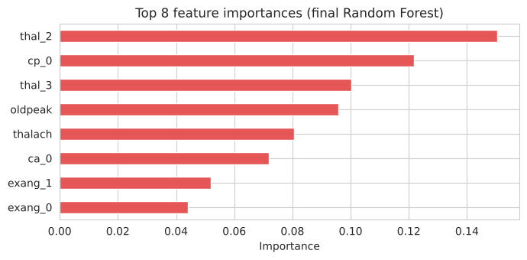
HEALTHCARE / AI ANALYTICS
06 / 09
Reading the results honestly
What improved, what did not, and what the model pays attention to.
Tuning helped, a little
Random Forest ROC-AUC rose from .879 to .889. The tuned Logistic Regression had the best accuracy of all, 81.6%.
The threshold did the heavy lifting
Recall went from 82.9% for the baseline Random Forest to 90.2% for the final model, at the cost of more false alarms.
Small data, small differences
Feature importance, final Random Forest
Only 76 test patients, so a few cases swing every percentage. None of these gaps is large.
Key point:
Chest pain type, number of vessels and thalassemia carry the most signal, which matches clinical intuition.
UCI Heart Disease (Cleveland) • Residency Project Day 2

Slide 7
HEALTHCARE / AI ANALYTICS
07 / 09
Ethical considerations
We checked the final model separately on patient subgroups in the test set.
Errors are not equal
SUBGROUP
N
ACCURACY
RECALL
A false negative can delay diagnosis and treatment. A false positive causes anxiety and extra testing.
Sex = 0
26
88.5%
100%
Sex = 1
50
68.0%
80.0%
Fairness was measured, not assumed
Accuracy and recall were computed by sex and by age band for the final model.
Age under 55
38
86.8%
96.2%
Age 55 and over
38
63.2%
80.0%
Privacy and oversight
Subgroups are small (26 to 50 records), so these numbers are noisy, but the pattern is consistent.
The data is a de-identified public set. Real use would need consent, secure handling and a clinician in charge.
Key point:
Performance is weakest for patients 55 and older, the group that needs detection most. That limits how this model could be used.
UCI Heart Disease (Cleveland) • Residency Project Day 2

Slide 8
HEALTHCARE / AI ANALYTICS
08 / 09
Real-world application
A triage aid in a cardiology or primary-care clinic, not a diagnosis tool.
1 INTAKE
2 SCORE
3 FLAG AT 0.40
4 CLINICIAN REVIEW
The 13 routine measurements already collected for a patient
The model scores the patient at intake
On our test set this flags 52 of 76 patients, including 37 of the 41 with disease
The clinician decides the workup. The model never decides alone
A responsible rollout
Run the model in shadow mode first: score patients in the background, compare with clinician decisions, and change nothing until the clinic trusts the pattern. Before any real use, it needs external validation on larger, current and more diverse data, with performance monitored by subgroup over time.
Key point:
The threshold lets each clinic match the tool to its capacity: more flags where follow-up is cheap, fewer where it is scarce.
UCI Heart Disease (Cleveland) • Residency Project Day 2

Slide 9
HEALTHCARE / AI ANALYTICS
09 / 09
Final thoughts and conclusion
Thank you. Questions and discussion are welcome.
What we built
An end-to-end Python workflow: Day 1 preprocessing and baselines, Day 2 tuning, threshold selection and ethical evaluation.
PROJECT FILES
GitHub repository:
github.com/SanjeeKoushik/
residency-project-day1
Day 2 notebook (Colab):
heart_disease_day2.ipynb
Team: Damaries Ongole, Iman
Parwaiz Sayeda, Sanjeev
Koushik Sennam Setty
What changed
Tuning plus the 0.40 threshold raised recall from 82.9% to 90.2%. Four of 41 cases are still missed.
What we take forward
Small, older, single-site data limits every claim. The next step is validation on current, diverse data with clinicians involved.
Dataset: Janosi, A., Steinbrunn, W., Pfisterer, M., & Detrano, R. (1989). Heart disease [Data set]. UCI Machine Learning Repository. https://doi.org/10.24432/C52P4X
UCI Heart Disease (Cleveland) • Residency Project Day 2

