Slide 1
Team kickoff:
who does what
Residency Project Day 1
Data preprocessing and initial model development in Python
Damaries Ongole · Iman Parwaiz Sayeda · Sanjeev Koushik Sennam Setty

Slide 2
Problem statement
Can routine patient data (age, sex, chest pain type, blood pressure, cholesterol, exercise test results) predict whether a patient has heart disease?
Who
Task
Success
Clinicians and administrators
Binary classification
Recall first
Clinicians need a transparent risk signal. Administrators need to prioritize diagnostic resources.
Target is 1 when heart disease is present and 0 when absent.
A missed diagnosis costs more than a false alarm. We also track accuracy and ROC-AUC.

Slide 3
Dataset: UCI Heart Disease (Cleveland)
302
13
0
54%
Patients
Predictors
Missing values
Have disease
303 records, 1 duplicate removed
Age, sex, cp, trestbps, chol, fbs, restecg, thalach, exang, oldpeak, slope, ca, thal
Ages 29 to 77, mean 54.4
164 with disease, 138 without: fairly balanced
Cholesterol (up to 564) and ST depression (up to 6.2) have extreme values, but they are clinically plausible, so we kept them.

Slide 4
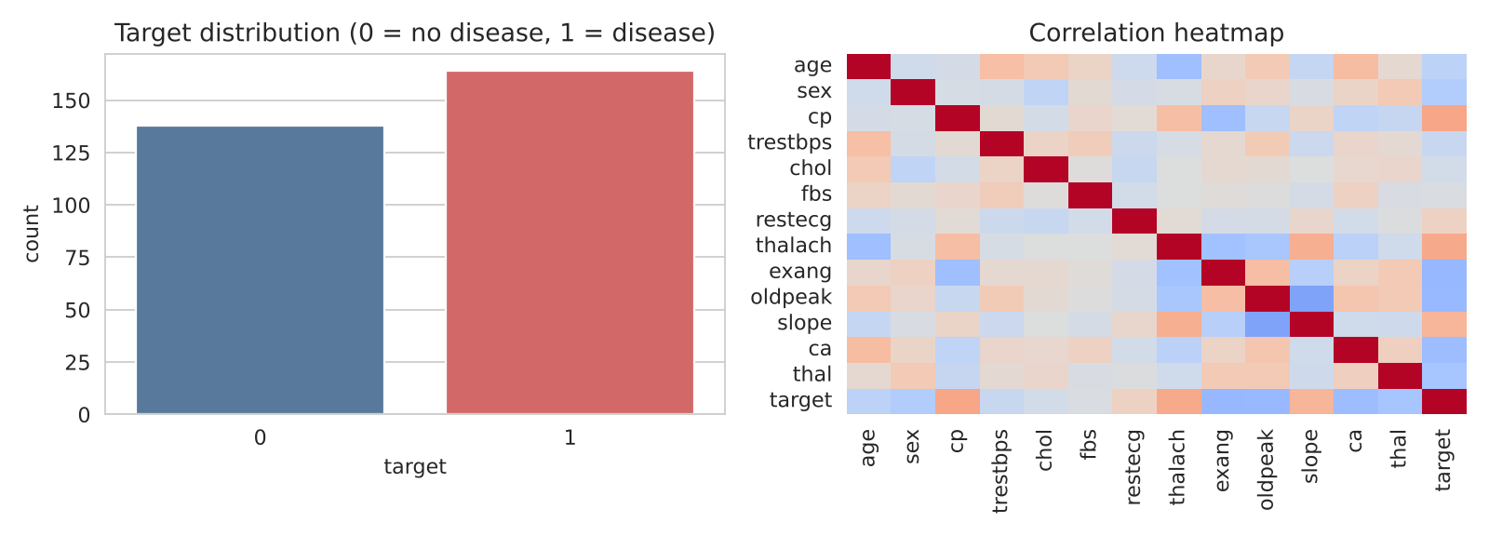
Exploration: what stands out
Positive with disease: chest pain type (0.43), max heart rate (0.42), slope (0.34)
Negative: exercise angina (-0.44), ST depression (-0.43), vessels (-0.41)
Disease rate: 75% for sex = 0, 45% for sex = 1

Slide 5
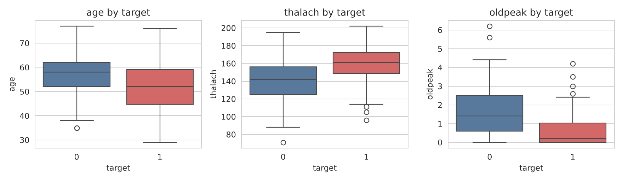
Patients with disease: higher heart rate, lower ST depression
Age, thalach (max heart rate) and oldpeak (ST depression), split by target (0 = no disease, 1 = disease).

Slide 6
Methods
1
2
3
4
Clean
Transform
Split
Model
Check missing values, drop 1 duplicate record
One-hot encode 8 categorical columns, standardize 5 numeric columns
75/25 stratified: 226 train, 76 test, random_state 42
Logistic Regression and Random Forest, 5-fold CV, then GridSearchCV
Scaling and encoding live inside a scikit-learn Pipeline fitted on training data only, so nothing leaks from the test set.

Slide 7
Results on the test set (n = 76)
Model | Accuracy | Precision | Recall | F1 | ROC-AUC
Logistic Regression | 0.803 | 0.783 | 0.878 | 0.828 | 0.895
Random Forest | 0.750 | 0.739 | 0.829 | 0.782 | 0.879
Random Forest (tuned) | 0.737 | 0.723 | 0.829 | 0.773 | 0.861
Cross-validated ROC-AUC was close for both models: 0.909 for Logistic Regression and 0.914 for Random Forest. Tuning (max_depth 10, 100 trees) did not help on the test set.

Slide 8
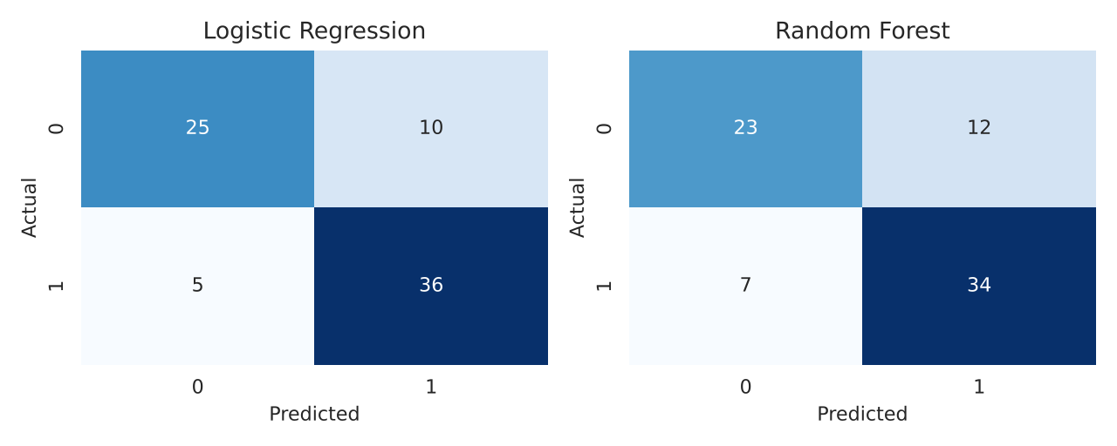
Logistic Regression missed 5 of 41 patients
Logistic Regression: 5 false negatives, 10 false alarms
Random Forest: 7 false negatives, 12 false alarms
Key features: chest pain type, thal, vessels (ca), ST depression, max heart rate

Slide 9
Limitations and ethics
Small data
Bias
Transparency
Privacy
302 patients, one clinic
Group performance
Protect patient data
Check recall and false negatives by sex and age before trusting any group.
Prefer interpretable
A real deployment needs HIPAA-compliant handling.
Differences of a few patients swing the metrics, so the models are comparable.
Logistic Regression coefficients show clinicians what drives a prediction.
Next steps: threshold tuning to raise recall, subgroup fairness checks, validation on a larger dataset.

Slide 10
Decisions for today
Dataset: UCI Heart Disease (303 patients) or another from the list?
Target metric: recall, since missing a patient is worse than a false alarm
Split: 75/25, as the instructor's hints suggest
Roles and a deadline for each section
Check the course policy on using AI help, and disclose it if required

Slide 11
What we submit: one report, 3.5 pages
Section | Length | What goes in it
1. Introduction and Problem Framing | 0.5 page | Business question, stakeholders, success metric
2. Dataset Exploration and Preprocessing | 1.5 pages | EDA, cleaning, encoding, scaling, split
3. Initial Model Development | 1 page | Models, metrics table, interpretation
4. Team Collaboration Process | 0.5 page | How we actually worked together
Tools: pandas, NumPy, Matplotlib, Seaborn, scikit-learn, Google Colab, GitHub

Slide 12
Proposed roles
Damaries
Iman
Sanjeev
Exploration and visualization
Preprocessing and evaluation
Framing, modeling, documentation
Section 2, first half: dataset overview, distributions, correlation heatmap, boxplots
Section 2, second half: cleaning, encoding, scaling, split; then metrics and confusion matrix
Sections 1 and 3: problem framing, Logistic Regression and Random Forest, final report
Section 4 is written together, from what we really do. Swap roles if you prefer another split.

Slide 13
How we work
1
2
3
4
Agree on the dataset
Set up the tools
Work in parallel
Merge and submit
Shared Colab notebook and a GitHub repo with a README
One branch per person, commit often, review each other's code
Combine sections, check page lengths, everyone reads before submitting
One dataset for everyone, confirmed today
Starting point: a draft report and working code already exist. We review it, run it ourselves, and rewrite it in our own words.

