Slide 1
"In God we trust, all others must bring Data."
--W. Edwards

Slide 2
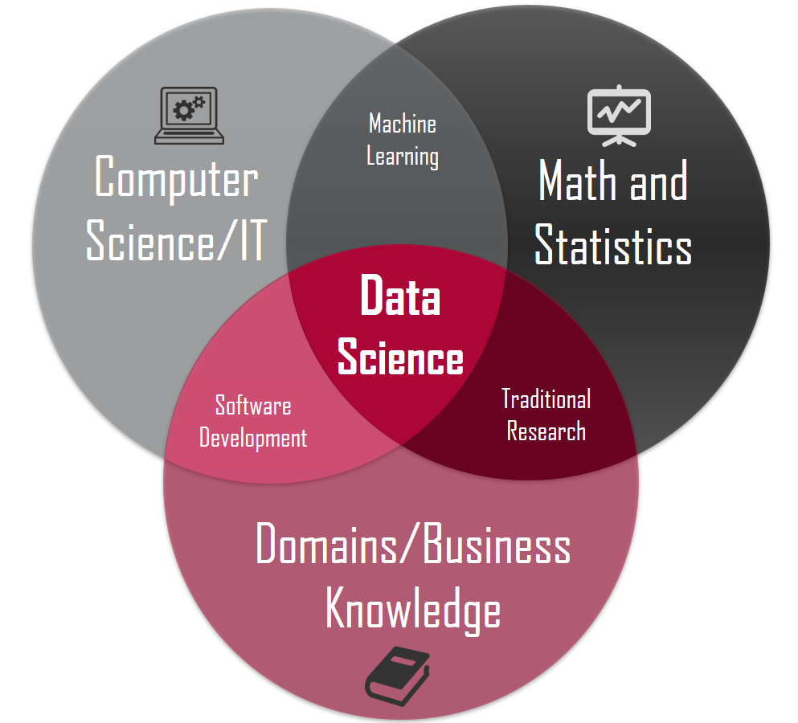
Data Science 101
Day 0: An Introduction to Data Science

Slide 3
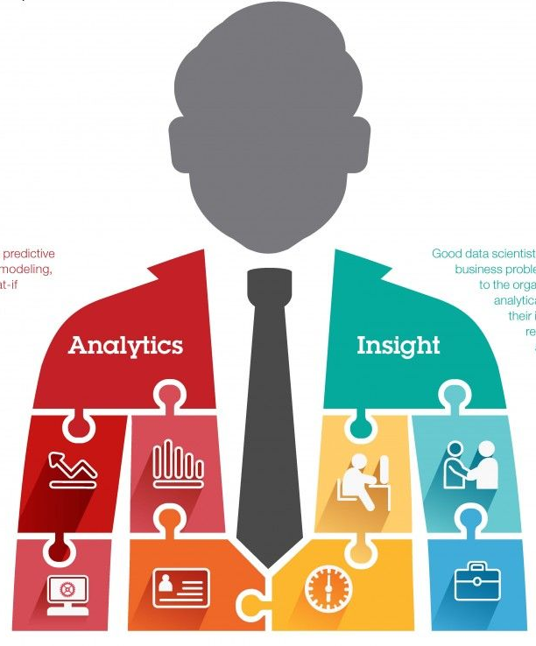
About Me
Join us: https://www.linkedin.com/groups/6707800/
Twitter: https://twitter.com/Sanjeet36284331
Linkedin: https://www.linkedin.com/in/sanjeetshukla/
Sanjeet Shukla
Data Scientist-Big Data
Cognizant Technology Solutions

Slide 4
What is data science?
Data science is a field of study that deals with extracting insight from data.
Data Science is a multi-disciplinary Field that requires Programming, Mathematics and Business knowledge

Slide 6
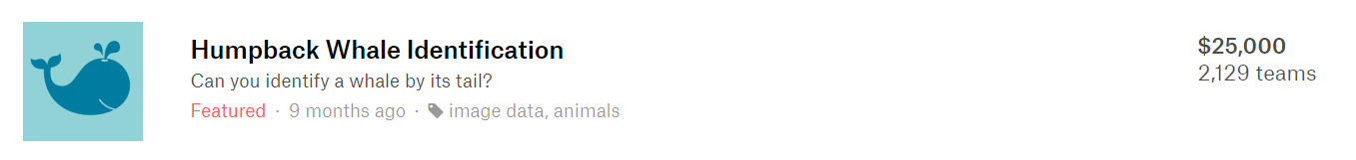
Example of Data Science
This Competition was hosted on Kaggle for a reward of $25000.
Competition consisted of Happy Whale’s database of over 25,000 images, And the goal was to build a model that can Identify species of whale from its image

Slide 7
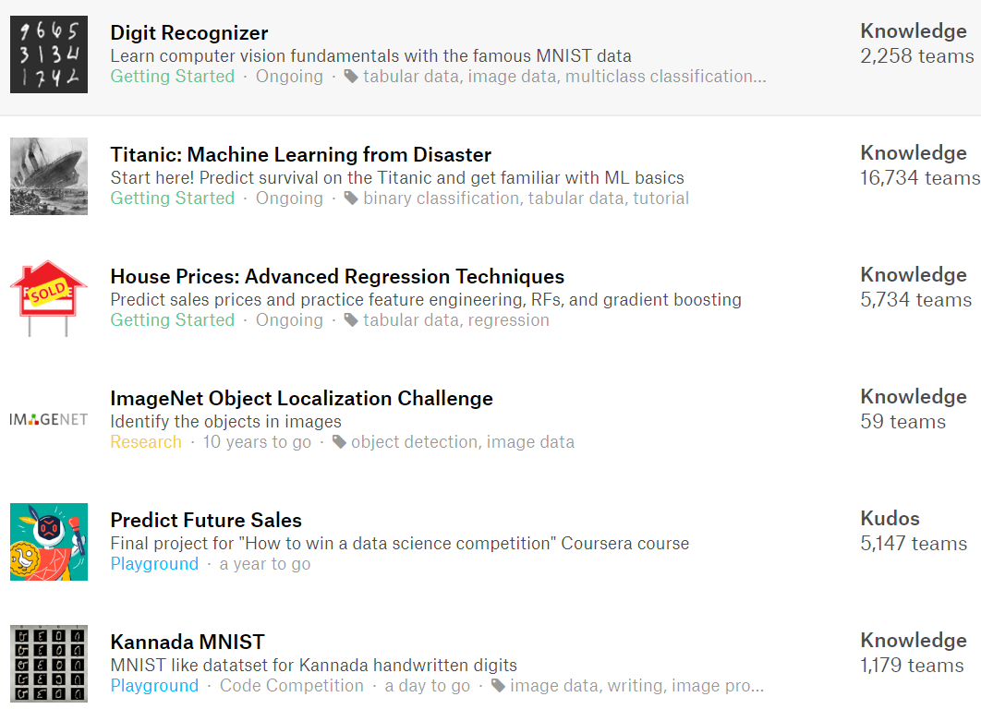
More Examples

Slide 8
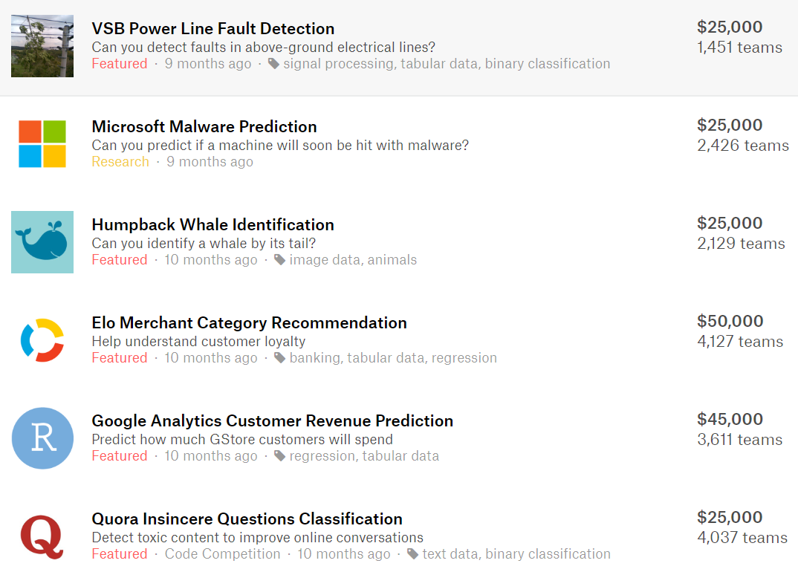
Even More

Slide 9





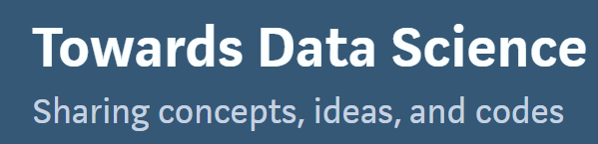


Data Science Playgrounds

Slide 10
What do Data Scientists do?
Define The Question
Acquire data set.
Clean the Data (Preprocessing) 90% of task is preprocessing
Exploratory Data Analysis (EDA)
Data Science Modelling/Prediction
Evaluate and challenge Model/Prediction.
Repeat Step 3, 4 and 5 to get better result.
Deploy best model.

Slide 11
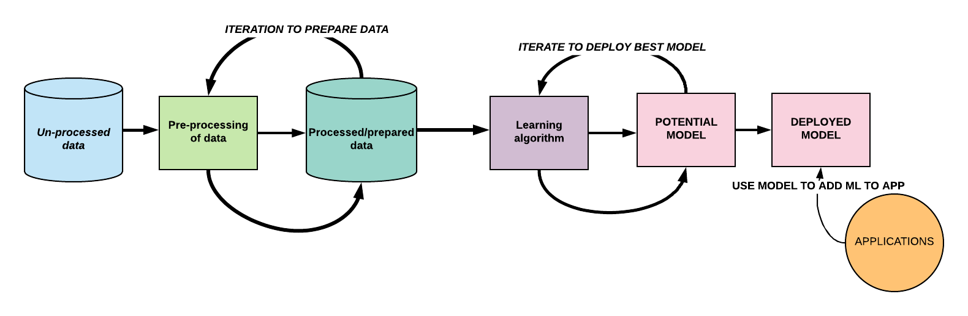
What do Data Scientists do?

Slide 12
Most Important thing in data science is Question
Data is the 2nd most important thing.

Slide 13
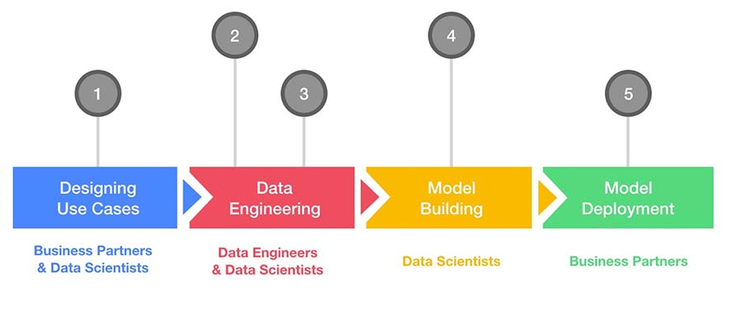
Data Science Project

Slide 14
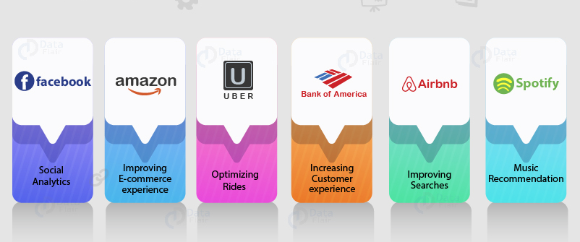
Business Use Cases

Slide 15
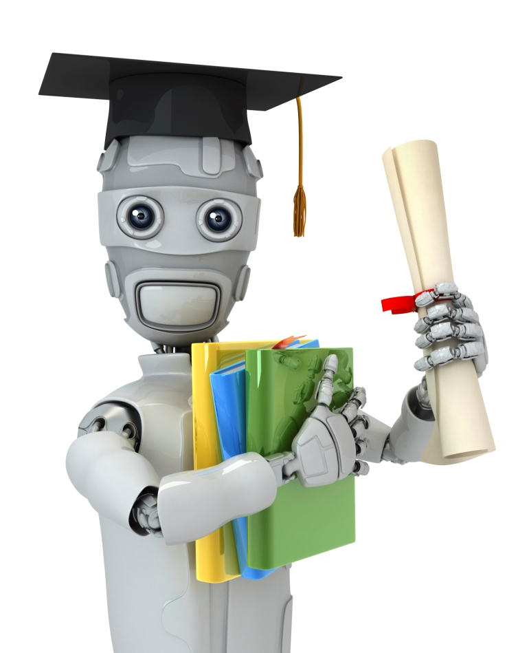
Data Science Techniques
Machine learning (ML)
Machine Learning = Building systems that can learn from experience
Deep Learning = Building systems that learn from experience on large data sets.
Deep learning (DL)
NLP = Building systems that can understand language.
Natural Language Processing (NLP)

Slide 16

Data Science Tools
Install Anaconda from this link https://www.anaconda.com/distribution/
If you have Anaconda-python
You don’t need anything else to get started.

Slide 17
Data Science Tools
Programming Language: Python is the Best.
Libraries: Most of these comes pre-installed with Anaconda
Numpy: Python Library with Highly Optimized Multi Dimensional Array
SciPy: Python Library with Statistical/Mathematical functions.
Pandas: Library of high performance data structure and analytics tools.
Scikit-learn: Machine Learning Library
NLTK: Natural Language ToolKit
OpenCV: Computer Vision Library for Image and Video Processing.
Many More like Tensorflow, Pytorch etc.

Slide 18
Data Science Tools
Data Visualization tool: Any one tool will be fine.
No Worries! We will learn all required things in this course.
Tableau
Pyplot
Seaborn
PowerBI
Chart.js

Slide 19
Data Science Career Path
Data Scientist (Data Science Generalist)
Machine Learning Engineer
Deep Learning Engineer
NLP Engineer
Works on
Machine Learning,
Deep Learning &NLP
Specializes in Machine Learning
Specializes in Deep Learning
Specializes in NLP

Slide 20
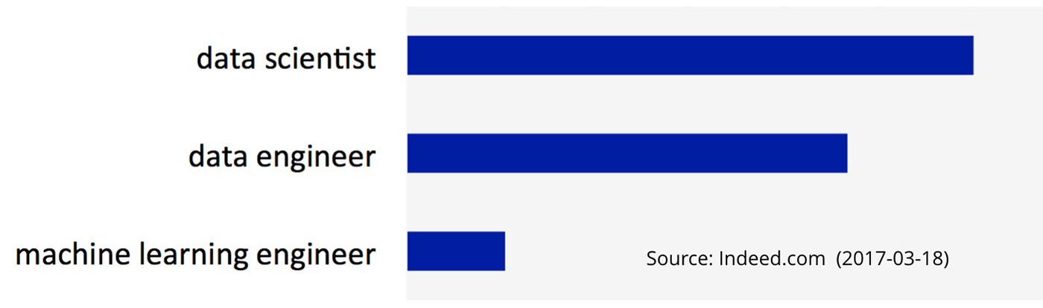
Data Science Job Opportunities
https://www.oreilly.com/radar/podcast/becoming-a-machine-learning-engineer/

Slide 21


