Slide 1
“Artificial Intelligence, deep learning, machine learning — whatever you’re doing if you don’t understand it — learn it.
Because otherwise you’re going to be a dinosaur within few years.” ~Mark Cuban

Slide 2

Data Science 101
Day 1: Introduction to Machine Learning

Slide 3
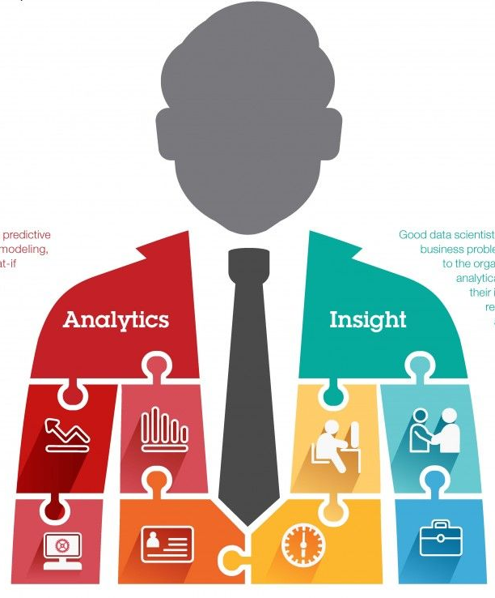
About Me
Join us: https://www.linkedin.com/groups/6707800/
Twitter: https://twitter.com/Sanjeet36284331
Linkedin: https://www.linkedin.com/in/sanjeetshukla/
Sanjeet Shukla
Data Scientist-Big Data
Cognizant Technology Solutions

Slide 4
What is Machine Learning?
Machine Learning is Study of algorithms that
Improve their performance (P)
At some task (T)
With experience (E)

Slide 5
Traditional Programming
Machine Learning
Data
Computer
Output
Program
Data
Computer
Program
Output

Slide 6
Machine Learning
Training Data/Train Set: The data that you use to train Machine Learning is called Train Set.
Test Data/ Test Set: The data that you use to evaluate the performance of Machine Learning model is called Test Set
Training Data
Computer
Program
Output

Slide 7
Machine Learning Steps
Problem Statement
Data retrieval: Getting data in structured or unstructured format
Data preparation:
Data processing and wrangling: Data Cleaning, Exploratory Data Analysis (EDA)
Feature extraction and engineering:
Feature scaling and selection:
Modeling: Select Algorithm and train it based on training data
Model evaluation: Test Model performance on Test/validation data set.
Hyper parameter tuning: Adjust algorithms parameter to get best result.
Deployment and Monitoring:

Slide 8
Standard ML Pipeline

Slide 9
Machine Learning Types
Supervised Learning: Detail in Subsequent slides
Unsupervised learning: Detail in Subsequent slides
Semi-supervised learning
Training data includes a few desired outputs
Reinforcement learning:
Rewards from sequence of actions
Decision making (robot, chess machine)

Slide 10
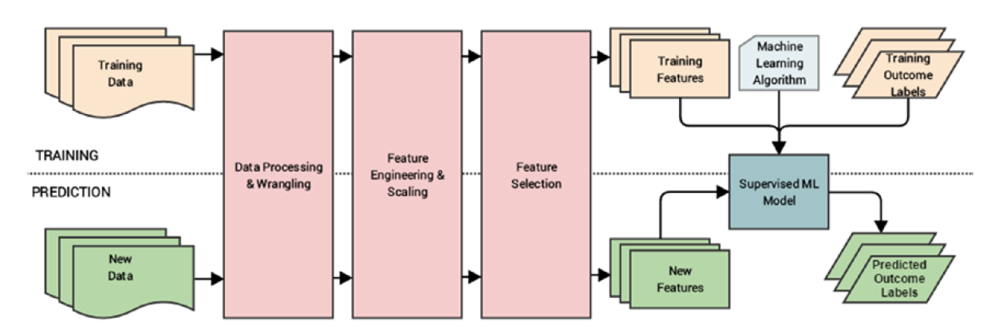
Supervised Learning :
Training data includes desired outputs
Classification (discrete labels), Regression (real values)

Slide 11
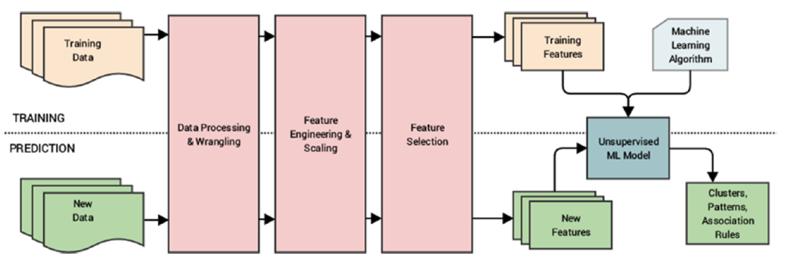
Unsupervised learning
Training data does not include desired outputs
Clustering, Probability distribution estimation, Anomaly Detection.
Finding association (in features), Dimension reduction (PCA)

Slide 12
Machine Learning Algorithms
Supervised learning
Regression
Simple Linear Regression
Polynomial Regression
Classification
Logistic Regression
Decision Tree
Naïve Bayes
K-Nearest Neighbor
Support Vector Machine (SVM)

Slide 13
Ensemble Methods
Bagging:
Random Forest
Boosting:
Adaboost
Gradient Boosting Tree
XGBoost (eXtreme Gradient Boosting)

Slide 14
Unsupervised learning Algorithms
K Mean Clustering
Hierarchial Clustering
One Class SVM
Isolation Forest

Slide 15
Model Evaluation Metrics
Classification Model
Confusion Matrix
F1 Score
AUC – ROC
Log Loss
Gini Coefficient
Regression Model
Root Mean Squared Error
R Square
Adjusted R Square
Mean Absolute Error

Slide 16
Model Evaluation Metrics
Accuracy
Precision and recall
Squared error
Likelihood
Posterior probability
Cost / Utility
Margin
Entropy
K-L divergence
Etc.

Slide 17
Model Optimization Techniques
Gradient Descent
Stochastic Gradient Descent (SGD)
AdaGrad
RMSProp
Adam

Slide 18
Machine Learning Challenges
Data quality issues lead to problems in data processing and feature extraction, Data acquisition, extraction, and retrieval is an extremely tedious and time consuming process.
Formulating business problems
Feature extraction and Feature engineering: Deciding which column is important and which is not.
Complexity: Complex models can be difficult to deploy in the real world.

Slide 19
Machine Learning Application
Product recommendation
Sentiment Analysis
Anomaly detection
Fraud detection
Weather forecasting
Stock market forecasting
• Market basket analysis
• Customer segmentation
• Object recognition (images & video)
• Speech recognition
• Churn analytics
• Click through predictions
• Failure/defect detection
• E-mail spam filtering

Slide 20
Additional Reading
https://machinelearningmastery.com/bagging-and-random-forest-ensemble-algorithms-for-machine-learning/
https://towardsdatascience.com/ensemble-methods-bagging-boosting-and-stacking-c9214a10a205
https://www.analyticsvidhya.com/blog/2015/11/quick-introduction-boosting-algorithms-machine-learning/
https://stats.stackexchange.com/questions/282459/xgboost-vs-python-sklearn-gradient-boosted-trees
https://www.analyticsvidhya.com/blog/2019/08/11-important-model-evaluation-error-metrics/
https://towardsdatascience.com/demystifying-optimizations-for-machine-learning-c6c6405d3eea
https://machinelearningmastery.com/overfitting-and-underfitting-with-machine-learning-algorithms/
https://medium.com/diogo-menezes-borges/give-me-the-antidote-for-the-curse-of-dimensionality-b14bce4bf4d2

Slide 21


