Slide 1
Garbage in, garbage out.
Quality data beats fancy algorithms.
https://towardsdatascience.com/the-ultimate-guide-to-data-cleaning-3969843991d4

Slide 2
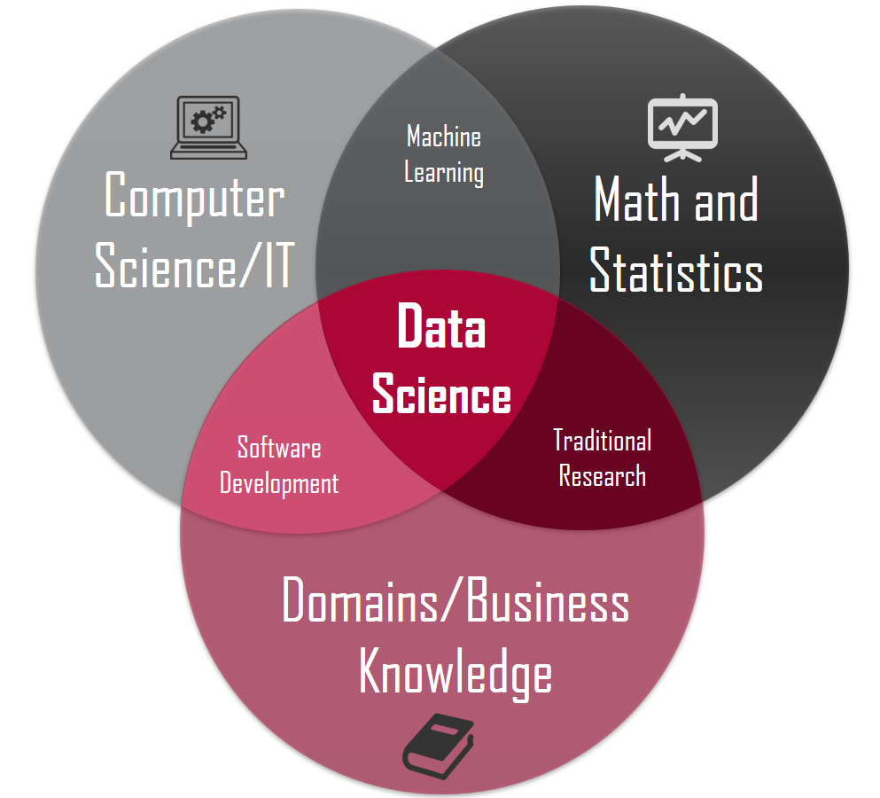
Data Science 101
Day 5: Data Preprocessing

Slide 3
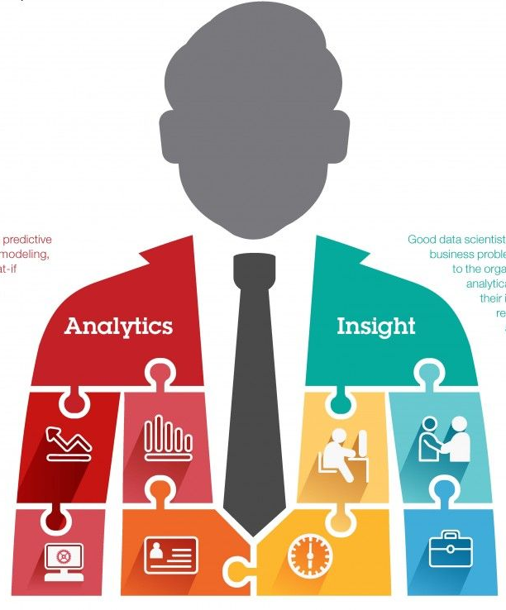
About Me
Join us: https://www.linkedin.com/groups/6707800/
Twitter: https://twitter.com/Sanjeet36284331
Linkedin: https://www.linkedin.com/in/sanjeetshukla/
Sanjeet Shukla
Data Scientist-Big Data
Cognizant Technology Solutions

Slide 4
Data Validity Check
Data-Type Constraints: values in a particular column must be of a particular datatype, e.g., Boolean, Numeric, date, etc.
Range Constraints: Typically, numbers or dates should fall within a certain range.
Mandatory Constraints: certain columns cannot be empty.
Unique Constraints: a field, or a combination of fields, must be unique across a dataset.
Set-Membership constraints: values of a column come from a set of discrete values, e.g. enum values. For example, a person’s gender may be male or female.

Slide 5
Data Validity Check..
Foreign-key constraints: as in relational databases, a foreign key column can’t have a value that does not exist in the referenced primary key.
Regular expression patterns: text fields that have to be in a certain pattern. For example, phone numbers may be required to have the pattern (999) 999–9999.
Cross-field validation: certain conditions that span across multiple fields must hold. For example, a patient’s date of discharge from the hospital cannot be earlier than the date of admission.

Slide 6
Data Preprocessing Workflow
Inspection
Cleaning
Verifying
Reporting
Inspection: Detect unexpected, incorrect, & inconsistent data.
Cleaning: Fix or remove the anomalies discovered in step 1.
Verifying: After cleaning, inspect & verify the result for correctness.
Reporting: A report about the changes made to the data is recorded.

Slide 7
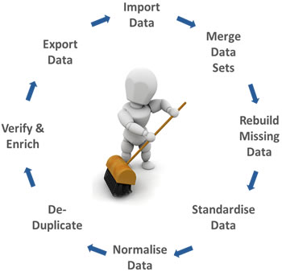

Slide 8
Inspection
Data profiling: A summary statistics about the data
How many values are missing?
How many unique values and their distribution.
Is this data set is linked to or have a relationship with another?
Visualizations:
Plotting to identify outliers.
Visualizing the data using statistical methods such as mean, standard deviation, range, or quantiles, one can find values that are unexpected and thus erroneous.
For example, The age can’t be negative, and so the height.

Slide 9
Cleaning: Remove, Correct, or impute
Irrelevant data: Taking only relevant rows and columns.
For health analysis phone number wouldn’t be necessary. –Column
Study patients who went to the surgery, and not everyone. –Row
Before removing data we should ask domain expert or take help from correlation matrix.
Duplicates:
They simply should be removed after careful observation.

Slide 10
Cleaning: Remove, Correct, or impute
Type conversion:
Make sure numbers are stored as numerical data types and dates as date object, or a Unix timestamp
Categorical values can be converted into and from numbers if needed.

Slide 11
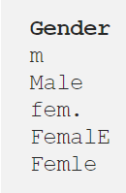
Cleaning
Syntax errors:
Remove white spaces: “ hello world “ => “hello world”
Pad strings: 313 => 000313 (6 digits)
Fix typos:

Slide 12
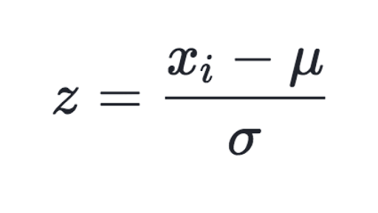
Standardization
For strings, make sure all values are either in lower or upper case.
For numerical values, make sure all values have a certain measurement unit.
Scaling / Transformation:
Transform your data so that it fits within a specific scale, i.e. 0–100 or 0–1.

Slide 13
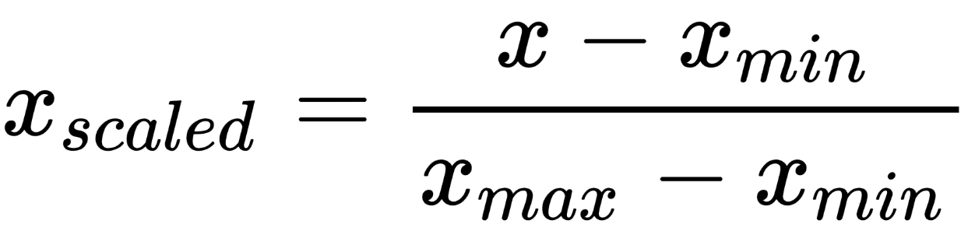
Normalization
Normalization also rescales the values into a range of 0–1, the intention here is to transform the data so that it is normally distributed.

Slide 14
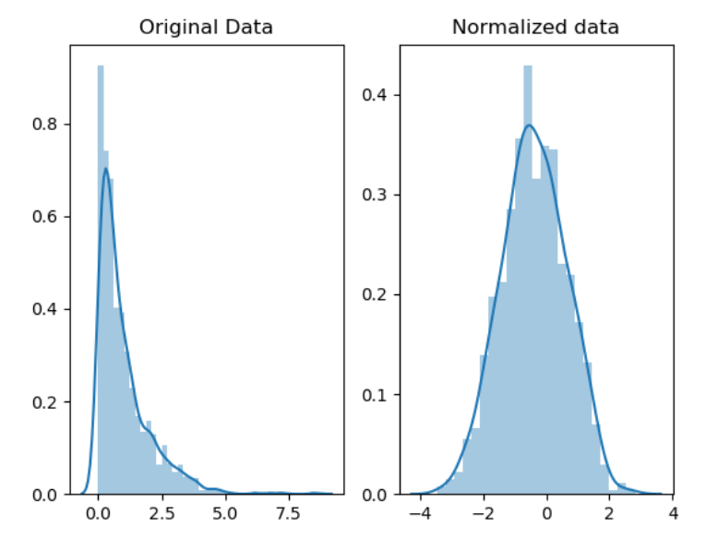
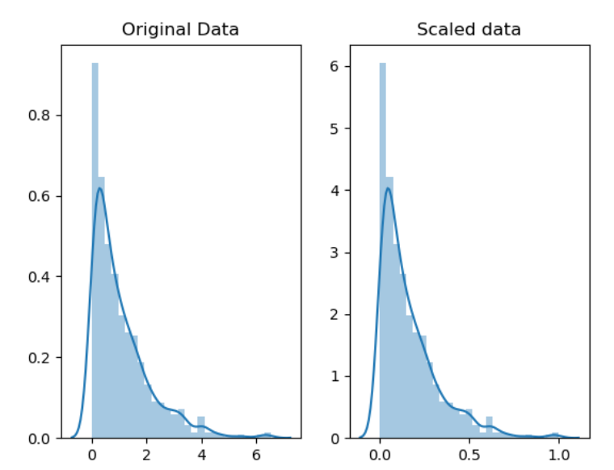

Slide 15
Standardization vs Normalization
Normalization: Data will be rescaled between 0-1
Why do we Normalize? 1. Normalization makes training less sensitive to the scale of features, so we can better solve for coefficients.
Standardization: Data is rescaled such that μ = 0 and 𝛔 = 1.
There is some debate stating it is better to have the input values centered around 0 — standardization — rather than between 0 - 1.
For most applications standardization is recommended.

Slide 16
Standardize or Normalize?
Normalization is useful when your data has varying scales and the algorithm you are using does not make assumptions about the distribution of your data, such as k-nearest neighbors and artificial neural networks.
Normalizing the data is sensitive to outliers, so if there are outliers in the data set it is a bad practice.
Standardization is useful when your data has varying scales and the algorithm you are using does make assumptions about your data having a Gaussian distribution, such as linear regression, logistic regression, and linear discriminant analysis.

Slide 17
Missing values
Drop:
Drop the observation(s) (rows) that have missing values.
Drop the whole column if missing value is frequent.
Impute:
Impute using mean, median etc, however it may introduce bias.
Means is useful if data is not skewed, while median is robust as it is not sensitive to outliers.
Impute data with random values between 2 standard deviation using following formula. (mean — 2 * std) & (mean + 2 * std).

Slide 18
Missing values Impute
Using a linear regression: Based on the existing data to get values of missing variables.
Hot Deck: Copying values from other similar records.
Sequential hot-deck imputation: The column containing missing values is sorted according to auxiliary variable(s) so that records that have similar auxiliaries occur sequentially. Next, each missing value is filled in with the value of the first following available record.
𝑘 nearest neighbour imputation: A missing value is filled out by finding first the 𝑘 records closest to the record with missing values.

Slide 19
Missing values Impute
Flag: Some argue that filling in the missing values leads to a loss in information, no matter what imputation method we used.
That’s because saying that the data is missing is informative in itself, and the algorithm should know about it. Otherwise, we’re just reinforcing the pattern already exist by other features.
Missing numeric data can be filled in with say, 0, but has these zeros must be ignored when calculating any statistical value or plotting the distribution.
While categorical data can be filled in with say, “Missing”: A new category which tells that this piece of data is missing.

Slide 20
Missing value is not same as Default Value
Missing values are not “unknown”.
A conducted research where some people didn’t remember whether they have been bullied or not at the school, should be treated and labelled as unknown and not missing.

Slide 21
Verifying
When done, one should verify correctness by re-inspecting the data and making sure it rules and constraints do hold.
For example, after filling out the missing data, they might violate any of the rules and constraints.
It might involve some manual correction if not possible otherwise.

Slide 22
Reporting
Reporting how healthy the data is, is equally important to cleaning.
As mentioned before, software packages or libraries can generate reports of the changes made, which rules were violated, and how many times.
In addition to logging the violations, the causes of these errors should be considered. Why did they happen in the first place?.

Slide 23
https://medium.com/omarelgabrys-blog/statistics-probability-exploratory-data-analysis-714f361b43d1#a7e5
https://towardsdatascience.com/the-ultimate-guide-to-data-cleaning-3969843991d4
https://medium.com/analytics-vidhya/dealing-with-noisy-data-in-data-science-e177a4e32621
https://towardsdatascience.com/normalization-vs-standardization-quantitative-analysis-a91e8a79cebf
https://medium.com/@swethalakshmanan14/how-when-and-why-should-you-normalize-standardize-rescale-your-data-3f083def38ff
https://www.researchgate.net/post/When_to_normalize_and_when_to_standardize_features_of_dataset

Slide 24


