Slide 1


HOSPITAL MANAGEMENT SYSTEM
Presented By:
SANJEET CHUKKA
Guided By: Babjee
Mentor: Kavin Kumar Govindaraj

Slide 2

INTRODUCTION
The project is aimed to design and implement ETL (Extract, Transform, Load) processes to manage and integrate data from various sources into a centralized data warehouse. The focus is on creating dimension tables for key entities such as patient, Physician, appointment, insurance, and billing modules. The project will utilize Talend, a leading data integration tool, to ensure efficient and reliable data processing.

Slide 3
OBJECTIVES
Build a Datawarehouse
Create a centralized repository
Increase data accessibility
Support Business Growth

Slide 4

HARDWARE AND SOFTWARE USED
Intel Pentium 90 or higher
Microsoft Windows 2010 or above.
Memory: 4GB of RAM (64MB or more recommended)
SQL DEVELOPER(Database)
Talend Real-time Big Data Platform 8.0.1 (ETL Tool)

Slide 5
Project Overview
ABC Hospital is a leading multispecialty hospital headquartered in Chennai. It offers comprehensive medical care in more than 40 specialties. It has vast pool of talented and experienced team of doctors who are further supported by team of highly qualified, experienced and dedicated support staff and cutting edge technology.
The following are the modules in this proposed system
a) Patient Module
b) Physician Module
c) Appointment Module
d) Insurance Module
e) Billing Module

Slide 6
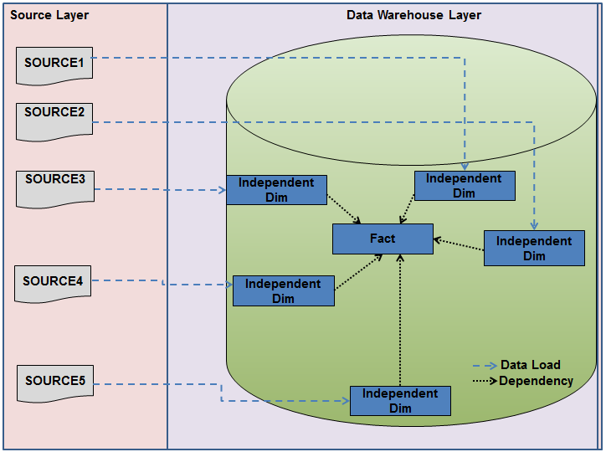
DATAWARE HOUSE
A data warehouse is a centralized repository that stores integrated data from multiple sources.
Dimension Tables:
Patient
Physician
Appointment
Insurance
Billing
Fact Tables:
Hospital_data

Slide 7

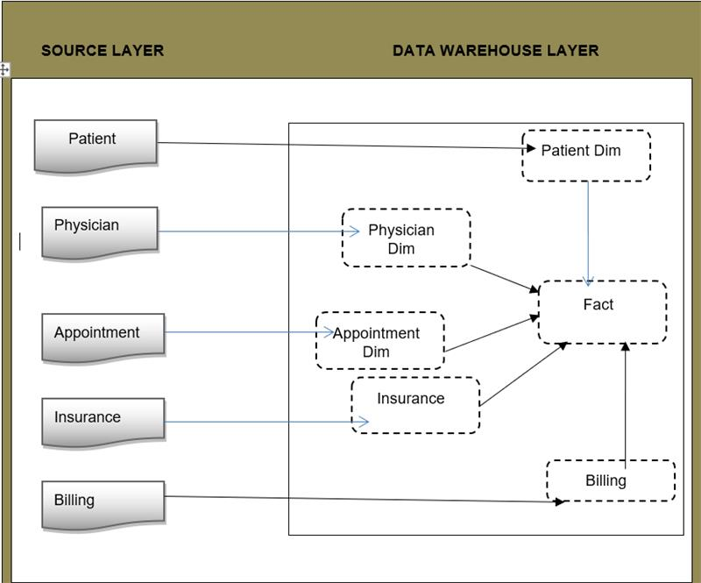
SCSCHEMA DIAGRAMHEMA DIAGRAM

Slide 8

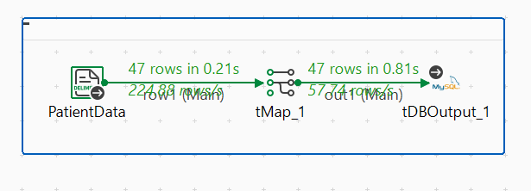
MAPPING DIAGRAM
Patient Staging

Slide 9
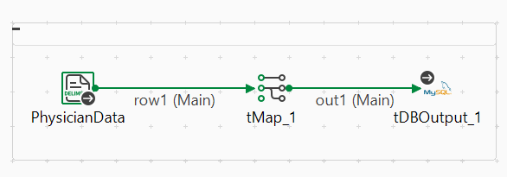
Physician Staging

Slide 10
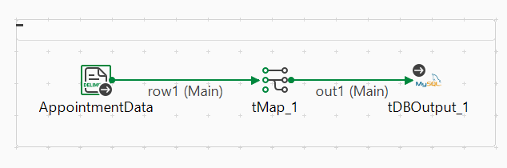
Appointment Staging

Slide 11
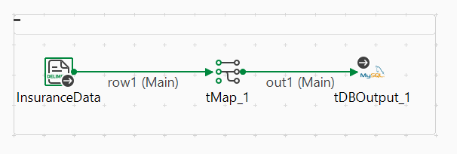
Insurance Staging

Slide 12
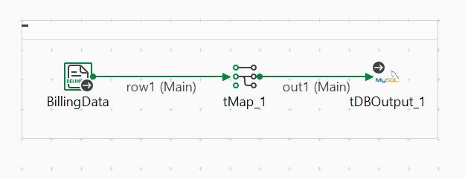
Billing Staging

Slide 13

DESIGN
Stagging Data
Patient_Stagging
Physician_Stagging
Appointment_Stagging
Insurance_stagging
Billing_Stagging
Physician_dim
Insurance _dim
Billing _dim
Patient _dim
Appointment _dim
Hospital_Fact_Table

Slide 14
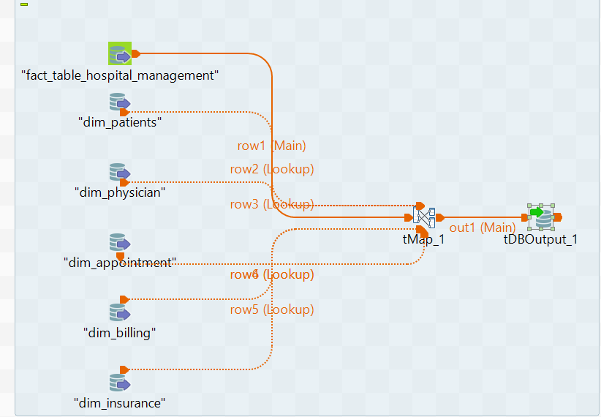
Star Schema

Slide 15
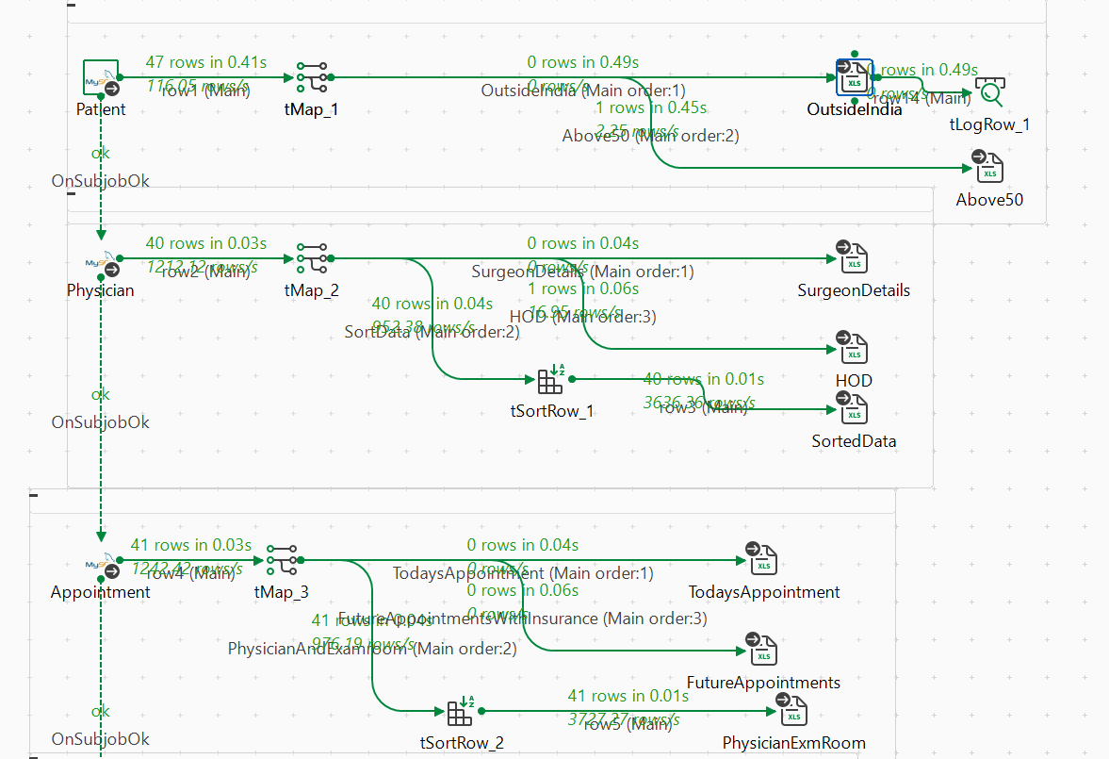
FUNCTIONAL_REQUIREMENTS
1. Patients

Slide 16

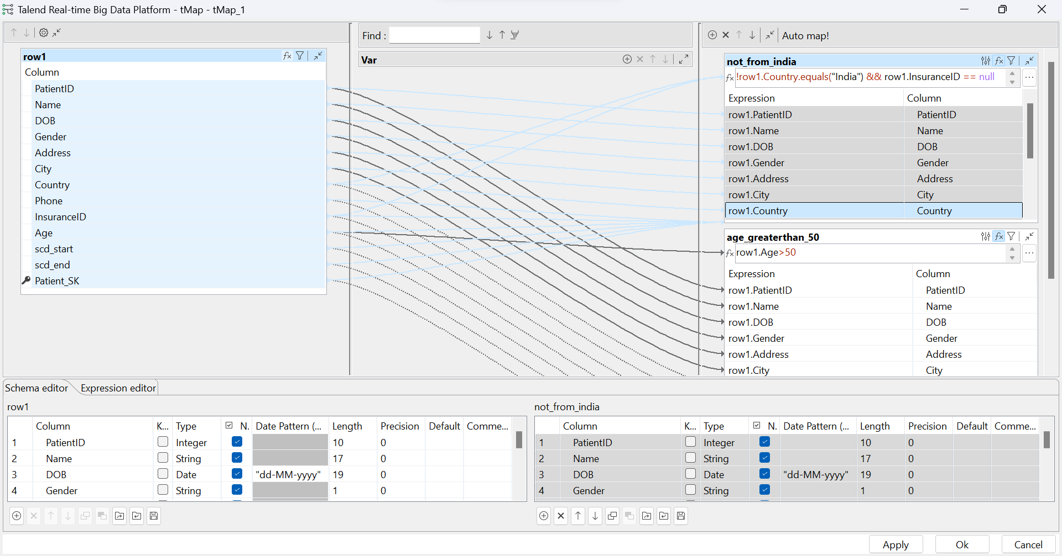

Slide 17
2. Physician

Slide 18
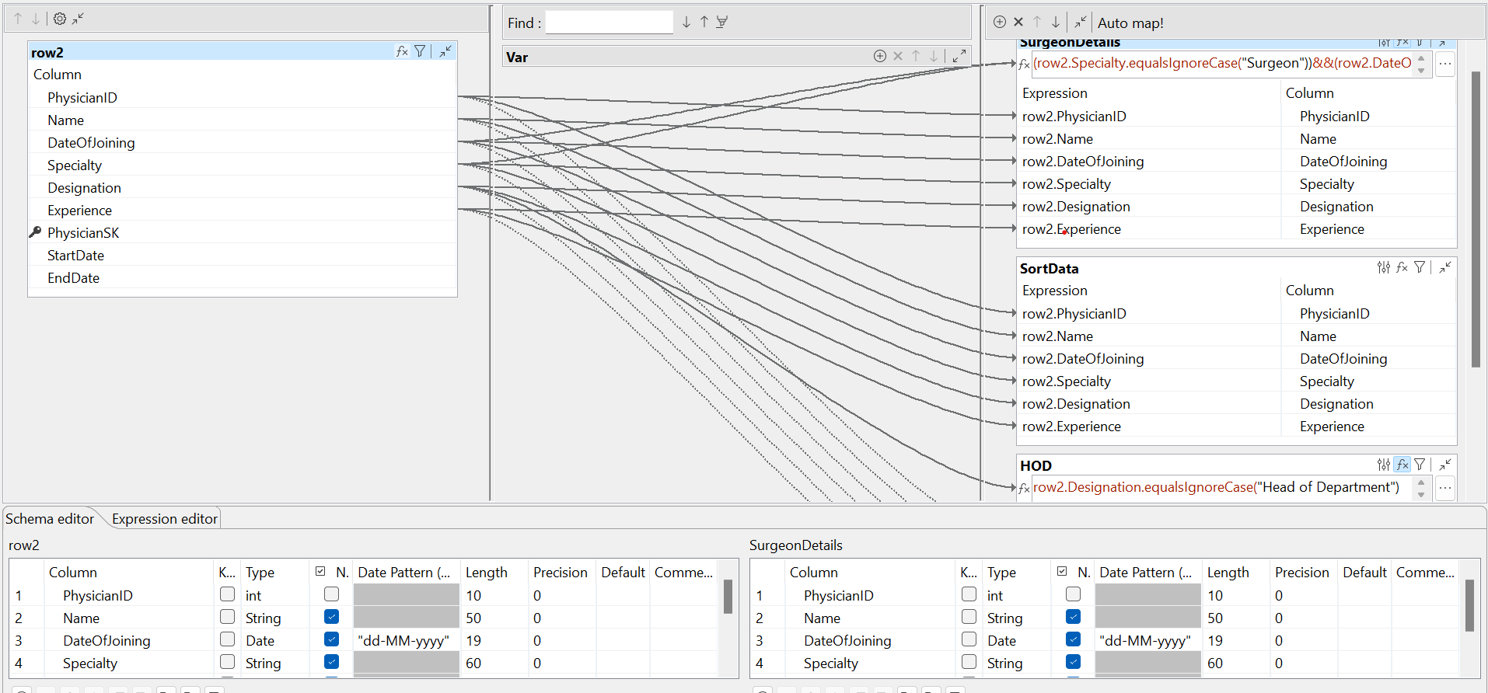

Slide 19
3.Appointment

Slide 20
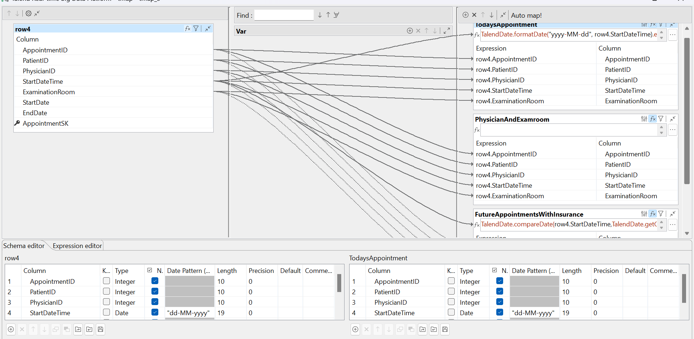

Slide 21
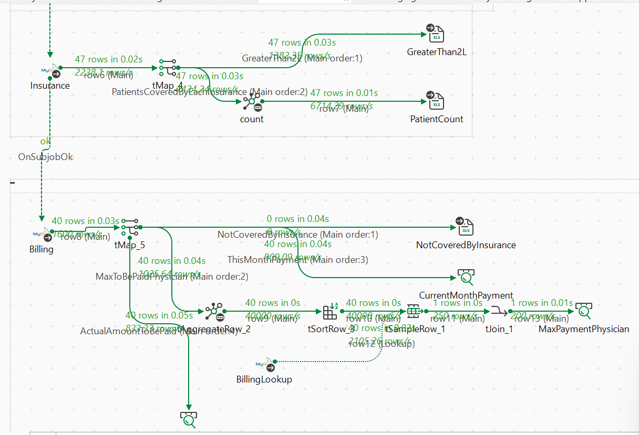
4.Insurance

Slide 22
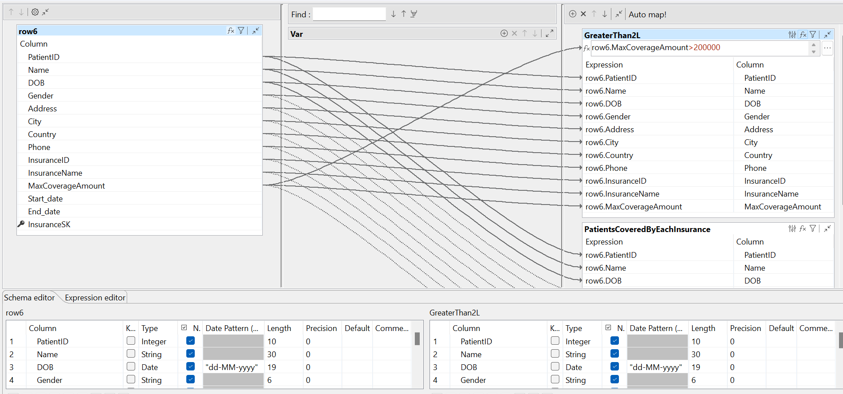

Slide 23
5.Billing

Slide 24
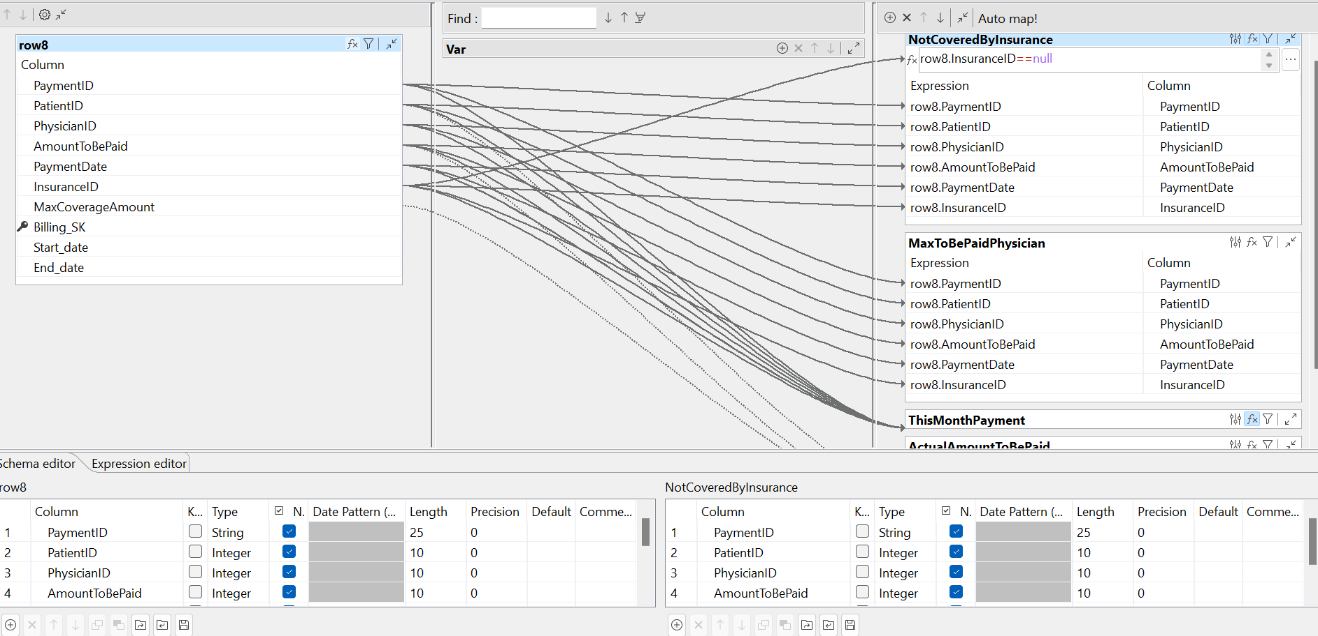

Slide 25
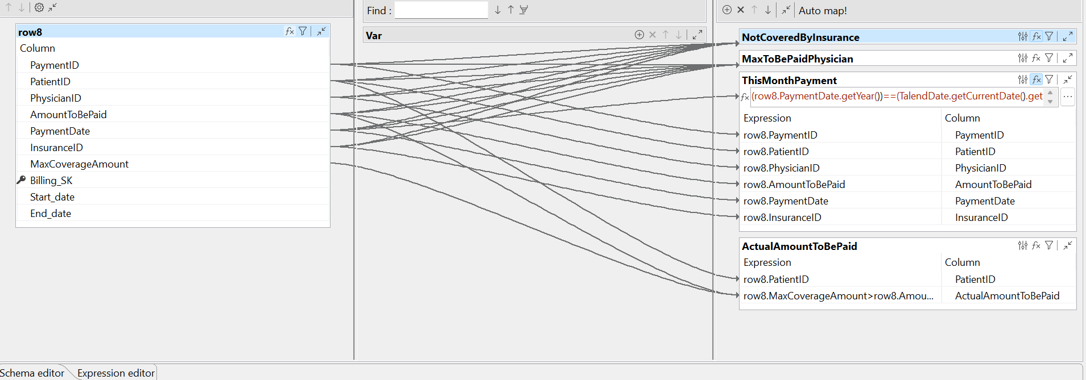

Slide 26

CONCLUSION
Comprehensive Data Integration: Implemented efficient ETL processes for vendor data using Informatica.
Enhanced Decision-Making: Enabled more informed and strategic decision-making capabilities.
Future Scope: Positioned to adapt to future data requirements and drive business growth through scalable ETL processes.

Slide 27

Thank You

