Slide 1

Uber Fare PREDICTION
RNS INSTITUTE OF TECHNOLOGY
BENGALURU - 98
DEPARTMENT OF INFORMATION SCIENCE & ENGINEERING
Presentation on Internship
L Sanjeetha
USN: 1RN18IS062
New Age Solutions Technologies
Internal Guide
Mrs. Chandan Rani S R
Ass. Professor, Dept of ISE, RNSIT
External Guide
Mr. Aman Upadhyay
Mentor, NASTECH and Bangalore

Slide 2
AGENDA
Abstract
About the Company
Introduction
Literature Survey
Requirements
System Design
Detailed Design
Implementation
Results
Conclusion and Future Enhancements
References
Q & A

Slide 3
ABSTRACT
Predictive analytics uses archival data to predict the values. Typically, past data is used to build a mathematical model and that model is used on current data to predict the future or to suggest actions to take for optimal outcomes.
Companies also use predictive analytics to create more accurate forecasts, such as forecasting the fare amount for a cab ride in the city.
This research aims to understand all patterns and to apply analytics for fare prediction. The proposed work is to design a system that predicts the fare amount for a cab ride in the city.
The aim is to build regression models, which will predict the continuous fare amount for each cab ride and help prediction depending on multiple time-based, positional and general factors.

Slide 4
ABOUT THE COMPANY
NASTECH is formed with the purpose of bridging the gap between Academic and Industry.
Nastech is one of the leading Global Certification and Training service providers for technical and management programs for educational institutions.
It collaborates with educational institutes to understand their requirements and form a strategy in consultation with all stakeholders to fulfill those by skilling, reskilling and upskilling the students and faculties on new age skills and technologies.

Slide 5
INTRODUCTION
We analyzed the Regression algorithms namely Decision Tree, Random Forest, Linear Regression based on their root mean square error, we identified the best regression algorithm which can be used in the uber fare prediction.
The proposed work predicts uber fare by exploring the regression algorithms and does performance analysis.
The objective of this study is to effectively predict the cost of the travelling in uber.

Slide 6
LITERATURE SURVEY
Author J. Chao tells us the popularity of uber in the recent years and about the urban citizens who are benefited by the uber.
A large part of the literature focuses primarily on spatial-temporal analysis and demand & price forecasting of the taxi trips. Popular destinations in New York City were uncovered by detecting popular drop-off locations linear regression model and implemented to analyse the travel patterns in urban areas for effective investment decisions in rapid transit infrastructure and service ( Hochmair, 2016) and density analysis was used to detect demand fluctuations (Markou, Rodrigues, & Pereira, 2017).
The travel time estimation problem was addressed with a big data-driven approach using a simple baseline for Travel Time Estimation (Wang, Kuo, Kifer, & Li, 2014). With the aid of the Semi-Markov process and approximate dynamic programming (ADP) approach, time of the pricing was determined with supply and demand fluctuations of taxis and resulted in increasing the market revenue by 10% (Qian & Ukkusuri, 2017).
Random Forest Regression model was implemented to build a system that delivers traffic insights and recommendations to help taxi drivers with useful guidelines (Ibrahim & Shafiq, 2019). A taxi searching algorithm with an accuracy of 97.59% accuracy was built using distributed coordination and clustering to minimize the time of taxi reaching the passengers (Agrawal, Raychoudhury, Saxena, & Kshemkalyani, 2018)

Slide 7
REQUIREMENTS
Hardware Requirements
Memory: 8 GB or 4GB
Graphics Card: AMD Radeon RX 480 or NVIDIA GeForce GTX 970
CPU: Intel Core i5-4590
File Size: 2 GB
OS: Windows 7 SP1
Software Requirements
Application: Google CoLab
Dataset: Uber Prediction Data Set
Language: Python

Slide 8
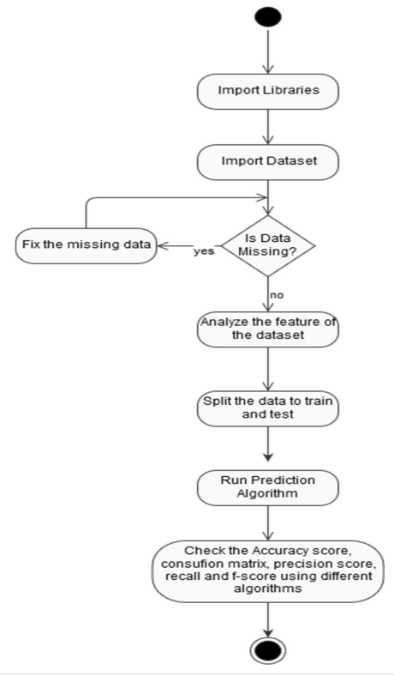
SYSTEM DESIGN
Design details – Architecture diagram
Activity Diagram

Slide 9
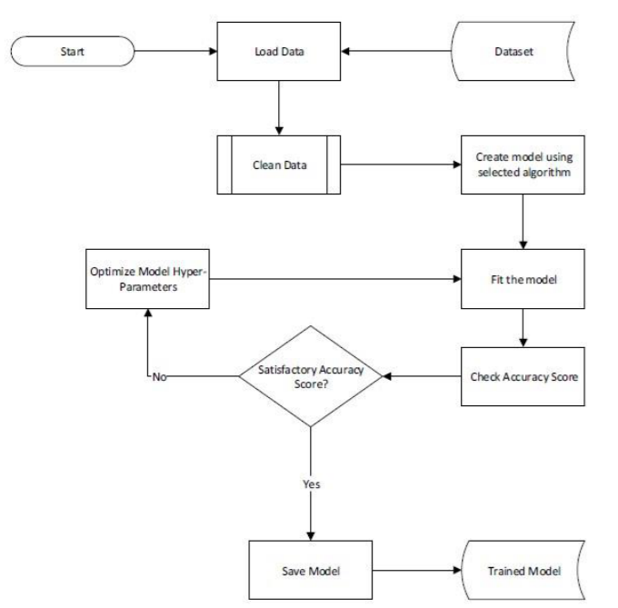
DESIGN
Workflow Diagram
Training model process

Slide 10
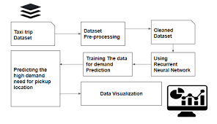
DESIGN
Workflow Diagram
Uber fare Prediction model

Slide 11
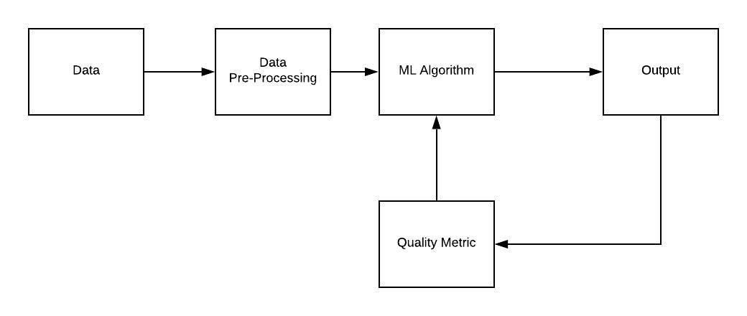
IMPLEMENTATION
Flow chart of Regression Algorithms
Flowchart of Linear regression model

Slide 12
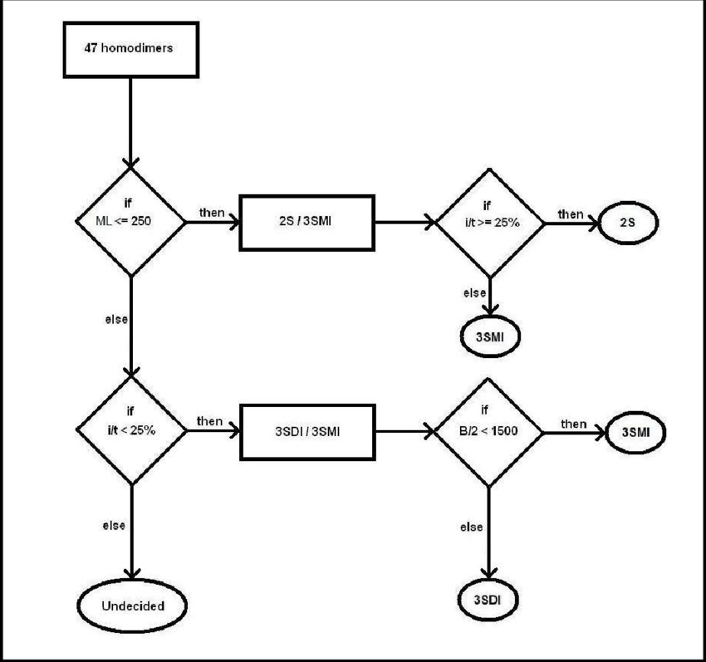
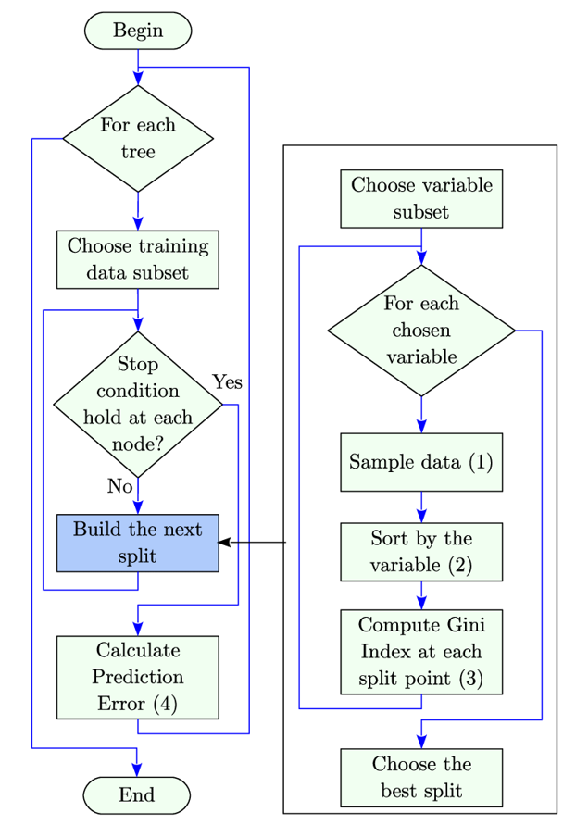
IMPLEMENTATION
Flow chart of Random forest regression Flowchart of Decision Tree

Slide 13
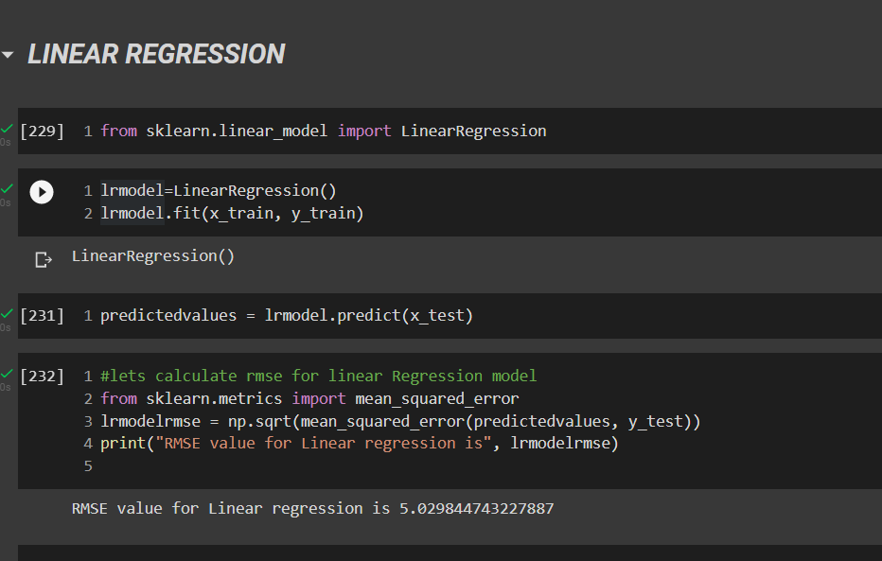
RESULTS
Linear Regression
RMSE value is 5.02984474

Slide 14
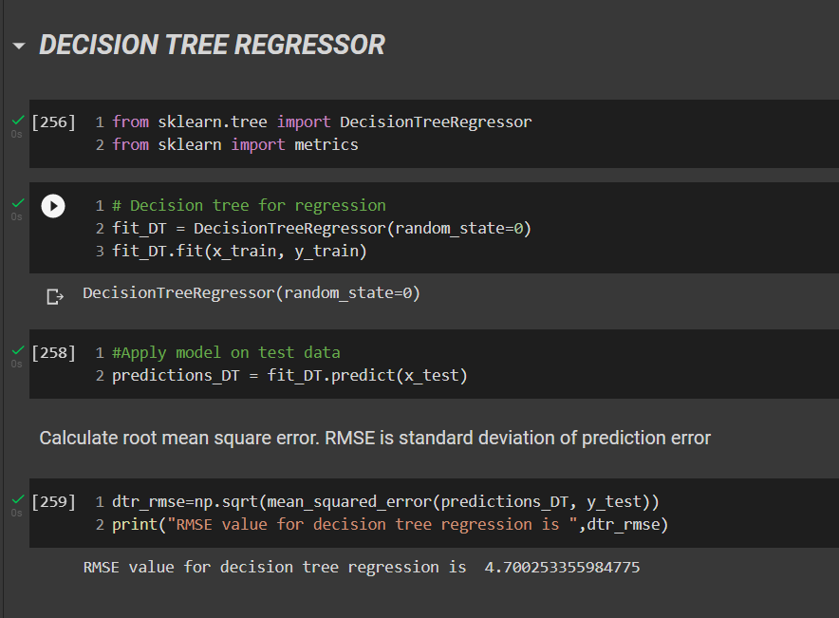
RESULTS
Decision Tree
RMSE value is 4.700253355

Slide 15
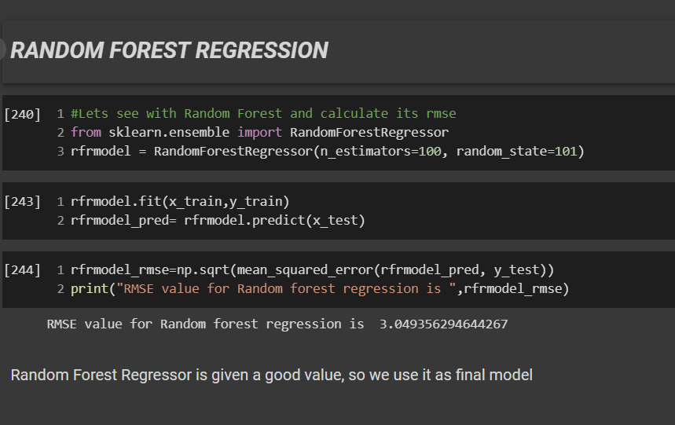
RESULTS
Random Forest Regression
RMSE value is 3.049356294

Slide 16
RESULTS
Root mean square error of the Regression Algorithms are given below:
The rmse using Linear Regression model is: 5.0298447
The rmse using Decision Regression model is: 4.7002533
The rmse using Random forest Regression model is: 3.0493562
By comparing all 3 Regression model Random forest regression has lower rmse value. So we will use Random forest Regression model to predict the cost for travelling in uber.

Slide 17
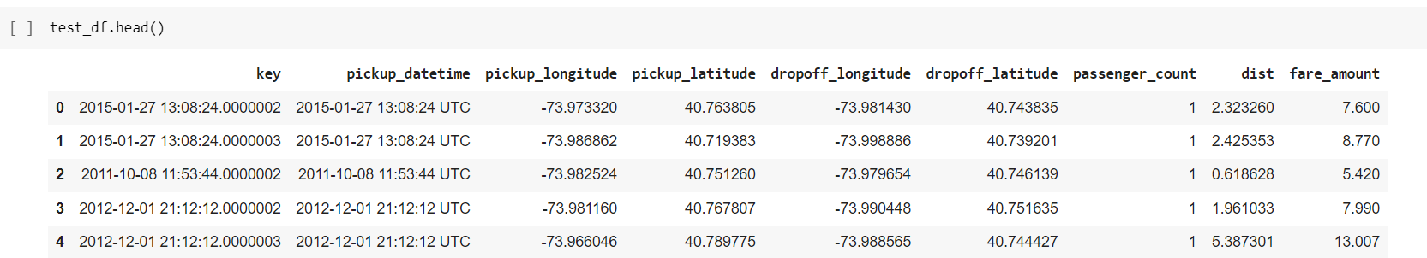
RESULTS
Prediction Uber Fare
Finding fare_amount using Random Forest Regression

Slide 18
CONCLUSIONS
The quality of a regression model depends on the matchup of predictions against actual values. In regression problems, the dependent variable is continuous. In classification problems, the dependent variable is categorical.
Random Forest can be used to solve both regression and classification problems. Decision trees are nonlinear; unlike linear regression, there is no equation to express the relationship between independent and dependent variables.
Out of the three models left, Random Forest is the best model as it has the lowest RMSE score and highest R-Squared score, which explains the highest variability and tells us how well the model fits in this data.

Slide 19
FUTURE ENHANCEMENTS
As is known, with an increase in the number of features; underlying equations become a higher-order polynomial equation, and it leads to overfitting of the data.
Generally, it is seen that an overfitted model performs worse on the testing data set, and it is also observed that the overfitted model performs worse on additional new test data set as well.
A kind of normalized regression type - Ridge Regression may be further considered.

Slide 20
REFERENCES
[1] John D. Kelleher, Fundamentals of Machine Learning for Predictive Data Analytics: Algorithms, Worked Examples, and Case Studies (The MIT Press), 1 st Edn.
[2] Data science work with public datasets, [Online] Available: https://www.kaggle.com, [3] Chong Ho Yu, Exploratory data analysis in the context of data mining and re-sampling, International Journal of psychological research, 2010, vol.3, No.1
[4] Ruben Oliva Ramos, Jen Stirrup, Advanced Analytics with R and Tableau, Packt Publishing, 2017, ISBN: 9781786460110
[5] Machine Learning in Python,[Online] Available https://scikit-learn.org/stable/
[6] T. Divya and A. Sonali, “A survey on Data Mining approaches for Healthcare”, International Journal of Biosciences and Bio-Technology, vol. 5, no. 5, (2013), pp. 241-266.
[7] Sebastian Raschka, Model Evaluation, Model Selection, and Algorithm Selection in Machine Learning, [Online] Available https://arxiv.org/abs/1811.12808,2016
[8] Weijie Wang and Yanmin Lu, Analysis of the Mean Absolute Error (MAE) and the Root Mean Square Error (RMSE) in Assessing Rounding Model, ICMEMSCE, IOP Publishing, 324 (2018), doi:10.1088/1757-899X/324/1/012049

Slide 21
Question and Answer

Slide 22
THANK YOU

