Slide 1
Advance PHp

Slide 2
Agenda
File Handling
Super Global Variables
Class and Objects
Sessions
Error Handling
Debugging
PHP Mysql integration
PHP & AJAX
Regular Expressions
JSON Data Vs Array
Email Functionality
Question Time

Slide 3
File Handling
  File handling is an important part of any web application. You often need to open and process a file for different tasks.
  Opening a file
  Reading a file
  Writing a file
  Closing a file
  The PHP fopen() function is used to open a file. It requires two arguments stating first the file name and then mode in which to operate.
  fopen( file name , mode );
  fopen returns a value of false if fails to open a file otherwise it returns a file pointer which is used for further reading or writing to that file.
Mode
r | Opens the file for reading only.
r+ | Opens the file for reading and writing
w | Opens the file for writing only
w+ | Opens the file for reading and writing only
a | Opens the file for writing only
a+ | Opens the file for reading and writing only

Slide 4
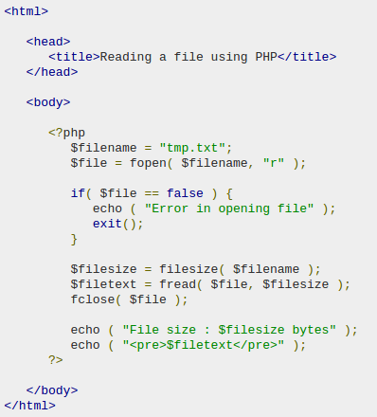
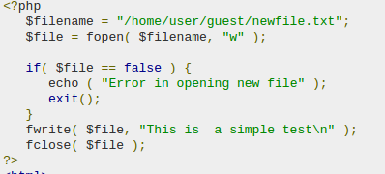
File Handling
  Open a file using fopen() function.
  Get the file's length using filesize() function.
  Read the file's content using fread() function.
  Close the file with fclose() function.
  Writing a file
  A new file can be written or text can be appended to an existing file using the PHP fwrite() function

Slide 5
Super Global Variables
  PHP provides a large number of predefined variables to any script which it runs. PHP provides an additional set of predefined arrays containing variables from the web server the environment, and user input. These new arrays are called superglobals.
Variable Description
$_SERVER | This is an array containing information such as headers, paths, and script locations. The entries in this array are created by the web server. There is no guarantee that every web server will provide any of these. See next section for a complete list of all the SERVER variables.
$_GET | An associative array of variables passed to the current script via the HTTP GET method.
$_POST | An associative array of variables passed to the current script via the HTTP POST method
$_FILES | An associative array of items uploaded to the current script via the HTTP POST method.
$_REQUEST | An associative array consisting of the contents of $_GET, $_POST, and $_COOKIE
$_COOKIE | An associative array of variables passed to the current script via HTTP cookie
$_SESSION | An associative array containing session variables available to the current script
$_PHP_SELF | A string containing PHP script file name in which it is called
$php_errormsg | $php_errormsg is a variable containing the text of the last error message generated by PHP

Slide 6
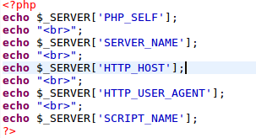
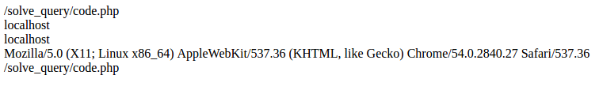
Super Global Variables
  Request
  Response

Slide 7
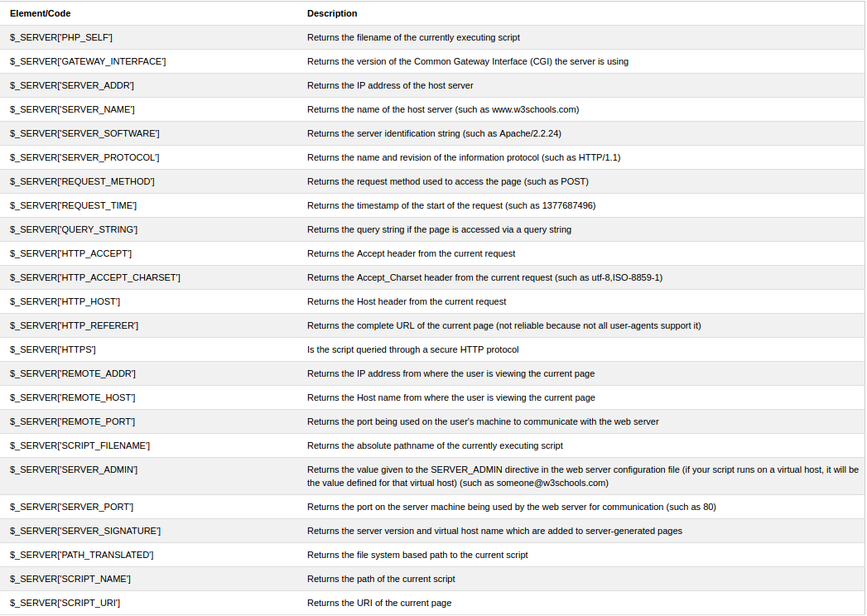
Super Global Variables

Slide 8
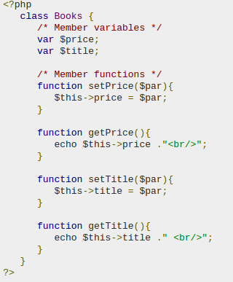
Class and Objects
  Class − This is a programmer-defined data type, which includes local functions as well as local data. You can think of a class as a template for making many instances of the same kind (or class) of object.
  The special form class, followed by the name
  of the class that you want to define.
  A set of braces enclosing any number of
  variable declarations and function definitions.
  Variable declarations start with the special form
  var, which is followed by a conventional $
  variable name; they may also have an
  initial assignment to a constant value.
  Function definitions look much like standalone
  PHP functions but are local to the class and
  will be used to set and access object data.

Slide 9

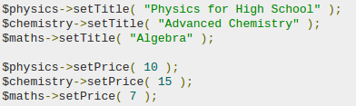

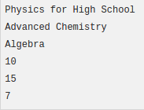
Class and Objects
  Object − An individual instance of the data structure defined by a class. You define a class once and then make many objects that belong to it. Objects are also known as instance.
  Once you defined your class, then you can create as many objects as you like of that class type. Following is an example of how to create object using new operator.
  Calling Member Functions
  set title and prices for the three books Now you call another member functions to get the
  by calling member functions. values set
  This will produce the following result

Slide 10
Sessions
  An alternative way to make data accessible across the various pages of an entire website is to use a PHP Session.
  A session creates a file in a temporary directory on the server where registered session variables and their values are stored. This data will be available to all pages on the site during that visit.
  When a session is started following things happen
  PHP first creates a unique identifier for that particular session which is a random string of 32 hexadecimal numbers such as 3c7foj34c3jj973hjkop2fc937e3443.
  A cookie called PHPSESSID is automatically sent to the user's computer to store unique session identification string.
  A file is automatically created on the server in the designated temporary directory and bears the name of the unique identifier prefixed by sess_ ie sess_3c7foj34c3jj973hjkop2fc937e3443.
  When a PHP script wants to retrieve the value from a session variable, PHP automatically gets the unique session identifier string from the PHPSESSID cookie and then looks in its temporary directory for the file bearing that name and a validation can be done by comparing both values.
  A session ends when the user loses the browser or after leaving the site, the server will terminate the session after a predetermined period of time, commonly 30 minutes duration.

Slide 11




Sessions
  Start of Session
  A PHP session is easily started by making a call to the session_start()function.This function first checks if a session is already started and if none is started then it starts one. It is recommended to put the call to session_start() at the beginning of the page.
  Session variables are stored in associative array called $_SESSION[]. These variables can be accessed during lifetime of a session.
  Destroyingof Session
  A PHP session can be destroyed by session_destroy() function. This function does not need any argument and a single call can destroy all the session variables. If you want to destroy a single session variable then you can use unset() function to unset a session variable.

Slide 12
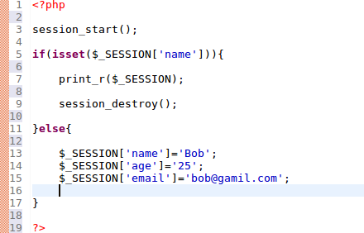
Sessions

Slide 13
Error Handling
  Error handling is the process of catching errors raised by your program and then taking appropriate action. If you would handle errors properly then it may lead to many unforeseen consequences.
Constant | Description
E_ERROR | Fatal run-time errors. Execution of the script is halted
E_WARNING | Non-fatal run-time errors. Execution of the script is not halted
E_PARSE | Compile-time parse errors. Parse errors should only be generated by the parser.
E_NOTICE | Run-time notices. The script found something that might be an error, but could also happen when running a script normally
E_CORE_ERROR | Fatal errors that occur during PHP's initial start-up.
E_CORE_WARNING | Non-fatal run-time errors. This occurs during PHP's initial start-up.
E_USER_ERROR | Fatal user-generated error. This is like an E_ERROR set by the programmer using the PHP function trigger_error()
E_USER_WARNING | Non-fatal user-generated warning. This is like an E_WARNING set by the programmer using the PHP function trigger_error()
E_USER_NOTICE | User-generated notice. This is like an E_NOTICE set by the programmer using the PHP function trigger_error()
E_STRICT | Run-time notices. Enable to have PHP suggest changes to your code which will ensure the best interoperability and forward compatibility of your code.
E_RECOVERABLE_ERROR | Catchable fatal error. This is like an E_ERROR but can be caught by a user defined handle (see also set_error_handler())
E_ALL | All errors and warnings, except level E_STRICT (E_STRICT will be part of E_ALL as of PHP 6.0)

Slide 14
Debugging
  Programs rarely work correctly the first time. Many things can go wrong in your program that cause the PHP interpreter to generate an error message. You have a choice about where those error messages go. The messages can be sent along with other program output to the web browser. They can also be included in the web server error log.
  PHP defines some constants you can use to set the value of error_reportingsuch that only errors of certain types get reported: E_ALL (for all errors except strict notices), E_PARSE (parse errors), E_ERROR (fatal errors), E_WARNING (warnings), E_NOTICE (notices), and E_STRICT (strict notices).
  There are following points which need to be verified while debugging your program.
  Missing Semicolons − Every PHP statement ends with a semicolon (;). PHP doesn't stop reading a statement until it reaches a semicolon. If you leave out the semicolon at the end of a line, PHP continues reading the statement on the following line.
  Not Enough Equal Signs − When you ask whether two values are equal in a comparison statement, you need two equal signs (==). Using one equal sign is a common mistake.
  Misspelled Variable Names − If you misspelled a variable then PHP understands it as a new variable. Remember: To PHP, $test is not the same variable as $Test.

Slide 15
Debugging
  Missing Dollar Signs − A missing dollar sign in a variable name is really hard to see, but at least it usually results in an error message so that you know where to look for the problem.
  Troubling Quotes − You can have too many, too few, or the wrong kind of quotes. So check for a balanced number of quotes.
  Missing Parentheses and curly brackets − They should always be in pairs.
  Array Index − All the arrays should start from zero instead of 1.

Slide 16

PHP & Mysql
  PHP will work with virtually all database software, including Oracle and Sybase but most commonly used is freely available MySQL database.

Slide 17
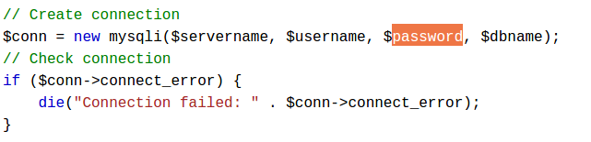
PHP & Mysql
  Opening Database Connection
  Closing Database Connection
Parameter | Description
servername | Optional − The host name running database server. If not specified then default value is localhost:3306.
username | Optional − The username accessing the database. If not specified then default is the name of the user that owns the server process.
password | Optional − The password of the user accessing the database. If not specified then default is an empty password.

Slide 18
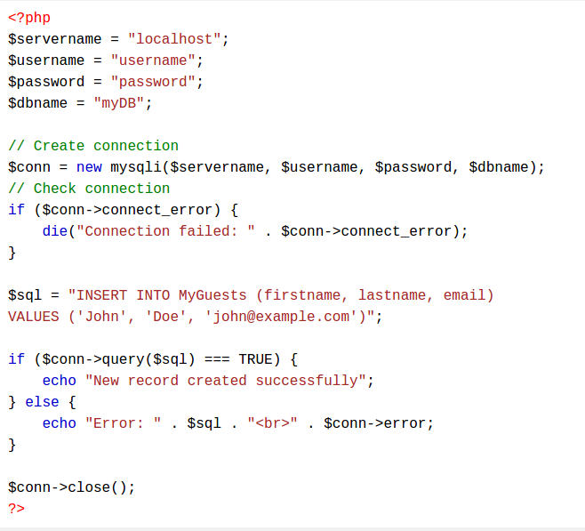
PHP & Mysql
  Example

Slide 19
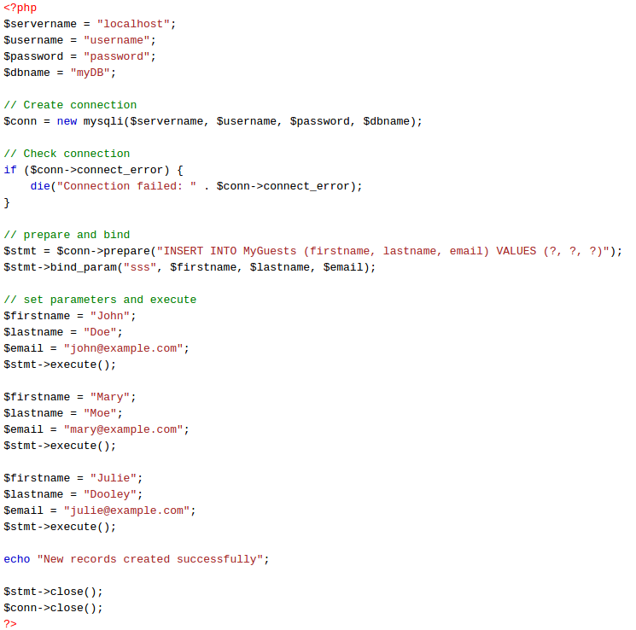
PHP & Mysql

Slide 20
PHP & Mysql
  Prepared Statements and Bound Parameters
  A prepared statement is a feature used to execute the same (or similar) SQL statements repeatedly with high efficiency.
  Prepared statements basically work like this:
  Prepare: An SQL statement template is created and sent to the database. Certain values are left unspecified, called parameters (labeled "?"). Example: INSERT INTO MyGuests VALUES(?, ?, ?)
  The database parses, compiles, and performs query optimization on the SQL statement template, and stores the result without executing it
  Execute: At a later time, the application binds the values to the parameters, and the database executes the statement. The application may execute the statement as many times as it wants with different values
  The argument may be one of four types:
  i - integer
  d - double
  s - string
  b - BLOB

Slide 21
PHP & AJAX
  What is AJAX ?
  AJAX stands for Asynchronous JavaScript and XML. AJAX is a new technique for creating better, faster, and more interactive web applications with the help of XML, HTML, CSS and Java Script.
  Conventional web application transmit information to and from the sever using synchronous requests. This means you fill out a form, hit submit, and get directed to a new page with new information from the server.
  With AJAX when submit is pressed, JavaScript will make a request to the server, interpret the results and update the current screen. In the purest sense, the user would never know that anything was even transmitted to the server.

Slide 22
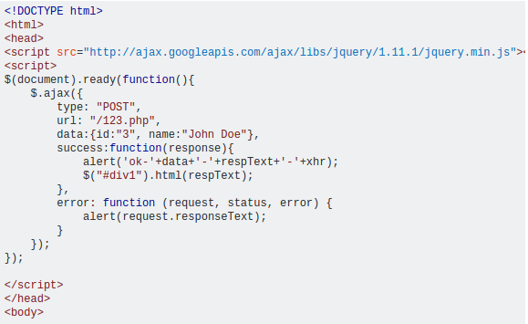
PHP & AJAX
  Ajax Example :
  Parameters
  type
  url
  data
  datatype
  success
  complete
  error

Slide 23
Regular Expressions
  Regular expressions are nothing more than a sequence or pattern of characters itself. They provide the foundation for pattern-matching functionality.
  Using regular expression you can search a particular string inside a another string, you can replace one string by another string and you can split a string into many chunks.
  POSIX Regular Expressions
  ereg()
  ereg_replace()
  split()
  PERL Style Regular Expressions
Function | Description
preg_match() | The preg_match() function searches string for pattern, returning true if pattern exists, and false otherwise.
preg_match_all() | The preg_match_all() function matches all occurrences of pattern in string.
preg_replace() | The preg_replace() function operates just like ereg_replace(), except that regular expressions can be used in the pattern and replacement input parameters.
preg_split() | The preg_split() function operates exactly like split(), except that regular expressions are accepted as input parameters for pattern.
preg_grep() | The preg_grep() function searches all elements of input_array, returning all elements matching the regexp pattern.
preg_ quote() | Quote regular expression characters

Slide 24
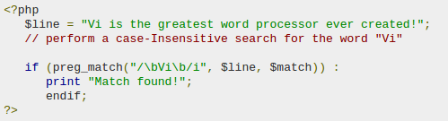
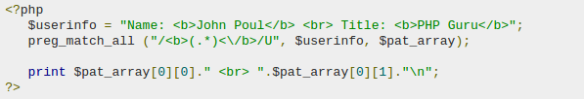


Regular Expressions
preg_match() : The preg_match() function searches string for pattern, returning true if pattern exists, and false otherwise.
preg_match_all() : The preg_match_all() function matches all occurrences of pattern in string.
preg_replace() : The ereg_replace() function searches for string specified by pattern and replaces pattern with replacement if found except that regular expressions can be used in the pattern and replacement input parameters.

Slide 25
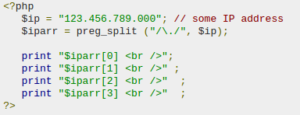

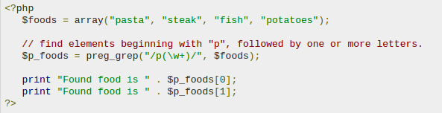
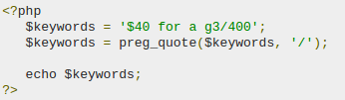
Regular Expressions
preg_split() : The preg_split() function will divide a string into various elements, the boundaries of each element based on the occurrence of pattern in string.
preg_grep() : Returns the array consisting of the elements of the input array that match the given pattern.
preg_ quote() : preg_quote() takes str and puts a backslash in front of every character that is part of the regular expression syntax.

Slide 26
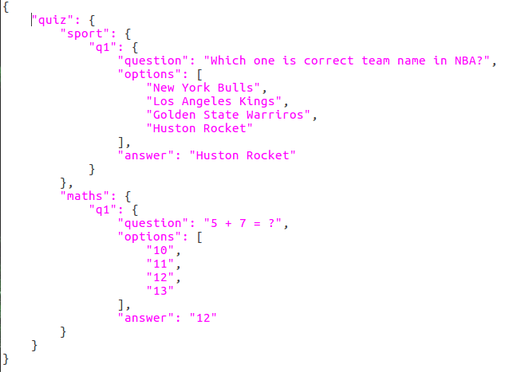
JSON Data Vs Array
  What is JSON ?
  JSON is a lightweight data-interchange format
  JSON is "self-describing" and easy to understand
  JSON is language independent
JSON: JavaScript Object Notation

Slide 27
JSON Data
  JSON Data Types
  In JSON, values must be one of the following data types:
  a string
  a number
  an object (JSON object)
  an array
  a boolean
  null
Types | Example
JSON Strings | { "name":"John" }
JSON Numbers | { "age":30 }
JSON Objects | {"employee":{ "name":"John", "age":30, "city":"New York" }}
JSON Arrays | {"employees":[ "John", "Anna", "Peter" ]}
JSON Booleans | { "sale":true }
JSON null | { "middlename":null }

Slide 28
Email Functionality
  PHP makes use of mail() function to send an email. This function requires three mandatory arguments that specify the recipient's email address, the subject of the the message and the actual message additionally there are other two optional parameters.
  As soon as the mail function is called PHP will attempt to send the email then it will return true if successful or false if it is failed.
Parameter | Description
to | Required. Specifies the receiver / receivers of the email
subject | Required. Specifies the subject of the email. This parameter cannot contain any newline characters
message | Required. Defines the message to be sent. Each line should be separated with a LF (\n). Lines should not exceed 70 characters
headers | Optional. Specifies additional headers, like From, Cc, and Bcc. The additional headers should be separated with a CRLF (\r\n)
parameters | Optional. Specifies an additional parameter to the send mail program

Slide 29
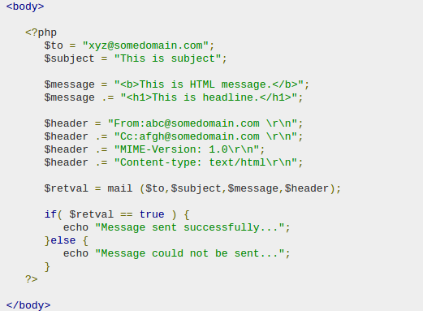
Email Functionality
  Sending HTML email
  PHP provides option to send an HTML message as actual HTML message.
  While sending an email message you can specify a Mime version, content type and character set to send an HTML email.

Slide 30
Questions time
  ?

