Slide 1
Compiled Analytics Work
By: Sanjeev Narasimhan
July 19, 2023

Slide 2
Introductory Analytics

Slide 3
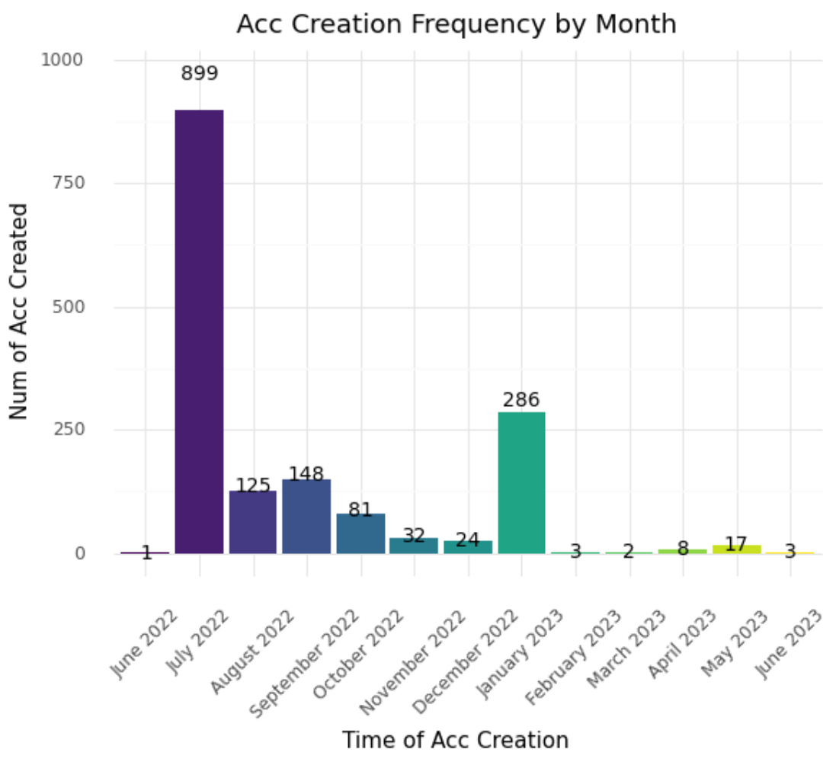
Looking at Account Creation Data
Notable Spikes: July 2022, September 2022, January 2023
Spikes in acc creation match with promotional events
Number of new accounts created is decreasing
Need for advertising to maintain general interest in game → spikes + consistent migration

Slide 4
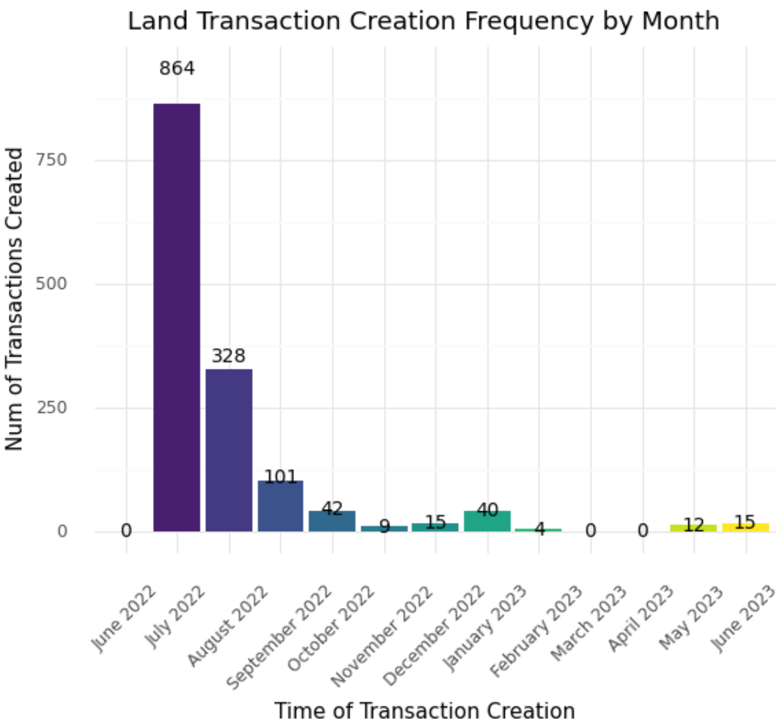
Looking at Land Transactions
Similar trend as the acc creation chart
Expectation: number of transactions >= number of users
Specifically looking at new users
Accounts being made but users are not playing
Need to look into means to increase user engagement
Gameplay aspects, login/ time based incentives, end goal

Slide 5
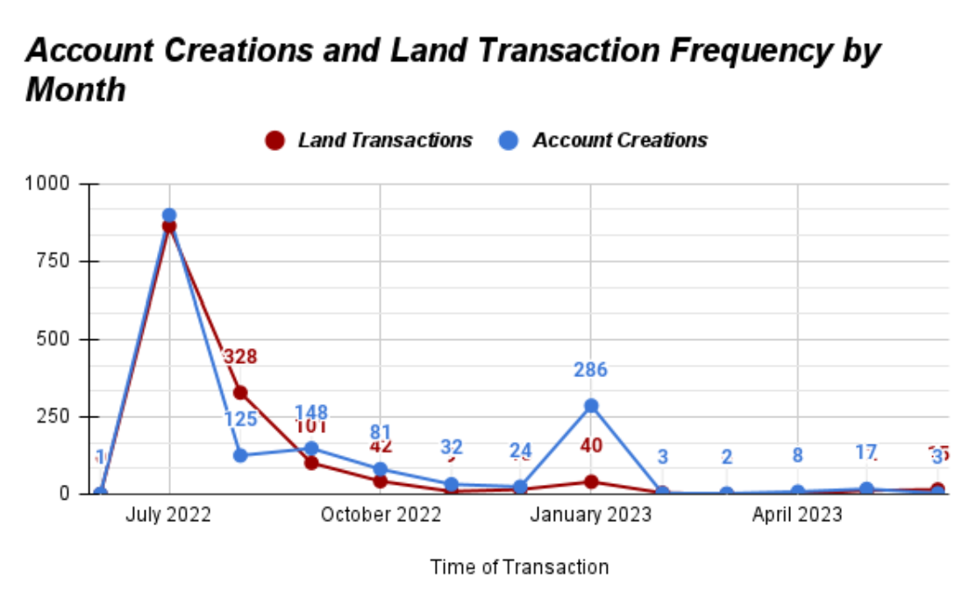
Extra Visualization for Prev Info

Slide 6
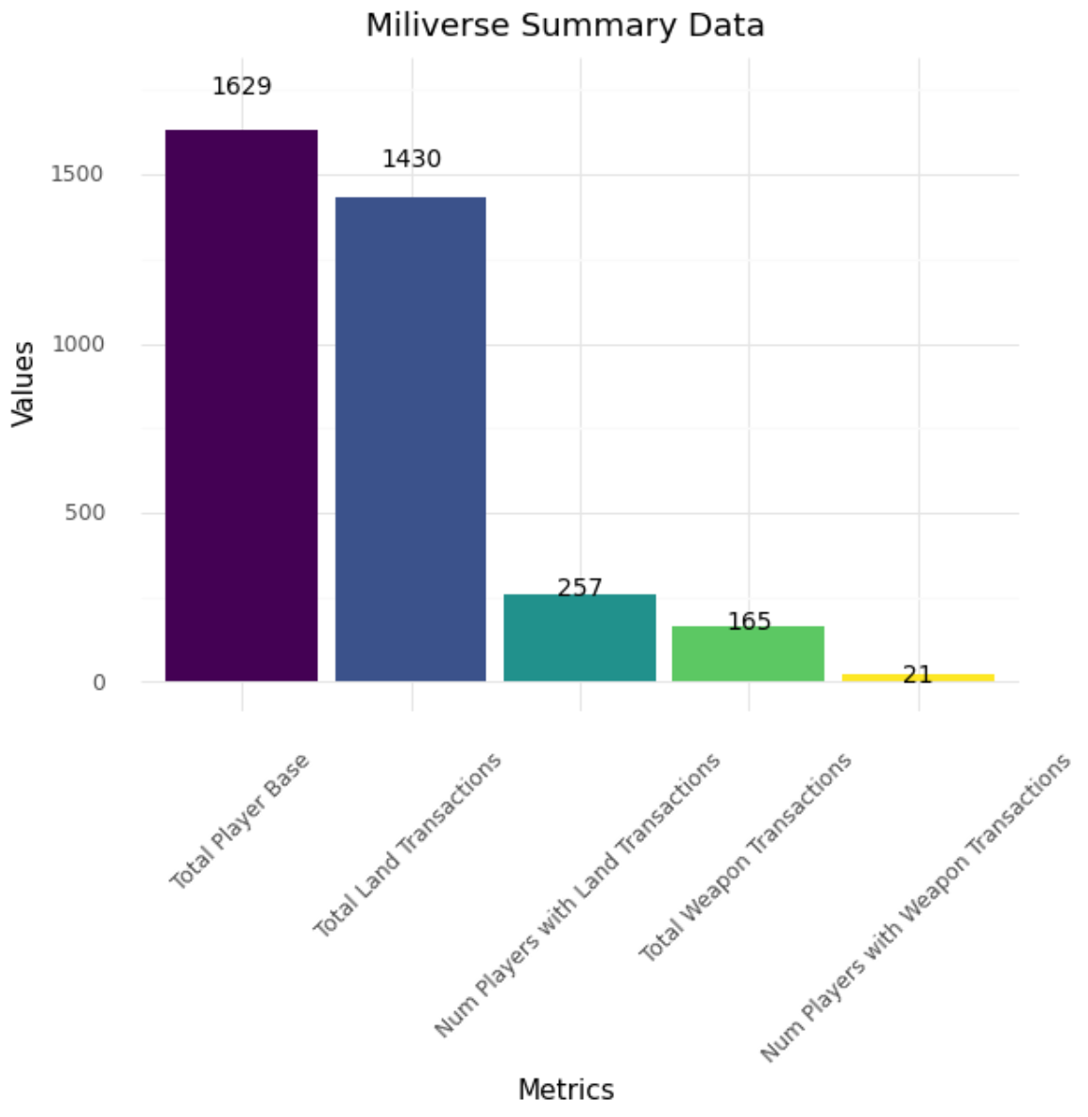
Takeaways from Data
Miliverse has 1629 users
257 players responsible for total 1430 land-based transactions
21 players responsible for total 165 weapon-based transactions
Supports the need to increase user engagement and retention

Slide 7
Understanding User Trends

Slide 8
Creating Master Data
Consists of only users who have made transactions (257 users)
Data Cleaning Done:
Transformation of Variables
Creating date/ time variables that can be used in algorithms
Merging, splicing, and subsetting previous datasets I made with Miliverse data
Original Miliverse Data → Land Transactions + Land Transaction Frequencies + Tiles of Land Owned + Weapon Transactions + Weapon Transaction Frequencies → Total Active Player Base, → Active Players Master Data
Variables:
Username
Email
Time of Acc Creation: Normal Time Format (“YYYY/ MM”) and Float Format (YYYYMM.0)
Time of Latest Transaction: Normal Time Format (“YYYY/ MM”) and Float Format (YYYYMM.0)
Number of Tiles
Number of Milipoints
Number of Transactions

Slide 9
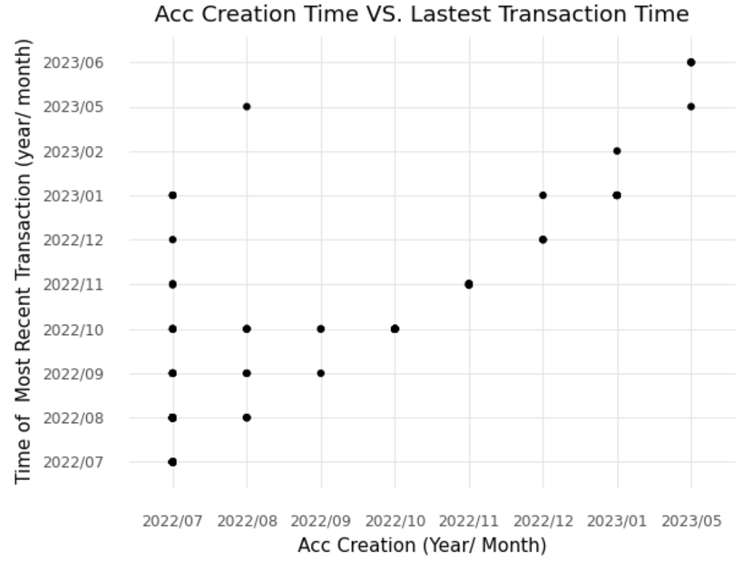
Visualizing User Trends Based on Acc Creation
Lets us see how active users are based on returning to the site (long term players)
Red line represents a 1-to-1 relation of acc creation and transactions
The higher the points are in relation to the red line the better
Users are engaging in the game even after the month of acc creation
Earlier users were most active
More recent users are only active for a short time after acc creation

Slide 10
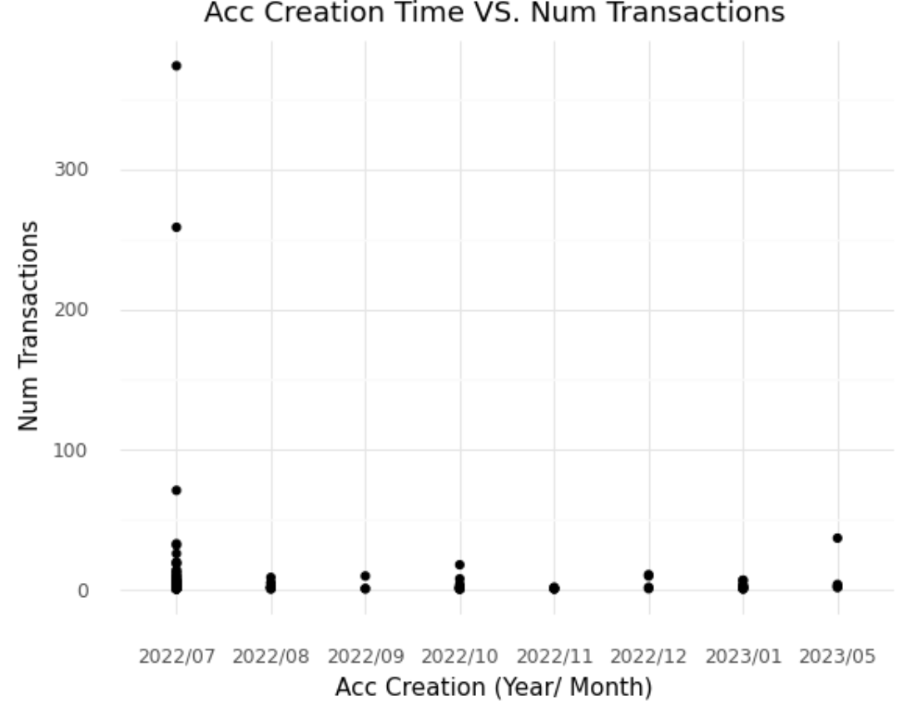
Visualizing User Trends Based on Acc Creation
Lets us see how active users are based on action engagement (participative players)
Red circles represent outliers
Have an inordinate number of transactions → not normal users
Earlier users were most active and interacted with gameplay frequently
Aside from first month relative stagnant activity

Slide 11
Developing Models

Slide 12
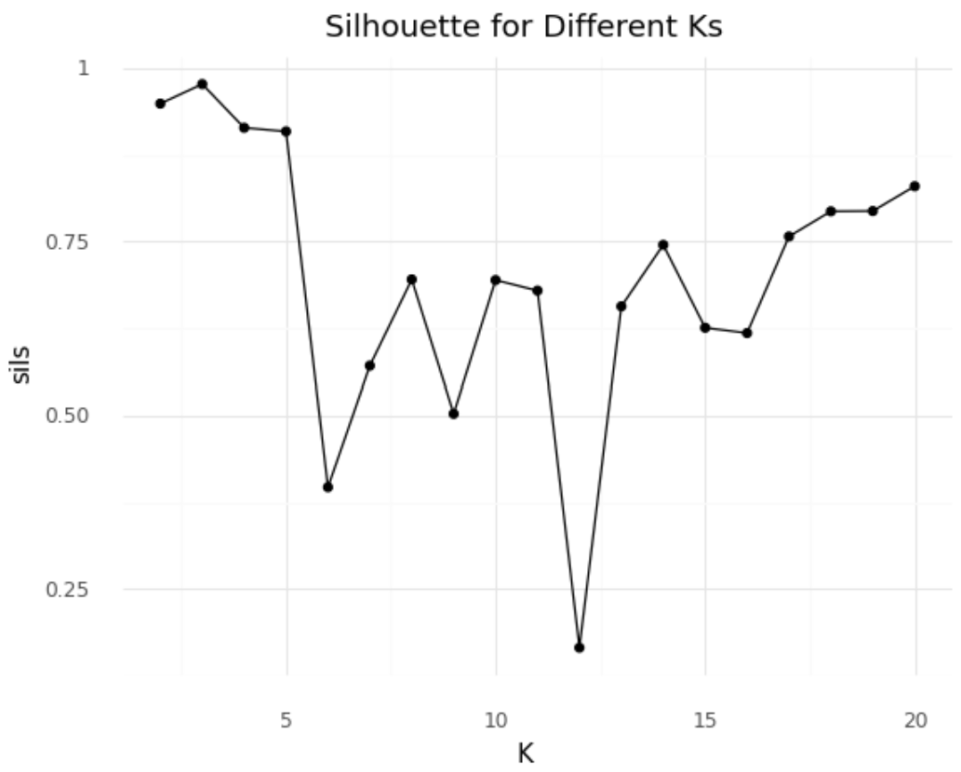
Gaussian Mixture Model
Clustering algorithm
Graph represents the strength of the model based on the number of clusters
Red circle represents optimal number of clusters (3)
Silhouette score calculates how good the clusters are based on cohesion and separation
Silhouette Score of ~0.978

Slide 13
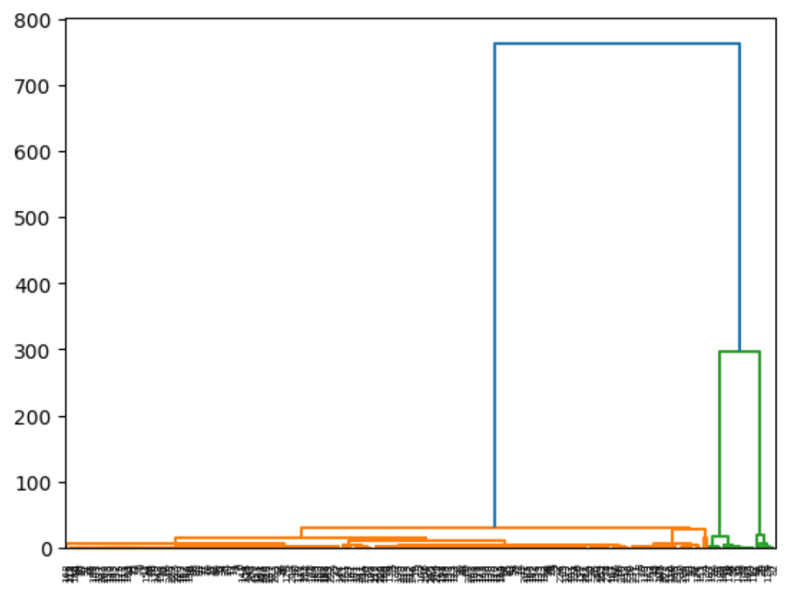
Hierarchical Agglomerative Model
Clustering algorithm
Graph uses the cohesiveness and separations of the data to determine optimal number of clusters (3)
Silhouette score calculates how good the clusters are based on cohesion and separation
Silhouette Score of ~0.978

Slide 14
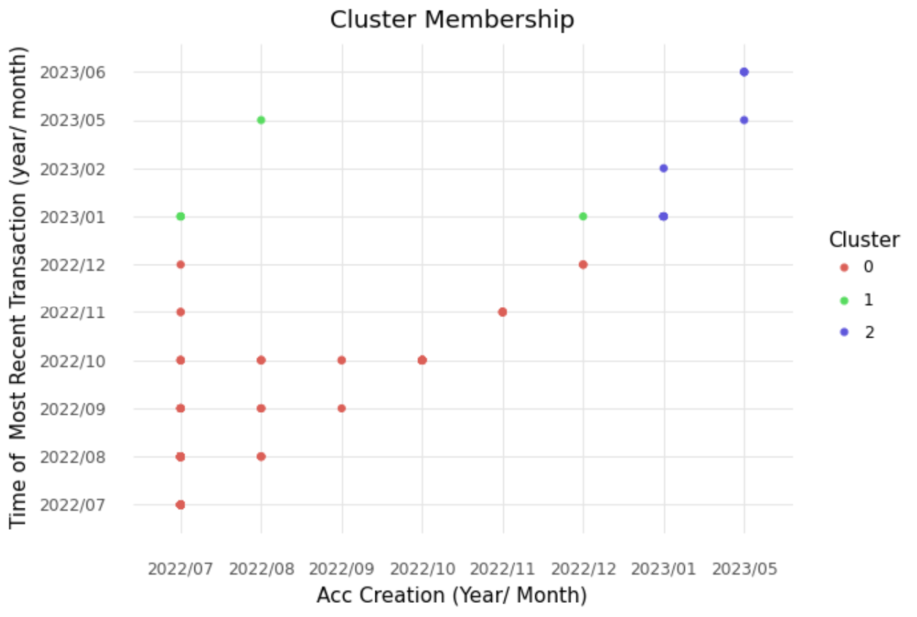
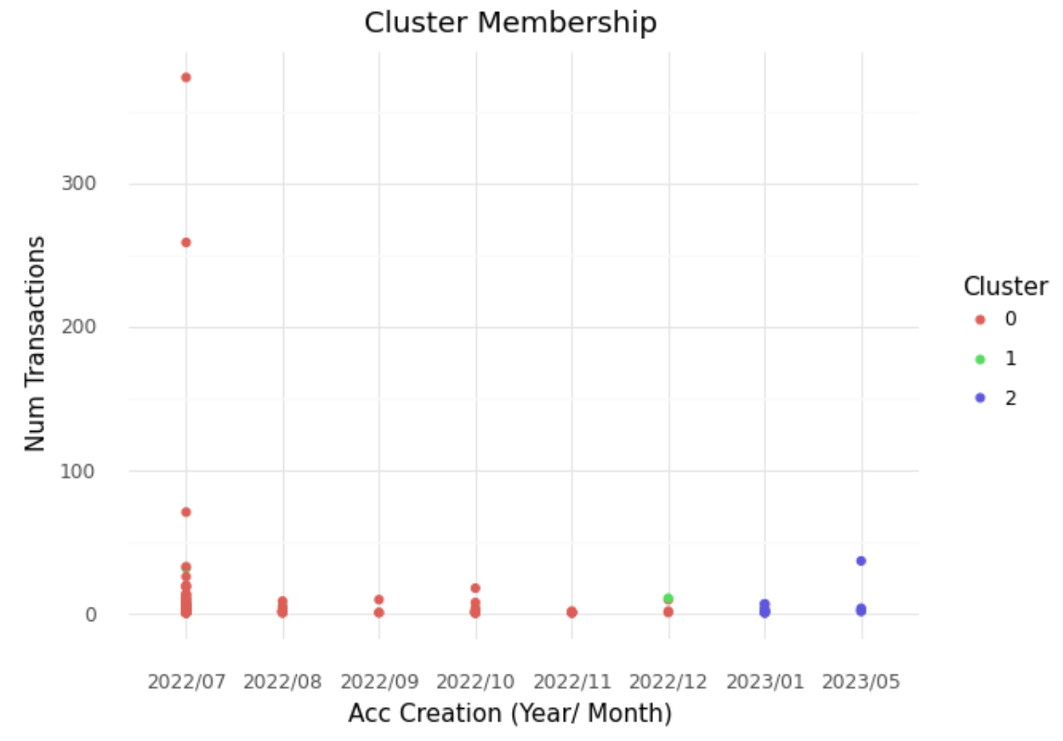
Applying Model – Looking at Trends Again

Slide 15
Within-Cluster Findings

Slide 16
Rudimentary Summary Statistics
Cluster 0:
230 Users
Acc Creation between July 2022 - December 2022
Avg Num Tiles: ~1,690
Avg Num Milipoints: ~7,130,000
Avg Transactions: ~7
Outliers: 006, EVA, Siho, solarceo, 도미니, 보리맘, 쇼박 --> have an inordinate amount of tiles and/ or milipoints
Cluster 1:
7 Users
Acc Creation between July 2022 - December 2022
Avg Num Tiles: ~1,510
Avg Num Milipoints: ~294,000,000
Avg Transactions: ~10
Outliers: carolha, demiha, ducky --> have an inordinate amount of milipoints/ tiles
Cluster 2:
17 Users
Acc Creation between January 2023 - May 2023
Avg Num Tiles: ~160
Avg Num Milipoints: ~51,000,000
Avg Transactions: ~5
Outliers:
deemax, Kain, kiltrek, OpElijah21 --> have 0 milipoints and only ~20 tiles
Paloaltodesigner and Tomo have an inordinately high number of milipoints and tiles

Slide 17
True Summary Statistics
Cluster 0:
223 Users
Acc Creation between July 2022 - December 2022
Avg Num Tiles: ~182
Avg Num Milipoints: ~623,000
Avg Transactions: ~4
Cluster 1:
4 Users
Acc Creation between July 2022 - December 2022
Avg Num Tiles: ~12
Avg Num Milipoints: ~2,550
Avg Transactions: ~5
Cluster 2:
11 Users
Acc Creation between January 2023 - May 2023
Avg Num Tiles: ~230
Avg Num Milipoints: ~15,000,000
Avg Transactions: ~7

Slide 18
Clustering Takeaways
Cluster 0:
We see the majority of Miliverse users
Considering that the game is not fully fleshed out in its functionality and gameplay:
These are positive numbers to have
The avg active player is contributing to the game via transactions
Cluster 1:
The "inactive" active players, or those who did not have many milipoints to work with
Low transaction count + low tile count → never had that many milipoints
Cluster 2:
We see a smaller part of the Miliverse player base → more wealthy in the game
These players are more active than those in cluster 0, and also have a lot of milipoints
Includes more recent players → appears to have engagement from this group
What do we want to see:
We want the average player to be in cluster 0
Users have enough milipoints + Buy many tiles → Contribute to the game
We would want cluster 2 to consist of long term players who are contributing and active in the game to garner a lot of wealth/ assets
Ideally, the current cluster 1 should not exist, and as users receive milipoints I do not believe that the cluster will continue to exist
Cluster 1 would ideally turn into a “new player” cluster (lot of milipoints, but few transactions/ tiles)

Slide 19
Applications to Miliverse/ DeOther

Slide 20
Miliverse Strategy (Product Development + Marketing)
Increasing User Engagement through Product Development
Implement another element of gameplay to increase user engagement (intern ideas below)
Simulated fights that consider land power, weapon power, and experience level
Fight CPU (historic generals + armies) to receive milipoints, weapons, exp, etc.
Fight other players’ armies to receive milipoints and exp
Promote historical aspect rather than fighting
Marketing Efforts
Promotion through Events
Advertisements on Social Media → promotional bonus if acc created from social media campaign
Will be more difficult to promote since it isn’t an app
Partnerships and game platform advertisement more uncommon for web-games

Slide 21
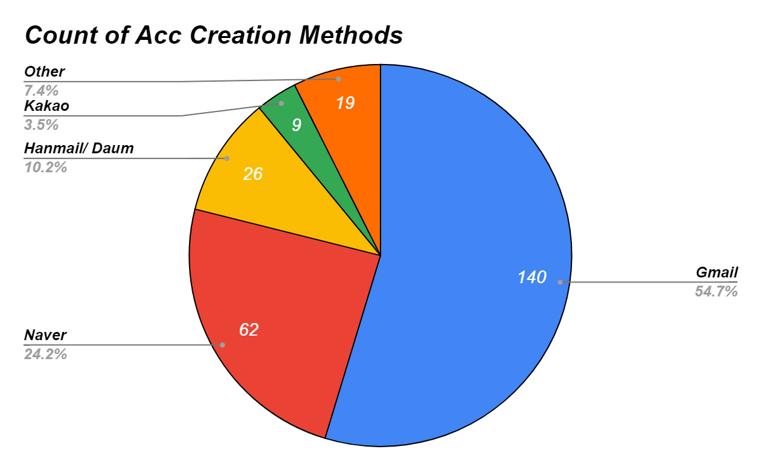
Player Location Frequency for Marketing Purposes
Shows us the most common emails used to register for Miliverse Accounts
Gmail, Naver, Hanmail/ Daum, Kakao,
Gmail users usually hint towards US based players, and looking at usernames this holds up
Gmail is also somewhat common in Korea because of Samsung phone use
Since we don't currently have location data, we can make some assumptions from this

Slide 22
Miliverse Strategy (In-Game Implementations)
Miliverse Goal: Develop a player base that on average has a large number of milipoints and continues to receive them through login/ active rewards to continue participating in the aspects of the game.
Generating Additional User Engagement
Keep the land and weapon pricing the same
New users start the game with 10 million milipoints
Implement login rewards of 10,000 milipoints per day
Keep the real money to milipoints conversion such that 10 or 50 cents is equal to 10,000 milipoints
Incentivise users to participate in gameplay aspects with receiving milipoints, weapons, and NFTs for achievements/ irl events

Slide 23
Regarding DeOther
DeOther faces similar problems to Miliverse
Need to follow similar metrics to gauge the performance of the game
Improving marketing and game development to increase user engagement
The game needs to begin saving and collecting in-app data
Cannot make improvements without collecting data → making changes while blind
Minimum Data Collection
Username + Email (used to create account)
Account Activation Date + Last Visit Date
In-Game Currency Held
In-Game Currency Transactions
Number of Minigame Plays
Other Data to be Collected
Daily/ Monthly Active Users
Session Count + Length

Slide 24
Other Analytics work to be Done
Once DeOther is collecting data and/ or Miliverse has made its improvements:
Want to understand retention rate of users who go to events
At promotional events send out demographics based survey (also asks for email + username used to sign up for account)
Can see how many new accounts created
Can track metrics specific to them and see how effective promotional events are at gaining long-term users
Can see how players’ perception of the game changes, and compare trends with existing players
See what features users like (in regards to minigames, transactions, etc.)

Slide 25
Future for this Role
Analytics is a continuous process
The work that I have done doesn’t guarantee things will go according to plan
With each iteration or new thing added, this same kind of work needs to be done again
After each update to the game, newer models will need to be used
Once more users migrate to the game, these same models can be applied to understand how the playerbase changed or how it didn't
It can also help with benchmarking the progress of the game against itself
With more data the models become more accurate, but a strong understanding of data is needed to make the connections, understand the trends, and determine a plan of action

Slide 26
Final Internship Remarks

Slide 27
Thank You

