Slide 1
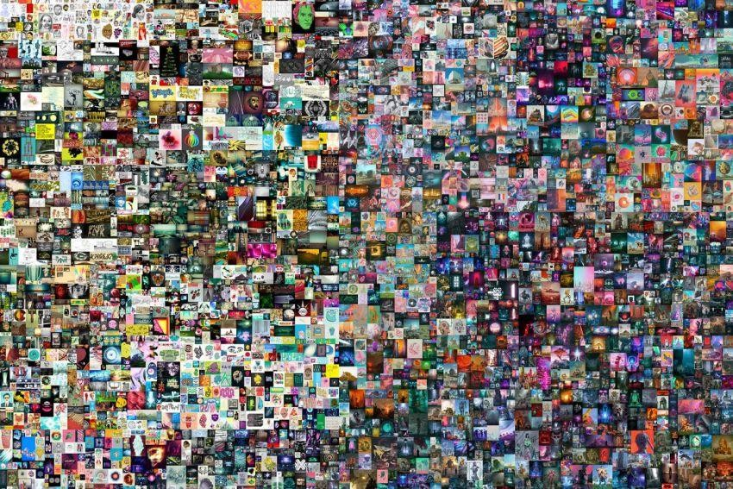
NFT (Non Fungible token)

Slide 2

What are we going to see
What Is a Non-Fungible Token (NFT) ?
How is NFT different from Bitcoin ?
Where do you use NFTs ?
Why is everyone investing in NFTS ?

Slide 3

What are NFTs ?
(NFT) is a unit of data stored on a blockchain
NFTs can really be anything digital (such as drawings, music, your brain downloaded and turned into an AI)

Slide 4
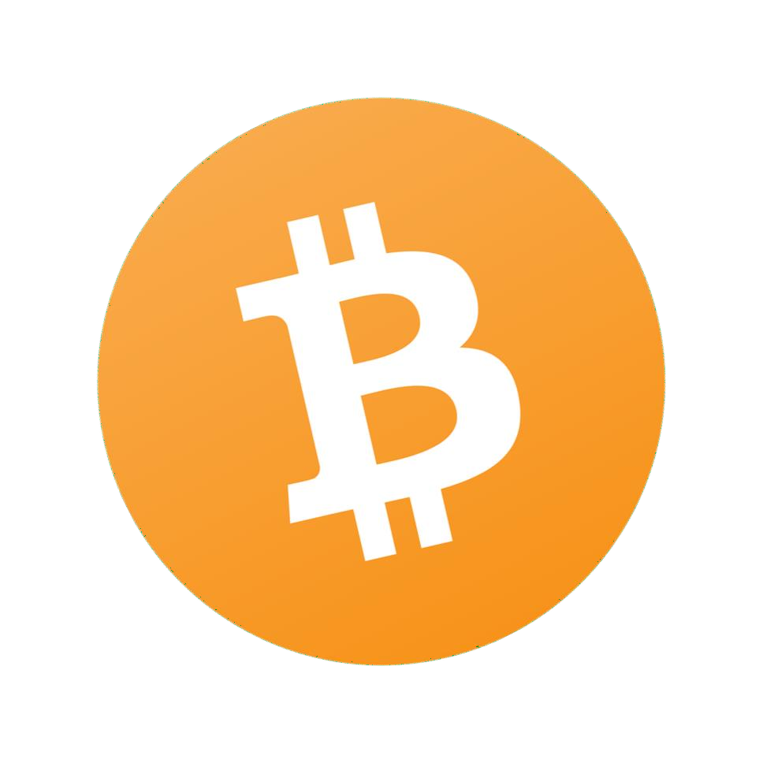
How is NFT different from Bitcoin ?
One bitcoin is indistinguishable from any other bitcoin and can be readily exchanged by contrast an NFT is unique.

Slide 5
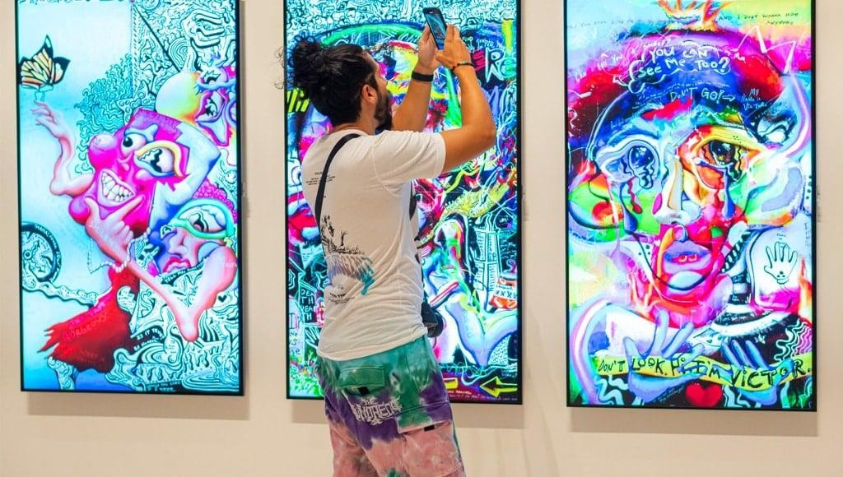
Where do you use NFTs ?
Art

Slide 6
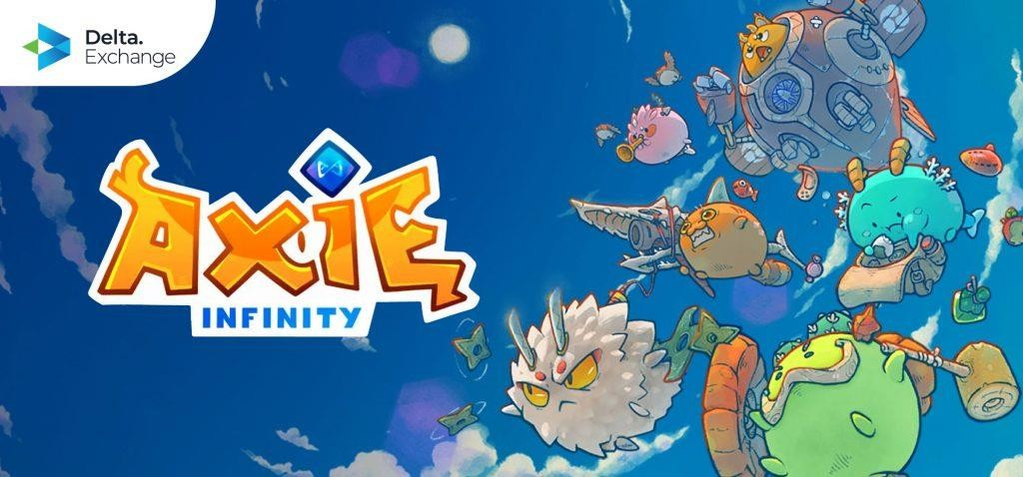
Gaming Industry

Slide 7
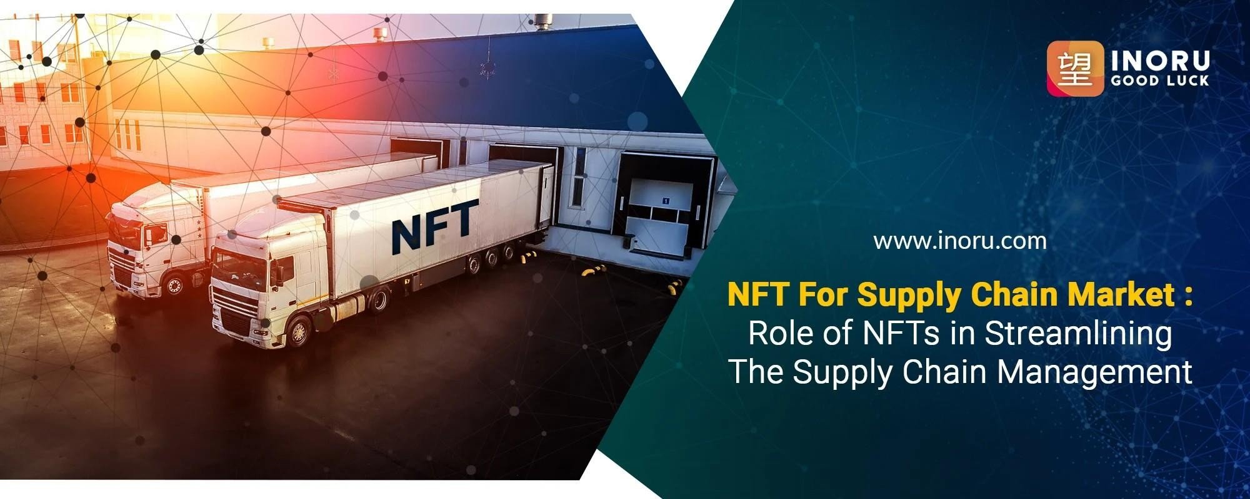
NFTs Supply Chains

Slide 8



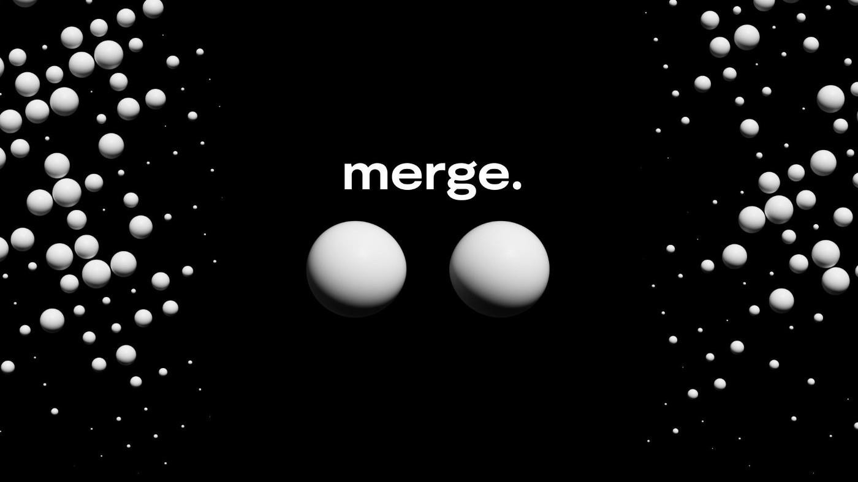
Why is everyone investing in NFTS ?

Slide 9
