Slide 1
Co-ordinate Descent , Dykstra’s algorithm and LASSO
ECE–273 Final Project:
Sanjeev Anthia Ganesh
PID : A53308351

Slide 2
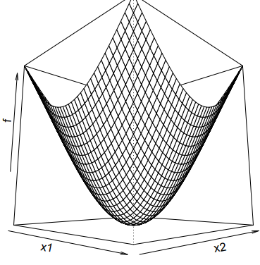

Co-ordinate Descent
Input: We are given a convex differentiable function $f\left(x\right):R^{n}→R$ whose minimizer needs to be found.
Let’s assume we have found the global minimizer of this convex function. This statement translates to the fact that the minimizer is achieved along all the co-ordinate axes.
.

Slide 3
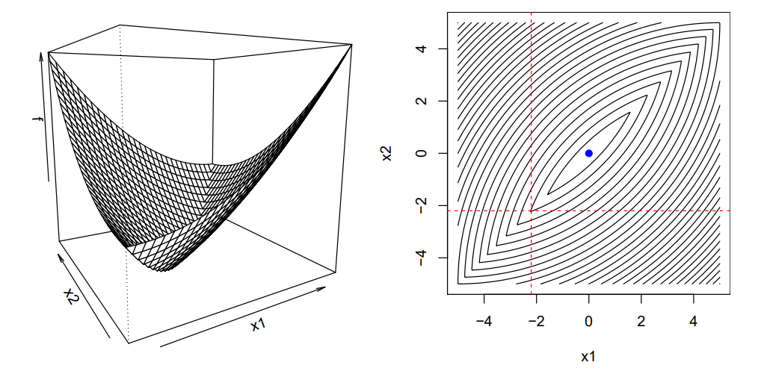
Observation on Co-ordinate Descent -> Function Type
What sort of functions are compatible to Co-ordinate Descent Algorithm.
Few Examples:
1) Non-differentiable and non-separable Convex function:
Notes:
We have to speak in terms of two cases -> What sort of functions are compatible to Co-ordinate descent algorithm and if co-ordinate algorithm fetches us the minimum

Slide 4
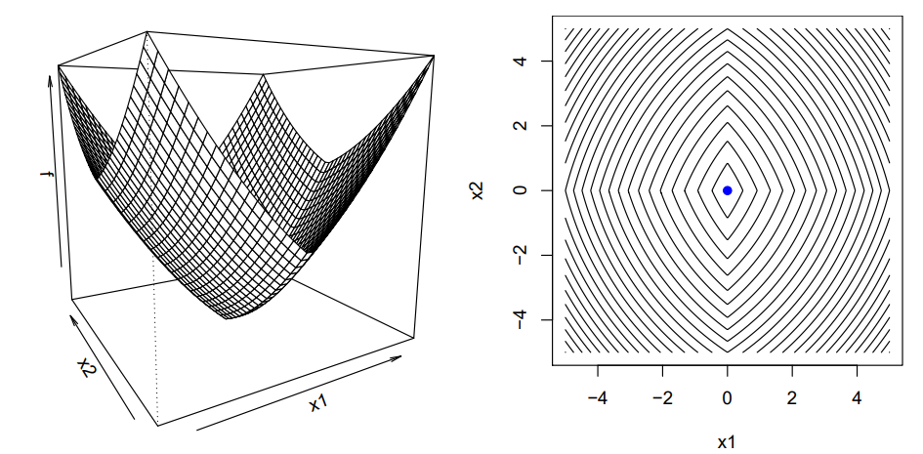
Observation on Co-ordinate Descent -> Function Type
What sort of functions are compatible to Co-ordinate Descent Algorithm.
Few Examples:
1) Non-differentiable but Separable Convex functions:
Notes:
We have to speak in terms of two cases -> What sort of functions are compatible to Co-ordinate descent algorithm and if co-ordinate algorithm fetches us the minimum

Slide 5
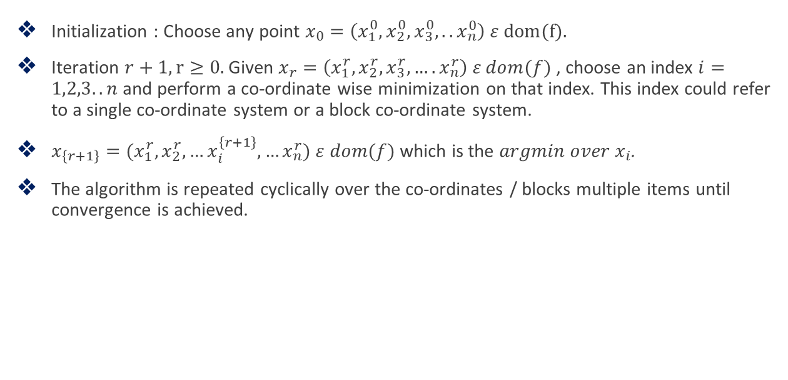
Algorithm for Co-ordinate Descent
Initialization : Choose any point $x_{0}=\left(x_{1}^{0},x_{2}^{0},x_{3}^{0},..x_{n}^{0}\right) ε dom(f).$
Iteration $r+1, r≥0.$ Given $x_{r}=\left(x_{1}^{r}, x_{2}^{r}, x_{3}^{r},….x_{n}^{r}\right) ε dom(f)$ , choose an index $i=1,2,3..n$ and perform a co-ordinate wise minimization on that index. This index could refer to a single co-ordinate system or a block co-ordinate system.
$x_{\left\{r+1\right\}}=(x_{1}^{r}, x_{2}^{r}, …x_{i}^{\left\{r+1\right\}},…x_{n}^{r})$ $ε dom(f)$ which is the $argmin over x_{i}$.
The algorithm is repeated cyclically over the co-ordinates / blocks multiple items until convergence is achieved.

Slide 6
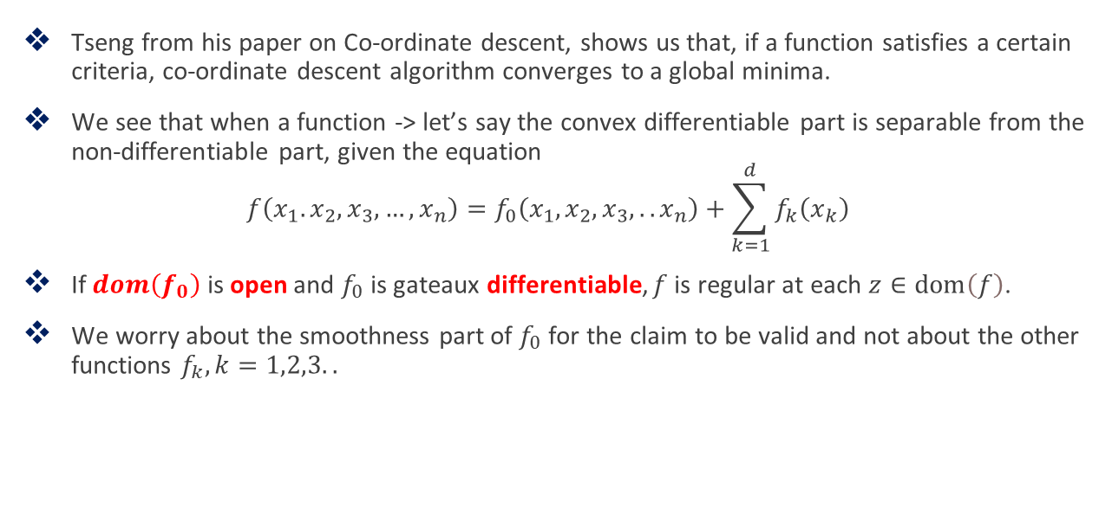
Observation on Co-ordinate Descent - Convergence
Tseng from his paper on Co-ordinate descent, shows us that, if a function satisfies a certain criteria, co-ordinate descent algorithm converges to a global minima.
We see that when a function -> let’s say the convex differentiable part is separable from the non-differentiable part, given the equation
$$f\left(x_{1}.x_{2},x_{3},…,x_{n}\right)=f_{0}\left(x_{1},x_{2},x_{3},..x_{n}\right)+\sum_{k=1}^{d}{f_{k}\left(x_{k}\right)}$$
If $dom\left(f_{0}\right)$ is open and $f_{0}$ is gateaux differentiable, $f$ is regular at each $z∈\operatorname{dom}\left(f\right)$.
We worry about the smoothness part of $f_{0}$ for the claim to be valid and not about the other functions $f_{k}, k=1,2,3..$

Slide 7
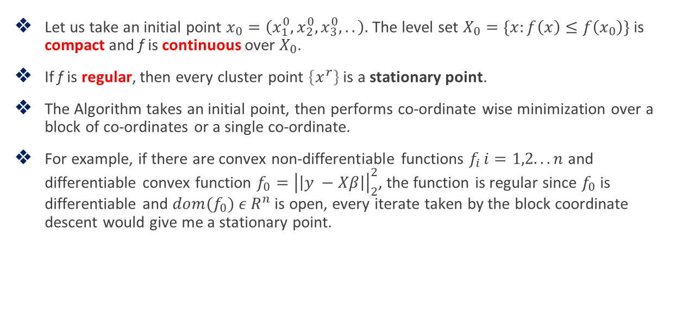
Observation on Co-ordinate Descent - Convergence
Let us take an initial point $x_{0}=\left(x_{1}^{0},x_{2}^{0},x_{3}^{0},..\right).$ The level set $X_{0}=\{x:f\left(x\right)≤f\left(x_{0}\right)\}$ is compact and f is continuous over $X_{0}$.
If f is regular, then every cluster point $\left\{x^{r}\right\}$ is a stationary point.
The Algorithm takes an initial point, then performs co-ordinate wise minimization over a block of co-ordinates or a single co-ordinate.
For example, if there are convex non-differentiable functions $f_{i }i=1,2...n$ and differentiable convex function $f_{0}={\left|\left|y −Xβ\right|\right|}_{2}^{2}$, the function is regular since $f_{0}$ is differentiable and ${dom(f}_{0}) ε R^{n}$ is open, every iterate taken by the block coordinate descent would give me a stationary point.
Notes:
For a function to be regular, the smoothness property of the differentiable part fo is evaluate

Slide 8
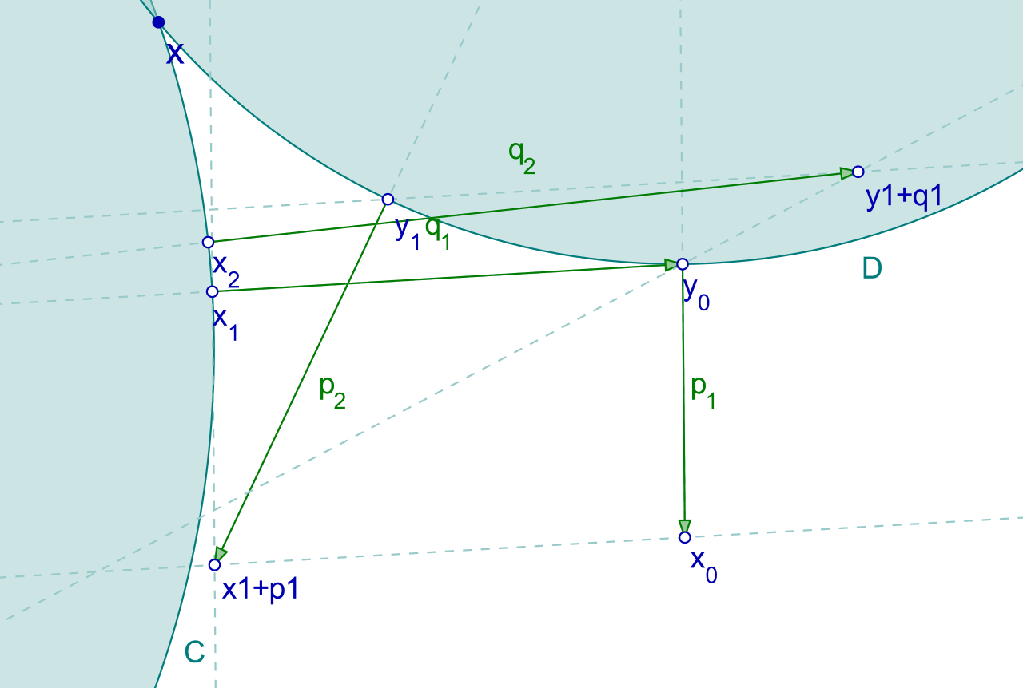

Dykstra’s Algorithm
Dykstra’s projection theorem solves the best approximation problem where given a point $y ε R^{n}$, we find the closest point $x ε C_{1}∩C_{2}∩…C_{d}$.
This algorithm is similar to Alternating Projections algorithm.

Slide 9
Dykstra’s Algorithm
In this Algorithm, Initially I am unaware of the points existing in the intersection of convex sets. So, I would start projecting the point towards one of the convex sets and then project this point towards another convex set in a cyclic fashion.
Dykstra’s algorithm is different from Alternating projections because it tracks the residue left after the projection.
In case of the intersection of convex sets being a single point, then the alternating projections is equal to the Dykstra’s.
When there are many points in the intersection, Dykstra’s projection theorem gives me the nearest point existing in the intersection of convex sets but Alternating projection theorem gives me one of the points.

Slide 10

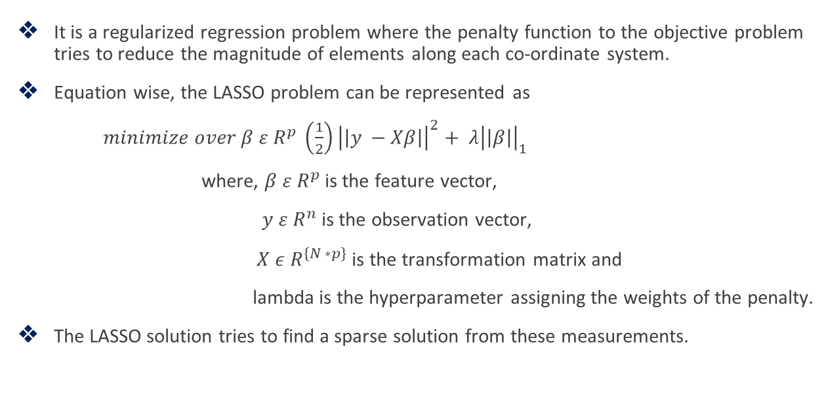
LASSO
It is a regularized regression problem where the penalty function to the objective problem tries to reduce the magnitude of elements along each co-ordinate system.
Equation wise, the LASSO problem can be represented as
$minimize over β ε R^{p} \left(\frac{1}{2}\right){\left|\left|y −Xβ\right|\right|}^{2}+ λ{\left|\left|β\right|\right|}_{1}$
where, $β ε R^{p}$ is the feature vector,
$y ε R^{n}$ is the observation vector,
$X ε R^{\left\{N ∗p\right\}}$ is the transformation matrix and
lambda is the hyperparameter assigning the weights of the penalty.
The LASSO solution tries to find a sparse solution from these measurements.

Slide 11
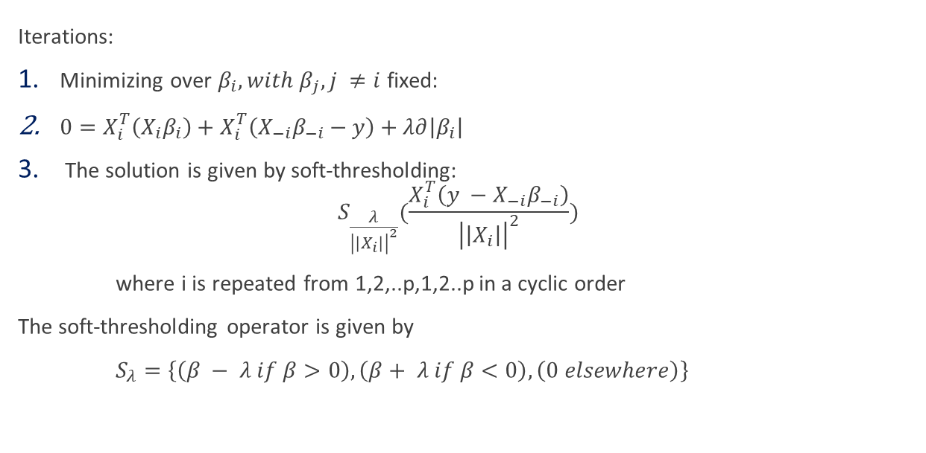
LASSO using Co-ordinate Descent
Iterations:
Minimizing over $β_{i}, with β_{j}, j ≠i$ fixed:
$0=X_{i}^{T}\left(X_{i}β_{i}\right)+X_{i}^{T}\left(X_{−i}β_{−i}−y\right)+λ∂\left|β_{i}\right|$
The solution is given by soft-thresholding:
$$S_{\frac{λ}{{\left|\left|X_{i}\right|\right|}^{2}}}(\frac{X_{i}^{T}\left(y −X_{−i}β_{−i}\right)}{{\left|\left|X_{i}\right|\right|}^{2}})$$
where i is repeated from 1,2,..p,1,2..p in a cyclic order
The soft-thresholding operator is given by
$S_{λ}=\left\{\left(β − λ if β>0\right),\left(β+ λ if β<0\right),\left(0 elsewhere\right)\right\}$

Slide 12
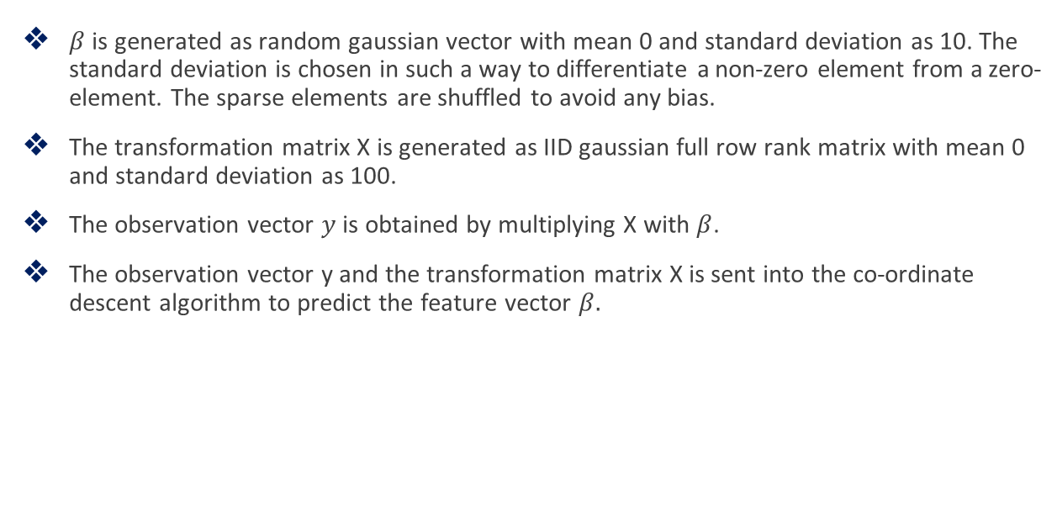
Generating the Dataset
$β$ is generated as random gaussian vector with mean 0 and standard deviation as 10. The standard deviation is chosen in such a way to differentiate a non-zero element from a zero-element. The sparse elements are shuffled to avoid any bias.
The transformation matrix X is generated as IID gaussian full row rank matrix with mean 0 and standard deviation as 100.
The observation vector $y$ is obtained by multiplying X with $β$.
The observation vector y and the transformation matrix X is sent into the co-ordinate descent algorithm to predict the feature vector $β.$

Slide 13
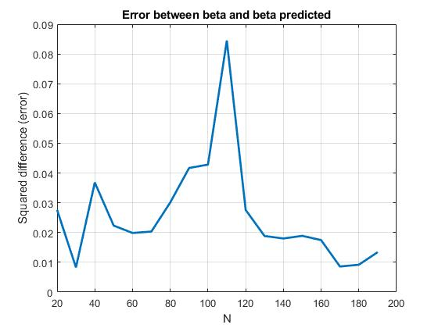
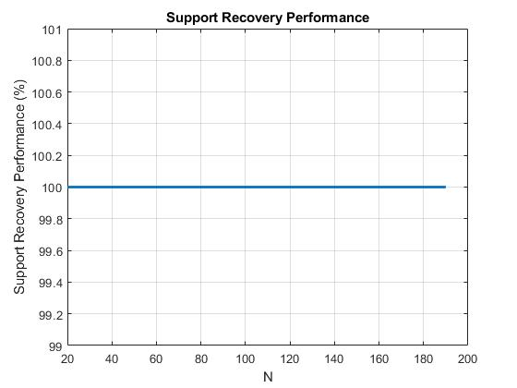
Observations from LASSO using Co-ordinate Descent
Variation on Number of Observations:
Number of observations (N) = 20 to 200, Number of features (p) = 100, Sparsity = 4, Number of iterations is 70000.

Slide 14
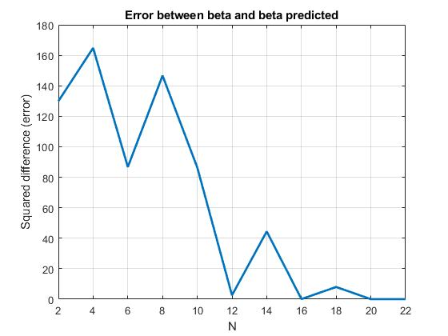
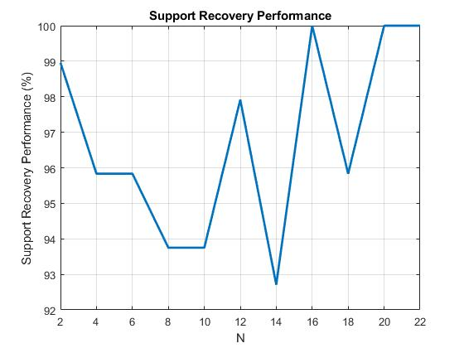
Observations from LASSO using Co-ordinate Descent
Number of observations (N) = 2 to 24, Number of features (p) = 100, Sparsity = 4, Number of iterations is 70000.

Slide 15
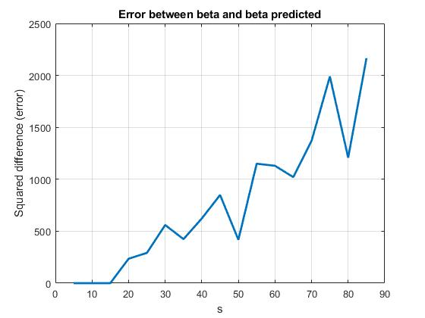
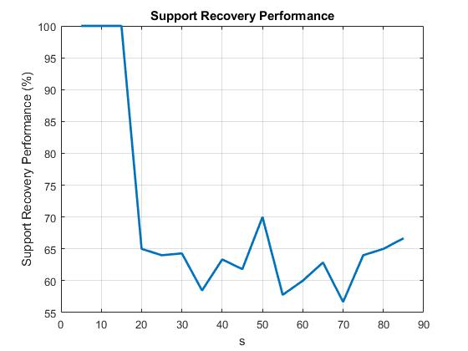
Observations from LASSO using Co-ordinate Descent
Variation of sparsity from 5% to 90%
Number of observations (N) = 50, Number of features (p) = 100 , Sparsity = 5 to 90

Slide 16
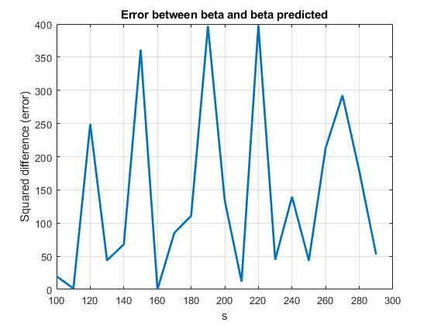
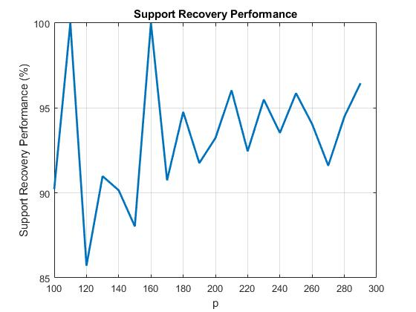
Observations from LASSO using Co-ordinate Descent
Variation of number of features (p):
Number of observations (N) = 50, Number of features (p) = 100 to 300, Sparsity (s) = 8

Slide 17
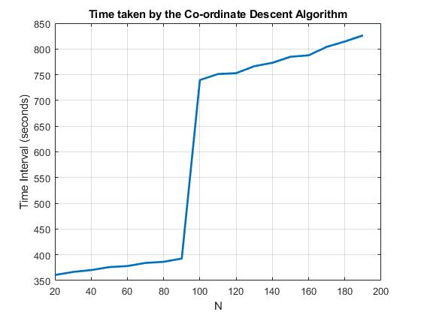
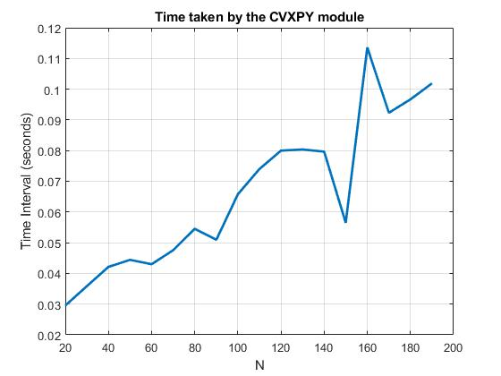
Performance of CVX module
Solver used: QSQP from CVXPY package. This solver is used in solving quadratic programs.
The time taken to solve the LASSO problem was minimal – a 100 fold lesser compared to the implementation of Co-ordinate descent. The number of iteration in Co-ordinate Descent had to be increased to match CVX module’s result.
However, given p, as N was increased, there was a significant increases in the time taken to converge.

Slide 18
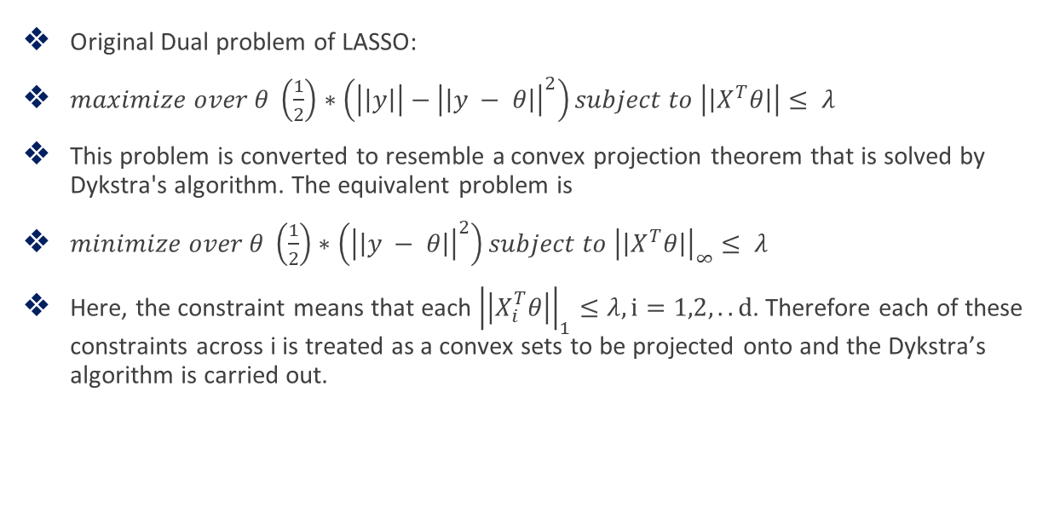
LASSO Dual using Dykstra’s Algorithm
Original Dual problem of LASSO:
$maximize over θ \left(\frac{1}{2}\right)∗\left(\left|\left|y\right|\right|−{\left|\left|y − θ\right|\right|}^{2}\right)subject to \left|\left|X^{T}θ\right|\right|≤ λ$
This problem is converted to resemble a convex projection theorem that is solved by Dykstra's algorithm. The equivalent problem is
$minimize over θ \left(\frac{1}{2}\right)∗\left({\left|\left|y − θ\right|\right|}^{2}\right)subject to {\left|\left|X^{T}θ\right|\right|}_{∞}≤ λ$
Here, the constraint means that each ${\left|\left|X_{i}^{T}θ\right|\right|}_{1}≤λ, i=1,2,..d$. Therefore each of these constraints across i is treated as a convex sets to be projected onto and the Dykstra’s algorithm is carried out.

Slide 19
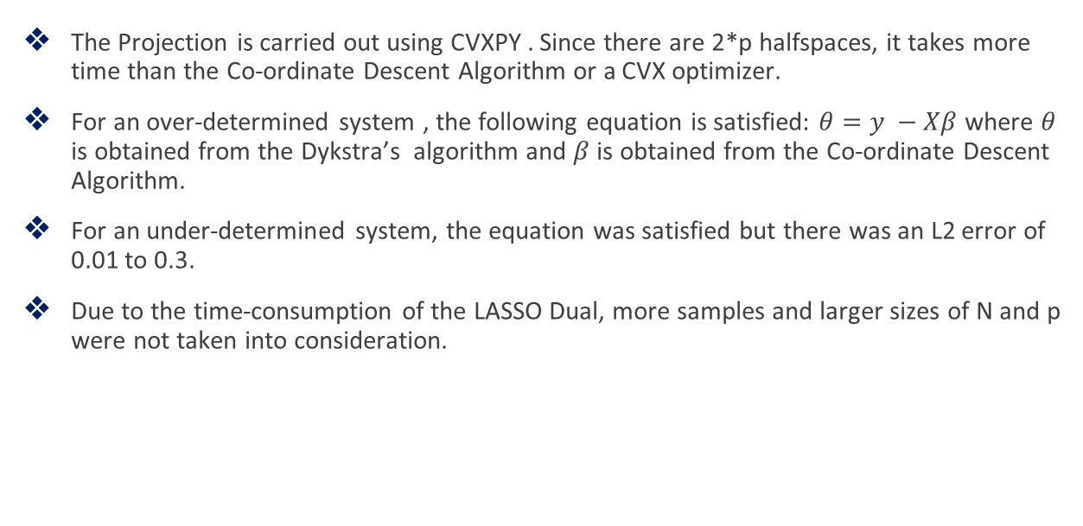
Observations on LASSO Dual
The Projection is carried out using CVXPY . Since there are 2*p halfspaces, it takes more time than the Co-ordinate Descent Algorithm or a CVX optimizer.
For an over-determined system , the following equation is satisfied: $θ=y −Xβ$ where $θ$ is obtained from the Dykstra’s algorithm and $β$ is obtained from the Co-ordinate Descent Algorithm.
For an under-determined system, the equation was satisfied but there was an L2 error of 0.01 to 0.3.
Due to the time-consumption of the LASSO Dual, more samples and larger sizes of N and p were not taken into consideration.

Slide 20
Applications to Co-ordinate Descent Algorithm
Antenna array synthesis using Co-ordinate Descent Method:
Co-ordinate descent method is used to find the weights on each of the antenna elements that satisfy a set of specifications on the beam pattern
Focused beam patterns with fixed nulls and upper bound constraints over all the side lobes can be solved using Convex Optimization
We are given the radiation pattern (specifications) and the number of elements as input.

Slide 21
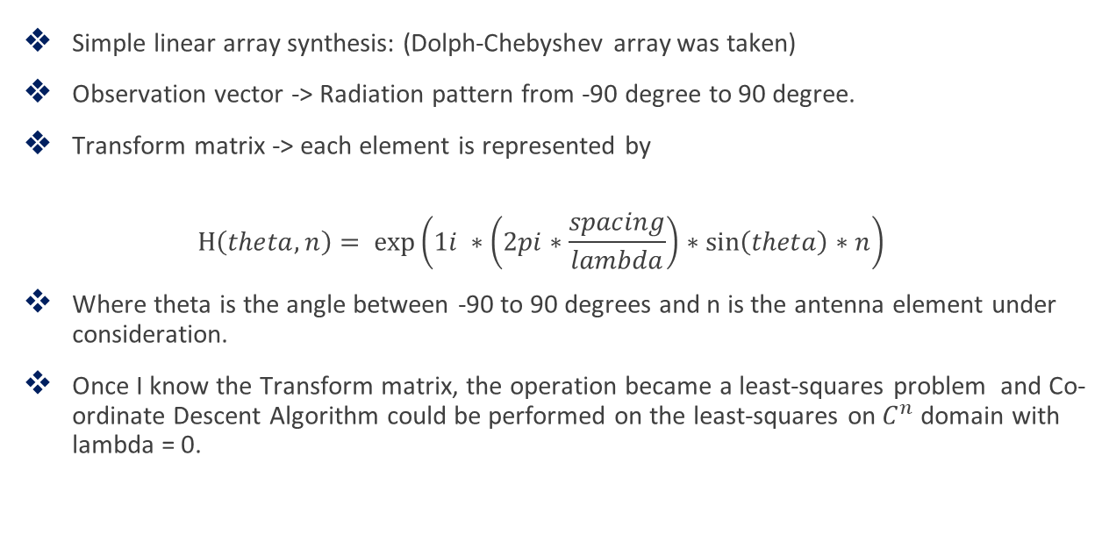
Applications to Co-ordinate Descent Algorithm
Simple linear array synthesis: (Dolph-Chebyshev array was taken)
Observation vector -> Radiation pattern from -90 degree to 90 degree.
Transform matrix -> each element is represented by
$$H\left(theta,n\right)= exp\left(1i ∗\left(2pi∗\frac{spacing}{lambda}\right)∗\sin\left(theta\right)∗n\right)$$
Where theta is the angle between -90 to 90 degrees and n is the antenna element under consideration.
Once I know the Transform matrix, the operation became a least-squares problem and Co-ordinate Descent Algorithm could be performed on the least-squares on $C^{n}$ domain with lambda = 0.

Slide 22
References:
https://stats.stackexchange.com/questions/123672/coordinate-descent-soft-thresholding-update-operator-for-lasso
https://www.cs.cmu.edu/~ggordon/10725-F12/slides/25-coord-desc.pdf
Tibshirani, R. J. (2017). Dykstra's algorithm, admm, and coordinate descent: Connections, insights, and extensions.
Tseng, P. (2001). Convergence of a block coordinate descent method for nondifferentiable minimization.
https://en.wikipedia.org/wiki/Dykstra%27s_projection_algorithm

