Slide 1

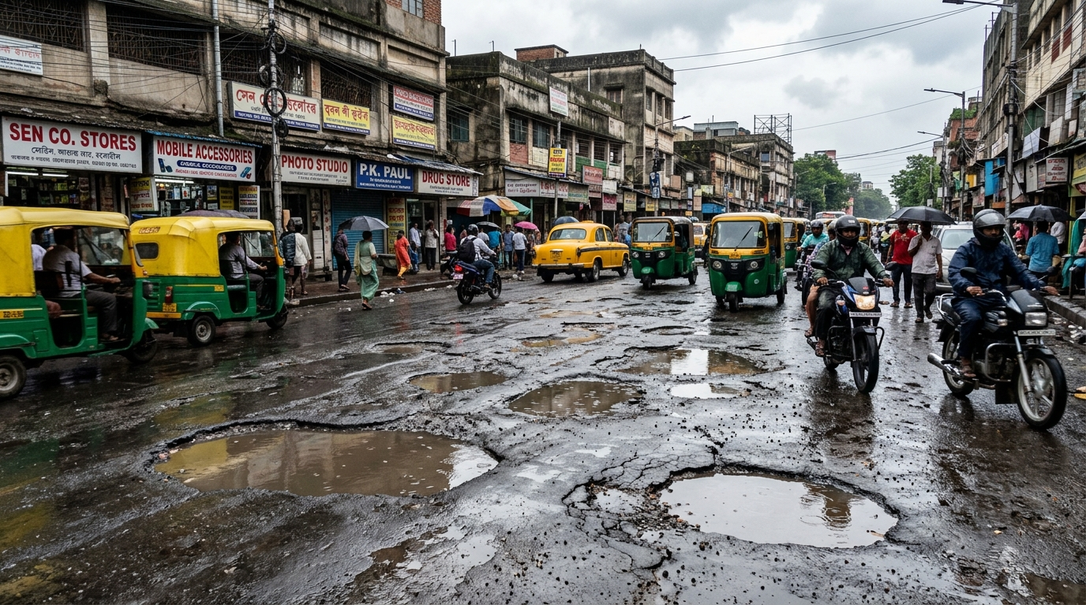
SMART INDIA HACKATHON 2026
VIGILANCE
Problem Statement ID: SIH26124
Problem Statement Title: AI-Powered Mobile Urban Intelligence Platform Using Public Transport Fleet
Organization: Bharat Electronics Limited (BEL)
Theme: Smart Transportation & Public Infrastructure
PS Category: Software Edition
Team Name: VIGILANCE
Institute: SRM Institute of Science and Technology
Core Innovation: Edge-AI Onboard Defect Detection & Centralized Geospatial Prioritization
⚠️ Ground Reality: 9,438 Indian pothole fatalities (2020–2024, Lok Sabha data). VIGILANCE turns municipal fleets into live road safety audit nodes.

Slide 2
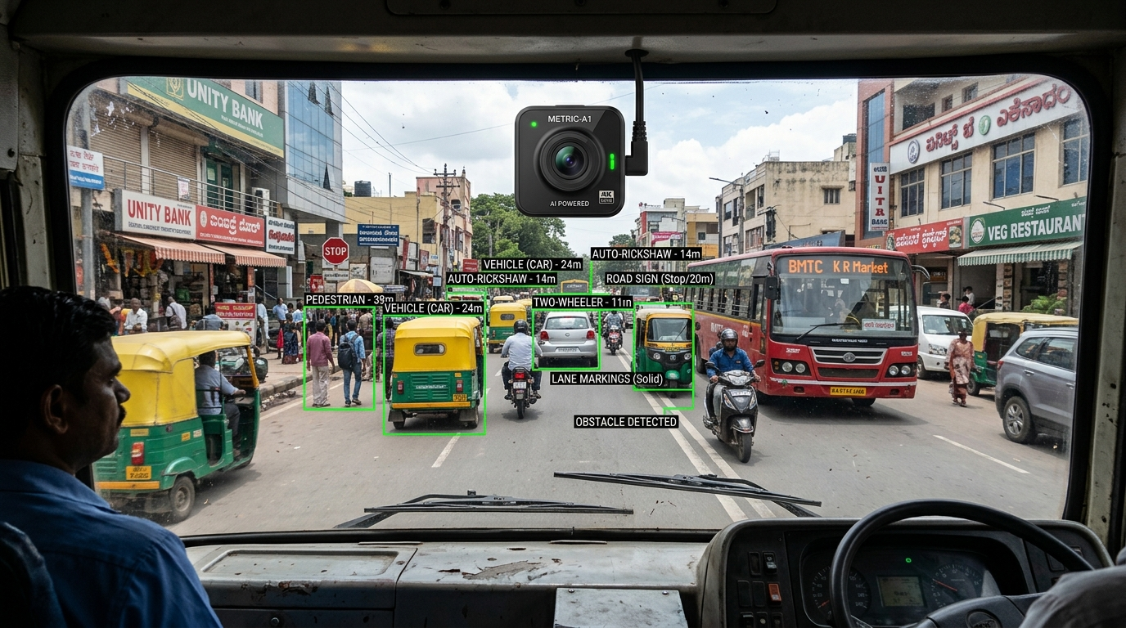
IDEA TITLE — VIGILANCE
VIGILANCE
Passive, Always-On Road Health Intelligence Grid — Edge-AI on Existing Municipal Fleets, Zero New Infrastructure
1
PROPOSED SOLUTION
Sub-₹3,000 smart camera units mounted on existing municipal buses, garbage trucks & patrol vehicles passively scan road networks at 15 FPS during normal daily routes.
2
MECHANISM & DEDUPLICATION
Edge YOLOv8-Nano model detects road defects; 3m DBSCAN spatial clustering merges multi-vehicle passes into unified master incidents.
3
INNOVATION & ECONOMIC MOAT
Zero dedicated survey fleet needed. Converts 63 lakh km of existing transit routes into a 24x7 automated road audit grid, replacing slow & costly manual surveys.
📷 Deployed Municipal Fleet Edge Camera Unit (Real-Time Road AI Vision)
Existing Fleet (Buses/Trucks) ➔ Edge YOLOv8-Nano ➔ 3m DBSCAN Spatial Dedup ➔ PostGIS RPI Index ➔ Municipal PWD Action

Slide 3
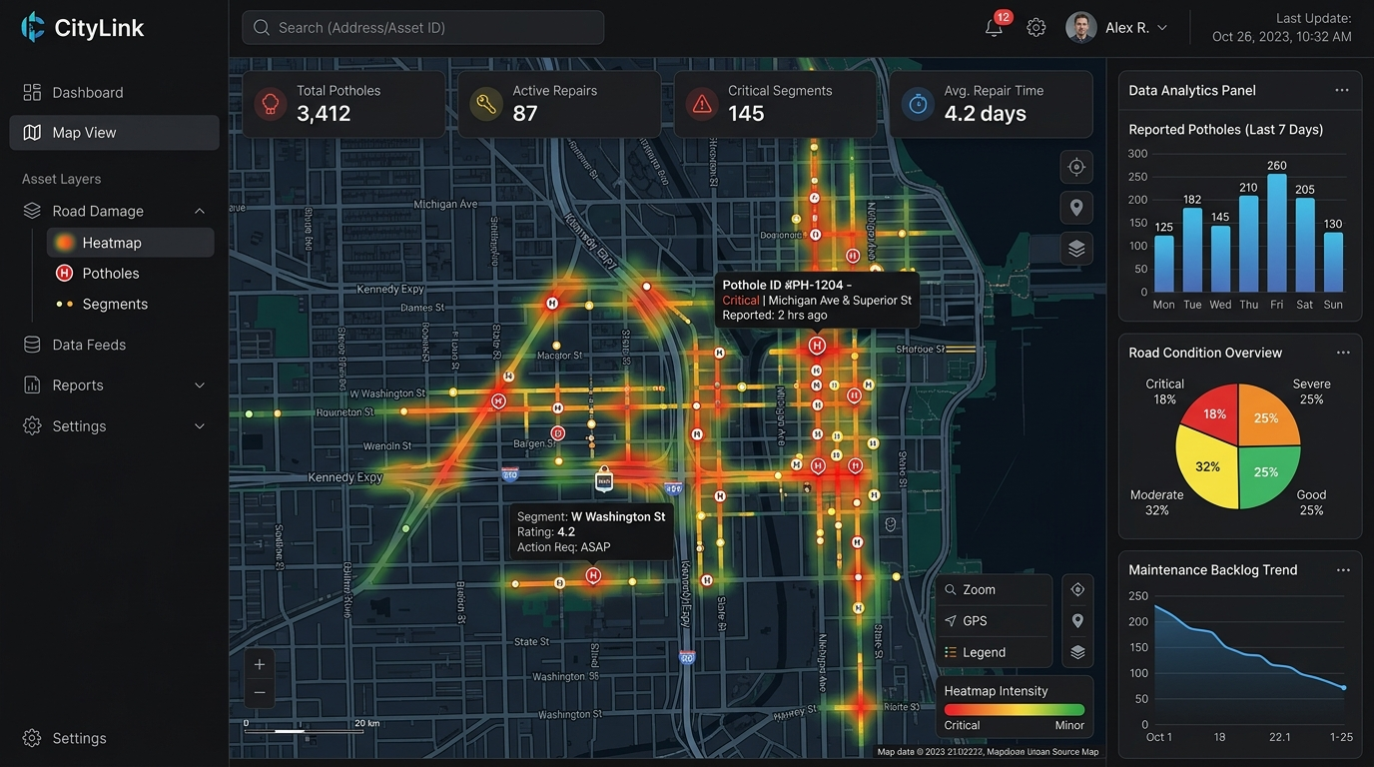
TECHNICAL APPROACH
VIGILANCE
🛠️ CATEGORIZED TECHNOLOGY STACK
• Edge Perception: YOLOv8-Nano (INT8 Quantized) • ONNX Runtime • SQLite FIFO Buffer
• Backend Compute: FastAPI • Redis Queue • Celery Asynchronous Workers
• Spatial Database: PostgreSQL 15 • PostGIS (R-Tree Spatial Indexing)
• WebGIS Dashboard: Next.js 14 • Mapbox GL • Leaflet.js • Tailwind CSS
🔄 5-STEP IMPLEMENTATION PIPELINE
1. Fleet Camera: 1080p @ 15 FPS video stream + GPS/IMU timestamp telemetry.
2. Edge YOLOv8: INT8 model classifies potholes & longitudinal cracks (conf ≥ 0.60).
3. 3m DBSCAN: Spatial clustering merges multi-vehicle passes into master incidents.
4. PostGIS Store: Geospatial indexing matches municipal ward boundaries & road IDs.
5. RPI Dispatch: Road Priority Index auto-generates PWD work-orders based on severity.
🖥️ Live Municipal GIS Web Dashboard (Heatmaps & Auto-Dispatch)
⚡ Real-time Telemetry (<1KB JSON) • Asynchronous Celery + Redis • Offline SQLite Buffer • Aligned with NHAI 40,000 km AI Dashcam Initiative

Slide 4
FEASIBILITY AND VIABILITY
VIGILANCE
1
TECHNICAL FEASIBILITY
INT8-quantized YOLOv8-Nano executes under 250 MB RAM at 30 FPS on standard mobile ARM CPUs (Snapdragon / Cortex-A76 / Raspberry Pi 4). Zero heavy in-vehicle GPU hardware needed.
2
POTENTIAL CHALLENGES
Vehicle vibration blur, intermittent 4G/5G cellular connectivity in dense/rural wards, monsoon lighting shifts, and multi-vehicle duplicate telemetry.
3
MITIGATION STRATEGIES
IMU accelerometer frame-filtering, offline SQLite FIFO sync buffer, confidence thresholding (≥0.60), and PostGIS R-tree spatial indexing for sub-second deduplication.
4
COMMERCIAL VIABILITY & CAPEX
Hardware target under ₹3,000 per municipal vehicle. Micro-payloads (<1 KB JSON) minimize cellular data bandwidth. Replaces ₹50–80 Lakh dedicated LiDAR survey vehicles.
💡 Economic Moat: ₹3,000 Edge unit converts existing transit routes into 24x7 audit infrastructure — 0 dedicated inspection cars needed.

Slide 5
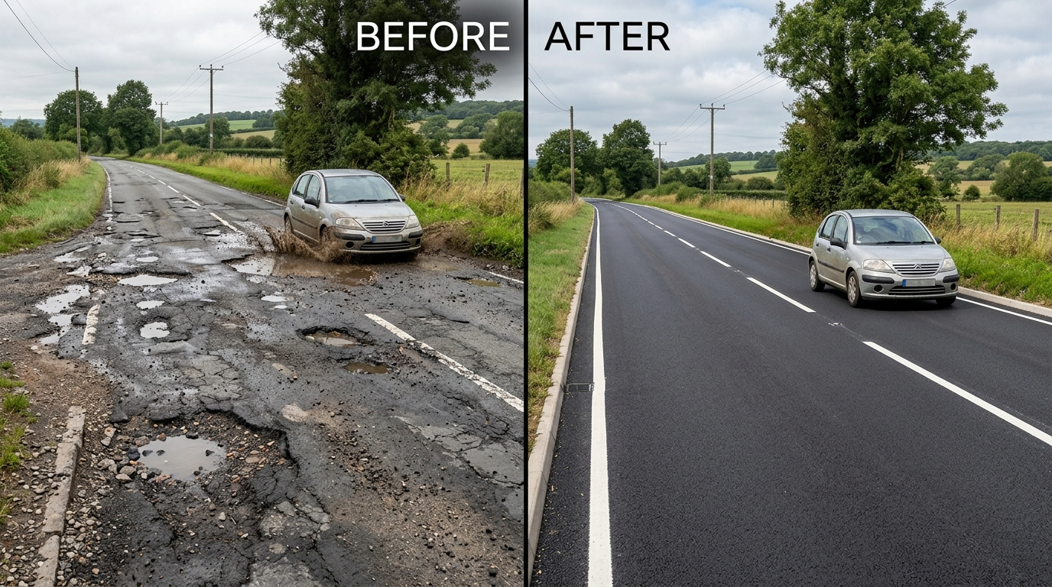
IMPACT AND BENEFITS
VIGILANCE
S
SOCIAL IMPACT
Targets 65% reduction in two-wheeler skidding crashes through early hazard detection (IRC:82 safety guidelines).
E
ECONOMIC VALUE
Proactive micro-patching of early surface cracks saves up to 10× vs full asphalt reconstruction (MoRTH pavement lifecycle data).
E
ENVIRONMENTAL
40% lower asphalt carbon footprint; eliminates stop-and-go idling emissions caused by road damage bottlenecks.
A
ACCOUNTABILITY
Immutable PostGIS before/after geotagged audit logs provide automated contractor proof-of-work, eliminating false billing.
🔄 Automated Repair Validation: Before & After AI Proof-of-Work
🚀 Scalability Roadmap: Phase 1: City Pilot (50 Buses) ➔ Phase 2: 10 Smart Cities & PWD Fleets ➔ Phase 3: NHAI Data Lake & PM GatiShakti

Slide 6
RESEARCH AND REFERENCES
VIGILANCE
1
IRC:82-2015
Indian Roads Congress standard used for pavement distress classification, severity index & maintenance intervention.
2
Ultralytics YOLOv8
Edge computer-vision architecture and real-time object detection benchmarks for roadway anomalies.
3
ONNX Runtime
INT8 quantization framework for high-efficiency edge CPU execution without dedicated GPUs.
4
DBSCAN (Ester et al.)
Density-based spatial clustering methodology for merging multi-pass GPS coordinate drift into unified incidents.
5
PostGIS Documentation
Spatial indexing, R-Tree bounding queries, and multi-layer geographic query harmonization.
6
NRDMS / Urban GIS
National natural resources & urban geospatial data infrastructure guidelines for civic management.
🇮🇳 National Alignment: Aligns directly with NHAI AI Dashcam Program (40,000 km), Smart Cities Mission, & PM GatiShakti Spatial Framework.

Slide 7
TEAM MEMBERS
VIGILANCE
Role | Name | Reg. No. | Dept. | Year | Sem. | Gender | Email id | Mobile no.
Team Leader | Sanjeev Aryan | RA2511047010030 | CINTEL | 2nd | 3rd | Male | sa8129@srmist.edu.in | 8102285766
Team Member | Parth Jaina | RA2511047010069 | CINTEL | 2nd | 3rd | Male | pj2752@srmist.edu.in | 9828285223
Team Member | Dhiti Mahajan | RA2511056010060 | DSBS | 2nd | 3rd | Female | dm5223@srmist.edu.in | 7339851899
Team Member | Shubh Garg | RA2511047010023 | CINTEL | 2nd | 3rd | Male | sg8735@srmist.edu.in | 8130763641
Team Member | Prakhar Sharma | RA2511003010764 | C-TECH | 2nd | 3rd | Male | ps1158@srmist.edu.in | 9235878237
Team Member | Navdeep Rathe | RA2511003010177 | C-TECH | 2nd | 3rd | Male | nr8188@srmist.edu.in | 9967580941
Faculty Mentor | Dr. Pavithra L | N/A | CINTEL | N/A | N/A | Female | pavithrl3@srmist.edu.in | 9150551899
Industry Mentor | Dr. Kishore Anthuvan Sahayaraj | N/A | C-TECH | N/A | N/A | Male | kishorea1@srmist.edu.in | 9043103219

