Slide 1
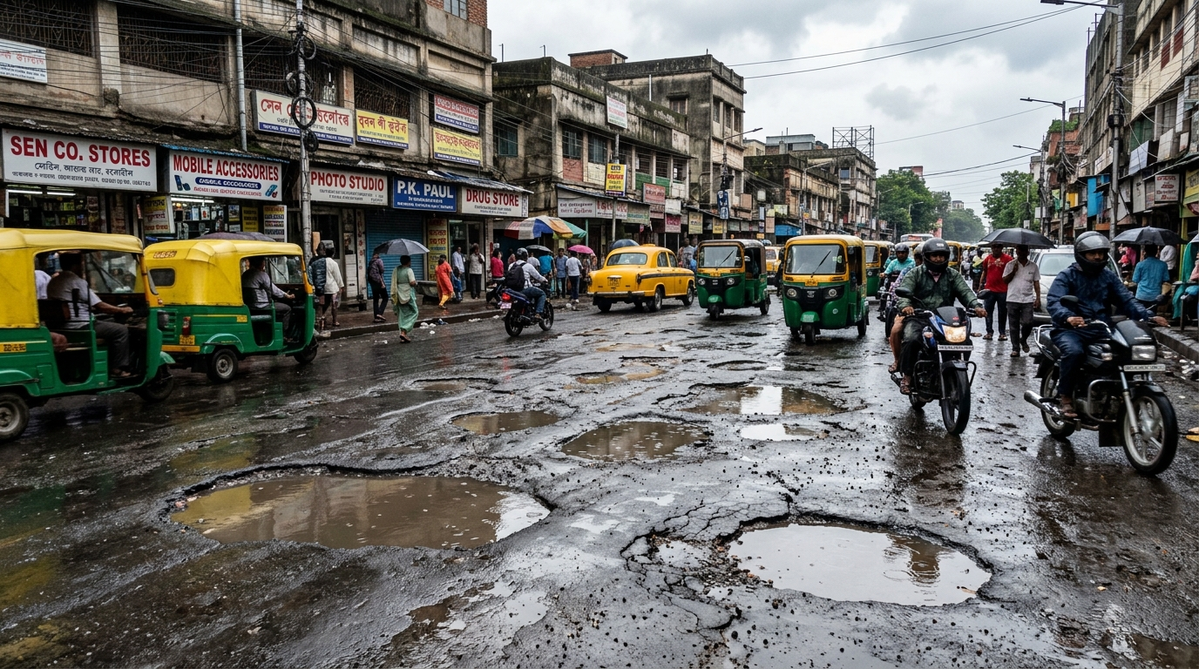

SMART INDIA HACKATHON 2026
VIGILANCE
Problem Statement ID –SIH26013
Problem Statement Title-Automated Integration and Intelligent Harmonization of Multi-source Geospatial Data for Urban Land Record & Infrastructure Management
Theme - Smart Transportation & Public InfrastructurePS Category- Software
⚠️ Ground Reality: 9,438 Indian pothole fatalities (2020–2024, Lok Sabha data)

Slide 2

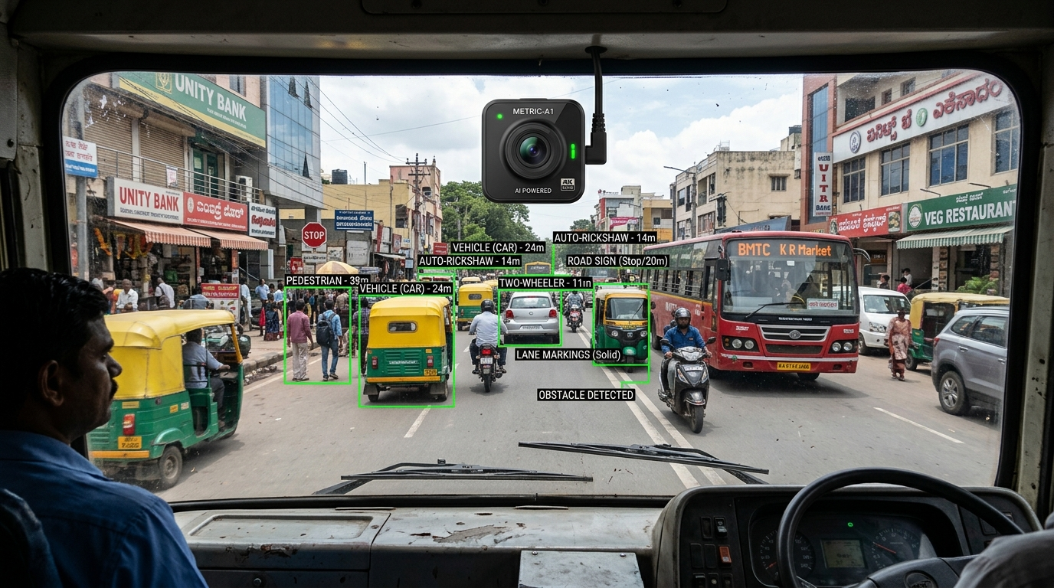
IDEA TITLE
Passive, Always-On Road Health Intelligence Grid Powered by Edge-AI & Geospatial Harmonization
1
PROPOSED SOLUTION
Sub-₹3,000 camera units on municipal buses & trucks passively capture road video feeds at 15 FPS during normal daily operations.
2
HOW IT ADDRESSES THE PROBLEM
YOLOv8 INT8 edge model detects potholes at 30 FPS. 3m DBSCAN clustering merges multi-pass detections into single master incidents.
3
INNOVATION & UNIQUENESS
Zero new fleet needed. Converts 63 lakh km of existing transit routes into a 24x7 automated road audit grid, replacing costly manual surveys.
📷 Deployed Municipal Fleet Edge Camera Unit (Real-Time AI Vision)
Existing Fleet (Buses/Trucks) ➔ Lightweight Edge AI (YOLOv8) ➔ 3m DBSCAN Spatial Dedup ➔ RPI Repair Index ➔ Municipal PWD Action

Slide 3
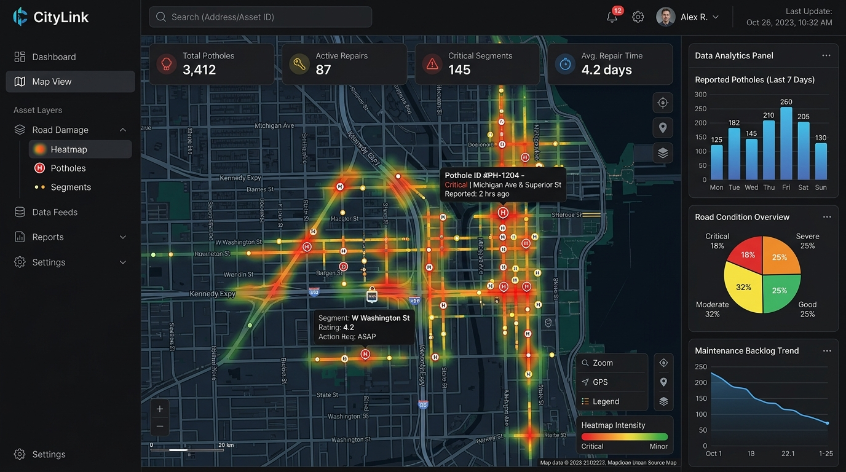
TECHNICAL APPROACH
TECHNOLOGIES TO BE USED
N
Next.js
L
Leaflet.js
M
Mapbox
TW
Tailwind
API
FastAPI
WS
WebSockets
C
Celery
PG
PostgreSQL
GIS
PostGIS
R
Redis
Y
YOLOv8
ON
ONNX
F
Flutter
SQL
SQLite
METHODOLOGY / IMPLEMENTATION FLOW
Fleet Camera
YOLOv8
DBSCAN
PostGIS
RPI
GPS + IMU
Defect detection
3 m deduplication
🖥️ Live Municipal GIS Web Dashboard (Heatmaps & Auto-Dispatch)
Master incident
Repair dispatch
⚡ Real-time Telemetry (<1KB JSON) • Asynchronous Celery + Redis • Offline SQLite Buffer • Aligned with NHAI 40,000 km AI Dashcam Program

Slide 4
FEASIBILITY AND VIABILITY
1
FEASIBILITY
2
CHALLENGE
INT8-quantized YOLOv8 executes under 250 MB RAM at 30 FPS on standard mobile ARM CPUs (Snapdragon / Cortex-A76 / Raspberry Pi 4).
Vehicle vibration blur, intermittent 4G/5G connectivity, weather lighting variations, and multi-vehicle duplicate telemetry.
3
MITIGATION
4
VIABILITY
IMU accelerometer frame-filtering, offline SQLite FIFO sync buffer, confidence threshold ≥0.60, and PostGIS R-tree spatial indexing.
Hardware cost under ₹3,000 per bus. Micro-payloads (<1 KB JSON) minimize server costs. Replaces ₹50–80 Lakh dedicated LiDAR survey cars.
💡 Economic Moat: ₹3,000 Edge unit converts existing transit routes into 24x7 audit infrastructure — 0 dedicated inspection cars needed.

Slide 5
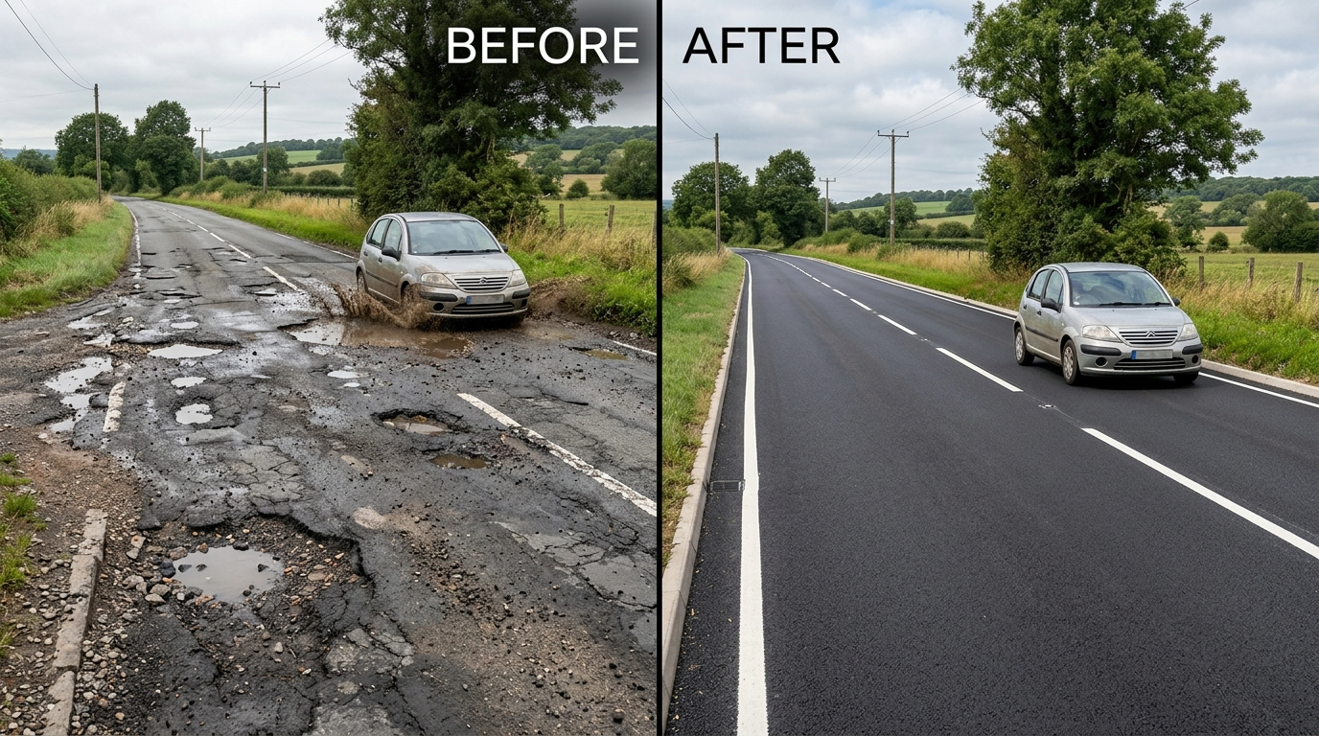
IMPACT AND BENEFITS
MEASURABLE
MEASURABLE
MEASURABLE
MEASURABLE
S
SOCIAL
E
ECONOMIC
Targets 65% reduction in two-wheeler skids & sudden swerves through early pothole detection (IRC:82 standards).
Proactive micro-patching of early surface cracks saves up to 10× vs full asphalt reconstruction (MoRTH data).
E
ENVIRONMENTAL
A
ACCOUNTABILITY
40% lower asphalt carbon footprint; eliminates stop-and-go idling emissions caused by road damage bottlenecks.
Immutable PostGIS before/after geotagged audit logs provide automated proof-of-work, eliminating false contractor claims.
🔄 Automated Repair Validation: Before & After AI Proof-of-Work
🚀 Scalability: Phase 1: City Pilot (50 Buses) ➔ Phase 2: 10 Smart Cities & PWD Fleets ➔ Phase 3: NHAI Data Lake & PM GatiShakti

Slide 6

RESEARCH AND REFERENCES
VIGILANCE
1
IRC:82-2015
2
Ultralytics YOLOv8
Indian Roads Congress standard used for pavement distress classification.
Edge computer-vision architecture and real-time detection reference.
3
ONNX Runtime
4
DBSCAN — Ester et al.
INT8 quantization / edge inference reference.
Density-based spatial clustering methodology.
5
PostGIS Documentation
6
NRDMS / Urban GIS Guidelines
Spatial indexing and geographic query capabilities.
Multi-source geospatial data integration context.
🇮🇳 Directly aligns with NHAI 40,000 km AI Dashcam Program, Smart Cities Mission, & PM GatiShakti Spatial Framework.

Slide 7
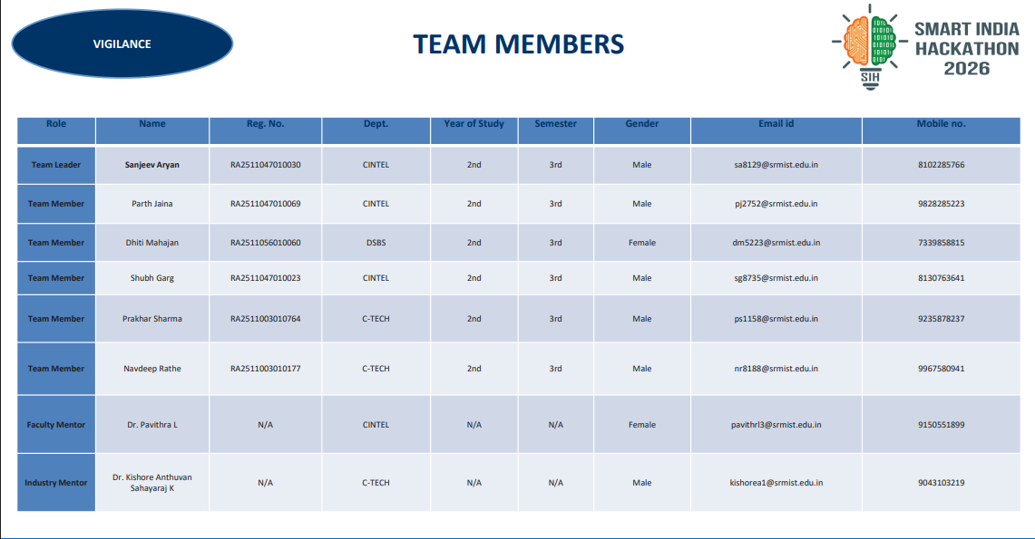
TEAM MEMBERS
VIGILANCE
Role | Name | Reg. No. | Dept. | Year | Sem. | Gender | Email id | Mobile no.
Team Leader | Sanjeev Aryan | RA2511047010030 | CINTEL | 2nd | 3rd | Male | sa8129@srmist.edu.in | 8102285766
Team Member | Parth Jaina | RA2511047010069 | CINTEL | 2nd | 3rd | Male | pj2752@srmist.edu.in | 9828285223
Team Member | Dhiti Mahajan | RA2511056010060 | DSBS | 2nd | 3rd | Female | dm5223@srmist.edu.in | 7339851899
Team Member | Shubh Garg | RA2511047010023 | CINTEL | 2nd | 3rd | Male | sg8735@srmist.edu.in | 8130763641
Team Member | Prakhar Sharma | RA2511003010764 | C-TECH | 2nd | 3rd | Male | ps1158@srmist.edu.in | 9235878237
Team Member | Navdeep Rathe | RA2511003010177 | C-TECH | 2nd | 3rd | Male | nr8188@srmist.edu.in | 9967580941
Faculty Mentor | Dr. Pavithra L | N/A | CINTEL | N/A | N/A | Female | pavithrl3@srmist.edu.in | 9150551899
Industry Mentor | Dr. Kishore Anthuvan Sahayaraj | N/A | C-TECH | N/A | N/A | Male | kishorea1@srmist.edu.in | 9043103219

