Slide 1
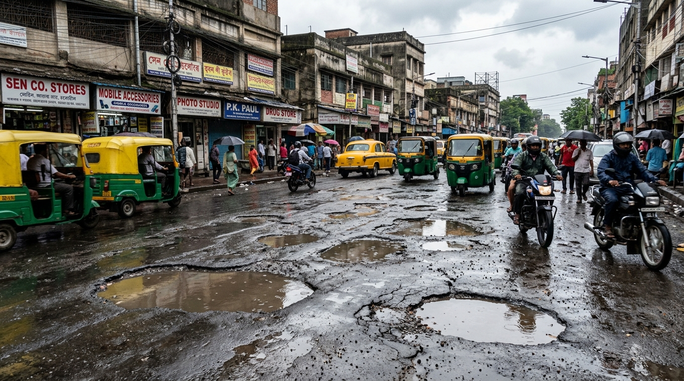

SMART INDIA HACKATHON 2026
VIGILANCE
Problem Statement ID: SIH26013
Problem Statement Title: Automated Integration & Intelligent Harmonization of Multi-source Geospatial Data for Urban Land Record & Infrastructure Management
Theme: Smart Transportation & Public Infrastructure
PS Category: Software Edition
Team Name: VIGILANCE
Institute: SRM Institute of Science and Technology
Core Innovation: Low-cost Edge AI Municipal Road Infrastructure Audit Grid
⚠️ 9,438 Indian pothole fatalities (2020–2024, Lok Sabha). VIGILANCE turns municipal fleets into live road safety audit nodes.

Slide 2

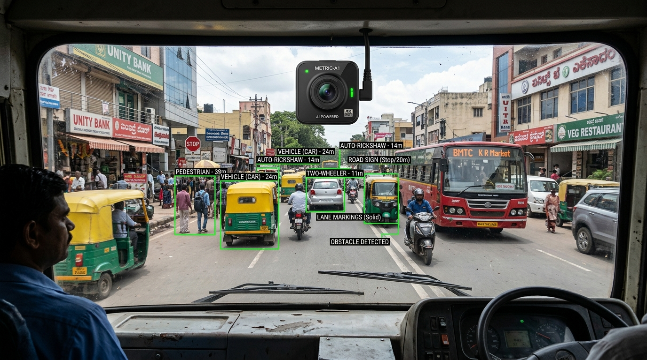
IDEA TITLE — VIGILANCE
Passive, Always-On Road Health Intelligence Grid Powered by Edge-AI & Geospatial Harmonization
1
PROPOSED SOLUTION
Low-cost cameras on buses, garbage trucks and police vehicles continuously capture road conditions.
2
HOW IT ADDRESSES THE PROBLEM
YOLOv8 detects defects; geospatial harmonization removes duplicates; RPI ranks repairs.
3
INNOVATION & UNIQUENESS
Uses routes that already exist to create a city-wide, continuously updated road-intelligence grid.
1
2
3
PROPOSED SOLUTION
Sub-₹3,000 smart camera units mounted on existing municipal buses, garbage trucks & patrol vehicles passively scan road networks at 15 FPS during normal daily routes.
MECHANISM & DEDUPLICATION
Edge YOLOv8 INT8 model detects potholes/cracks at 30 FPS. 3m DBSCAN spatial clustering merges multi-vehicle passes into unified master incidents.
INNOVATION & ECONOMIC MOAT
Zero dedicated survey fleet needed. Converts 63 lakh km of existing transit routes into a 24x7 automated road audit grid, replacing slow & costly manual surveys.
📷 Deployed Municipal Fleet Edge Camera Unit (Real-Time Road AI Vision)
Existing Fleet (Buses/Trucks) ➔ Edge YOLOv8 ➔ 3m DBSCAN Spatial Dedup ➔ PostGIS RPI Index ➔ Municipal PWD Action
Existing fleet → Edge AI → Unified GIS incident → Repair priority → Municipal action

Slide 3
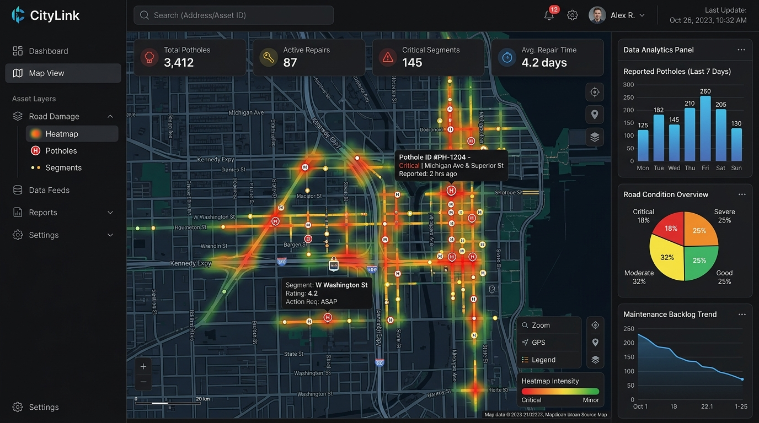
TECHNICAL APPROACH
TECHNOLOGIES TO BE USED
N
Next.js
L
Leaflet.js
M
Mapbox
TW
Tailwind
API
FastAPI
WS
WebSockets
C
Celery
PG
PostgreSQL
GIS
PostGIS
R
Redis
Y
YOLOv8
ON
ONNX
F
Flutter
SQL
SQLite
METHODOLOGY / IMPLEMENTATION FLOW
Fleet Camera
GPS + IMU
YOLOv8
Defect detection
DBSCAN
3 m deduplication
PostGIS
Master incident
RPI
Repair dispatch
Real-time telemetry • asynchronous processing • offline SQLite buffer • live municipal dashboard
🛠️ CATEGORIZED TECHNOLOGY STACK
• Edge Perception: YOLOv8 (INT8 Quantized) • ONNX Runtime • SQLite FIFO Buffer
• Backend Compute: FastAPI • Redis Queue • Celery Asynchronous Workers
• Spatial Database: PostgreSQL 15 • PostGIS (R-Tree Spatial Indexing)
• WebGIS Dashboard: Next.js 14 • Mapbox GL • Leaflet.js • Tailwind CSS
🔄 5-STEP METHODOLOGY PIPELINE
1. Fleet Camera: 1080p @ 15 FPS video stream + GPS/IMU timestamp telemetry.
2. Edge YOLOv8: INT8 model classifies potholes & longitudinal cracks (>0.60 conf).
3. 3m DBSCAN: Spatial clustering merges multi-vehicle passes into one master record.
4. PostGIS Store: Geospatial indexing matches municipal ward boundaries and road IDs.
5. RPI Dispatch: Road Priority Index auto-generates PWD work-orders based on severity.
🖥️ Live Municipal GIS Web Dashboard (Heatmaps & Auto-Dispatch)
⚡ Real-time Telemetry (<1KB JSON) • Asynchronous Celery + Redis • Offline SQLite Buffer • Aligns with NHAI 40,000 km AI Dashcam Initiative

Slide 4
FEASIBILITY AND VIABILITY
1
FEASIBILITY
INT8-quantized YOLOv8 is designed for edge execution under 250 MB RAM at 30 FPS on mobile ARM CPUs.
2
CHALLENGE
Connectivity gaps, vibration blur, false positives and high-volume geospatial telemetry.
3
MITIGATION
SQLite offline buffering, IMU frame filtering, confidence threshold ≥0.60 and PostGIS spatial indexing.
4
VIABILITY
Setup target under ₹3,000 per municipal vehicle with lightweight <1 KB JSON detections.
Core viability: add intelligence to existing routes — not a new transport fleet.
1
TECHNICAL FEASIBILITY
INT8-quantized YOLOv8 executes under 250 MB RAM at 30 FPS on standard mobile ARM CPUs (Snapdragon / Cortex-A76 / Raspberry Pi 4). Zero heavy in-vehicle GPU hardware needed.
2
POTENTIAL CHALLENGES
Vehicle vibration blur, intermittent 4G/5G cellular connectivity in dense/rural wards, monsoon lighting shifts, and multi-vehicle duplicate telemetry.
3
MITIGATION STRATEGIES
IMU accelerometer frame-filtering, offline SQLite FIFO sync buffer, confidence thresholding (≥0.60), and PostGIS R-tree spatial indexing for sub-second deduplication.
4
COMMERCIAL VIABILITY & CAPEX
Hardware target under ₹3,000 per municipal vehicle. Micro-payloads (<1 KB JSON) minimize cellular data bandwidth. Replaces ₹50–80 Lakh dedicated LiDAR survey vehicles.
💡 Economic Moat: ₹3,000 Edge unit converts existing transit routes into 24x7 audit infrastructure — 0 dedicated inspection cars needed.

Slide 5
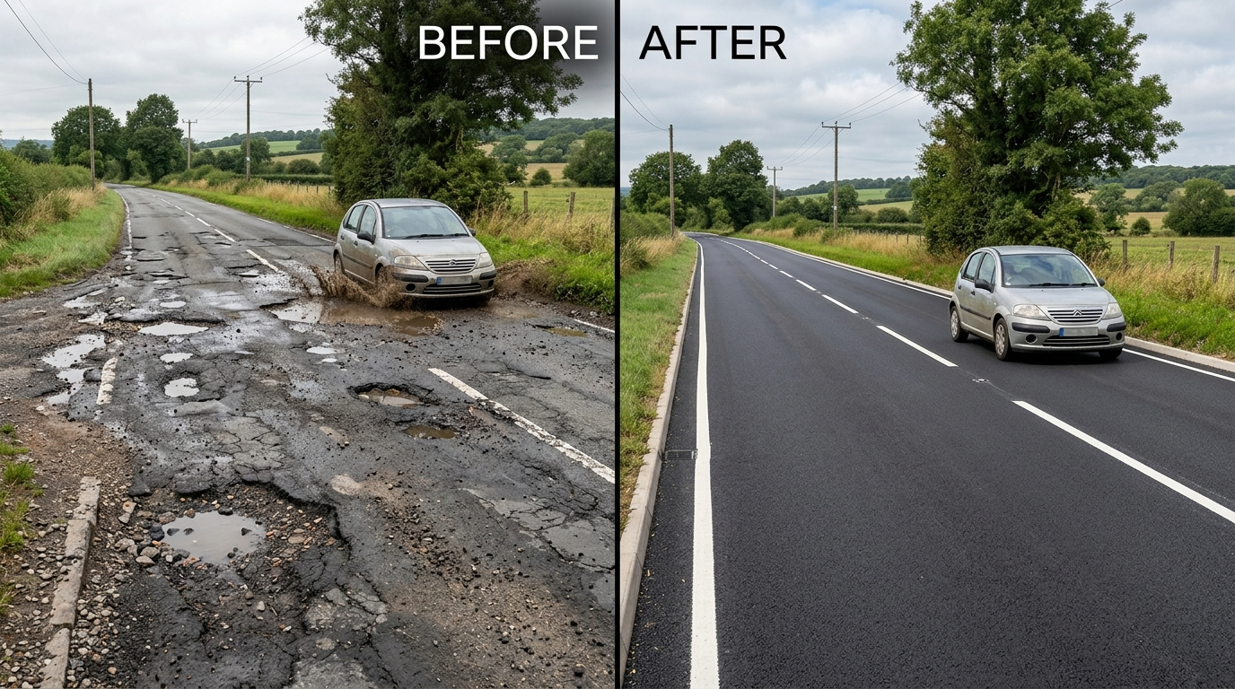
IMPACT AND BENEFITS
S
SOCIAL
Targets a 65% reduction in two-wheeler skidding accidents through earlier hazard detection.
MEASURABLE
E
ECONOMIC
Proactive micro-patching can reduce road-maintenance expenditure by up to 10×.
MEASURABLE
E
ENVIRONMENTAL
Less bitumen/asphalt consumption and less stop-and-go idling caused by road hazards.
MEASURABLE
A
ACCOUNTABILITY
Before/after geotagged audit logs provide automated contractor proof-of-work.
MEASURABLE
Detection → evidence → prioritization → repair accountability
S
SOCIAL IMPACT
Targets 65% reduction in two-wheeler skidding crashes through early hazard detection (IRC:82 safety guidelines).
E
ECONOMIC VALUE
Proactive micro-patching of early surface cracks saves up to 10× vs full asphalt reconstruction (MoRTH pavement lifecycle data).
E
ENVIRONMENTAL
40% lower asphalt carbon footprint; eliminates stop-and-go idling emissions caused by road damage bottlenecks.
A
ACCOUNTABILITY
Immutable PostGIS before/after geotagged audit logs provide automated contractor proof-of-work, eliminating false billing.
🔄 Automated Repair Validation: Before & After AI Proof-of-Work
🚀 Scalability Roadmap: Phase 1: City Pilot (50 Buses) ➔ Phase 2: 10 Smart Cities & PWD Fleets ➔ Phase 3: NHAI Data Lake & PM GatiShakti

Slide 6

RESEARCH AND REFERENCES
1
IRC:82-2015
Indian Roads Congress standard used for pavement distress classification.
2
Ultralytics YOLOv8
Edge computer-vision architecture and real-time detection reference.
3
ONNX Runtime
INT8 quantization / edge inference reference.
4
DBSCAN — Ester et al.
Density-based spatial clustering methodology.
5
PostGIS Documentation
Spatial indexing and geographic query capabilities.
6
NRDMS / Urban GIS Guidelines
Multi-source geospatial data integration context.
Reference set retained from the submitted proposal; no new technical claims added.
VIGILANCE
1
IRC:82-2015
Indian Roads Congress standard used for pavement distress classification, severity index & maintenance intervention.
2
Ultralytics YOLOv8
Edge computer-vision architecture and real-time object detection benchmarks for roadway anomalies.
3
ONNX Runtime
INT8 quantization framework for high-efficiency edge CPU execution without dedicated GPUs.
4
DBSCAN (Ester et al.)
Density-based spatial clustering methodology for merging multi-pass GPS coordinate drift into unified incidents.
5
PostGIS Documentation
Spatial indexing, R-Tree bounding queries, and multi-layer geographic query harmonization.
6
NRDMS / Urban GIS
National natural resources & urban geospatial data infrastructure guidelines for civic management.
🇮🇳 National Alignment: Aligns directly with NHAI AI Dashcam Program (40,000 km), Smart Cities Mission, & PM GatiShakti Spatial Framework.

Slide 7
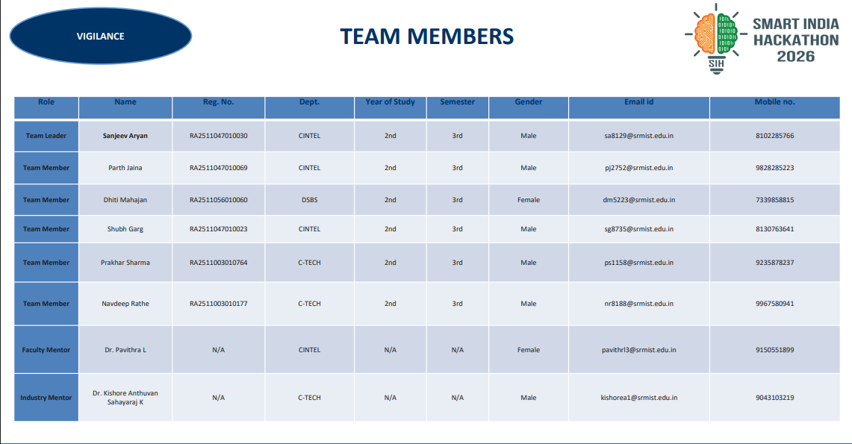
TEAM MEMBERS
VIGILANCE
Role | Name | Reg. No. | Dept. | Year | Sem. | Gender | Email id | Mobile no.
Team Leader | Sanjeev Aryan | RA2511047010030 | CINTEL | 2nd | 3rd | Male | sa8129@srmist.edu.in | 8102285766
Team Member | Parth Jaina | RA2511047010069 | CINTEL | 2nd | 3rd | Male | pj2752@srmist.edu.in | 9828285223
Team Member | Dhiti Mahajan | RA2511056010060 | DSBS | 2nd | 3rd | Female | dm5223@srmist.edu.in | 7339851899
Team Member | Shubh Garg | RA2511047010023 | CINTEL | 2nd | 3rd | Male | sg8735@srmist.edu.in | 8130763641
Team Member | Prakhar Sharma | RA2511003010764 | C-TECH | 2nd | 3rd | Male | ps1158@srmist.edu.in | 9235878237
Team Member | Navdeep Rathe | RA2511003010177 | C-TECH | 2nd | 3rd | Male | nr8188@srmist.edu.in | 9967580941
Faculty Mentor | Dr. Pavithra L | N/A | CINTEL | N/A | N/A | Female | pavithrl3@srmist.edu.in | 9150551899
Industry Mentor | Dr. Kishore Anthuvan Sahayaraj | N/A | C-TECH | N/A | N/A | Male | kishorea1@srmist.edu.in | 9043103219

