Slide 1

SMART INDIA HACKATHON 2026
VIGILNCE
Problem Statement ID –SIH26013
Problem Statement Title-Automated Integration and Intelligent Harmonization of Multi-source Geospatial Data for Urban Land Record & Infrastructure Management
Theme - Smart Transportation & Public InfrastructurePS Category- Software

Slide 2

IDEA TITLE
A continuous road-quality audit platform that converts existing municipal vehicles into mobile sensing nodes.
1
PROPOSED SOLUTION
2
HOW IT ADDRESSES THE PROBLEM
3
INNOVATION & UNIQUENESS
Low-cost cameras on buses, garbage trucks and police vehicles continuously capture road conditions.
YOLOv8 detects defects; geospatial harmonization removes duplicates; RPI ranks repairs.
Uses routes that already exist to create a city-wide, continuously updated road-intelligence grid.
Existing fleet → Edge AI → Unified GIS incident → Repair priority → Municipal action

Slide 3
TECHNICAL APPROACH
TECHNOLOGIES TO BE USED
N
Next.js
L
Leaflet.js
M
Mapbox
TW
Tailwind
API
FastAPI
WS
WebSockets
C
Celery
PG
PostgreSQL
GIS
PostGIS
R
Redis
Y
YOLOv8
ON
ONNX
F
Flutter
SQL
SQLite
METHODOLOGY / IMPLEMENTATION FLOW
Fleet Camera
YOLOv8
DBSCAN
PostGIS
RPI
GPS + IMU
Defect detection
3 m deduplication
Master incident
Repair dispatch
Real-time telemetry • asynchronous processing • offline SQLite buffer • live municipal dashboard

Slide 4
FEASIBILITY AND VIABILITY
1
FEASIBILITY
2
CHALLENGE
INT8-quantized YOLOv8 is designed for edge execution under 250 MB RAM at 30 FPS on mobile ARM CPUs.
Connectivity gaps, vibration blur, false positives and high-volume geospatial telemetry.
3
MITIGATION
4
VIABILITY
SQLite offline buffering, IMU frame filtering, confidence threshold ≥0.60 and PostGIS spatial indexing.
Setup target under ₹3,000 per municipal vehicle with lightweight <1 KB JSON detections.
Core viability: add intelligence to existing routes — not a new transport fleet.

Slide 5
IMPACT AND BENEFITS
S
E
E
A
SOCIAL
ECONOMIC
ENVIRONMENTAL
ACCOUNTABILITY
Targets a 65% reduction in two-wheeler skidding accidents through earlier hazard detection.
Proactive micro-patching can reduce road-maintenance expenditure by up to 10×.
Less bitumen/asphalt consumption and less stop-and-go idling caused by road hazards.
Before/after geotagged audit logs provide automated contractor proof-of-work.
MEASURABLE
MEASURABLE
MEASURABLE
MEASURABLE
Detection → evidence → prioritization → repair accountability

Slide 6

RESEARCH AND REFERENCES
VIGILANCE
1
IRC:82-2015
2
Ultralytics YOLOv8
Indian Roads Congress standard used for pavement distress classification.
Edge computer-vision architecture and real-time detection reference.
3
ONNX Runtime
4
DBSCAN — Ester et al.
INT8 quantization / edge inference reference.
Density-based spatial clustering methodology.
5
PostGIS Documentation
6
NRDMS / Urban GIS Guidelines
Spatial indexing and geographic query capabilities.
Multi-source geospatial data integration context.
Reference set retained from the submitted proposal; no new technical claims added.

Slide 7
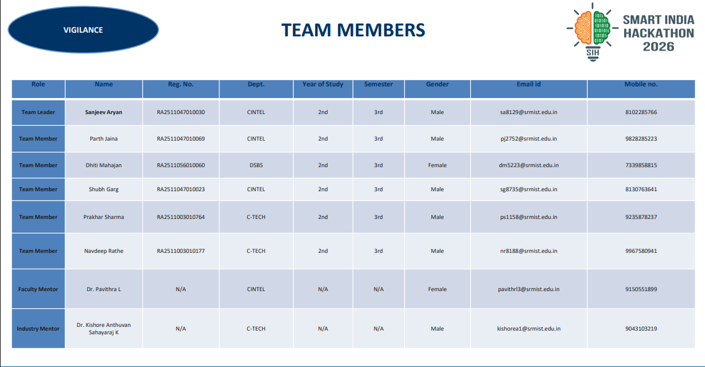
TEAM MEMBERS
VIGILANCE
Role | Name | Reg. No. | Dept. | Year | Sem. | Gender | Email id | Mobile no.
Team Leader | Sanjeev Aryan | RA2511047010030 | CINTEL | 2nd | 3rd | Male | sa8129@srmist.edu.in | 8102285766
Team Member | Parth Jaina | RA2511047010069 | CINTEL | 2nd | 3rd | Male | pj2752@srmist.edu.in | 9828285223
Team Member | Dhiti Mahajan | RA2511056010060 | DSBS | 2nd | 3rd | Female | dm5223@srmist.edu.in | 7339851899
Team Member | Shubh Garg | RA2511047010023 | CINTEL | 2nd | 3rd | Male | sg8735@srmist.edu.in | 8130763641
Team Member | Prakhar Sharma | RA2511003010764 | C-TECH | 2nd | 3rd | Male | ps1158@srmist.edu.in | 9235878237
Team Member | Navdeep Rathe | RA2511003010177 | C-TECH | 2nd | 3rd | Male | nr8188@srmist.edu.in | 9967580941
Faculty Mentor | Dr. Pavithra L | N/A | CINTEL | N/A | N/A | Female | pavithrl3@srmist.edu.in | 9150551899
Industry Mentor | Dr. Kishore Anthuvan Sahayaraj | N/A | C-TECH | N/A | N/A | Male | kishorea1@srmist.edu.in | 9043103219

