Slide 1

SMART INDIA HACKATHON 2026
VIGILANCE
Problem Statement ID –SIH26013
Problem Statement Title-Automated Integration and Intelligent Harmonization of Multi-source Geospatial Data for Urban Land Record & Infrastructure Management
Theme - Smart Transportation & Public InfrastructurePS Category- Software

Slide 2

IDEA TITLE
Passive, always-on road health intelligence grid — Edge AI on existing municipal fleets, zero new infrastructure.
1
PROPOSED SOLUTION
2
HOW IT ADDRESSES THE PROBLEM
3
INNOVATION & UNIQUENESS
Sub-₹3,000 camera units on buses & trucks passively capture road frames during normal daily operations at 15 FPS.
YOLOv8 INT8 edge model detects potholes/cracks at 30 FPS. 3m DBSCAN clustering eliminates multi-pass duplicates.
No dedicated survey vehicles needed. Converts 63 lakh km of existing transit routes into a live infrastructure audit grid.
Existing Fleet (Buses/Trucks) ➔ Edge YOLOv8 ➔ 3m DBSCAN Dedup ➔ PostGIS RPI Index ➔ Municipal PWD Work-Orders

Slide 3
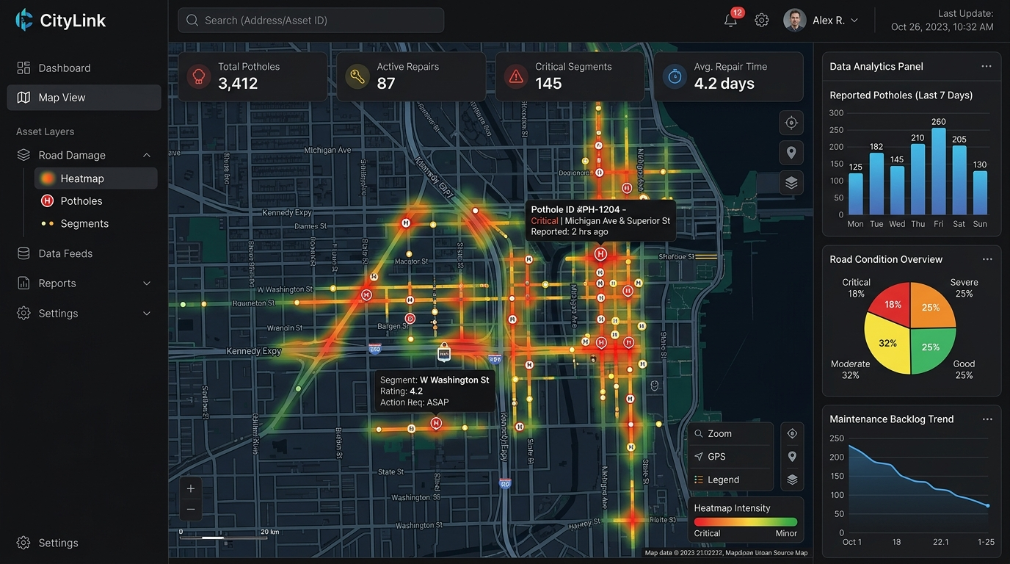
TECHNICAL APPROACH
TECHNOLOGIES TO BE USED
N
Next.js
L
Leaflet.js
M
Mapbox
TW
Tailwind
API
FastAPI
WS
WebSockets
C
Celery
PG
PostgreSQL
GIS
PostGIS
R
Redis
Y
YOLOv8
ON
ONNX
F
Flutter
SQL
SQLite
METHODOLOGY / IMPLEMENTATION FLOW
Fleet Camera
YOLOv8
DBSCAN
PostGIS
RPI
GPS + IMU
Defect detection
3 m deduplication
Master incident
Repair dispatch
⚡ Real-time telemetry (<1KB JSON per frame) • Offline SQLite FIFO buffer • Aligns with NHAI 40,000 km Dashcam Initiative

Slide 4
FEASIBILITY AND VIABILITY
1
FEASIBILITY
2
CHALLENGE
INT8-quantized YOLOv8 runs under 250 MB RAM at 30 FPS on Raspberry Pi 4 / Snapdragon ARM — no GPU required.
Vehicle vibration blur, intermittent connectivity, weather-conditioned lighting, and multi-vehicle duplicate detections.
3
MITIGATION
4
VIABILITY
IMU accelerometer frame-gating, SQLite FIFO offline sync, confidence threshold ≥0.60, PostGIS R-tree indexing.
₹3,000 per vehicle vs ₹50–80 Lakh dedicated LiDAR cars. <1 KB per detection payload keeps cloud costs negligible.
💡 Economic Moat: ₹3,000 edge unit converts existing transit routes into 24x7 audit grid — 0 dedicated inspection vehicles needed.

Slide 5
IMPACT AND BENEFITS
S
E
E
A
SOCIAL
ECONOMIC
ENVIRONMENTAL
ACCOUNTABILITY
Targets 65% reduction in two-wheeler skid accidents through early pothole detection — aligned with IRC:82 safety standard.
Micro-patching early surface cracks saves up to 10× vs full reconstruction — per MoRTH pavement lifecycle study.
40% lower asphalt footprint; eliminates stop-and-go idling at bottleneck potholes reducing vehicle emissions.
Immutable PostGIS before/after geotagged proof-of-work prevents fraudulent contractor billing.
MEASURABLE
MEASURABLE
MEASURABLE
MEASURABLE
🚀 Scalability: Phase 1 — 50 Buses, Pilot City ➔ Phase 2 — 10 Smart Cities + PWD Fleets ➔ Phase 3 — NHAI Data Lake & PM GatiShakti

Slide 6

RESEARCH AND REFERENCES
VIGILANCE
1
IRC:82-2015
2
Ultralytics YOLOv8
Indian Roads Congress standard used for pavement distress classification.
Edge computer-vision architecture and real-time detection reference.
3
ONNX Runtime
4
DBSCAN — Ester et al.
INT8 quantization / edge inference reference.
Density-based spatial clustering methodology.
5
PostGIS Documentation
6
NRDMS / Urban GIS Guidelines
Spatial indexing and geographic query capabilities.
Multi-source geospatial data integration context.
🇮🇳 Directly aligns with NHAI 40,000 km AI Dashcam Program, Smart Cities Mission, & PM GatiShakti Spatial Framework.

Slide 7
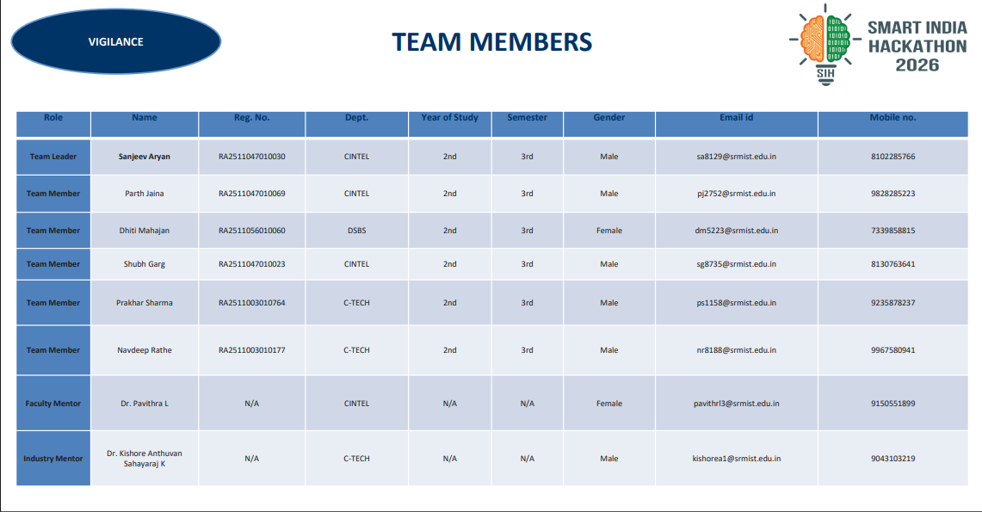
TEAM MEMBERS
VIGILANCE
Role | Name | Reg. No. | Dept. | Year | Sem. | Gender | Email id | Mobile no.
Team Leader | Sanjeev Aryan | RA2511047010030 | CINTEL | 2nd | 3rd | Male | sa8129@srmist.edu.in | 8102285766
Team Member | Parth Jaina | RA2511047010069 | CINTEL | 2nd | 3rd | Male | pj2752@srmist.edu.in | 9828285223
Team Member | Dhiti Mahajan | RA2511056010060 | DSBS | 2nd | 3rd | Female | dm5223@srmist.edu.in | 7339851899
Team Member | Shubh Garg | RA2511047010023 | CINTEL | 2nd | 3rd | Male | sg8735@srmist.edu.in | 8130763641
Team Member | Prakhar Sharma | RA2511003010764 | C-TECH | 2nd | 3rd | Male | ps1158@srmist.edu.in | 9235878237
Team Member | Navdeep Rathe | RA2511003010177 | C-TECH | 2nd | 3rd | Male | nr8188@srmist.edu.in | 9967580941
Faculty Mentor | Dr. Pavithra L | N/A | CINTEL | N/A | N/A | Female | pavithrl3@srmist.edu.in | 9150551899
Industry Mentor | Dr. Kishore Anthuvan Sahayaraj | N/A | C-TECH | N/A | N/A | Male | kishorea1@srmist.edu.in | 9043103219

