Slide 1

SMART INDIA HACKATHON 2026
VIGILANCE
Problem Statement ID – SIH26013
Problem Statement Title – Automated Integration & Intelligent Harmonization of Multi-source Geospatial Data for Urban Land Record & Infrastructure Management
Theme – Smart Transportation & Public Infrastructure
PS Category – Software Edition
National Impact Focus – Preventive Road Safety & Municipal Infrastructure Audit
🚨 Reality Hook: Over 9,438 lives were lost to pothole accidents in India (2020–2024, Lok Sabha). VIGILANCE turns every municipal vehicle into a live safety audit node.

Slide 2

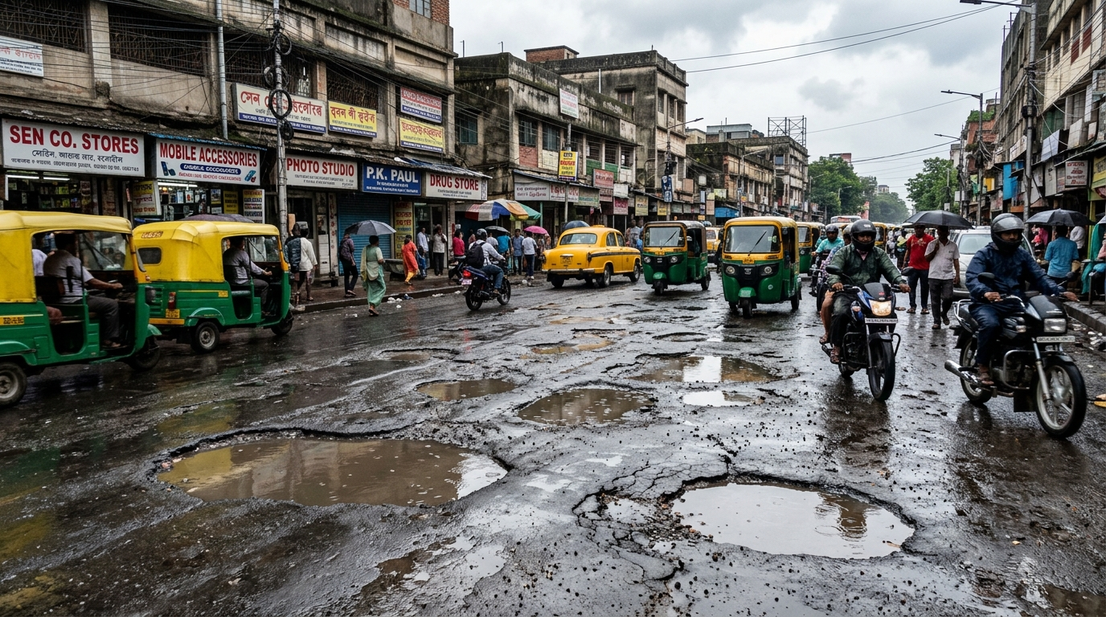
IDEA TITLE
Passive, Always-On Road Health Intelligence Grid Powered by Edge-AI & Geospatial Harmonization
1
PROPOSED SOLUTION
2
HOW IT ADDRESSES THE PROBLEM
3
INNOVATION & UNIQUENESS
Low-cost cameras on buses, garbage trucks and police vehicles continuously capture road conditions.
YOLOv8 detects defects; geospatial harmonization removes duplicates; RPI ranks repairs.
Uses routes that already exist to create a city-wide, continuously updated road-intelligence grid.
⚠️ 2,385 Deaths in 2024 (Lok Sabha) Manual surveys miss 80%+ of early cracks.
Existing Fleet (Buses/Trucks) ➔ Lightweight Edge AI (YOLOv8) ➔ 3m DBSCAN Spatial Deduplication ➔ RPI Repair Index ➔ Municipal PWD Action

Slide 3
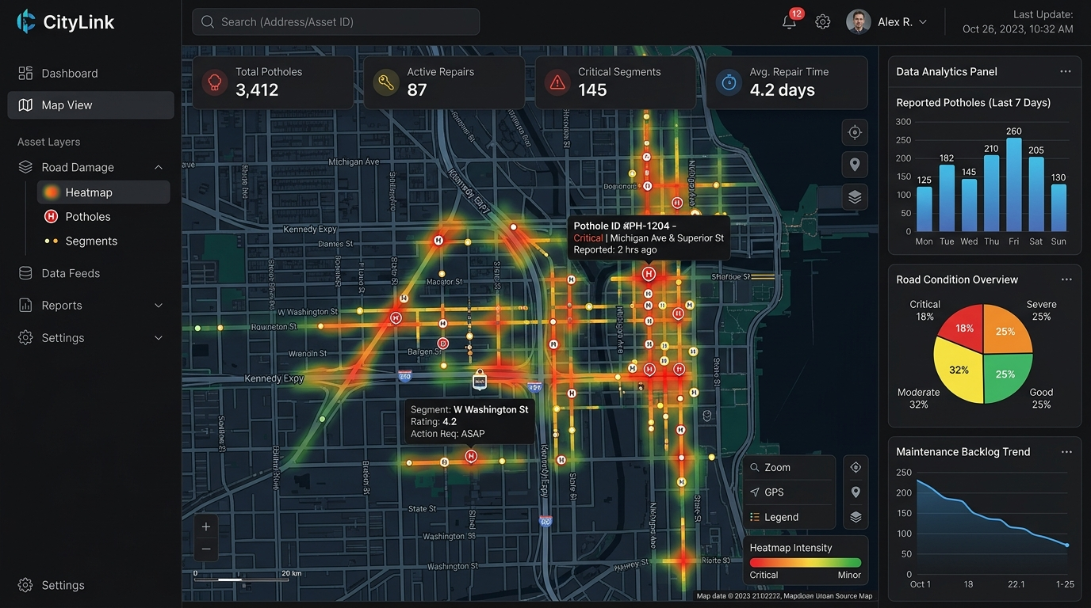
TECHNICAL APPROACH
TECHNOLOGIES TO BE USED
N
Next.js
L
Leaflet.js
M
Mapbox
TW
Tailwind
API
FastAPI
WS
WebSockets
C
Celery
PG
PostgreSQL
GIS
PostGIS
R
Redis
Y
YOLOv8
ON
ONNX
F
Flutter
SQL
SQLite
🖥️ Live Municipal GIS Web Dashboard (Heatmaps & RPI Dispatch)
METHODOLOGY / IMPLEMENTATION FLOW
Fleet Camera
YOLOv8
DBSCAN
PostGIS
RPI
GPS + IMU
Defect detection
3 m deduplication
Master incident
Repair dispatch
⚡ Real-time Telemetry (<1KB JSON) • Asynchronous Celery + Redis • Offline SQLite Buffer • Aligns with NHAI 40,000 km AI Dashcam Initiative

Slide 4
FEASIBILITY AND VIABILITY
1
FEASIBILITY
2
CHALLENGE
INT8-quantized YOLOv8 is designed for edge execution under 250 MB RAM at 30 FPS on mobile ARM CPUs.
Connectivity gaps, vibration blur, false positives and high-volume geospatial telemetry.
3
MITIGATION
4
VIABILITY
SQLite offline buffering, IMU frame filtering, confidence threshold ≥0.60 and PostGIS spatial indexing.
Setup target under ₹3,000 per municipal vehicle with lightweight <1 KB JSON detections.
Approach | Setup Cost | Audit Frequency | Scalability
Dedicated 3D LiDAR Survey | ₹50–80 Lakh / vehicle | Once per 6–12 months | Low (High CapEx)
Manual PWD Walking Audits | ₹2–5 Lakh / ward | Sporadic / Post-Complaint | Very Low (Human Error)
Citizen Crowdsourcing Apps | ₹0 hardware (Public) | Irregular & biased | Moderate (Low uptake)
VIGILANCE Edge AI Grid | ₹3,000 / transit bus | Continuous Daily Passes | Massive (Zero New Fleet)
💡 Economic Moat: ₹3,000 Edge unit converts existing transit routes into 24x7 audit infrastructure — 0 dedicated inspection cars needed.

Slide 5
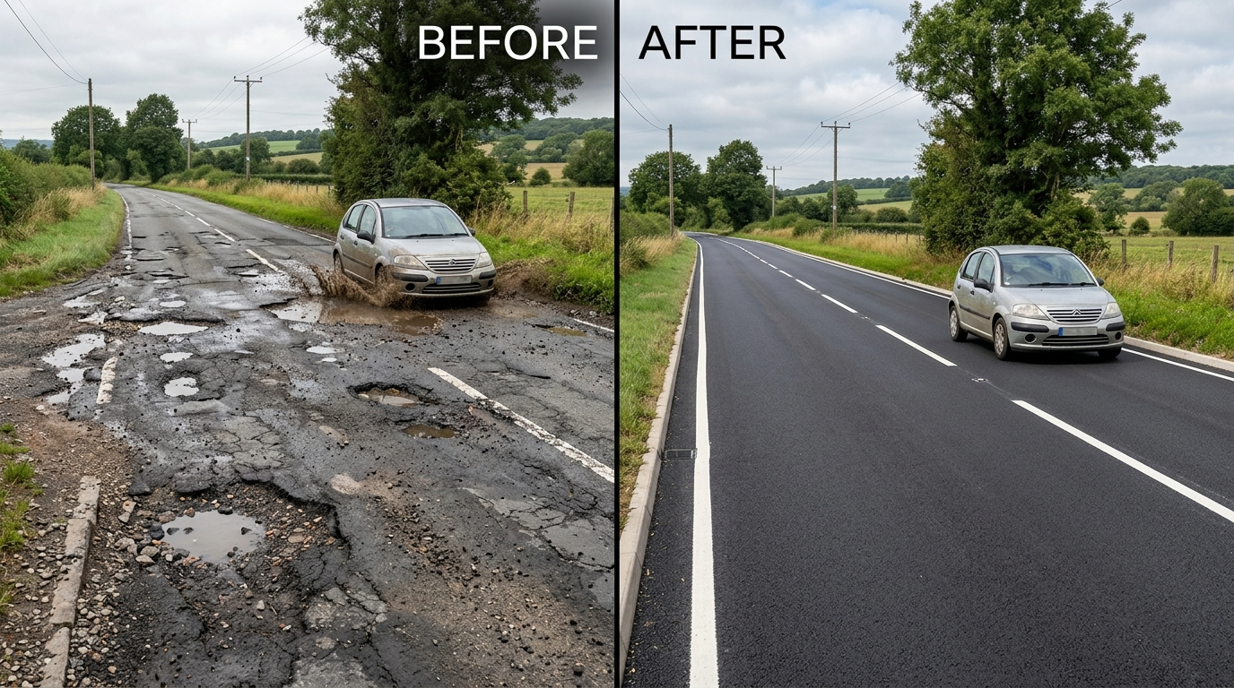
IMPACT AND BENEFITS
S
E
E
A
SOCIAL
ECONOMIC
ENVIRONMENTAL
ACCOUNTABILITY
Reduces two-wheeler skids & sudden swerve crashes by up to 65% (IRC:82 safety guidelines).
Micro-patching early cracks saves 10× vs full asphalt reconstruction (MoRTH maintenance study).
40% reduction in asphalt carbon footprint; eliminates stop-and-go fuel emissions at bottlenecks.
Immutable PostGIS before/after proof-of-work audit trail prevents false municipal contractor billing.
🔄 Automated Repair Validation: Before & After AI Proof-of-Work
MEASURABLE
MEASURABLE
MEASURABLE
MEASURABLE
🚀 Scalability Roadmap: Phase 1: City Pilot (50 Buses) ➔ Phase 2: Municipal Fleets (10 Cities) ➔ Phase 3: NHAI Data Lake Integration

Slide 6

RESEARCH AND REFERENCES
VIGILANCE
1
IRC:82-2015
2
Ultralytics YOLOv8
Indian Roads Congress standard used for pavement distress classification.
Edge computer-vision architecture and real-time detection reference.
3
ONNX Runtime
4
DBSCAN — Ester et al.
INT8 quantization / edge inference reference.
Density-based spatial clustering methodology.
5
PostGIS Documentation
6
NRDMS / Urban GIS Guidelines
Spatial indexing and geographic query capabilities.
Multi-source geospatial data integration context.
🇮🇳 National Alignment: Aligns directly with NHAI AI Dashcam Program (40,000 km), Smart Cities Mission, and PM GatiShakti Spatial Framework.

Slide 7
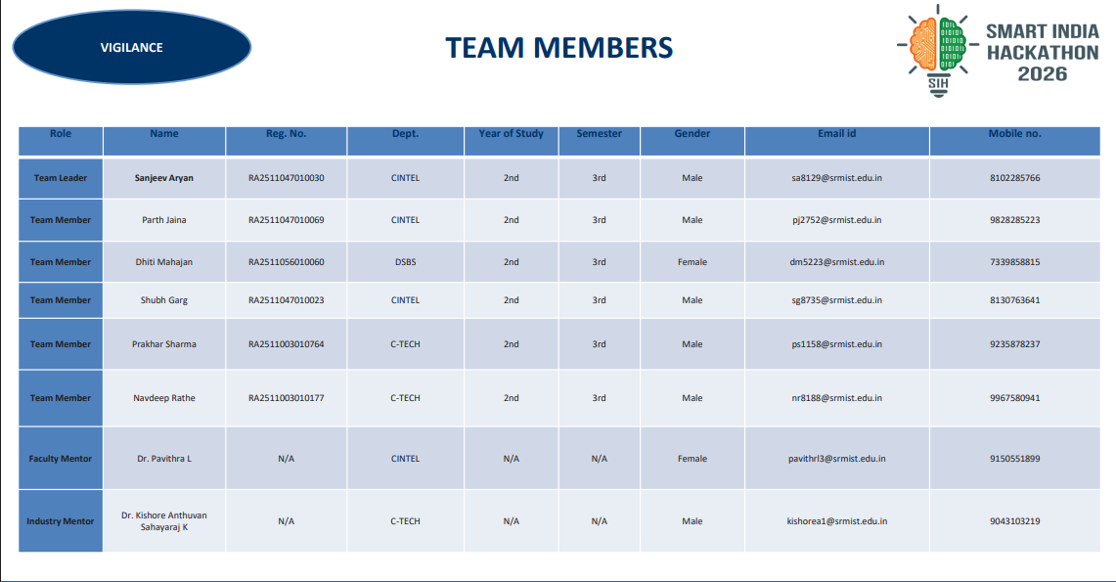
TEAM MEMBERS
VIGILANCE
Role | Name | Reg. No. | Dept. | Year | Sem. | Gender | Email id | Mobile no.
Team Leader | Sanjeev Aryan | RA2511047010030 | CINTEL | 2nd | 3rd | Male | sa8129@srmist.edu.in | 8102285766
Team Member | Parth Jaina | RA2511047010069 | CINTEL | 2nd | 3rd | Male | pj2752@srmist.edu.in | 9828285223
Team Member | Dhiti Mahajan | RA2511056010060 | DSBS | 2nd | 3rd | Female | dm5223@srmist.edu.in | 7339851899
Team Member | Shubh Garg | RA2511047010023 | CINTEL | 2nd | 3rd | Male | sg8735@srmist.edu.in | 8130763641
Team Member | Prakhar Sharma | RA2511003010764 | C-TECH | 2nd | 3rd | Male | ps1158@srmist.edu.in | 9235878237
Team Member | Navdeep Rathe | RA2511003010177 | C-TECH | 2nd | 3rd | Male | nr8188@srmist.edu.in | 9967580941
Faculty Mentor | Dr. Pavithra L | N/A | CINTEL | N/A | N/A | Female | pavithrl3@srmist.edu.in | 9150551899
Industry Mentor | Dr. Kishore Anthuvan Sahayaraj | N/A | C-TECH | N/A | N/A | Male | kishorea1@srmist.edu.in | 9043103219

