Slide 1
Hackathon Challenge Presentation
SPONSORED BY CCIBT - TECHNOLOGY
HYDERABAD & BANGALORE: MONDAY, DECEMBER 15
CHARLOTTE & NEW YORK: TUESDAY, DECEMBER 16

Slide 2
Meet the team
Sudhir R Puchakayala
Suhail A Mansoori
Vijay rahul
Vamsi Krishna
Sanjeev Kumar
Shruthi R
Siddarth Chhetri
Challenge Description
Commercial Real Estate Analyzer
The highly time consuming, requiring hours per deal to gather property details, market conditions, demographics, and risk factors. This manual process limits the number of opportunities bankers can evaluate, creates inconsistent underwriting quality, and delays customer response times-reducing competitiveness

Slide 3
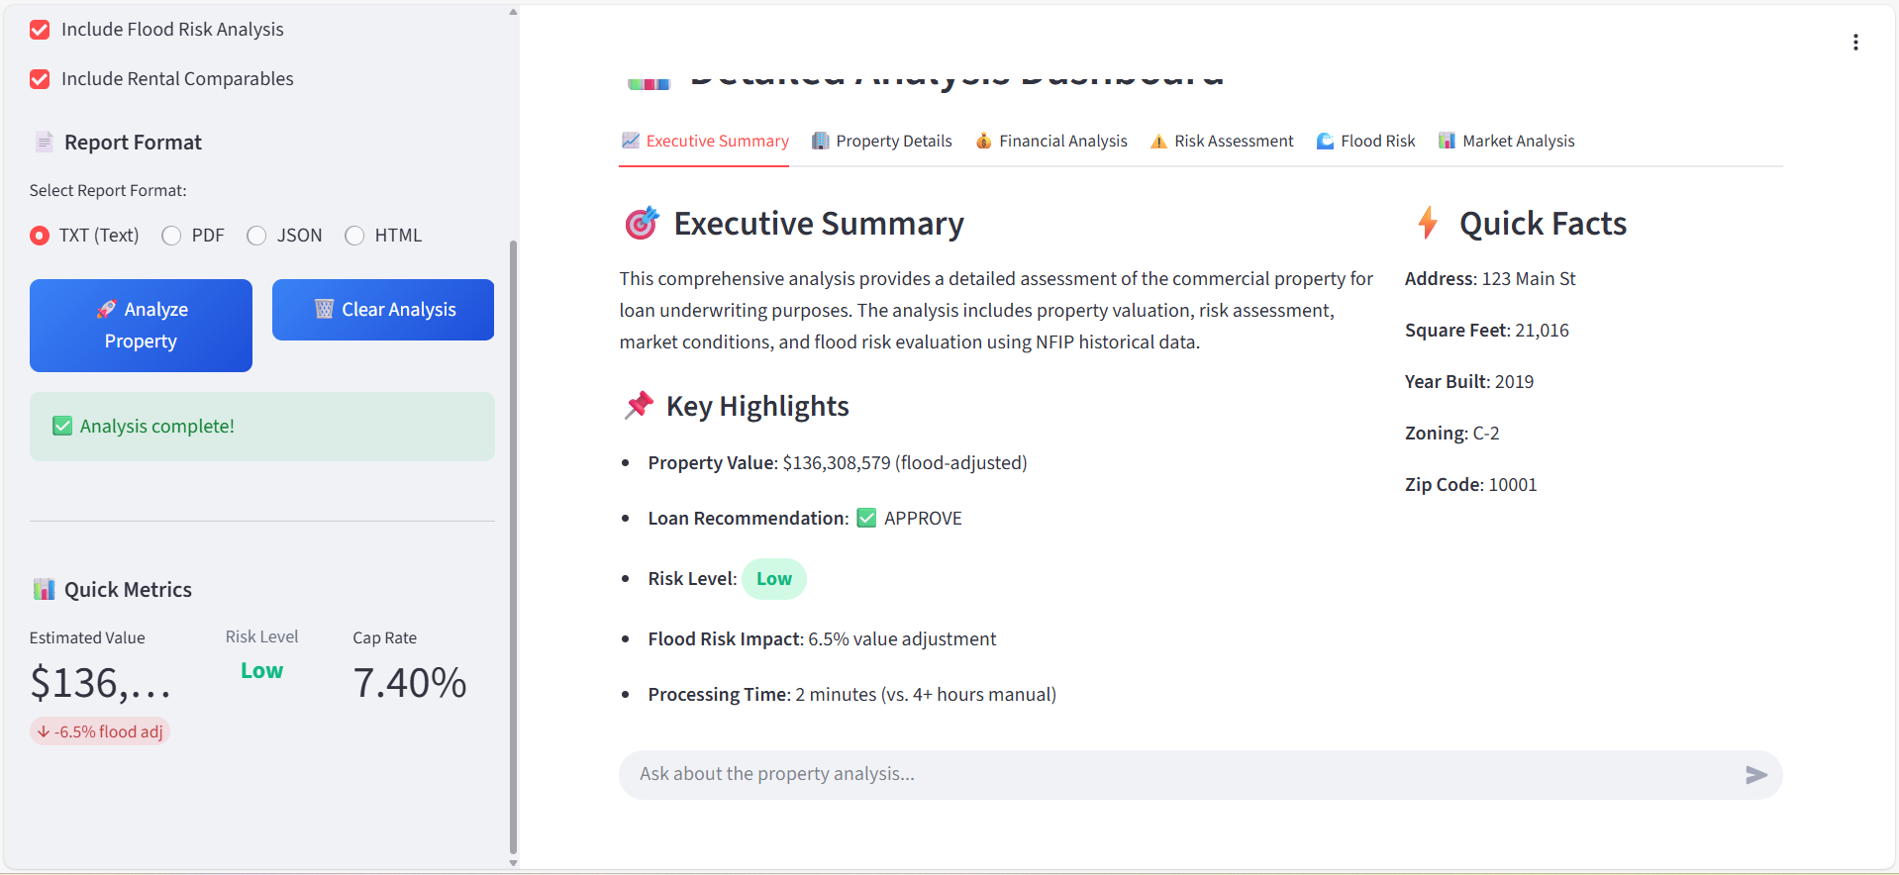
Solution Overview
Solution Approach
Data Unification Combining 6+ BigQuery datasets: Property, Market Trends, and Flood Risk.
Algorithmic Valuation Automatically calculates the property's fair value by incorporating real-time market trends and site-specific risk assessments.
Instant Deal Memos Gemini Pro synthesizes risk scores into comprehensive PDF reports.

Slide 4






High-Level Architecture
2. Core Logic (Processor)
Steps: - Query Data Layer (Go to Step 3) - Execute Valuation / Risk Adjustment - Call Intelligence Layer (Go to Step 4) Output: Final Report Data & Memo
1. User Interface (Input)
3. Data Layer (Source)
User inputs address and triggers analysis request.
cre_data.properties
cre_data.market_trends
cre_data.nfip_policy
Call Gemini
cre_data.risks
(Returns Data to Logic)
4. Intelligence (Memo Gen)
Synthesizes scores into natural language Deal Memos.
Return Data

Slide 5
Major System Components
Core System Modules
Key Technologies
Data Sources (BigQuery)
Data Ingestion & Preprocessing
Valuation & Risk Engine
Dashboard Visualization
Deal Memo Generation
Python (Backend Logic)
Streamlit (Interactive Frontend UI)
Google Cloud BigQuery (Central Data Warehouse)
Gemini Pro (Memo Synthesis & NLP)
cre_data.properties (Asset Details)
cre_data.market_trends (Cap Rates, Pricing)
cre_data.nfip_policy (Flood Insurance Data)
cre_data.risks (Zone Risk Adjustments)

Slide 6
Thank you

