Slide 1

RestoQ – Aspect Based Sentiment Analysis
Ashish Chandra Jha
Lalit Agarwal
Sanjeev Kumar Jha
MBA in Business Analytics,
REVA University, Bengaluru

Slide 2
Approach
Data Collection
Reviews Collected
Data Preparation
Data Modelling
Presentation Of Output
Zomato Data
Getting raw reviews of customer
Select Data
Naïve Bayes Model
Score Based on Sentiment
Recommend the best restaurant with best aspect
Describe Data
Clean Data
Lexicon Based
Score Based on Aspect
Explore Data
Tokenize
Create a file for reviews
Stop Word Removal
Label Data Manually
Word Frequency and Word Cloud Distribution
Stemming and POS Tagging

Slide 3
Approach
Training Split | Test Split | Lexicon Test Accuracy | Naive Bayes Test Accuracy
90% | 10% | ? | ?
80% | 20% | ? | ?
70% | 30% | ? | ?
60% | 40% | ? | ?

Slide 4
Literature Survey
Sentiment analysis is a process of automatic extraction of features by mode of notions of others about specific product, services or experience[1].
Sentiment analysis on restaurants reviews are considered to be positive, negative or neutral on the overall score of the sentence. To some extent it is very useful and many customers are using it before ordering their food on daily basis.[2][3]
Aspect Based Sentiment Analysis (ABSA) aims at identifying the sentiment polarity (e.g. positive, negative and neutral) of one specific aspect in its context sentence. For example, given a sentence “great food but the service was dreadful” the sentiment polarity for aspects “food” and “service” are positive and negative respectively. [4]

Slide 5

Business Understanding
What people are looking for before placing the order online?

Slide 6




Aspect of Food Ordering
Food Service
Food Quality
Ambience
Cost

Slide 7
Understanding Data
Data Source: Zomato website
Reviews Collected
Sentiment Identified
Feature Selection
Sentiment are Classified

Slide 8
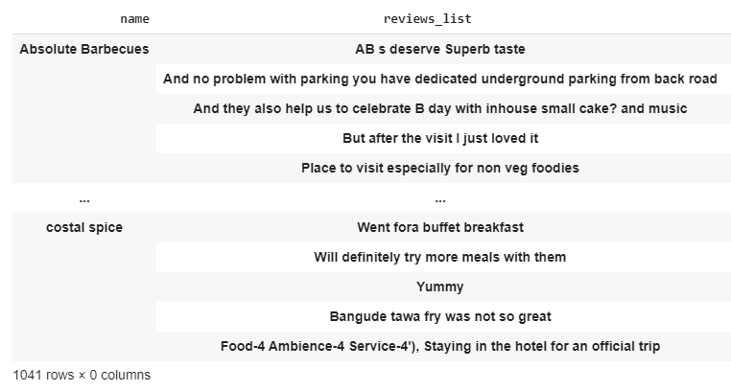
Understanding Data
Dataset description: Data Contains Restaurant name and Customer Reviews

Slide 9
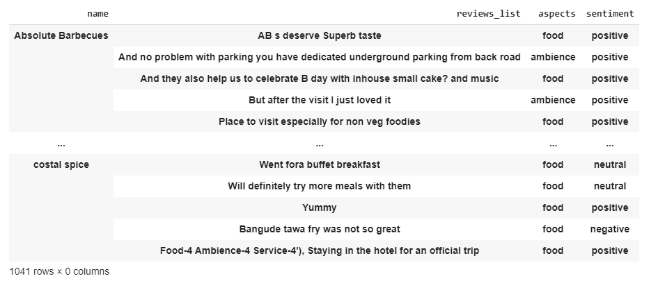
Understanding Data
Dataset Labeling : Labeled the data manually

Slide 10
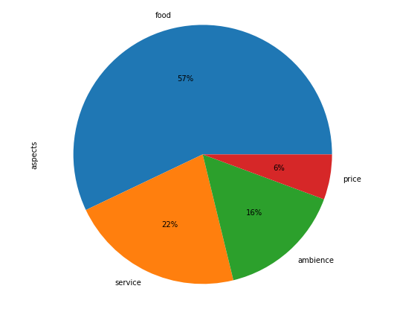
Data Exploration
Aspect of the review

Slide 11
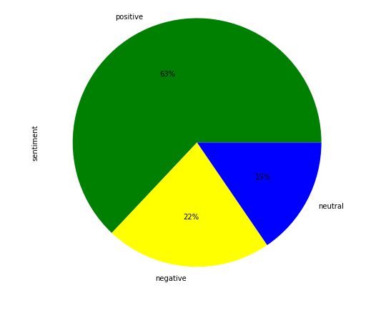
Data Exploration
Sentiments of the review

Slide 12
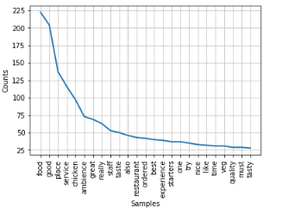
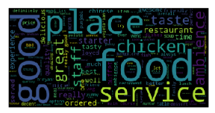
Data Exploration
Visualization of Data
Most popular words from the review
Most popular words shown on word cloud

Slide 13
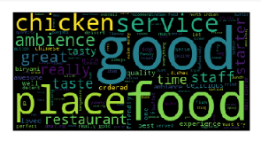
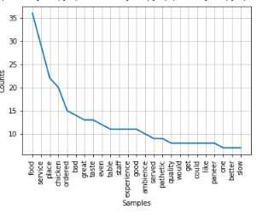
Data Preparation
Data is cleaned with help of Stopwords:
Most popular words after removing stopwords
Most popular words shown on word cloud after removing stopwords

Slide 14
Modeling
We are using supervised and unsupervised learning technique to build the model.
In supervised learning, Naive Bayes classifier has been used.
In unsupervised learning, Lexicon based classifier has been used.

Slide 15
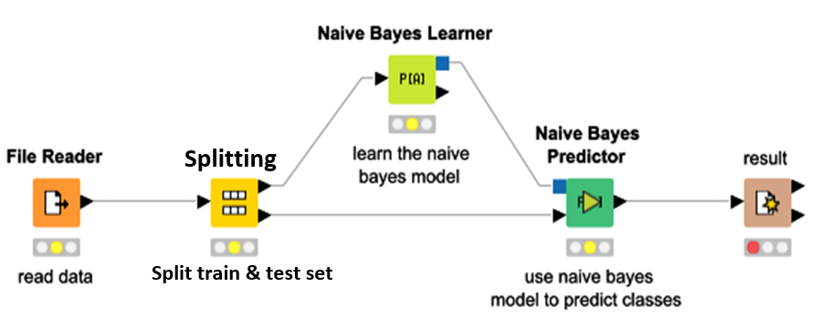
Naïve Bayes Model

Slide 16
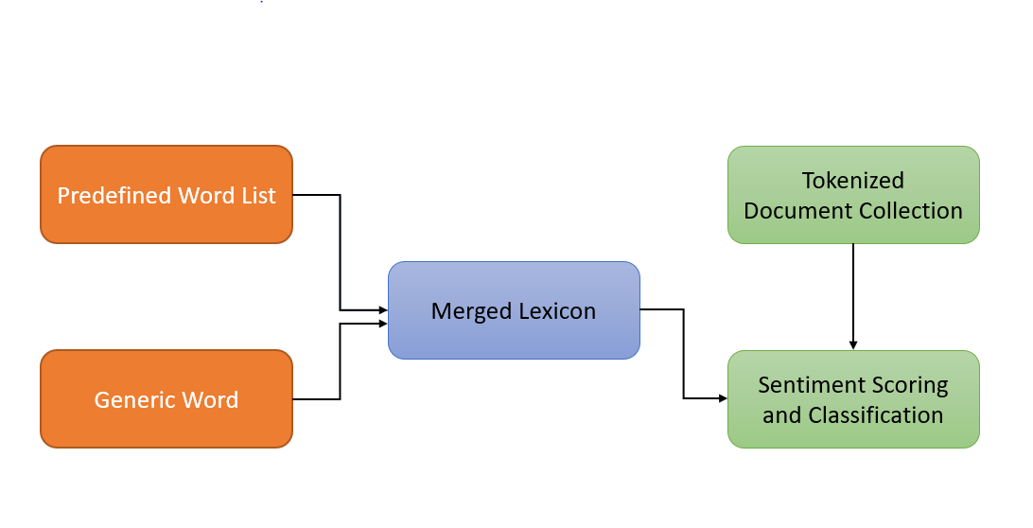
Lexicon Based Model

Slide 17
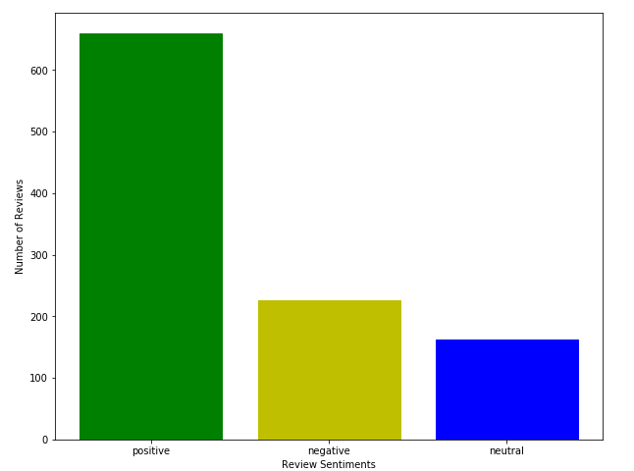
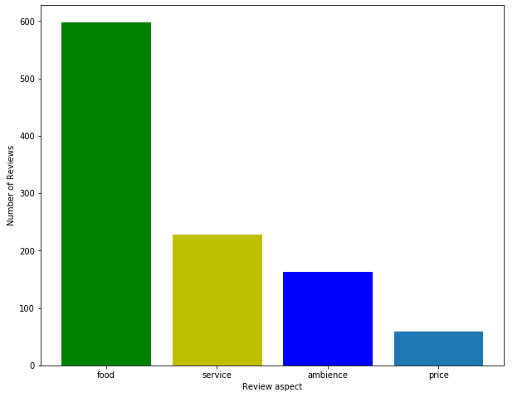
Modeling - Lexicon Based
Sentiments of the Aspect
Sentiments of the review

Slide 18
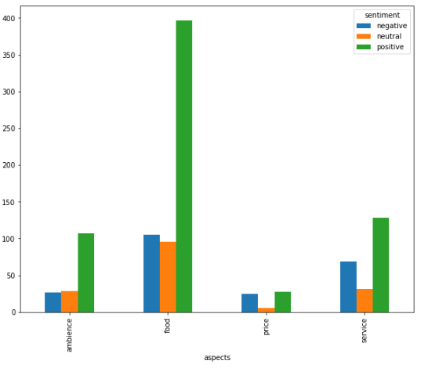
Modeling - Lexicon Based
Sentiment and Aspect

Slide 19
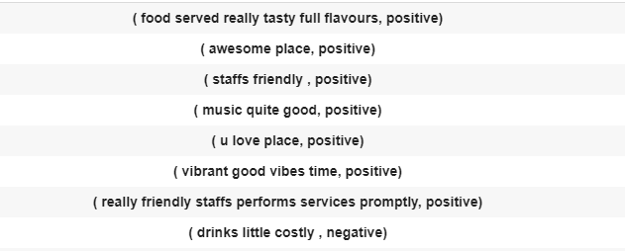
Lexicon Based Model

Slide 20
Conclusion:
Training Split | Test Split | Lexicon Test Accuracy | Naive Bayes Test Accuracy
90% | 10% | 71% | 72%
80% | 20% | 68% | 65%
70% | 30% | 70% | 65%
60% | 40% | 68% | 63%
Conclusion : As we can see from our analysis the Unsupervised learning is better than Supervised. We,ve much accurate results with it.

Slide 21
References
A Study on Sentiment Analysis: Methods and Tools by Abhishek Kaushik1, Anchal Kaushik2, Sudhanshu Naithani3 https://pdfs.semanticscholar.org/c151/dfad8c1bf88b0afc716758c77d533ded7dd0.pdf
Identifying Restaurant Features via Sentiment Analysis on Yelp Reviews https://arxiv.org/ftp/arxiv/papers/1709/1709.08698.pdf
SENTIMENT ANALYSIS OF RESTAURANT REVIEWS USING HYBRID CLASSIFICATION METHOD http://iraj.in/journal/journal_file/journal_pdf/4-54-140014488817-23.pdf
Sethia, A., & Bhattacharyyaa, P. Aspect Based Sentiment Analysis-A Survey. Accessed on August 2019; http://www.cfilt.iitb.ac.in/resources/surveys/aspect-based-sentiment-analysis_survey.pdf

Slide 22
Thank You!

Slide 23
Q&A

