Slide 1

Lecture 18: Implementing Graphs
CSE 373: Data Structures and Algorithms

Slide 2
Administrivia
HW 5 Part 2 due Friday, last day to turn in Monday
Optional: HW 3 regrade to be turned in with your HW 5 Part 2

Slide 3
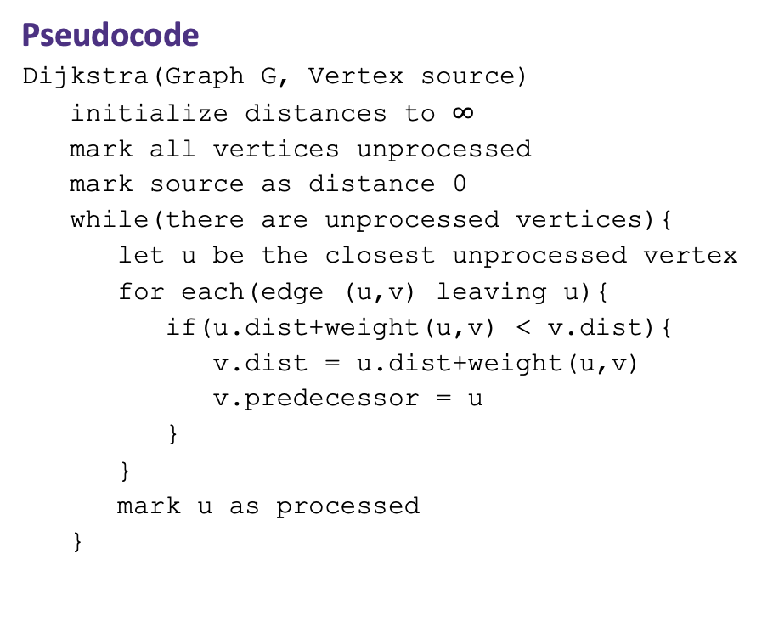
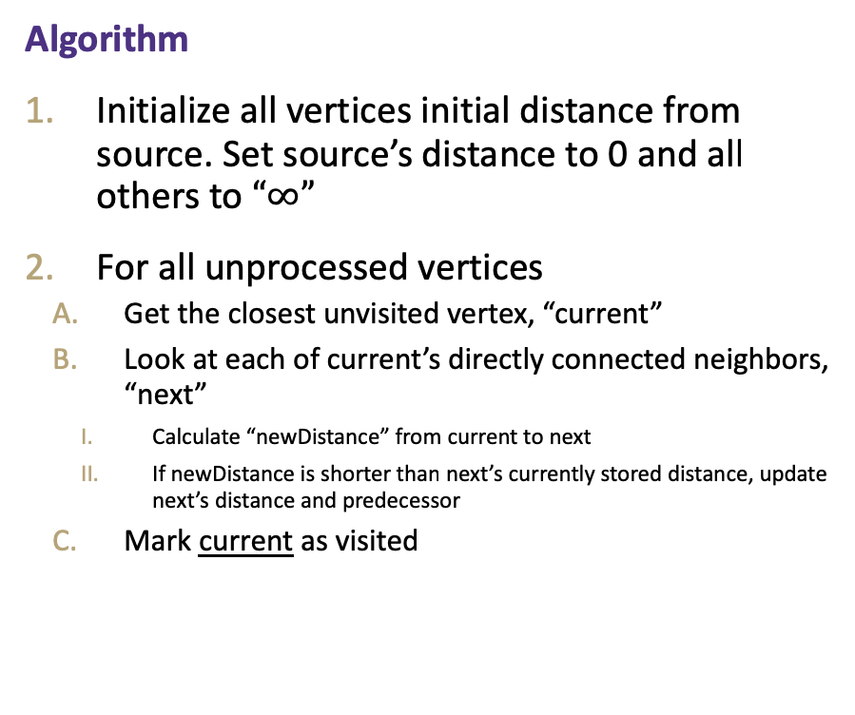
Dijkstra’s Algorithm
Basic idea: Greedily pick the vertex with smallest distance, update other vertices distance based on choice, repeat until all vertices have been processed
(Greedy algorithms pick the locally optimal choice at each step and repeat to achieve a global solution)
Algorithm
Initialize all vertices initial distance from source. Set source’s distance to 0 and all others to $“∞”$
For all unprocessed vertices
Get the closest unvisited vertex, “current”
Look at each of current’s directly connected neighbors, “next”
Calculate “newDistance” from current to next
If newDistance is shorter than next’s currently stored distance, update next’s distance and predecessor
Mark current as visited
Pseudocode
Dijkstra(Graph G, Vertex source)
initialize distances to $∞$
mark all vertices unprocessed
mark source as distance 0
while(there are unprocessed vertices){
let u be the closest unprocessed vertex
for each(edge (u,v) leaving u){
if(u.dist+weight(u,v) < v.dist){
v.dist = u.dist+weight(u,v)
v.predecessor = u
}
}
mark u as processed
}
1.
2.
A.
B.
I.
II.
C.

Slide 4
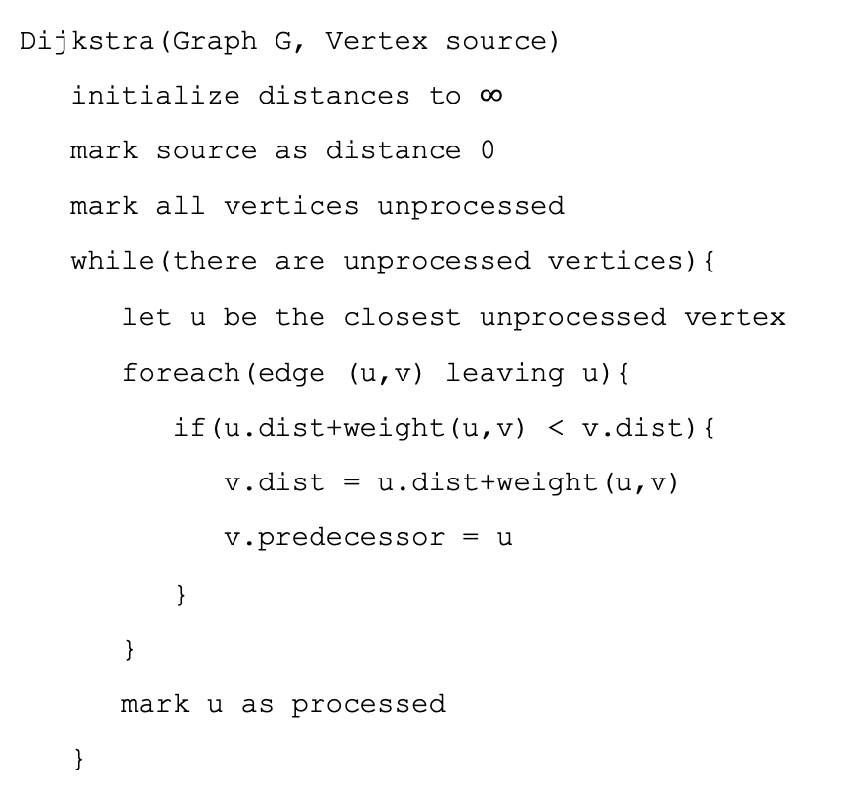
Dijkstra’s Pseuodocode
Dijkstra(Graph G, Vertex source)
initialize distances to $∞$
mark source as distance 0
mark all vertices unprocessed
while(there are unprocessed vertices){
let u be the closest unprocessed vertex
foreach(edge (u,v) leaving u){
if(u.dist+weight(u,v) < v.dist){
v.dist = u.dist+weight(u,v)
v.predecessor = u
}
}
mark u as processed
}
Min Priority Queue ADT
state
Set of comparable values - Ordered by “priority”
Wut?
behavior
peek() – find the element with the smallest priority
insert(value) – add new element to collection
removeMin() – returns and removes element with the smallest priority

Slide 5
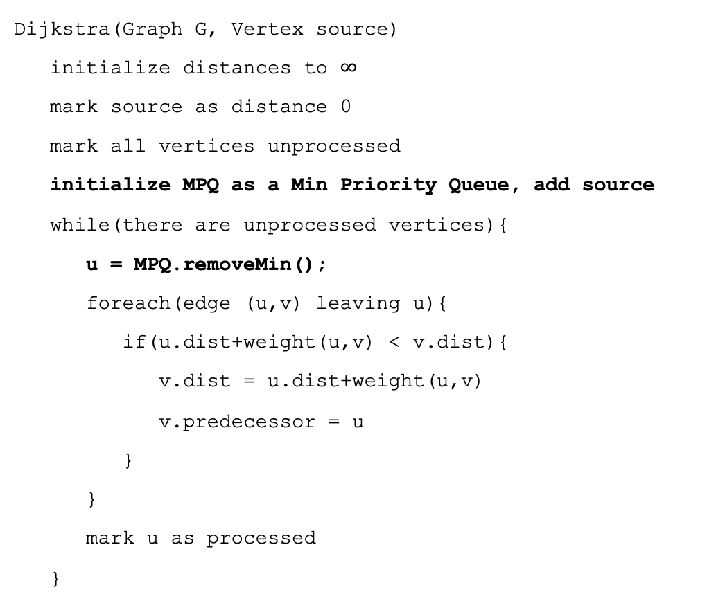
Dijkstra’s Pseuodocode
Dijkstra(Graph G, Vertex source)
initialize distances to $∞$
mark source as distance 0
mark all vertices unprocessed
initialize MPQ as a Min Priority Queue, add source
while(there are unprocessed vertices){
u = MPQ.removeMin();
foreach(edge (u,v) leaving u){
if(u.dist+weight(u,v) < v.dist){
v.dist = u.dist+weight(u,v)
v.predecessor = u
}
}
mark u as processed
}
Min Priority Queue ADT
state
Set of comparable values - Ordered by “priority”
How?
behavior
peek() – find the element with the smallest priority
insert(value) – add new element to collection
removeMin() – returns and removes element with the smallest priority

Slide 6
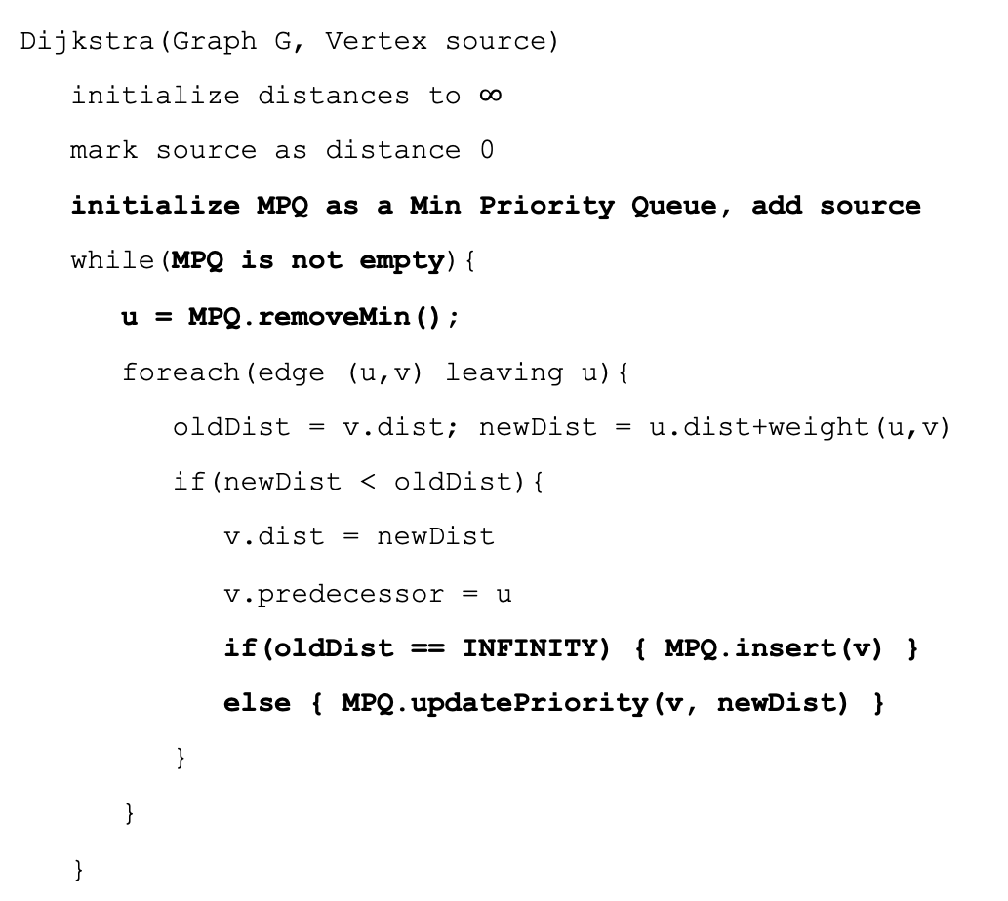
Dijkstra’s Pseuodocode
Dijkstra(Graph G, Vertex source)
initialize distances to $∞$
mark source as distance 0
initialize MPQ as a Min Priority Queue, add source
while(MPQ is not empty){
u = MPQ.removeMin();
foreach(edge (u,v) leaving u){
oldDist = v.dist; newDist = u.dist+weight(u,v)
if(newDist < oldDist){
v.dist = newDist
v.predecessor = u
if(oldDist == INFINITY) { MPQ.insert(v) }
else { MPQ.updatePriority(v, newDist) }
}
}
}
Min Priority Queue ADT
How?
state
Set of comparable values - Ordered by “priority”
behavior
Wut?
peek() – find the element with the smallest priority
insert(value) – add new element to collection
Huh?
removeMin() – returns and removes element with the smallest priority
decreaseKey(e, p) – decreases priority of element e down to p

Slide 7
Dijkstra’s Pseuodocode
Vertex<E>
Edge<E>
state
state
data
dist
predecessor
vertex1
vertex2
cost
Dijkstra(Graph G, Vertex source)
for (Vertex v : G.getVertices()) { v.dist = INFINITY; }
G.getVertex(source).dist = 0;
initialize MPQ as a Min Priority Queue, add source
while(MPQ is not empty){
u = MPQ.removeMin();
for (Edge e : u.getEdges(u)){
oldDist = v.dist; newDist = u.dist+weight(u,v)
if(newDist < oldDist){
v.dist = newDist
v.predecessor = u
if(oldDist == INFINITY) { MPQ.insert(v) }
else { MPQ.updatePriority(v, newDist) }
}
}
}
behavior
behavior
…
…
AdjacencyListGraph<V, E>
state
Dictionary<V, Set<E>> graph
behavior
getEdges(v) – return set of outgoing edges from given vertex
getVertices() – return keyset of graph
getVertex(value) – return Vertex with given value stored
…

Slide 8
Dijkstra’s Runtime
Dijkstra(Graph G, Vertex source)
for (Vertex v : G.getVertices()) { v.dist = INFINITY; }
G.getVertex(source).dist = 0;
initialize MPQ as a Min Priority Queue, add source
while(MPQ is not empty){
u = MPQ.removeMin();
for (Edge e : u.getEdges(u)){
oldDist = v.dist; newDist = u.dist+weight(u,v)
if(newDist < oldDist){
v.dist = newDist
v.predecessor = u
if(oldDist == INFINITY) { MPQ.insert(v) }
else { MPQ.updatePriority(v, newDist) }
}
}
}
+V
+C₁
Code Model = C₁ + V + V(logV + E(C₂ + 2logV))
= C₁ + V + VlogV + VEC₂ + VEC₃logV
Tight O Bound = O(VElogV)
+logV
+C₂
How often do we actually update the MPQ thanks to this if statement?
E times!
Tight O Bound = O(VlogV + ElogV)
+V
+E
+logV
+?
(assume logV)

Slide 9
More Dijkstra’s Implementation
How do we keep track of vertex costs?
Create a vertex object with a cost field
Store a dictionary that maps vertices to costs
How do we find vertex with smallest distance?
Loop over dictionary of costs to find smallest
Use a min heap with priority based on distance
How do we keep track of shortest paths?
Create a vertex object with a predecessor field, update while running Dijkstra’s update fields
While running Dijkstra’s build dictionary of vertix to edge backpointers
Find shortest path from A to B
Run Dijkstra’s, navigate backpointers from B to A

Slide 10
Minimum Spanning Trees

Slide 11

Minimum Spanning Trees
It’s the 1920’s. Your friend at the electric company needs to choose where to build wires to connect all these cities to the plant.
B
6
3
E
2
1
C
A
10
9
5
7
4
D
8
She knows how much it would cost to lay electric wires between any pair of locations, and wants the cheapest way to make sure electricity from the plant to every city.

Slide 12
Minimum Spanning Trees
What do we need? A set of edges such that:
Every vertex touches at least one of the edges. (the edges span the graph)
The graph on just those edges is connected.
The minimum weight set of edges that meet those conditions.
Assume all edge weights are positive.
Claim: The set of edges we pick never has a cycle. Why?
Notice we do not need a directed graph!
B
B
B
B
2
2
2
2
3
3
3
3
E
E
E
E
1
1
1
1
C
C
C
C
7
7
A
7
A
A
A
5
5
5
4
4
4
4
D
D
D
D

Slide 13
Aside: Trees
B
2
Our BSTs had:
A root
Left and/or right children
Connected and no cycles
Our heaps had:
A root
Varying numbers of children
Connected and no cycles
On graphs our tees:
Don’t need a root (the vertices aren’t ordered, and we can start BFS from anywhere)
Varying numbers of children
Connected and no cycles
3
E
1
C
A
4
D
An undirected, connected acyclic graph.
Tree (when talking about graphs)

Slide 14
MST Problem
What do we need? A set of edges such that:
Every vertex touches at least one of the edges. (the edges span the graph)
The graph on just those edges is connected.
The minimum weight set of edges that meet those conditions.
Our goal is a tree!
We’ll go through two different algorithms for this problem today.
Given: an undirected, weighted graph G
Find: A minimum-weight set of edges such that you can get from any vertex of G to any other on only those edges.
Minimum Spanning Tree Problem

Slide 15
Example
Try to find an MST of this graph:
Graph Algorithm Toolbox
B
B
B
B
B
B
6
6
6
6
6
BFS/DFS
Pick an arbitrary starting point
Queue up unprocessed neighbors
Process next neighbor in queue
Repeat until all vertices in queue have been processed
Dijkstra’s
Start at source
Update distance from current to unprocessed neighbors
Process optimal neighbor
Repeat until all vertices have been marked processed
6
3
3
3
3
3
3
E
E
E
E
E
E
2
2
2
2
2
2
1
1
1
1
1
1
C
C
C
C
C
C
10
10
10
10
10
A
10
A
A
A
A
A
9
9
9
9
9
9
5
5
5
5
5
5
7
7
7
7
7
7
4
4
4
4
4
4
F
F
F
F
F
D
F
D
D
D
D
D
8
8
8
8
8
8

Slide 16
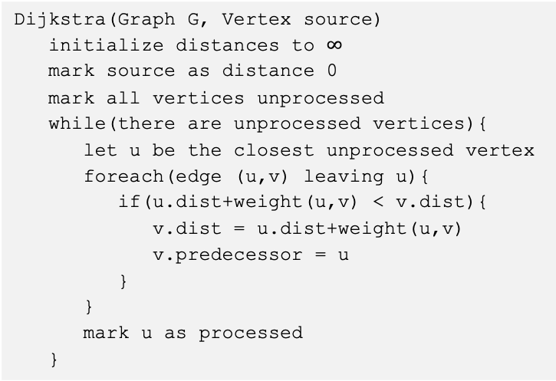
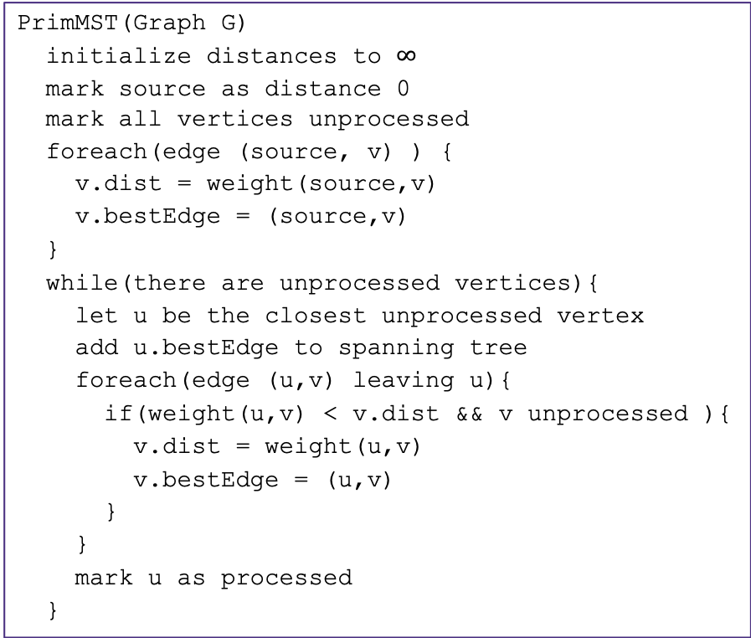
Prim’s Algorithm
Dijkstra’s
Start at source
Update distance from current to unprocessed neighbors
Process optimal neighbor
Repeat until all vertices have been marked processed
Algorithm idea:
choose an arbitrary starting point
Investigate edges that connect unprocessed vertices
Add the lightest edge to solution (be greedy)
Repeat until solution connects all vertices
PrimMST(Graph G)
initialize distances to $∞$
mark source as distance 0 mark all vertices unprocessed
foreach(edge (source, v) ) {
v.dist = weight(source,v)
v.bestEdge = (source,v)
}
while(there are unprocessed vertices){
let u be the closest unprocessed vertex
add u.bestEdge to spanning tree
foreach(edge (u,v) leaving u){
if(weight(u,v) < v.dist && v unprocessed ){
v.dist = weight(u,v)
v.bestEdge = (u,v)
}
}
mark u as processed
}
Dijkstra(Graph G, Vertex source)
initialize distances to $∞$
mark source as distance 0
mark all vertices unprocessed
while(there are unprocessed vertices){
let u be the closest unprocessed vertex
foreach(edge (u,v) leaving u){
if(u.dist+weight(u,v) < v.dist){
v.dist = u.dist+weight(u,v)
v.predecessor = u
}
}
mark u as processed
}

Slide 17
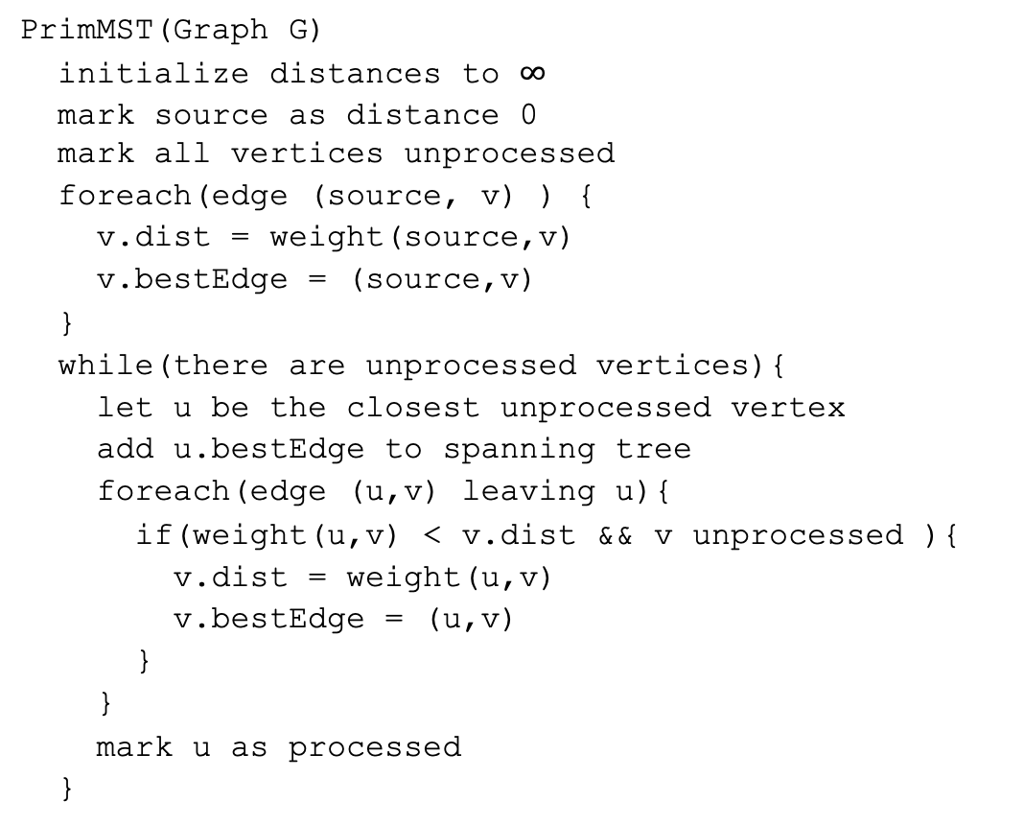
Try it Out
G
50
6
B
2
3
E
PrimMST(Graph G)
initialize distances to $∞$
mark source as distance 0 mark all vertices unprocessed
foreach(edge (source, v) ) {
v.dist = weight(source,v)
v.bestEdge = (source,v)
}
while(there are unprocessed vertices){
let u be the closest unprocessed vertex
add u.bestEdge to spanning tree
foreach(edge (u,v) leaving u){
if(weight(u,v) < v.dist && v unprocessed ){
v.dist = weight(u,v)
v.bestEdge = (u,v)
}
}
mark u as processed
}
4
C
5
A
9
2
7
7
F
D
8
Vertex | Distance | Best Edge | Processed
A
B
C
D
E
F
G

Slide 18
Try it Out
G
50
6
B
2
3
E
PrimMST(Graph G)
initialize distances to $∞$
mark source as distance 0 mark all vertices unprocessed
foreach(edge (source, v) ) {
v.dist = weight(source,v)
v.bestEdge = (source,v)
}
while(there are unprocessed vertices){
let u be the closest unprocessed vertex
add u.bestEdge to spanning tree
foreach(edge (u,v) leaving u){
if(weight(u,v) < v.dist && v unprocessed ){
v.dist = weight(u,v)
v.bestEdge = (u,v)
}
}
mark u as processed
}
4
C
5
A
9
2
7
7
F
D
8
Vertex | Distance | Best Edge | Processed
A
B
C
D
E
F
G
-
X
✓
2
(A, B)
✓
4
(A, C)
✓
--------(C, D)
---2
(A, D)
✓
7
(B, E)
6
--------(C, E)
✓
---5
3
(B, F)
✓
50
(B, G)
✓

Slide 19
A different Approach
Prim’s Algorithm started from a single vertex and reached more and more other vertices.
Prim’s thinks vertex by vertex (add the closest vertex to the currently reachable set).
What if you think edge by edge instead?
Start from the lightest edge; add it if it connects new things to each other (don’t add it if it would create a cycle)
This is Kruskal’s Algorithm.

Slide 20
Kruskal’s Algorithm
KruskalMST(Graph G)
initialize each vertex to be a connected component
sort the edges by weight
foreach(edge (u, v) in sorted order){
if(u and v are in different components){
add (u,v) to the MST
Update u and v to be in the same component
}
}

Slide 21
Try It Out
B
3
6
E
2
KruskalMST(Graph G)
initialize each vertex to be a connected component
sort the edges by weight
foreach(edge (u, v) in sorted order){
if(u and v are in different components){
add (u,v) to the MST
Update u and v to be in the same component
}
}
1
C
A
10
5
9
7
4
D
F
8
Edge | Include? | Reason
(A,C)
(C,E)
(A,B)
(A,D)
(C,D)
Edge (cont.) | Inc? | Reason
(B,F)
(D,E)
(D,F)
(E,F)
(C,F)

Slide 22
Try It Out
B
3
6
E
2
KruskalMST(Graph G)
initialize each vertex to be a connected component
sort the edges by weight
foreach(edge (u, v) in sorted order){
if(u and v are in different components){
add (u,v) to the MST
Update u and v to be in the same component
}
}
1
C
A
10
5
9
7
4
D
F
8
Edge | Include? | Reason
(A,C) | Yes
(C,E) | Yes
(A,B) | Yes
(A,D) | Yes
(C,D) | No | Cycle A,C,D,A
Edge (cont.) | Inc? | Reason
(B,F) | Yes
(D,E) | No | Cycle A,C,E,D,A
(D,F) | No | Cycle A,D,F,B,A
(E,F) | No | Cycle A,C,E,F,D,A
(C,F) | No | Cycle C,A,B,F,C

Slide 23
Kruskal’s Algorithm: Running Time
KruskalMST(Graph G)
initialize each vertex to be a connected component
sort the edges by weight
foreach(edge (u, v) in sorted order){
if(u and v are in different components){
add (u,v) to the MST
Update u and v to be in the same component
}
}

Slide 24
Kruskal’s Algorithm: Running Time
Running a new BFS in the partial MST, at every step seems inefficient.
Do we have an ADT that will work here?
Not yet…

Slide 25
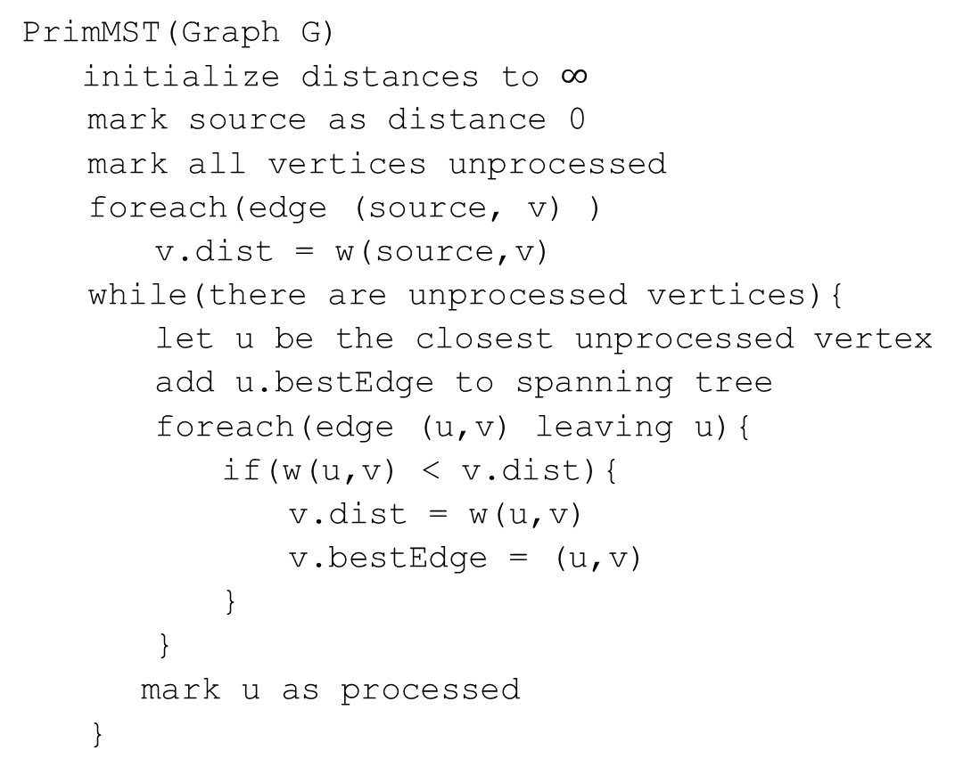
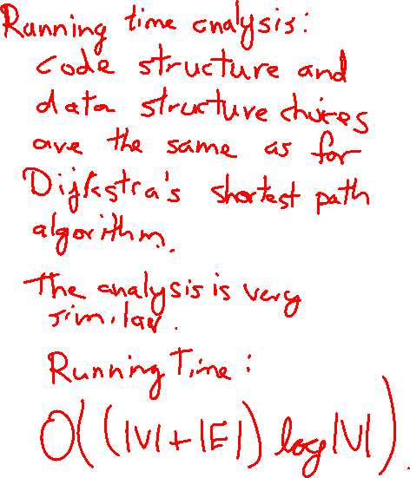
Code
PrimMST(Graph G)
initialize distances to $∞$
mark source as distance 0
mark all vertices unprocessed
foreach(edge (source, v) )
v.dist = w(source,v)
while(there are unprocessed vertices){
let u be the closest unprocessed vertex
add u.bestEdge to spanning tree
foreach(edge (u,v) leaving u){
if(w(u,v) < v.dist){
v.dist = w(u,v)
v.bestEdge = (u,v)
}
}
mark u as processed
}

