Slide 1

Minimum Spanning Trees
Data Structures and Algorithms

Slide 2
Warm Up
Run Dijkstra’s Algorithm on this graph to find the shortest paths from s to t.
c
3
d
2
2
3
1
a
10
5
s
8
7
b
t
1

Slide 3
Today
Last Time: Topological Sorting and Strongly Connected Components
Today: One more graph algorithm. Something completely different: Minimum Spanning Trees

Slide 4

Minimum Spanning Trees
It’s the 1920’s. Your friend at the electric company needs to choose where to build wires to connect all these cities to the plant.
B
6
3
E
2
1
C
A
10
9
5
7
4
D
8
She knows how much it would cost to lay electric wires between any pair of locations, and wants the cheapest way to make sure electricity from the plant to every city.

Slide 5
Minimum Spanning Trees
1950’s
boss
phone
It’s the 1920’s. Your friend at the electric company needs to choose where to build wires to connect all these cities to the plant.
each other.
B
6
3
E
2
1
C
A
10
9
5
7
4
D
F
8
phone
She knows how much it would cost to lay electric wires between any pair of locations, and wants the cheapest way to make sure electricity from the plant to every city.
Everyone can call everyone else.

Slide 6

Minimum Spanning Trees
today
ISP
It’s the 1920’s. Your friend at the electric company needs to choose where to build wires to connect all these cities to the plant.
Internet with fiber optic cable
B
6
3
E
2
1
C
A
10
9
5
7
4
D
8
cable
She knows how much it would cost to lay electric wires between any pair of locations, and wants the cheapest way to make sure electricity from the plant to every city.
Everyone can reach the server

Slide 7
Minimum Spanning Trees
What do we need? A set of edges such that:
Every vertex touches at least one of the edges. (the edges span the graph)
The graph on just those edges is connected.
The minimum weight set of edges that meet those conditions.
Assume all edge weights are positive.
Claim: The set of edges we pick never has a cycle. Why?

Slide 8
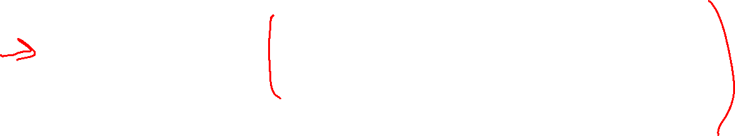
Aside: Trees
Our BSTs had:
A root
Left and/or right children
Connected and no cycles
Our heaps had:
A root
Varying numbers of children
Connected and no cycles
On graphs our tees:
Don’t need a root (the vertices aren’t ordered, and we can start BFS from anywhere)
Varying numbers of children
Connected and no cycles
An undirected, connected acyclic graph.
Tree (when talking about graphs)

Slide 9
MST Problem
What do we need? A set of edges such that:
Every vertex touches at least one of the edges. (the edges span the graph)
The graph on just those edges is connected.
The minimum weight set of edges that meet those conditions.
Our goal is a tree!
We’ll go through two different algorithms for this problem today.
Given: an undirected, weighted graph G
Find: A minimum-weight set of edges such that you can get from any vertex of G to any other on only those edges.
Minimum Spanning Tree Problem

Slide 10
Example
Try to find an MST of this graph:
B
6
3
E
2
1
C
A
10
9
5
7
4
D
F
8

Slide 11
Prim’s Algorithm
Algorithm idea: choose an arbitrary starting point. Add a new edge that:
Will let you reach more vertices.
Is as light as possible
We’d like each not-yet-connected vertex to be able to tell us the lightest edge we could add to connect it.

Slide 12
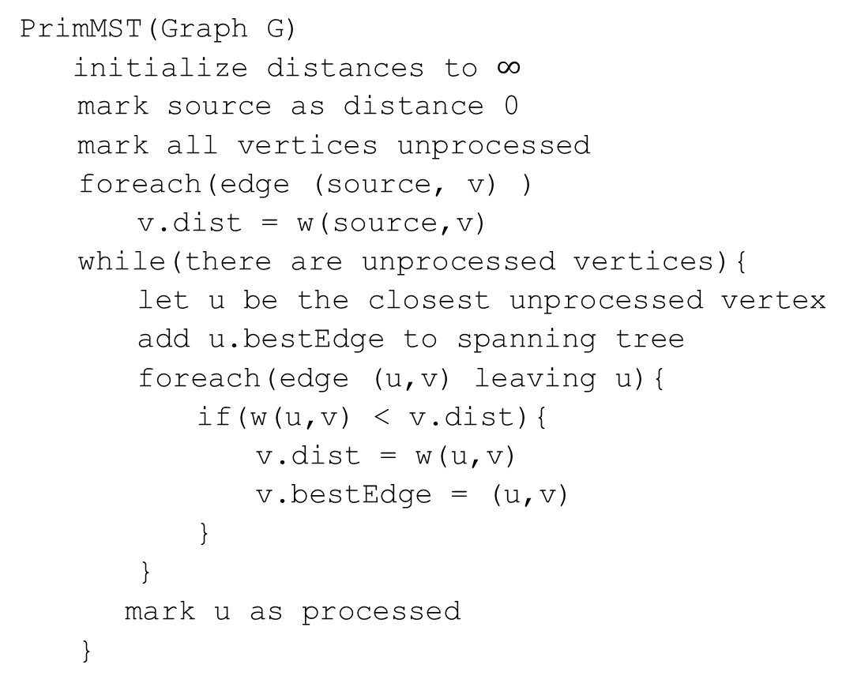
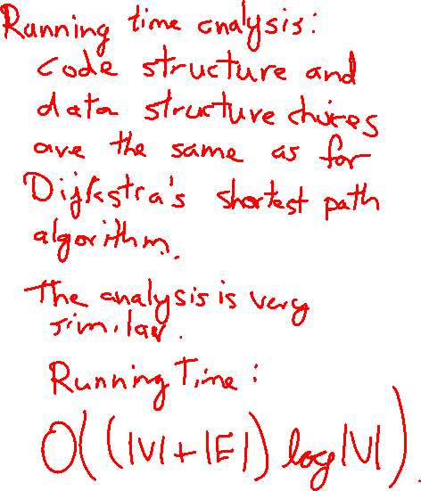
Code
PrimMST(Graph G)
initialize distances to $∞$
mark source as distance 0
mark all vertices unprocessed
foreach(edge (source, v) )
v.dist = w(source,v)
while(there are unprocessed vertices){
let u be the closest unprocessed vertex
add u.bestEdge to spanning tree
foreach(edge (u,v) leaving u){
if(w(u,v) < v.dist){
v.dist = w(u,v)
v.bestEdge = (u,v)
}
}
mark u as processed
}

Slide 13
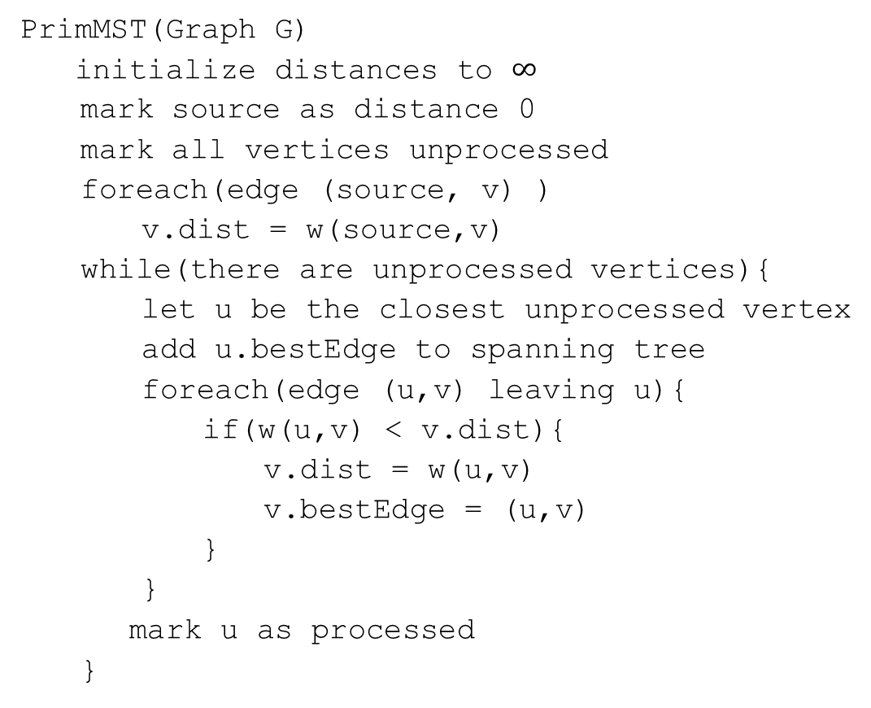

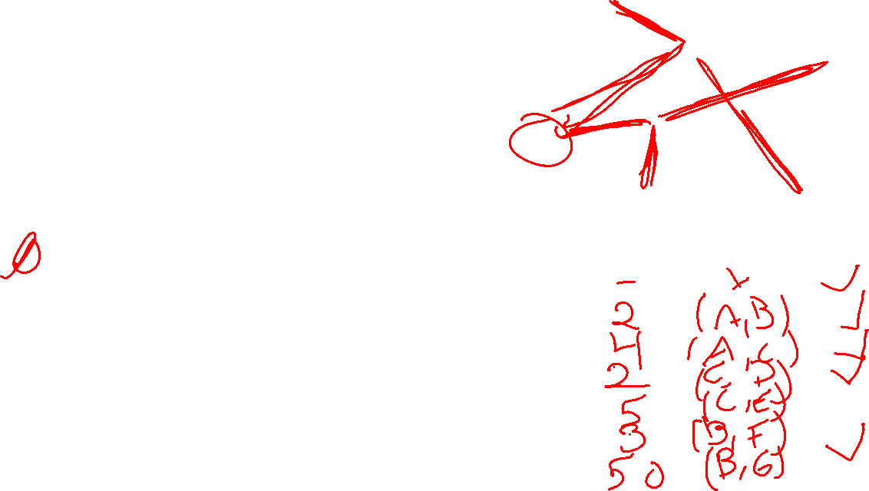
Try it Out
G
50
6
B
PrimMST(Graph G)
initialize distances to $∞$
mark source as distance 0
mark all vertices unprocessed
foreach(edge (source, v) )
v.dist = w(source,v)
while(there are unprocessed vertices){
let u be the closest unprocessed vertex
add u.bestEdge to spanning tree
foreach(edge (u,v) leaving u){
if(w(u,v) < v.dist){
v.dist = w(u,v)
v.bestEdge = (u,v)
}
}
mark u as processed
}
2
3
E
4
C
5
A
9
2
7
7
F
D
8
Vertex | Distance | Best Edge | Processed
A
B
C
D
E
F
G

Slide 14
Does This Algorithm Always Work?
Prim’s Algorithm is a greedy algorithm. Once it decides to include an edge in the MST it never reconsiders its decision.
Greedy algorithms rarely work.
There are special properties of MSTs that allow greedy algorithms to find them.
Robbie can tell you more offline.
In fact MSTs are so magical that there’s more than one greedy algorithm that works.

Slide 15
A different Approach
Prim’s Algorithm started from a single vertex and reached more and more other vertices.
Prim’s thinks vertex by vertex (add the closest vertex to the currently reachable set).
What if you think edge by edge instead?
Start from the lightest edge; add it if it connects new things to each other (don’t add it if it would create a cycle)
This is Kruskal’s Algorithm.

Slide 16
Kruskal’s Algorithm
KruskalMST(Graph G)
initialize each vertex to be a connected component
sort the edges by weight
foreach(edge (u, v) in sorted order){
if(u and v are in different components){
add (u,v) to the MST
Update u and v to be in the same component
}
}

Slide 17
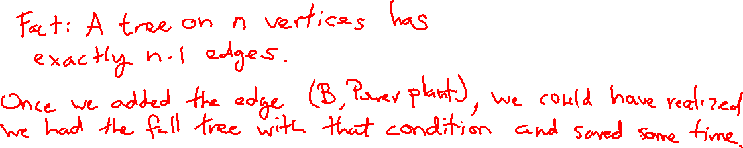
Try It Out
B
KruskalMST(Graph G)
initialize each vertex to be a connected component
sort the edges by weight
foreach(edge (u, v) in sorted order){
if(u and v are in different components){
add (u,v) to the MST
Update u and v to be in the same component
}
}
6
3
E
2
1
C
A
10
9
5
7
4
D
F
8

Slide 18
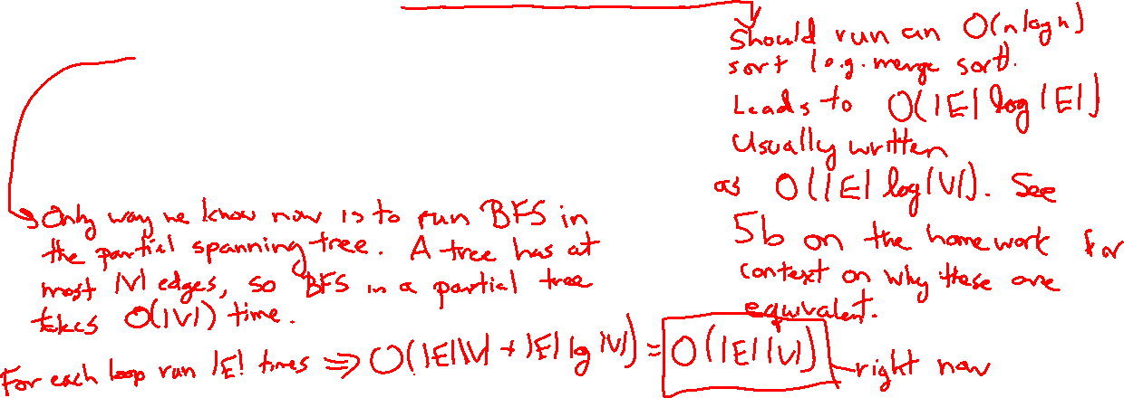
Kruskal’s Algorithm: Running Time
KruskalMST(Graph G)
initialize each vertex to be a connected component
sort the edges by weight
foreach(edge (u, v) in sorted order){
if(u and v are in different components){
add (u,v) to the MST
Update u and v to be in the same component
}
}

Slide 19
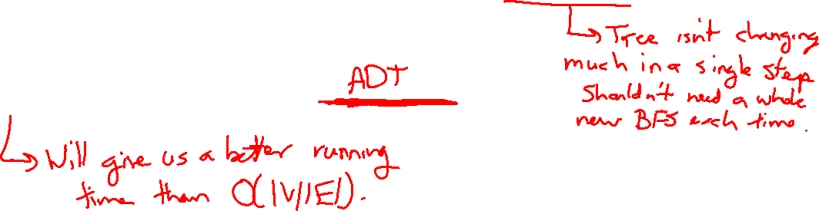
Kruskal’s Algorithm: Running Time
Running a new [B/D]FS in the partial MST, at every step seems inefficient.
Do we have an ADT that will work here?
Not yet…
Kasey will tell you about the “Union-Find” data structure next week.

Slide 20
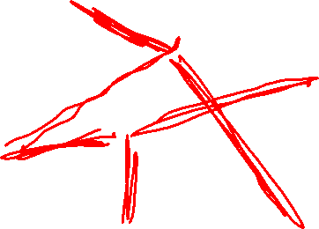
Try it Out
KruskalMST(Graph G)
initialize each vertex to be a connected component
sort the edges by weight
foreach(edge (u, v) in sorted order){
if(u and v are in different components){
add (u,v) to the MST
Update u and v to be in the same component
}
}
G
50
6
B
2
3
E
4
C
5
A
9
2
7
7
F
D
8

Slide 21
Some Extra Comments
Prim was the employee at Bell Labs in the 1950’s
The mathematician in the 1920’s was Boruvka
He had a different also greedy algorithm for MSTs.
Boruvka’s algorithm is trickier to implement, but is useful in some cases.
There’s at least a fourth greedy algorithm for MSTs…
If all the edge weights are distinct, then the MST is unique.
If some edge weights are equal, there may be multiple spanning trees. Prim’s/Dijkstra’s are only guaranteed to find you one of them.

Slide 22
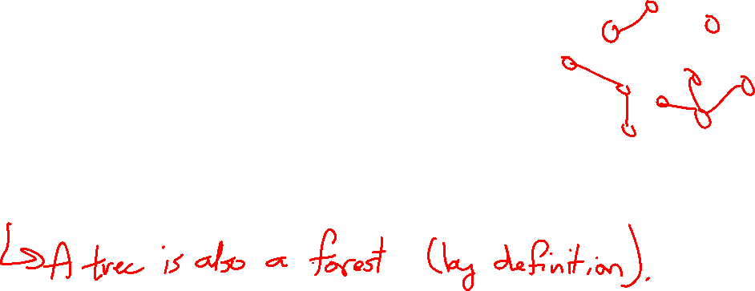
Aside: A Graph of Trees
A tree is an undirected, connected, and acyclic graph.
How would we describe the graph Kruskal’s builds.
It’s not a tree until the end.
It’s a forest!
A forest is any undirected and acyclic graph

Slide 23

EVERY TREE IS A FOREST.

Slide 24
Appendix: MST Properties, Another MST Application

Slide 25
Why do all of these MST Algorithms Work?
MSTs satisfy two very useful properties:
Cycle Property: The heaviest edge along a cycle is NEVER part of an MST.
Cut Property: Split the vertices of the graph any way you want into two sets A and B. The lightest edge with one endpoint in A and the other in B is ALWAYS part of an MST.
Whenever you add an edge to a tree you create exactly one cycle, you can then remove any edge from that cycle and get another tree out.
This observation, combined with the cycle and cut properties form the basis of all of the greedy algorithms for MSTs.

Slide 26
One More MST application
Let’s say you’re building a new building.
There are very important building donors coming to visit TOMORROW,
and the hallways are not finished.
You have n rooms you need to show them, connected by the unfinished hallways.
Thanks to your generous donors you have n-1 construction crews, so you can assign one to each of that many hallways.
Sadly the hallways are narrow and you can’t have multiple crews working on the same hallway.
Can you finish enough hallways in time to give them a tour?
Given: an undirected, weighted graph G
Find: A spanning tree such that the weight of the maximum edge is minimized.
Minimum Bottleneck Spanning Tree Problem

Slide 27
MSTs and MBSTs
Given: an undirected, weighted graph G
Find: A minimum-weight set of edges such that you can get from any vertex of G to any other on only those edges.
Minimum Spanning Tree Problem
Given: an undirected, weighted graph G
Find: A spanning tree such that the weight of the maximum edge is minimized.
Minimum Bottleneck Spanning Tree Problem
B
B
2
2
3
3
C
C
A
A
1
1
2
2
4
4
D
D
Graph on the right is a minimum bottleneck spanning tree, but not a minimum spanning tree.

Slide 28
Finding MBSTs
Algorithm Idea: want to use smallest edges. Just start with the smallest edge and add it if it connects previously unrelated things (and don’t if it makes a cycle).
Hey wait…that’s Kruskal’s Algorithm!
Every MST is an MBST (because Kruskal’s can find any MST when looking for MBSTs)
but not vice versa (see the example on the last slide).
If you need an MBST, any MST algorithm will work.
There are also some specially designed MBST algorithms that are faster (see Wikipedia)
Takeaway: When you’re modeling a problem, be careful to really understand what you’re looking for. There may be a better algorithm out there.

