Slide 1

P vs. NP
Data Structures and Algorithms

Slide 2
Goals for today
Wrap up our discussion of reductions
Define “P, NP, and NP-complete”
Explain the P vs. NP problem
why it’s the biggest open problem in CS.
And what to do when a problem you want to solve is “NP-complete”

Slide 3
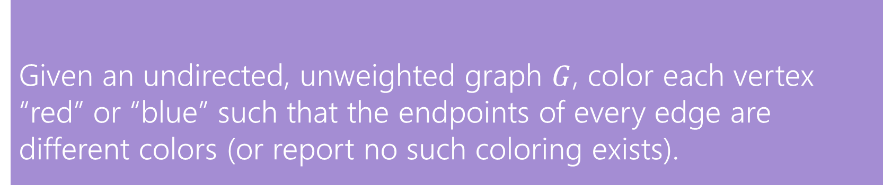
Warm-up
Can these graphs be 2-colored? If so find a 2-coloring. If not try to explain why one doesn’t exist.
E
B
C
B
C
E
A
D
A
D
Given an undirected, unweighted graph $G$, color each vertex “red” or “blue” such that the endpoints of every edge are different colors (or report no such coloring exists).
2-Coloring

Slide 4
Warm-up
Can these graphs be 2-colored? If so find a 2-coloring. If not try to explain why one doesn’t exist.
E
B
C
B
C
E
A
D
A
D
Given an undirected, unweighted graph $G$, color each vertex “red” or “blue” such that the endpoints of every edge are different colors (or report no such coloring exists).
2-Coloring

Slide 5
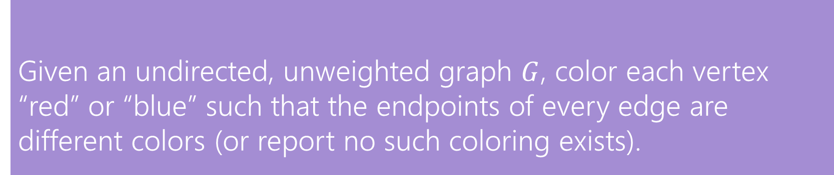
Last Time
We found an algorithm to solve 2-SAT, and said we’d try to reduce 2-Coloring to 2-SAT.
Given: A set of Boolean variables, and a list of requirements, each of the form:
variable1==[True/False] || variable2==[True/False]
Find: A setting of variables to “true” and “false” so that all of the requirements evaluate to “true”
2-Satisfiability (“2-SAT”)
Given an undirected, unweighted graph $G$, color each vertex “red” or “blue” such that the endpoints of every edge are different colors (or report no such coloring exists).
2-Coloring

Slide 6
2-Coloring
Why would we want to 2-color a graph?
We need to divide the vertices into two sets, and edges represent vertices that can’t be together.
You can modify BFS to come up with a 2-coloring (or determine none exists)
This is a good exercise!
But coming up with a whole new idea sounds like work.
And we already came up with that cool 2-SAT algorithm.
Maybe we can be lazy and just use that!
Let’s reduce 2-Coloring to 2-SAT!
Use our 2-SAT algorithm
to solve 2-Coloring

Slide 7
A Reduction
We need to describe 2 steps
1. How to turn a graph for a 2-color problem into an input to 2-SAT
2. How to turn the ANSWER for that 2-SAT input into the answer for the original 2-coloring problem.
How can I describe a two coloring of my graph?
Have a variable for each vertex – is it red?
How do I make sure every edge has different colors? I need one red endpoint and one blue one, so this better be true to have an edge from v1 to v2:
(v1IsRed || v2isRed) && (!v1IsRed || !v2IsRed)

Slide 8
Transform Input
C
(AisRed||BisRed)&&(!AisRed||!BisRed)
(AisRed||DisRed)&&(!AisRed||!DisRed)
(BisRed||CisRed)&&(!BisRed||!CisRed)
(BisRed||EisRed)&&(!BisRed||!EisRed)
(DisRed||EisRed)&&(!DisRed||!EisRed)
B
E
A
D
2-SAT Algorithm
AisRed = True
BisRed = False
CisRed = True
DisRed = False
EisRed = True
Transform Output
B
C
E
A
D

Slide 9
Taking a step back
So far this quarter, we’ve given you a bunch of problems that (with some clever tricks) you can solve really quickly.
To wrap up the quarter, we’re going to talk about problems we don’t know how to solve really quickly.
But first, what do I mean by “quickly”?

Slide 10
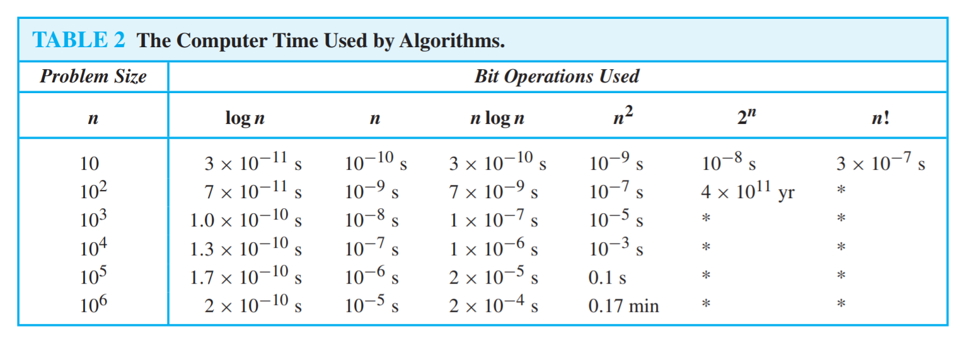
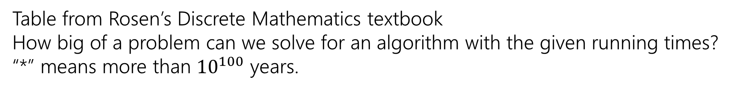
Running Times
Table from Rosen’s Discrete Mathematics textbook How big of a problem can we solve for an algorithm with the given running times?
“*” means more than ${10}^{100}$ years.

Slide 11
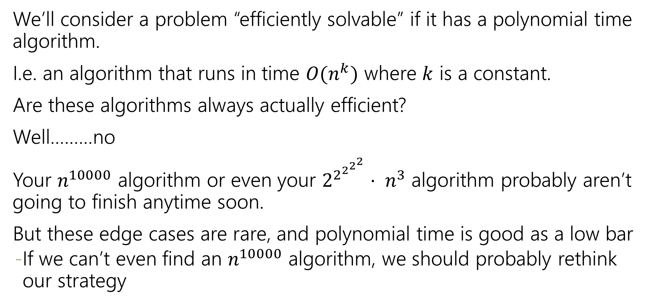
Efficient
We’ll consider a problem “efficiently solvable” if it has a polynomial time algorithm.
I.e. an algorithm that runs in time $O(n^{k})$ where $k$ is a constant.
Are these algorithms always actually efficient?
Well………no
Your $n^{10000}$ algorithm or even your $2^{2^{2^{2^{2}}}}⋅ n^{3}$ algorithm probably aren’t going to finish anytime soon.
But these edge cases are rare, and polynomial time is good as a low bar
If we can’t even find an $n^{10000}$ algorithm, we should probably rethink our strategy

Slide 12
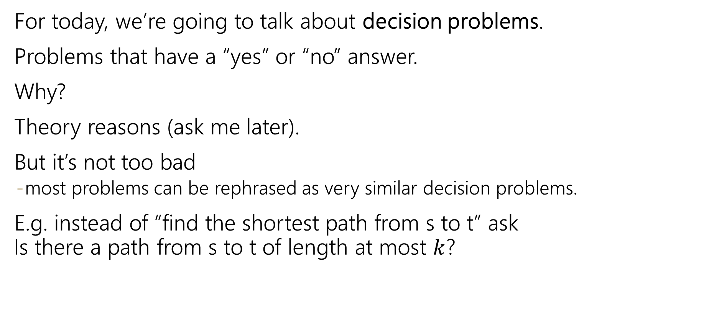
Decision Problems
For today, we’re going to talk about decision problems.
Problems that have a “yes” or “no” answer.
Why?
Theory reasons (ask me later).
But it’s not too bad
most problems can be rephrased as very similar decision problems.
E.g. instead of “find the shortest path from s to t” ask Is there a path from s to t of length at most $k$?

Slide 13
P
The set of all decision problems that have an algorithm that runs in time $O\left(n^{k}\right)$ for some constant $k$.
P (stands for “Polynomial”)
The decision version of all problems we’ve solved in this class are in P.
P is an example of a “complexity class”
A set of problems that can be solved under some limitations (e.g. with some amount of memory or in some amount of time).

Slide 14
I’ll know it when I see it.
Another class of problems we want to talk about.
“I’ll know it when I see it” Problems.
Decision Problems such that:
If the answer is YES, you can prove the answer is yes by
Being given a “proof” or a “certificate”
Verifying that certificate in polynomial time.
What certificate would be convenient for short paths?
The path itself. Easy to check the path is really in the graph and really short.

Slide 15
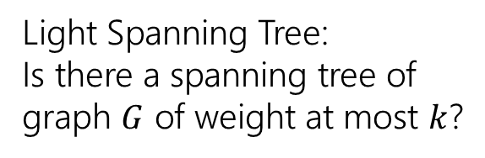
I’ll know it when I see it.
For each of the following problems: what is your “certificate” that the answer is YES, and how do you check it?
Light Spanning Tree:
Is there a spanning tree of graph $G$ of weight at most $k$?
2-Coloring:
Can you color vertices of a graph red and blue so every edge has differently colored endpoints?
2-SAT:
Given a set of variables and a list of requirements:
(variable==[T/F] || variable==[T/F])
Find a setting of the variables to make every requirement true.
The spanning tree itself.
Verify by checking it really connects every vertex and its weight.
The coloring. Verify by checking each edge.
The assignment of variables. Verify by checking each requirement.
If the answer is NO, is there a certificate?
There might be, or there might not be – it’s not required by the definition.

Slide 16
I’ll know it when I see it.
More formally,
It’s a common misconception that NP stands for “not polynomial” Please never ever ever ever say that.
Please.
Every time you do a theoretical computer scientist sheds a single tear.
(That theoretical computer scientist is me)
The set of all decision problems such that if the answer is YES, there is a proof of that which can be verified in polynomial time.
NP (stands for “nondeterministic polynomial”)

Slide 17
P vs. NP
Are P and NP the same complexity class?
That is, can every problem that can be verified in polynomial time also be solved in polynomial time.
P vs. NP
No one knows the answer to this question.
In fact, it’s the biggest open problem in Computer Science.

Slide 18
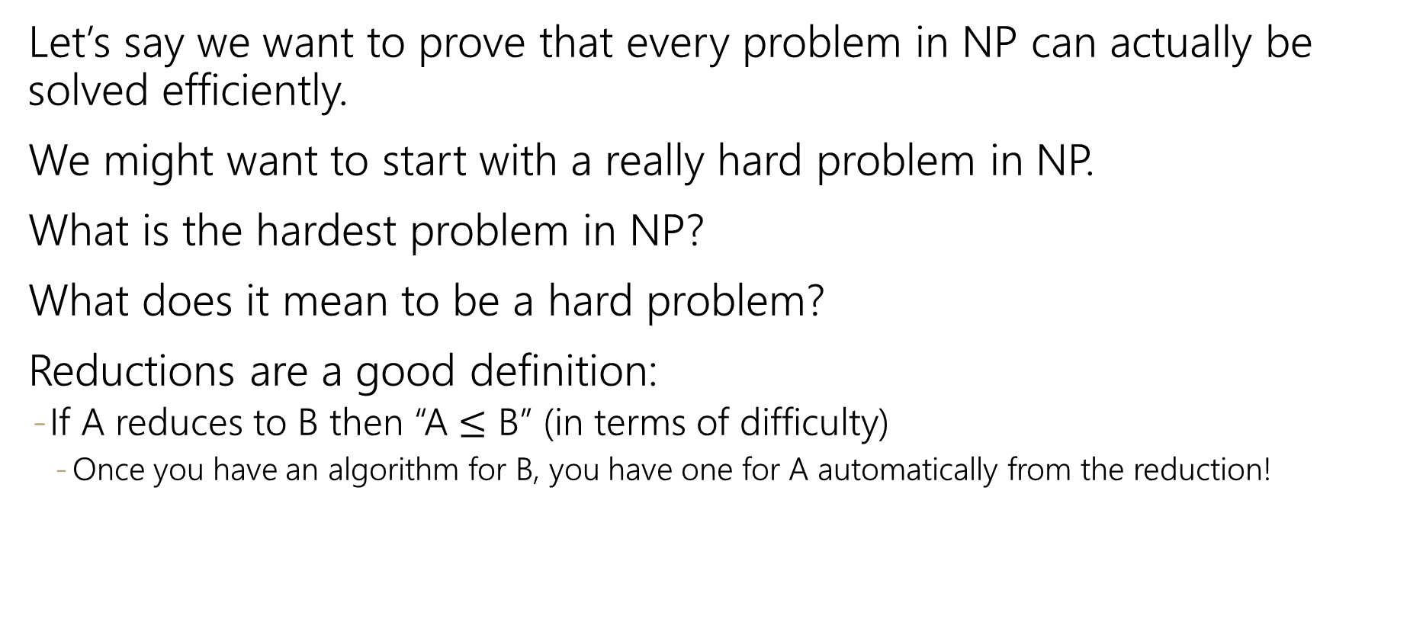
Hard Problems
Let’s say we want to prove that every problem in NP can actually be solved efficiently.
We might want to start with a really hard problem in NP.
What is the hardest problem in NP?
What does it mean to be a hard problem?
Reductions are a good definition:
If A reduces to B then “A $≤$ B” (in terms of difficulty)
Once you have an algorithm for B, you have one for A automatically from the reduction!

Slide 19
NP-Completeness
The problem B is NP-complete if B is in NP and for all problems A in NP, A reduces to B.
NP-complete
An NP-complete problem is a “hardest” problem in NP.
If you have an algorithm to solve an NP-complete problem, you have an algorithm for every problem in NP.
An NP-complete problem is a universal language for encoding “I’ll know it when I see it” problems.
Does one of these exist?

Slide 20
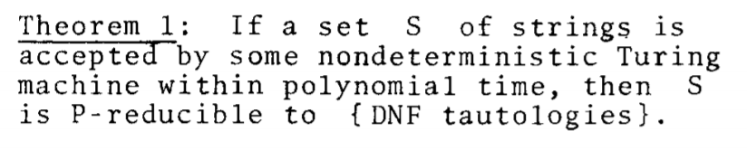
NP-Completeness
An NP-complete problem does exist!
3-SAT is NP-complete
Cook-Levin Theorem (1971)
This sentence (and the proof of it) won Cook the Turing Award.

Slide 21
2-SAT vs. 3-SAT
Given: A set of Boolean variables, and a list of requirements, each of the form:
variable1==[True/False] || variable2==[True/False]
Find: A setting of variables to “true” and “false” so that all of the requirements evaluate to “true”
2-Satisfiability (“2-SAT”)
Given: A set of Boolean variables, and a list of requirements, each of the form:
variable1==[True/False]||variable2==[True/False]||variable3==[True/False]
Find: A setting of variables to “true” and “false” so that all of the requirements evaluate to “true”
3-Satisfiability (“3-SAT”)

Slide 22
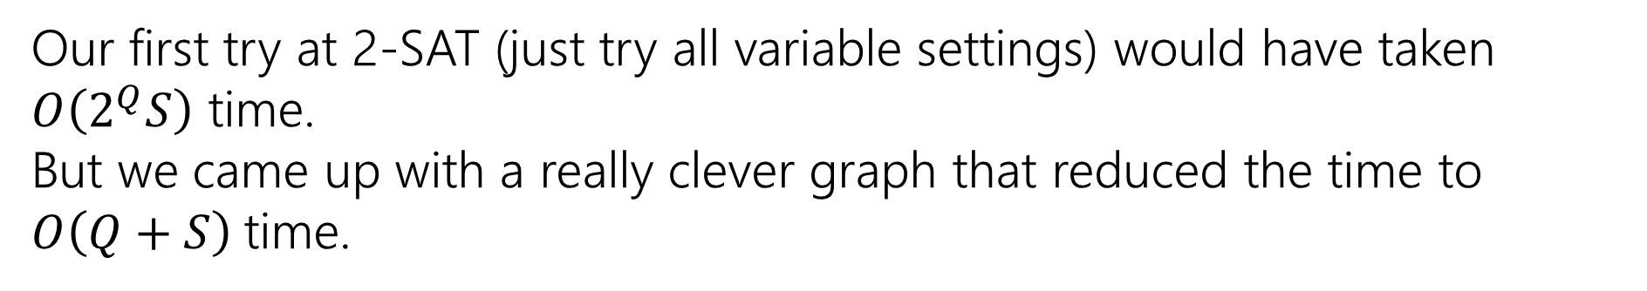
2-SAT vs. 3-SAT
Given: A set of Boolean variables, and a list of requirements, each of the form:
variable1==[True/False] || variable2==[True/False]
Find: A setting of variables to “true” and “false” so that all of the requirements evaluate to “true”
2-Satisfiability (“2-SAT”)
Our first try at 2-SAT (just try all variable settings) would have taken $O\left(2^{Q}S\right)$ time.
But we came up with a really clever graph that reduced the time to $O\left(Q+S\right)$time.

Slide 23
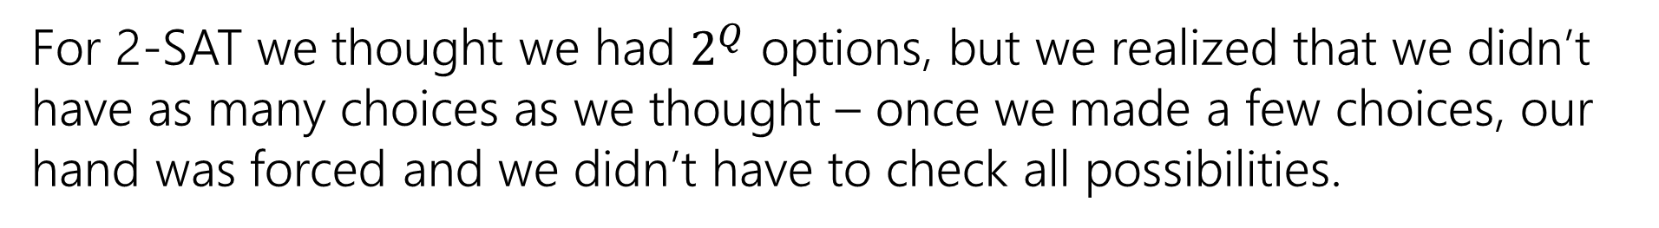
2-SAT vs. 3-SAT
NO Big-O
NO recurrence
Can we do the same for 3-SAT?
For 2-SAT we thought we had $2^{Q}$ options, but we realized that we didn’t have as many choices as we thought – once we made a few choices, our hand was forced and we didn’t have to check all possibilities.
Given: A set of Boolean variables, and a list of requirements, each of the form:
variable1==[True/False]||variable2==[True/False]||variable3==[True/False]
Find: A setting of variables to “true” and “false” so that all of the requirements evaluate to “true”
3-Satisfiability (“3-SAT”)

Slide 24
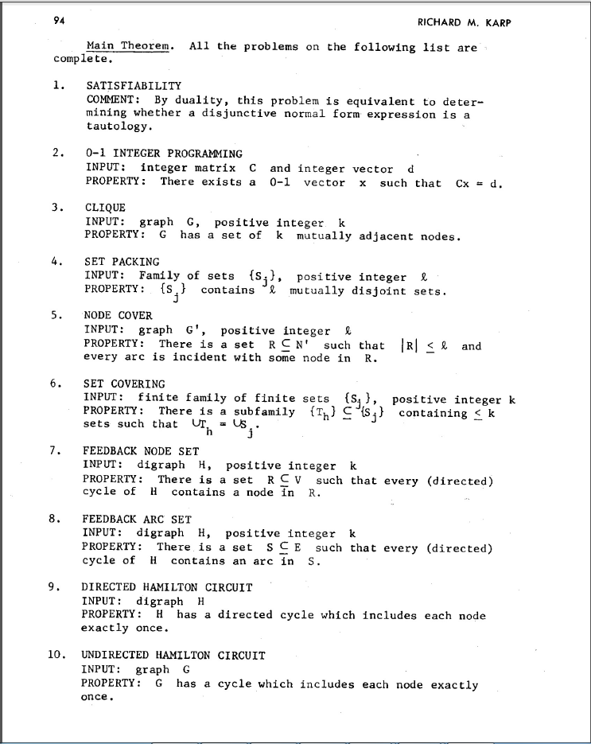
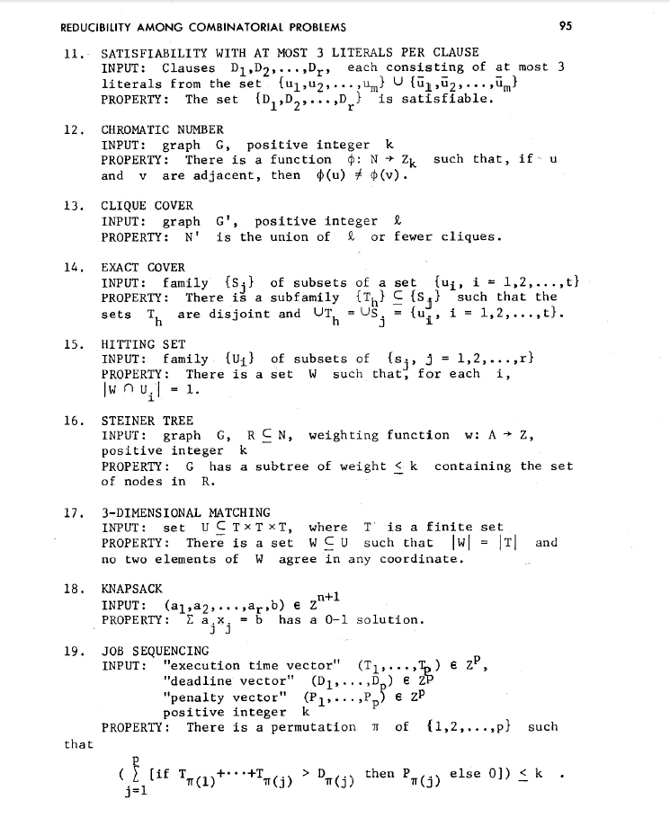
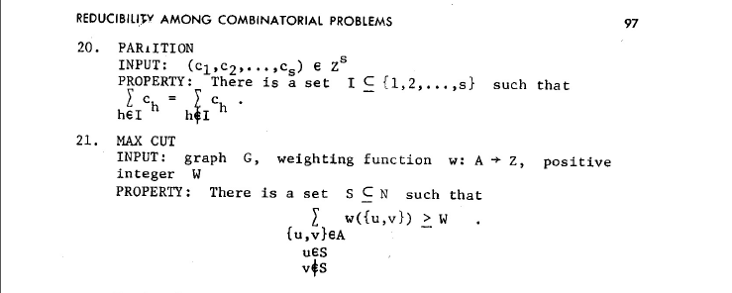
NP-Complete Problems
But Wait! There’s more!
A lot of problems are NP-complete
Karp’s Theorem (1972)

Slide 25
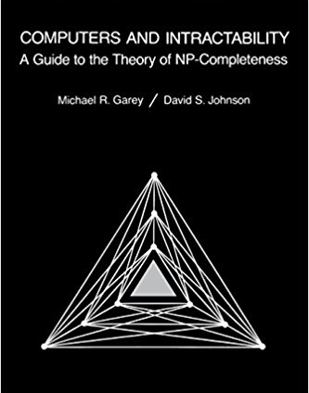
NP-Complete Problems
But Wait! There’s more!
By 1979, at least 300 problems had been proven NP-complete.
Garey and Johnson put a list of all the NP-complete problems they could find in this textbook.
Took almost 100 pages to just list them all.
No one has made a comprehensive list since.

Slide 26
NP-Complete Problems
But Wait! There’s more!
In the last month, mathematicians and computer scientists have put papers on the arXiv claiming to show (at least) 25 more problems are NP-complete.
There are literally thousands of NP-complete problems known.
And some of them look weirdly similar to problems we’ve already studied.

Slide 27
Examples
There are literally thousands of NP-complete problems.
And some of them look weirdly similar to problems we do know efficient algorithms for.
In P
NP-Complete
Given a directed graph, report if there is a path from s to t of length at most $k$.
Short Path
Given a directed graph, report if there is a path from s to t of length at least$k$.
Long Path

Slide 28
Examples
In P
NP-Complete
Given a weighted graph, find a spanning tree (a set of edges that connect all vertices) of weight at most $k$.
Light Spanning Tree
Given a weighted graph, find a tour (a walk that visits every vertex and returns to its start) of weight at most $k$.
Traveling Salesperson
The electric company just needs a greedy algorithm to lay its wires.
Amazon doesn’t know a way to optimally route its delivery trucks.

Slide 29
Dealing with NP-Completeness
Option 1: Maybe it’s a special case we understand
Maybe you don’t need to solve the general problem, just a special case
Option 2: Maybe it’s a special case we don’t understand (yet)
There are algorithms that are known to run quickly on “nice” instances. Maybe your problem has one of those.
One approach: Turn your problem into a SAT instance, find a solver and cross your fingers.

Slide 30
Dealing with NP-Completeness
Option 3: Approximation Algorithms
You might not be able to get an exact answer, but you might be able to get close.
Given a weighted graph, find a tour (a walk that visits every vertex and returns to its start) of minimum weight.
Optimization version of Traveling Salesperson
Algorithm:
Find a minimum spanning tree.
Have the tour follow the visitation order of a DFS of the spanning tree.
Theorem: This tour is at most twice as long as the best one.

Slide 31
Why should you care about P vs. NP
Most computer scientists are convinced that P$≠$NP.
Why should you care about this problem?
It’s your chance for:
$1,000,000. The Clay Mathematics Institute will give $1,000,000 to whoever solves P vs. NP (or any of the 5 remaining problems they listed)
To get a Turing Award

Slide 32
Why should you care about P vs. NP
Most computer scientists are convinced that P$≠$NP.
Why should you care about this problem?
It’s your chance for:
$1,000,000. The Clay Mathematics Institute will give $1,000,000 to whoever solves P vs. NP (or any of the 5 remaining problems they listed)
To get a Turing Award the Turing Award renamed after you.

Slide 33
Why Should You Care if P=NP?
Suppose P=NP.
Specifically that we found a genuinely in-practice efficient algorithm for an NP-complete problem. What would you do?
$1,000,000 from the Clay Math Institute obviously, but what’s next?

Slide 34
Why Should You Care if P=NP?
We found a genuinely in-practice efficient algorithm for an NP-complete problem. What would you do?
Another $5,000,000 from the Clay Math Institute
Put mathematicians out of work.
Decrypt (essentially) all current internet communication.
No more secure online shopping or online banking or online messaging…or online anything.
A world where P=NP is a very very different place from the world we live in now.

Slide 35
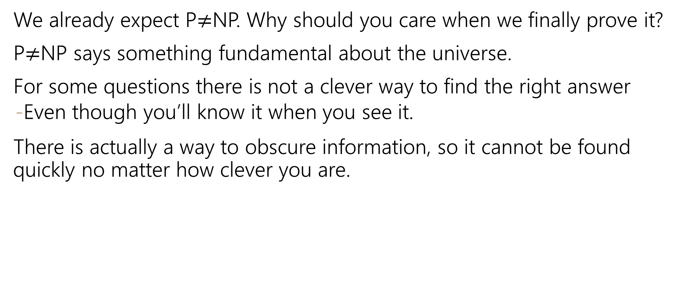
Why Should You Care if P$≠$NP?
We already expect P$≠$NP. Why should you care when we finally prove it?
P$≠$NP says something fundamental about the universe.
For some questions there is not a clever way to find the right answer
Even though you’ll know it when you see it.
There is actually a way to obscure information, so it cannot be found quickly no matter how clever you are.

Slide 36
Why Should You Care if P$≠$NP?
To prove P$≠$NP we need to better understand the differences between problems.
Why do some problems allow easy solutions and others don’t?
What is the structure of these problems?
We don’t care about P vs NP just because it has a huge effect about what the world looks like.
We will learn a lot about computation along the way.

