Slide 1

The College Scorecard ANALYSIS OF THE COSTS OF HIGHER EDUCATION IN US UNIVERSITIES AND THE ROI OVER THE YEARS 2009-2013
SANJEEV SUKUMARAN

Slide 2
Dataset Overview
“College Scorecard” dataset released by the US Department of Education
This dataset was created by matching information from the student financial aid system with federal tax returns for the years 1996 – 2013. (We have focused on the years 2009-2013)
Original dataset “Scorecard.csv” contained over 120,000 rows and 1,731 associated columns.
Dataset broadly covers the following –
Root (OPEID, Unit ID)
School Info (Demographics)
Academics (Degree info)
Admissions (SAT/ACT scores, Adm rates)
Costs (Tuition etc.)
Student Body (Count, Ethnic Diversity)
Financial Aid (PELL, Federal)
College Completion (for first-time, full time students)
Outcomes for Title IV Students (NSLDS Completion and Transfer Rates)
Earnings (Mean, Median Incomes)
Repayment (Cohort Default Rate, Federal Loan Repayment)

Slide 3
Importance of College Scorecard
Average Tuition costs in US far exceed median family incomes
Current Undergraduate and Graduate students are taking on huge student debt by the time they complete their education
A top ranked college with high cost of attendance need not provide the best ROI
Students need to make smarter choices in College selection, they need to balance –
Cost
Financial Aid
Prospects of Gainful future employment
College Scorecard aims to facilitate this decision making process by providing relevant statistics
Tools used: R, SPSS Statistics

Slide 4
Exploratory Results Institutes with Highest Median Salaries and Best ROI
Median Earnings in USD | Institution Name
91600 | Massachusetts Institute of Technology
87200 | Harvard University
82800 | Stevens Institute of Technology
81700 | Rensselaer Polytechnic Institute
80900 | Stanford University
78900 | Rose-Hulman Institute of Technology
78600 | Harvey Mudd College
78200 | University Of Pennsylvania
77600 | Worcester Polytechnic Institute
77600 | Washington and lee University
ROI | Institution Name
3.87 | SUNY Maritime College
3.74 | Georgia Institute of Technology – Main Campus
3.58 | Brigham Young University - Provo
3.52 | University of Colorado Denver
3.09 | Missouri University of Science and Technology
2.97 | Colorado School of Mines
2.95 | Stony Brook University
2.92 | SUNY at Binghamton
2.88 | George Mason University
2.84 | California Polytechnic State University- San Luis

Slide 5
Exploratory Results Institutes with Lowest Admission Rates and Highest Costs
Admission Rates | Institution Name
0.0569 | Stanford University
0.0584 | Harvard University
0.0705 | Yale University
0.0741 | Princeton University
0.0742 | Columbia University (NY)
0.0774 | Cooper Union (Science and Arts)
0.0815 | Massachusetts Institute of Technology
0.0918 | Brown University
0.0978 | Dartmouth College
0.1055 | California Institute of Technology
Average Cost in USD per year | Institution Name
62594 | Washington University in St. Louis
61540 | Columbia University (NY)
61398 | Dartmouth College
60729 | Northwestern University
60613 | Harvey Mudd College
60065 | Claremont McKenna College
60059 | New York University
59890 | Vanderbilt University
59865 | Trinity College
59787 | University of Southern California

Slide 6
Exploratory Results Mid SAT scores for Critical Reading and Math
SAT VR | Institution Name
760 | California Institute of Technology
750 | Yale University
750 | Harvard University
750 | Princeton University
740 | Vanderbilt University
735 | Columbia University (NY)
730 | Washington University in St. Louis
730 | Stanford University
725 | Pomona College
725 | Northwestern University
SAT MATH | Institution Name
785 | California Institute of Technology
775 | Massachusetts Institute of Technology
764 | Franklin W. Olin College of Engineering
760 | Harvey Mudd College
755 | Harvard University
755 | Washington University in St. Louis
755 | Princeton University
750 | Yale University
750 | Vanderbilt University
745 | Northwestern University

Slide 7
Exploratory Results Most Popular Fields of Study and States with most colleges
Popularity | Fields of Study
16.63 | Health professions
15.40 | Business
13.51 | Liberal Arts and Sciences
4.60 | Social Sciences
3.91 | Education
3.60 | Psychology
3.06 | Computer Services
3.03 | Biological and Biomedical Sciences
2.63 | Communications
2.57 | Engineering
Count | State
47 | California
35 | Pennsylvania
35 | Texas
32 | New York
23 | Ohio
21 | Michigan
17 | Massachusetts
16 | Florida
16 | Virginia
14 | Indiana

Slide 8
Does the ROI depend upon the location?
Challenges
Our dataset didn’t contain any information regarding the nature of the University location (Rural or Urban). Hence we took the help of SAS in-built dataset to know whether a particular zipcode has MSA or not. If a zip code has MSA, it belongs to urban region else rural region.
Approach
We conducted t-test to check whether the nature of location matters in the return of investment of a particular university
Results
p-value < 2.2e-16 , Mean of ROI in case of Rural: 2.06
Mean of ROI in case of Urban: 1.75
Conclusion
Hence location does matter in the return of investment, with Universities in rural areas having better ROI than urban

Slide 9
K-Means Cluster Analysis
Motive-To identify the types of US engineering colleges
Clustering Algorithm used-K Means
Data Preparation
Only those colleges were considered which offered predominantly bachelors degree and offers engineering degree and year 2011 was considered, because data was most complete for 2011.
All the null values were removed.
Data was then normalized using min-max transformation.
Data was then submitted into cluster analysis.
Challenges: Our file consisted of data for 10 years, and each of the dataset consisted of 100s of variable. Hence we had to identify the set of variables which will help us identify our clusters efficiently. We utilized RSQLlite package to filter out variable and year.

Slide 10
Variables considered for Cluster Analysis

Slide 11
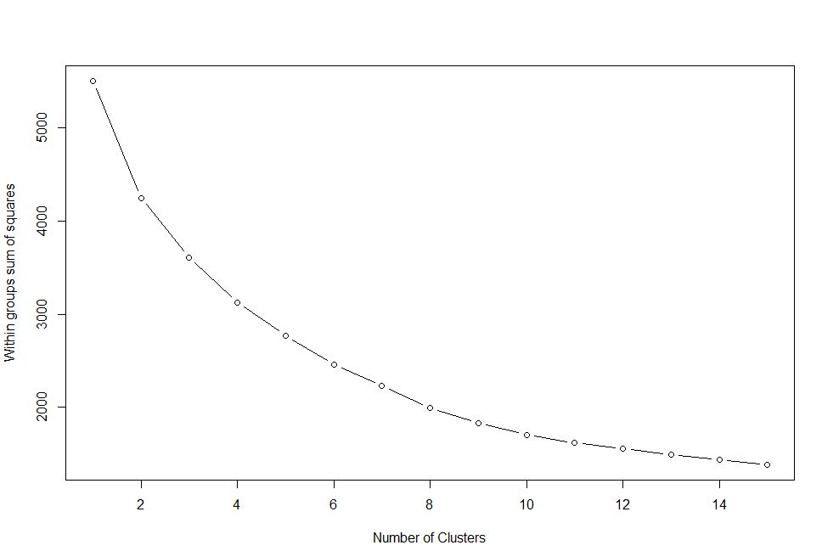
SCREE PLOT

Slide 12
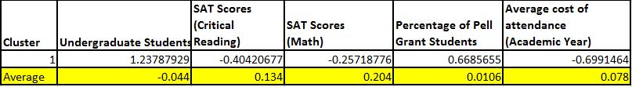
Cluster Analysis Results – Cluster 1
Cluster 1:
1. Large number of students
2. Lower SAT requirement
3. Ethnically diverse
4. Easier to get grants (Federal Loan / Pell Grants)
5. Lower cost of attendance
Example: UTD, UIC, ARIZONA STATE UNIVERSITY

Slide 13

Cluster Analysis Results – Cluster 2
Cluster 2:
Relatively easier to get into (high admission rate)
Low grants
Ethnically less diverse
EXAMPLE: University of Alabama at Huntsville
Florida State University

Slide 14
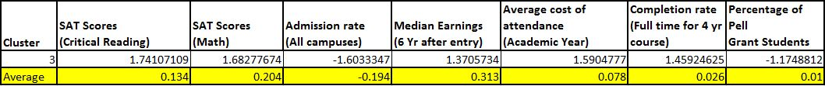
Cluster Analysis Results – Cluster 3
Cluster 3:
1. High SAT requirement
2. Low admission rate
3. Great salary
4. High dropout rate
5. Very expensive
6. Lowest number of grants
Example: MIT, UNIVERSITY OF CALIFORNIA BERKLEY

Slide 15
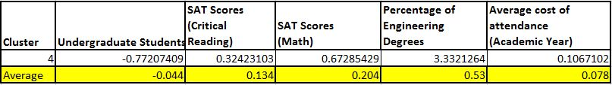
Cluster Analysis Results – Cluster 4
Cluster 4:
1. Very few students
2. High SAT requirements
3. Most of the courses are engineering based (very few health related)
4. Mostly known for a particular branch of engineering.
Example: Embry-Riddle Aeronautical University-Prescott
Colorado School of Mines

Slide 16
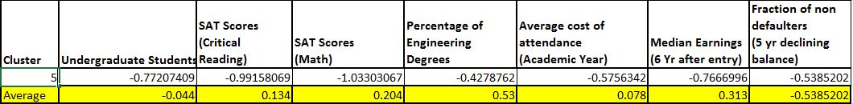
Cluster Analysis Results – Cluster 5
Cluster 5:
1. Less ethnically diverse (Mostly minorities)
2. Fewer engineering related courses
3. Very low SAT requirement and low fee
4. High number of grants
5. Low median income and lowest fraction of non-defaulters
EXAMPLE: Virginia State University, Johnson C Smith University

Slide 17
Earning prospects for Students – Significant factors
We wish to identify the significant factors which may influence future earning prospects for the student.
Challenges:
Variables concerning Income stats include Median, Mean and Threshold (% over 25k) figures 6,7,8,9 and 10 years after college. Also, these variables each contained between 7k to 12k values (i.e. approximately just 20% - 30% of total dataset)
Approach:
We chose Median Income (6 years) as our target variable since it contained the maximum non-zero values (12111 records) and Mean values were at the risk of being affected by outliers. We ran Stepwise Linear Regression on these records (All inclusive and separately as per Institution Control type – Public / Private for Non profit / Private for Profit)
All School and Academics info like Ownership types and Degrees offered were recoded to Flag variables.

Slide 18
Median Income: Linear Regression Results
Stepwise Linear Regression Model Median Earnings | Standardized coefficients: Beta
 | All Institutes (n= 12111) | Public Institutes (n= 3886) | Private - Non Profit (n= 2941) | Private - For Profit (n= 5284)
Adjusted R Square -> | 0.525 | 0.629 | 0.516 | 0.909
ACT Score Math (Mid Point) | 0.658 | 0.85 | 0.751 | 0.788
ACT Score English (Mid Point) | -0.694 | -0.978 | -0.697
Highest Degree: Bachelor's | -0.184 |  | -0.217 | -0.273
Average Cost of Attendance | 0.148 |  | 0.104 | -0.277
Average SAT Score | 0.736 | 0.837
SAT Critical Reading (Mid) | -0.575 |  | -0.506
SAT Score Math (Mid) | 0.647 |  | 0.897
Highest Degree: Certification | 0.113
Private Non-Profit Institute | 0.1
Degree Certification | -0.07 |  | 0.075
ACT Cumulative score (Mid) | -0.316
ACT Scores for Math and English are significant although English scores have a negative correlation
In Public Institutions, Average SAT scores are also highly significant and SAT Critical Reading and Math scores are highly significant in Private non profit institutions
In Both above cases:
Better scores-> Better University -> Better Income prospects
p<0.001 ***
p<0.01 **
p<0.05 *

