Slide 1
Websites For Python Learning & Practice

Slide 2
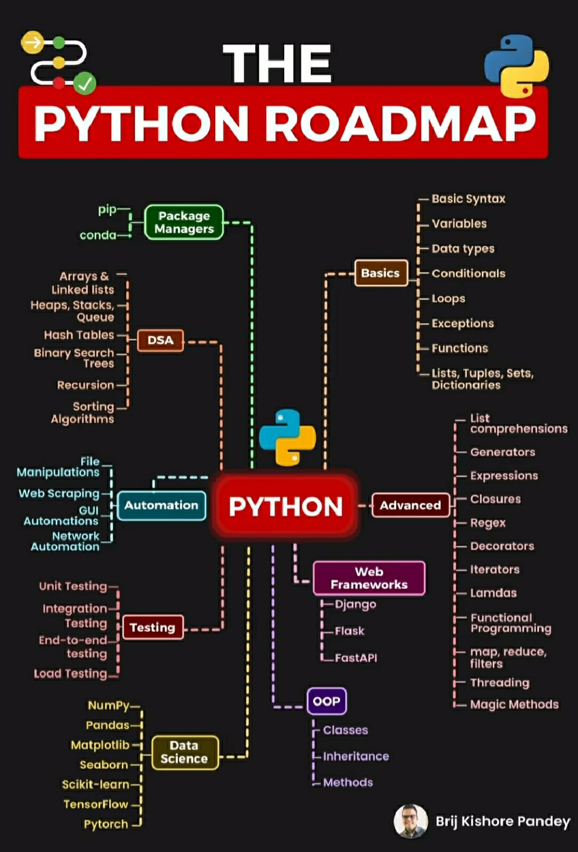
Python Roadmap For Topic Wise Learning You Can Follow This road Map

Slide 3

Python : W3school
Tutorial :- https://www.w3schools.com/python/
Pandas :- https://www.w3schools.com/python/pandas/default.asp
Numpy :- https://www.w3schools.com/python/numpy/default.asp
FileHandling :https://www.w3schools.com/python/python_file_handling.asp

Slide 4
Durga Sir Python Course - In English
I Have Attached (Durga Sir Notes) PDF Python Beginner To Advanced
Course
Video Tutorial : Total Videos (87)
https://youtube.com/playlist?list=PL6X5MDnC9oqOrCtwCxo3VsVMbLpNW7SkK&si=u_gsXANaXHNjudEg
Or you can search on youtube by typing
Learn Python Programming Tutorial Online Training by Durga Sir

Slide 5
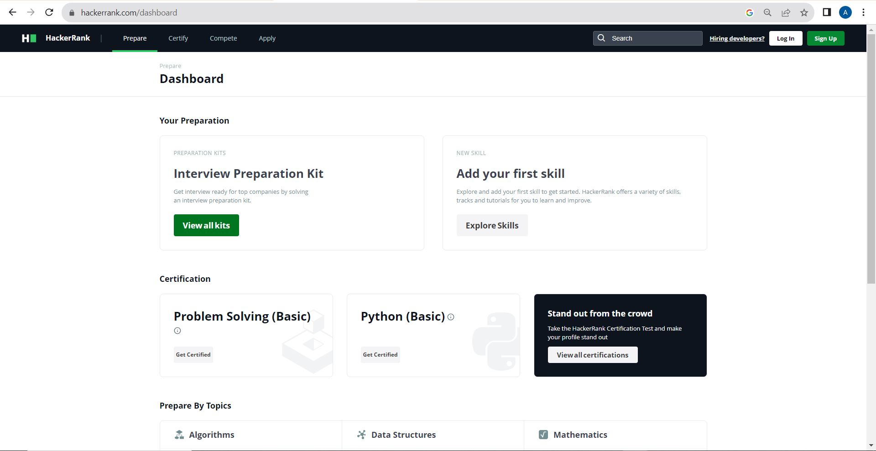
Hacker Rank
For Coding Practice Create One DeveloperPractice Account On Hacker
Rank.
Link :- https://www.hackerrank.com/

Slide 6
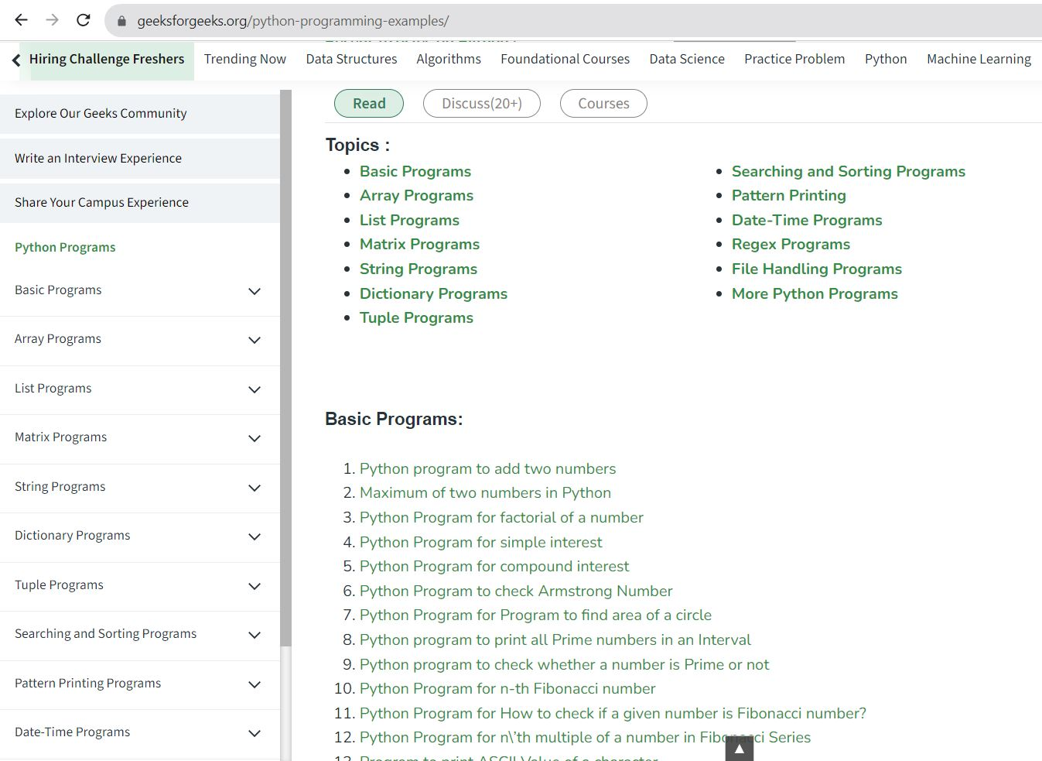
Best Python Programming Example (Topic Wise)
https://www.geeksforgeeks.org/python-programming-examples/

Slide 7
GeeksForGeeks
Python Tutorial : https://www.geeksforgeeks.org/python-programming-language/
Python Exercises, Practice Questions and Solutions : https://www.geeksforgeeks.org/python-exercises-practice-questions-and-solutions/

Slide 8
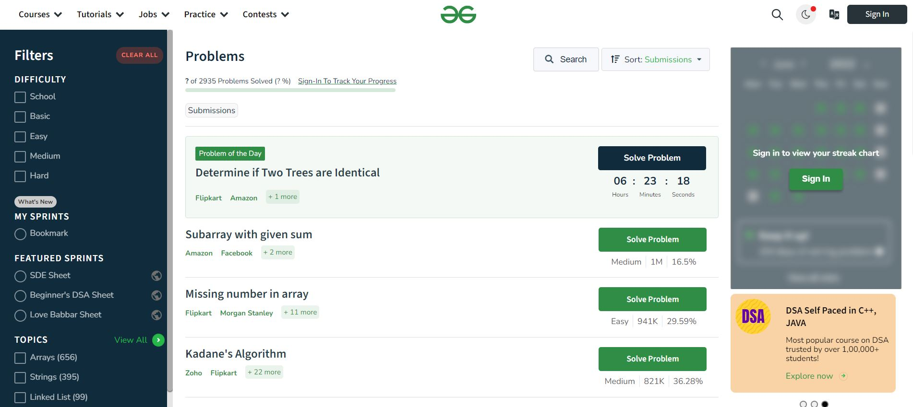
Create Practice Account On GFG
https://www.geeksforgeeks.org/explore?page=1&sortBy=submissions&itm_source=geeksforgeeks&itm_medium=main_header&itm_campaign=practice_header

Slide 9
Leet Code
Blind 75 Leetcode problems
https://leetcode.com/discuss/general-discussion/460599/blind-75-leetcode-questions
Neet Code roadmap(150+) with video Solutions
https://neetcode.io/roadmap

