Slide 1



Personalized Text Normalization of Clinical Notes
CS733: Team 12
Sanjeeva Reddy Dodlapati
Mohammad Shiri
Notes:
Hello, we are team 12 consist of me, Mohammad, and Sanjeev. And I want to present you our research project on Personalized Text Normalization of Clinical Notes.

Slide 2
Text Normalization
Text normalization is a process of standardizing the text by replacing non-standard words or removing irrelevant components.
Before | After
A baby giraffe is 6ft tall and weighs 150 lbs | A baby giraffe is six feet tall and weighs one hundred fifty pounds
I live at 123 King Ave | I live at one two three King Ave
This looks cooooooooollllll | This looks cool
UNDP helps reducing poverty | United Nations Development Program helps helps reducing poverty
Measurement shows 2 mA current | Measurement shows two milliamperes current
Notes:
First lets see what is text normalization?
Text normalization is the process of standardizing the text by replacing non-standard words with standard words and removing irrelevant components. This process reduces randomness in the information and improves efficiency of downstream applications such as information retrieval, text to speech and machine translation.
In the table you can see some example of our targeted challenge. The left side entries are clinical notes including medical abbreviations and the right side entries are the notes with expanded abbreviations.

Slide 3
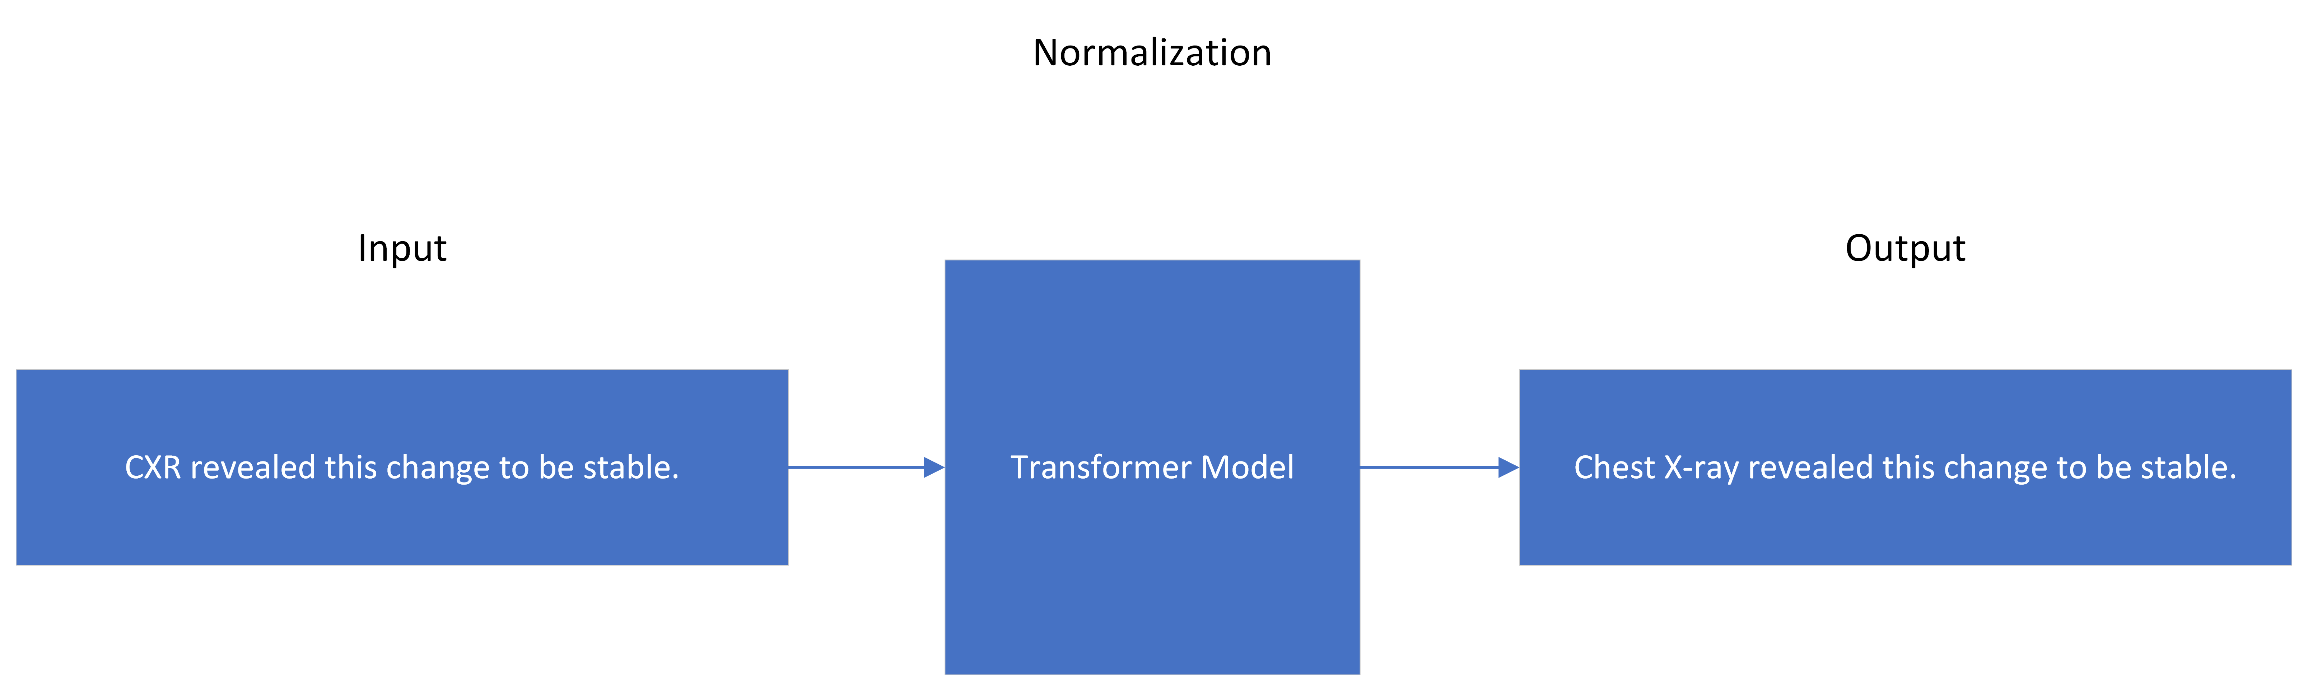
Proposed Scheme
Text normalization is a process of standardizing the text.
Notes:
Here is the proposed scheme for text normalization which you give input of clinical note including medical abbreviation to a transformer based model and it outputs the note containing expanded abbreviations.

Slide 4
Personalized Text Normalization
Personalized text normalization is a process where text is standardized differently for different users.
For example, if the user is a doctor or nurse only some of the acronyms to be replace because they have substantial medical knowledge to understand them.
On the other hand, non-medical background persons may require all the acronyms to be expanded so that they can understand their health records.
Notes:
But in this project we wanted to do personalized text normalization for different users such as non-medical people, nurses and doctors.
For example, if the user is a non-medical person we decide to replace all the acronyms understand their health records but for nurses only some of the acronyms need to be replace because they have substantial medical knowledge to understand them. And doctors may even need much fewer replacements.

Slide 5
Related Work
Deep learning-based methods to tackle text normalization
Treated text normalization problem as a machine translation task
Personalized text normalization has not been widely explored
AsiaSpic: probabilistic method to support the use of user-defined short-forms in a multilingual chat system by exploiting a personalized dictionary for each user to support user-defined short-forms.

Slide 6
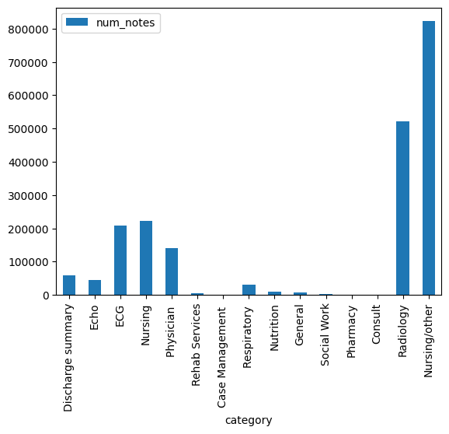
The Data: Acquisition and description
MIMIC-III Data (used as train and validation set)
Clinical notes of different categories (e.g. discharge summary notes)
From forty thousand patients in critical care units
n2c2(track-2) NLP Research Data (used as test set):
Clinical notes of medication and discharge notes
From multiple visits of thousands of patients
Two dictionaries of medical terminology abbreviations
Notes:
MIMIC dataset contains different categories of notes such as notes by nurses, notes about lab test results, scanning reports, and discharge notes etc. Combined different category of notes there are approximately 2.5 million notes in the dataset. Due to constraints of resources and time, we have preprocessed discharge summary notes and prepared label sentences in which medical terminology abbreviations are expanded.

Slide 7
Data Preprocess
Removed unnecessary information in text (e.g. date)
Replaced abbreviations with their meaning from terminology dictionary(a.c. --> before meals)
Labeled for three personalized users; non-medical, nurses, doctors
Sequences with around 500 word long
Screenshot of preprocessed personalized input and output examples of clinical notes
Notes:
he data preprocessing is performed on the texts extracted from MIMIC dataset. First, we removed unnecessary information inside the texts including dates, repetitive titles, hospital ids, new lines, numbering, uninformative symbols and punctuation. This along with replacing meaningful words make the text easier and more readable for the model to not get deviated from capturing targeted insight from input text. The text is collection of many notes assigned to patients so we extracted sentences from them.
We combined two dictionaries of medical terminology abbreviations with their meaning to prepare labeled input data by replacing abbreviations in the sentences. Whole dictionary is used to replace abbreviations for non-medical users, while 60% and 36% of it used for nurses and and doctors, respectively which the latter is a subset of the former. Each row of prepared input data consists of around 500 words long sequence of sentences in two columns, without and with replacement of abbreviations. Each of these records have three replicates to show replacements for the three personalized categories by including the name of category at the begining of sequence in double quotation marks. So the final preprocessed input file is consist of about 60 thousends records.

Slide 8

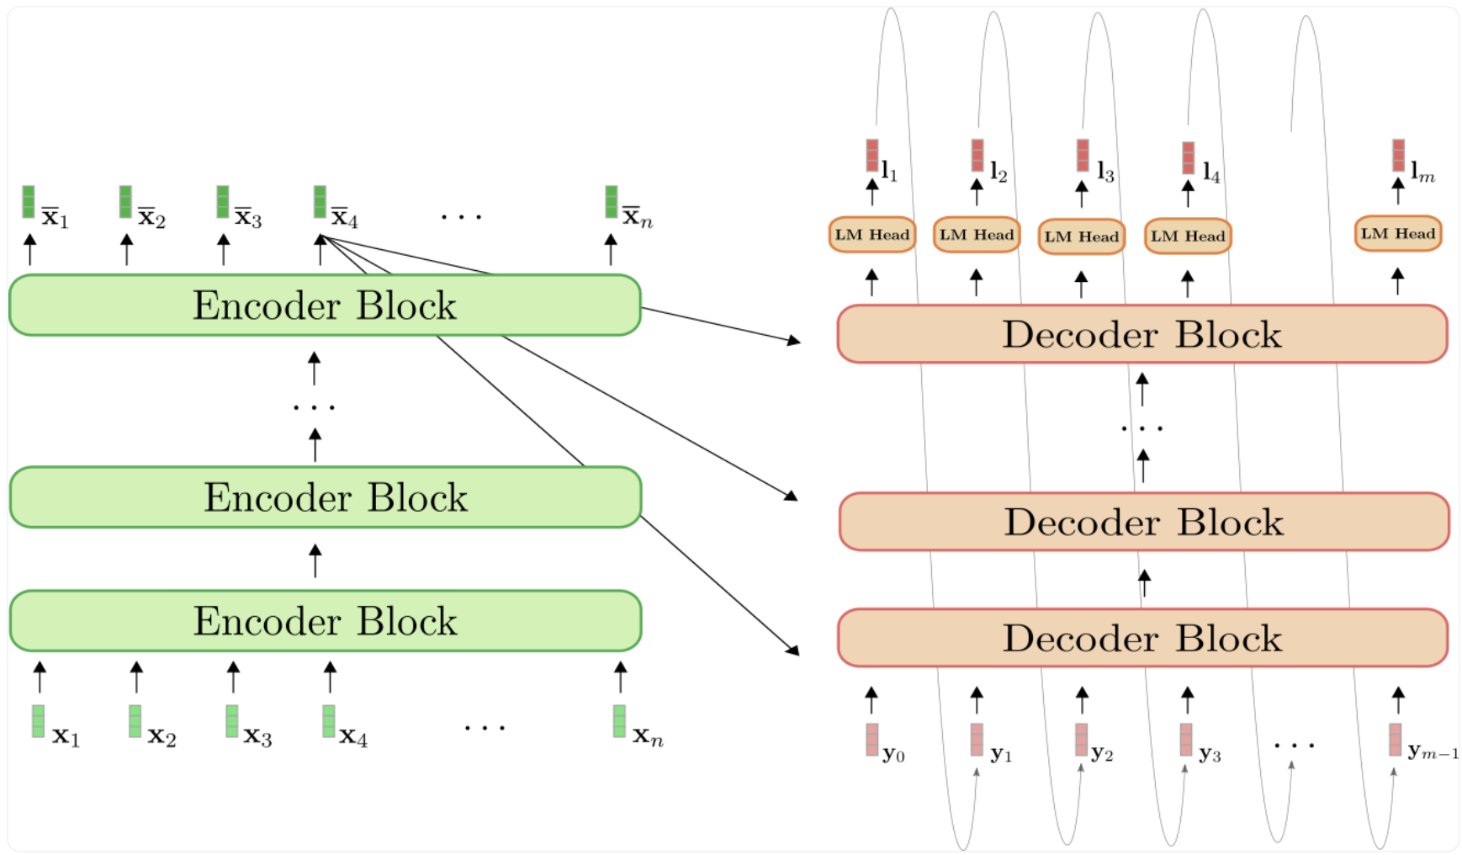
Model Architecture
Built a Bert2bert Encoder-Decoder
Both the encoder and decoder are initiated with the weights of ClinicalBERT, which is pretrained on MIMIC-III data
Even though some existing studies suggest that GPT3 decoder performs better than bert decoder, we have chosen ClinicalBERT to avoid pretraining GPT3 from scratch
Inputs are the sentences that contain abbreviations (acronyms)
Labels are the sentences with the expanded abbreviations
Encoder-Decoder model architecture of Clinical-text-Norm-BERT

Slide 9
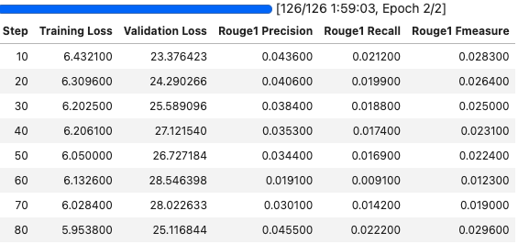
Model Training & Evaluation
Figure on the right shows training progress on a small dataset
ROUGE metrics are a set of metrics to calculate unigram, or bigram or multi-gram metrics
On larger dataset (5%), maximum ROUGE-1 (unigram) precision 30%
Recall and F1 score are hovering around 10%
Training metrics on small dataset

Slide 10
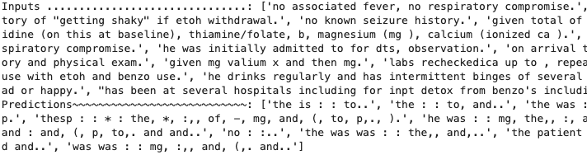
Model Training & Evaluation continued…
Model is paying more attention to punctuation and special characters like backslash, parenthesis, star symbol
Higher length penalty encourages model to generate longer sentences
Screenshot of input sentences to the model and predicted sentences generated by the model

Slide 11

Discussion
Model performance is not up to our satisfaction. Much needs to be improved
The probable reasons for the model unable to learn quickly:
Due to time and resource constrains model trained on just 5% of the data available
Data preprocessing was a very challenging task and further cleanup needed.
Predicting whole sentence instead of just abbreviation expansion.
Hyperparameters like learning rate and weight decay used are default setting. Needs to find optimal settings.

Slide 12
Future work
Further clean up of the input data is required to remove leftover special characters
Training model on larger dataset. May take several days to train on cluster with gpu resources.
Normalizing all the terms including fractions, numbers, medical codes, and acronyms
Finding optimal hyper-parameters

Slide 13
Conclusion
For the first time, we have attempted to implement personalized text normalization on electronic health records.
We have collected the clinical notes from two different databases and annotated with labels for personalized text normalization.
We have built encoder-decoder architecture initialized from ClinicalBERT model.
Trained the proposed model on 5% of the 2.5 million notes to achieve 30% of ROUGE-1 precision.
Further experiments to improve model training are underway and the results will be updated in the near future.

Slide 14

Thank you for your kind attention!
If you have any questions or comments, we would be happy to receive them by:
mshir001@odu.edu
sdodlapa@odu.edu
Code is made available at: https://github.com/SanjeevaRDodlapati/Clinical-Text-Norm-BERT

