Slide 1
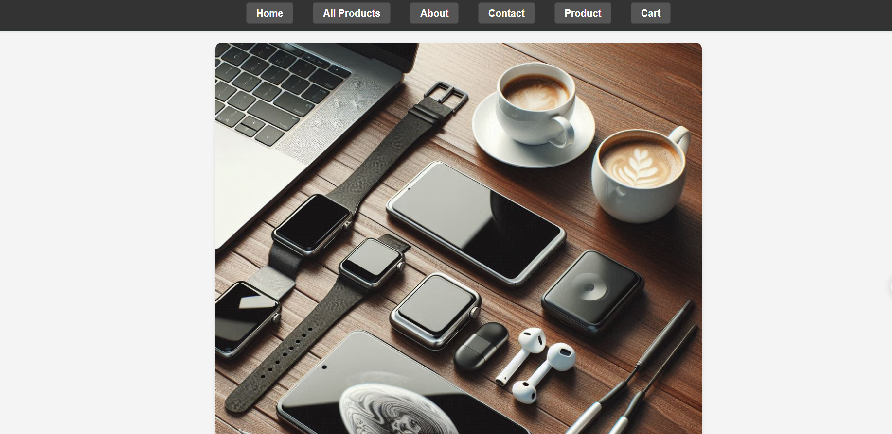

Slide 2
The above page is the beginning page of the website “Electromart” I have made using HTML, CSS, Javascript.
It has the following features
Home
All products
About
Contact
Product
Cart
Home is to welcome people to our website “Electromart”, with a carousel and a section of recommended products of our website.

Slide 3
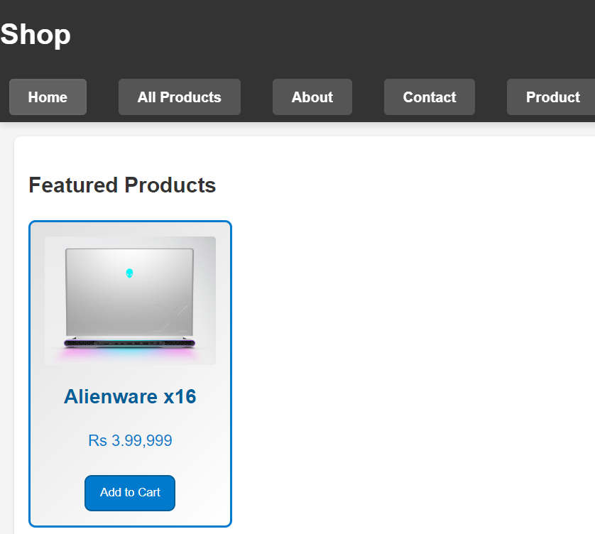
The home page also has an contact us function.
Next we have the “All products” page which on clicking would take us to a page of all products showing all the available electronics and accessories.
There is a hovering feature available on all the products.
The products page first shows the featured product in that category.

Slide 4

Then there are the options to select the category of the product, price filter and a popularity filter.
Then comes the products, there are about 20 products, and you can arrange in according to category or price or popularity.
On clicking on any of the products you can see its picture, name of the product, price, a small description of it and an option to buy it now and option to add to cart.

Slide 5
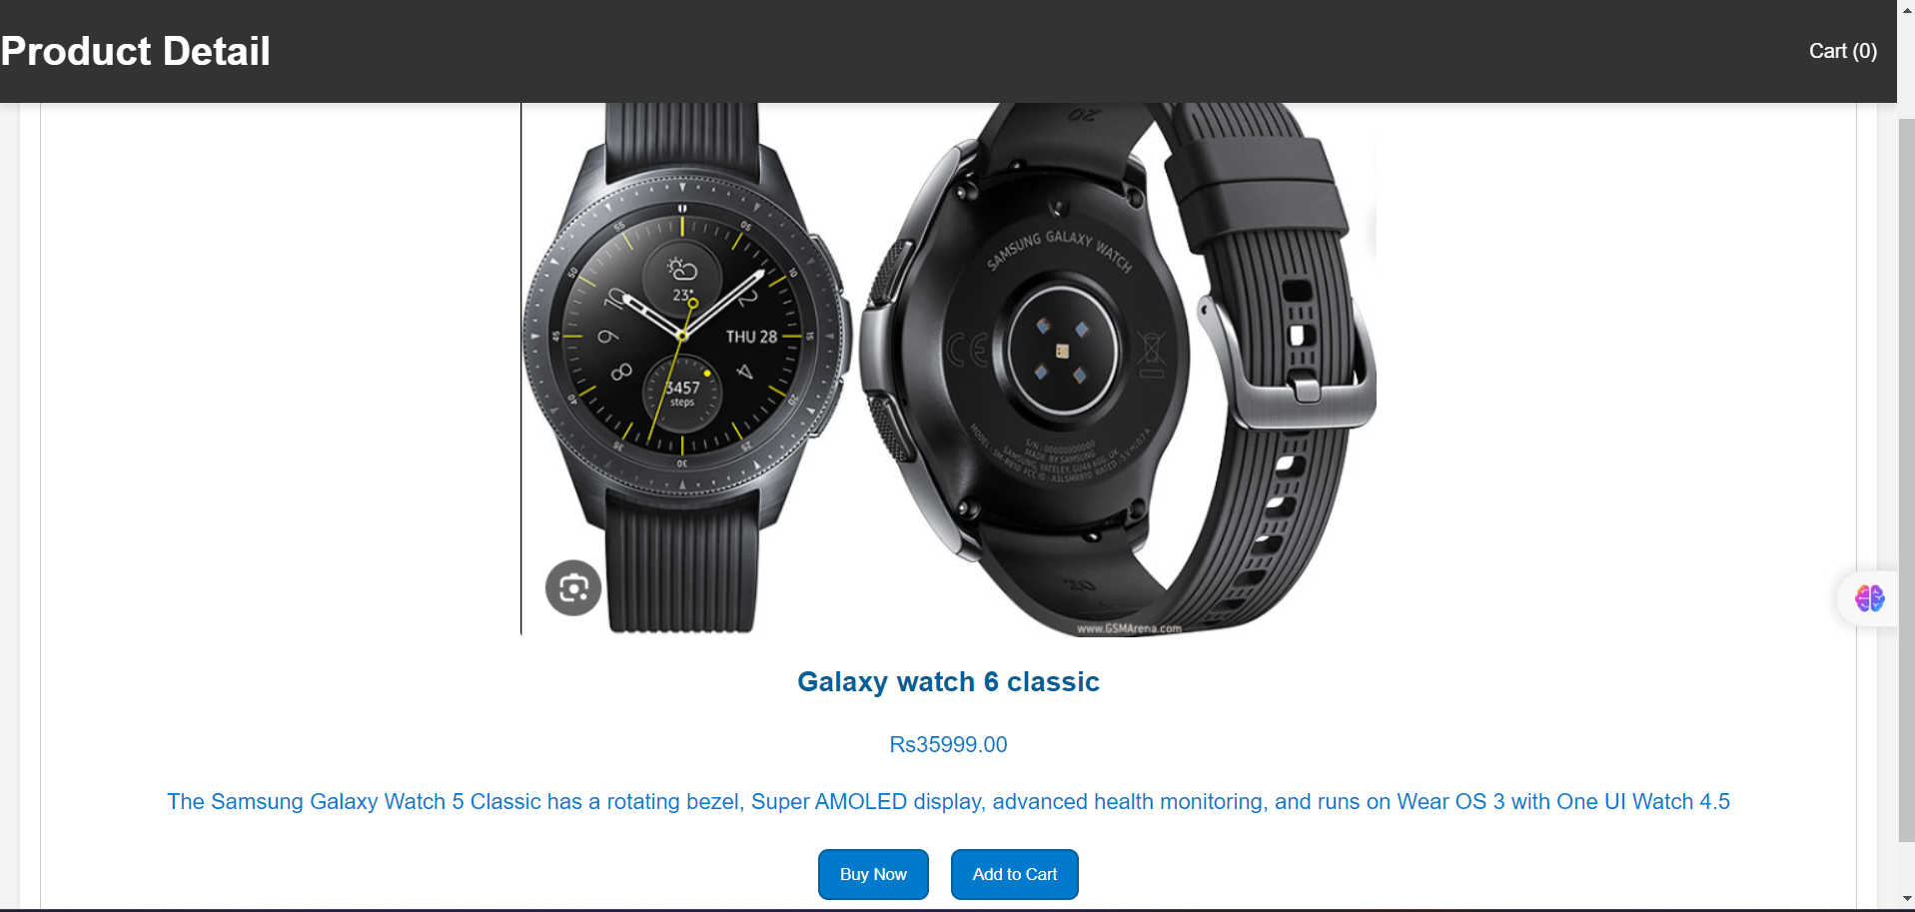

Slide 6
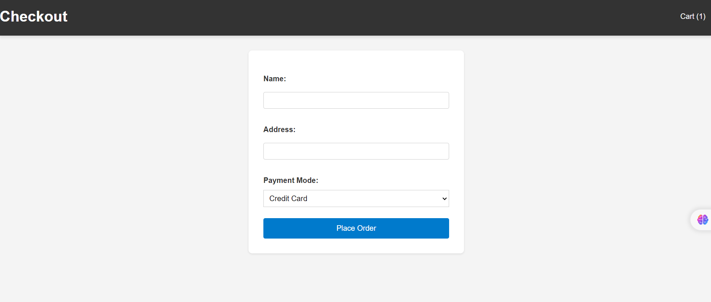
Then on adding the product to cart, there is an option to checkout where you have to give name, address and mode of payment and on clicking ok you will be back to home page.

Slide 7
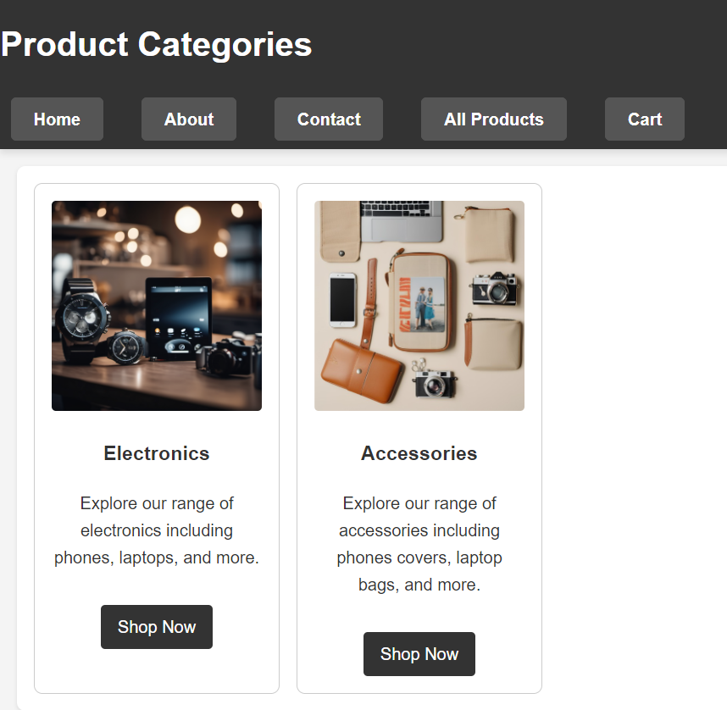
Then there is an about page, which gives all the information about the company.
Then there is a contact us page which helps the customers to send their queries or requests
Then there is product page that gives you two options to choose from, electronics and accessories

Slide 8
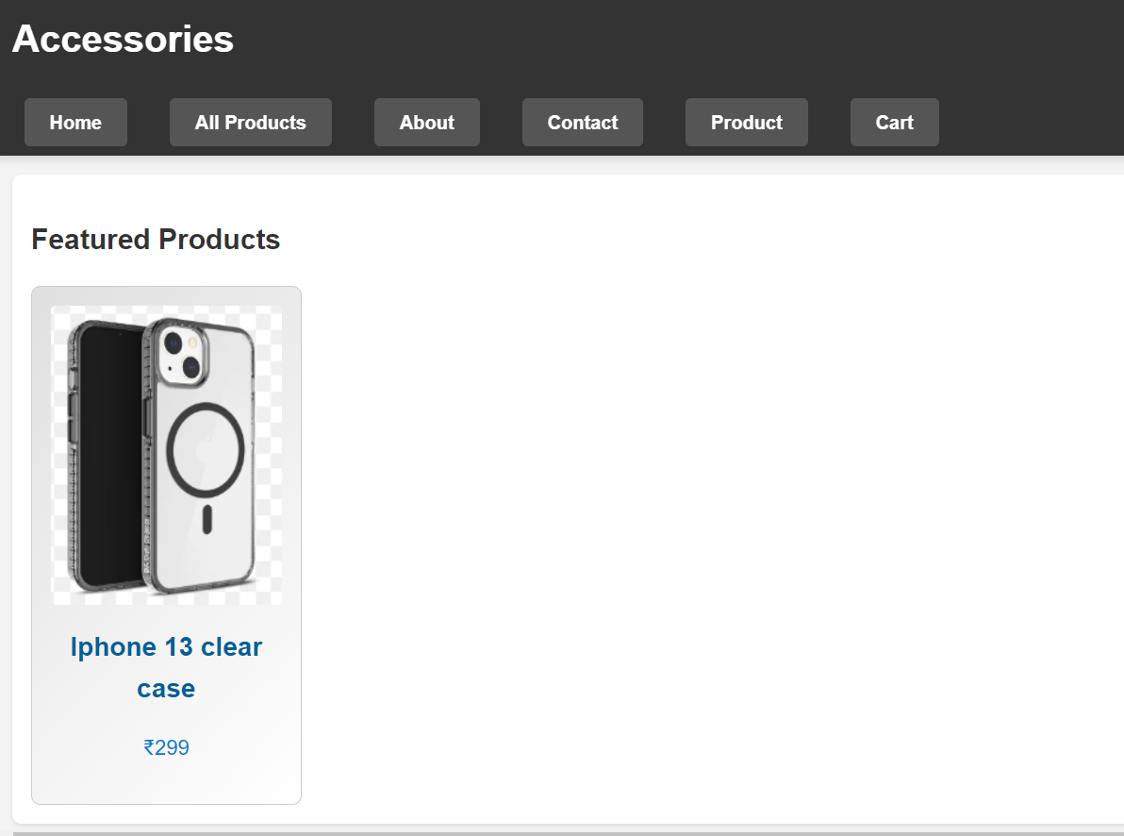
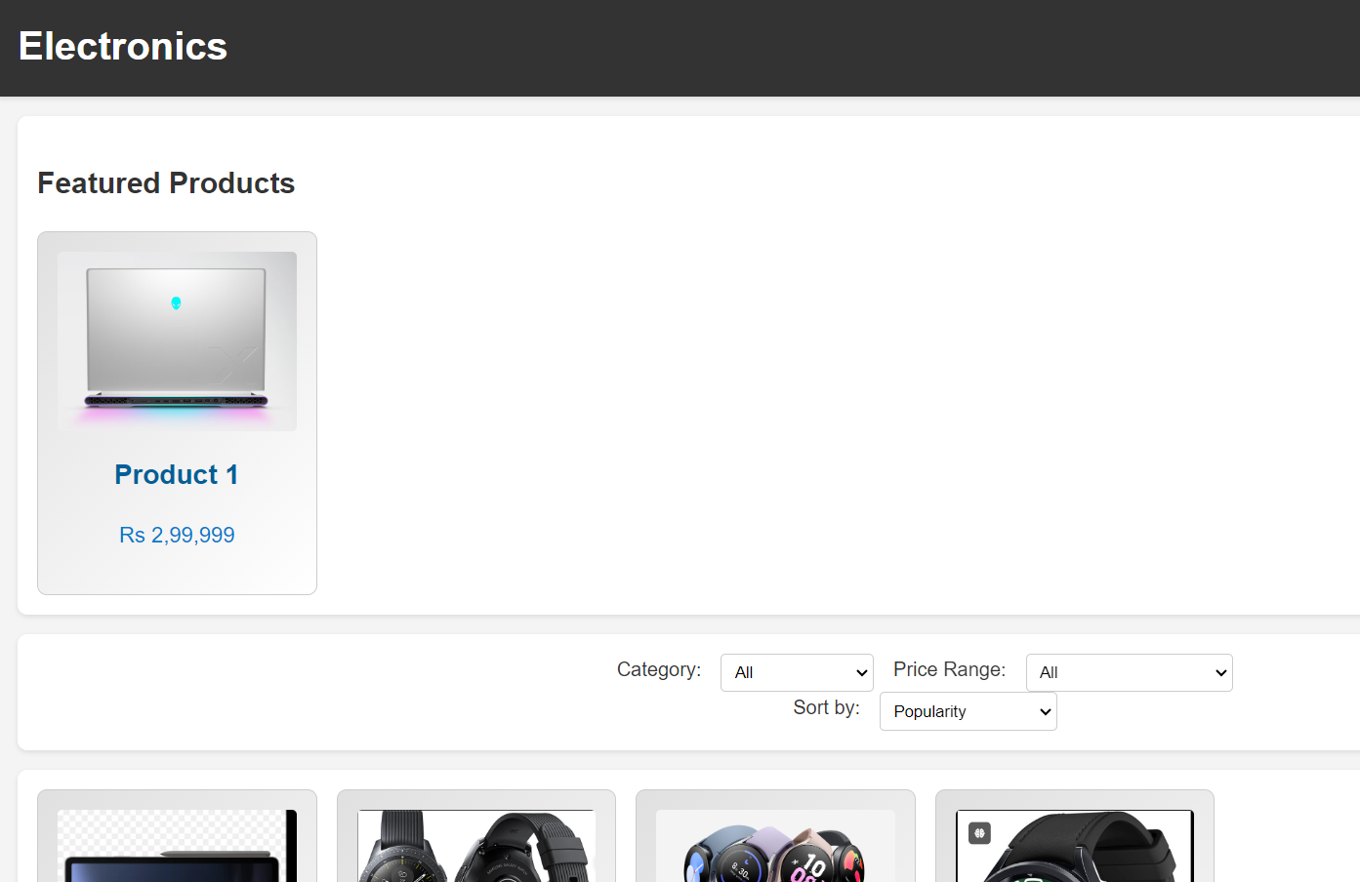
Accessories page gives access to only the accessories and the electronics page to electronics only.

Slide 9
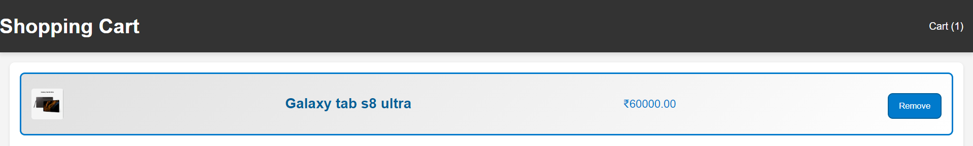
Here you can select any needed electronic and accessory you want from separate sections or choose from the total bunch at once from the “All products” section.
Then there is cart page too, to buy all the products at once after adding all the products at once.
The cart page also shows the number of products available in the cart.
So this is the overview of the e-commerce website page.
It shows the hovering feature everywhere possible, it is a simple looking fully functional e-commerce website.

