Slide 1
Boosting Algorithm

Slide 2
Boosting Algorithm
Boosting is an ensemble technique that combines multiple weak learners to create a strong predictive model, focusing on correcting errors made by previous models
Boosting enhances model accuracy and robustness, making it a crucial method in machine learning for improving performance on complex datasets
Boosting Algorithm
Ada Boost
XG Boost
LG Boost

Slide 3
Adaptive Boosting Algorithm

Slide 4
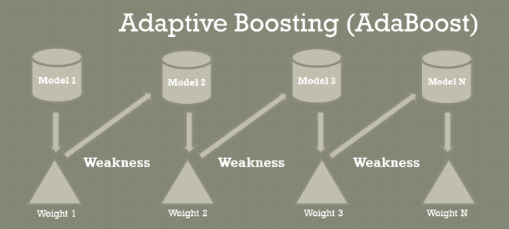
Ada Boost (Adaptive Boost Algorithm)
Improves model performance by iteratively adjusting sample weights
Basic Concepts
01. Weighting of Weak Learners
In AdaBoost, weak learners are assigned different weights based on their accuracy. Misclassified instances receive greater weights, guiding subsequent learners to focus on difficult cases.
02. Combination of Predictions
The final prediction in AdaBoost is achieved by combining the predictions of all weak learners. Each learner contributes based on its weight, leading to a strong composite model that improves accuracy

Slide 5
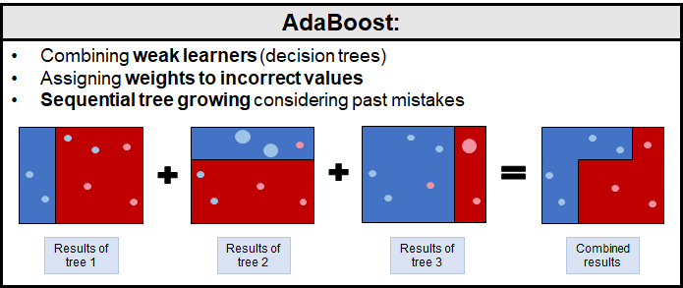
Ada Boost (Adaptive Boost Algorithm)
Iterative Learning
During training, AdaBoost adjusts the weights of each sample after every iteration. This adjustment emphasizes misclassified samples, ensuring the model learns from its previous mistakes.

Slide 6
Ada Boost (Adaptive Boost Algorithm)
Decision Stumps
Implementation of Decision Stumps → Decision stumps serve as a simple, single- level decision tree used for classification tasks, emphasizing swift computational efficiency and ease of implementation.
Comparison with Other Learners → This section explores how decision stumps stack up against more complex algorithms, highlighting their strengths in speed and simplicity versus limitations in accuracy.
Steps involved →
Start with an equal weight distribution across training samples
Train a weak learner (e.g., a decision stump)
Misclassified samples receive higher weights
Train the next weak learner, focusing on hard-to-classify points
Combine weak learners into a strong classifier

Slide 7
Ada Boost (Adaptive Boost Algorithm)
Performance Benefits
Reduction of Bias and Variance → AdaBoost effectively combines multiple weak learners to create a strong predictive model, resulting in lower bias and variance, which improves overall model robustness
High Accuracy → AdaBoost enhances accuracy by focusing on misclassified instances, thereby adjusting weights and iteratively refining predictions to achieve results that often outperform other algorithms
Integration with Other Models → AdaBoost can easily be integrated with various machine learning models, including decision trees and support vector machines, allowing for hybrid approaches that leverage strengths of multiple algorithms.
Application
Computer Vision: Face detection
Finance: Fraud detection in transactions
Healthcare: Disease prediction models
Marketing: Customer churn prediction

Slide 8
XG Boosting Algorithm

Slide 9
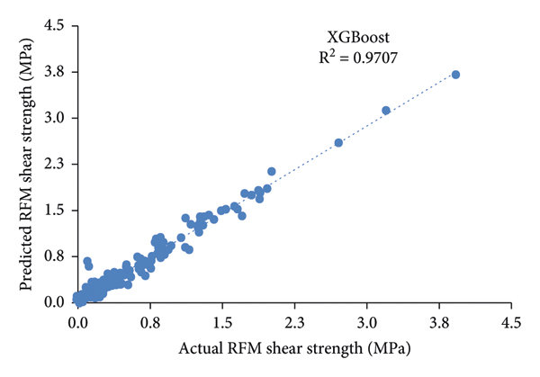
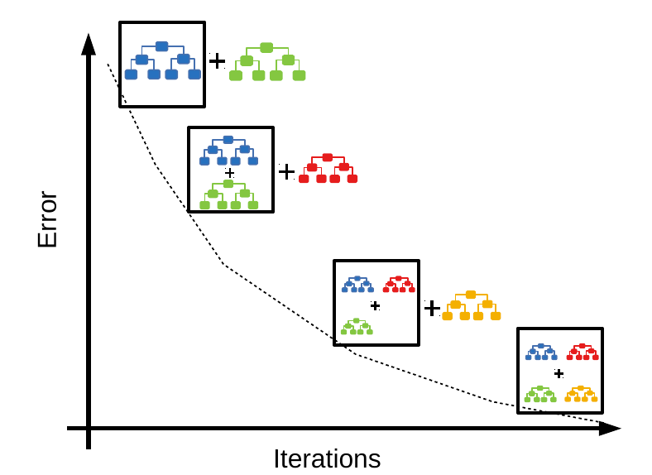
2. XG Boost (Extreme Gradient Boosting)
XGBoost is an optimized version of Gradient Boosting, designed for speed and performance
Uses Gradient Boosting, where new trees correct errors of previous trees
Key Features
High efficiency & scalability
Handles missing values automatically
Supports both classification and regression

Slide 10
2. XG Boost (Extreme Gradient Boosting)
Steps involved →
Initialize with a weak learner (usually a decision tree)
Compute residual errors and fit new trees to minimize these errors
Use gradient descent to optimize predictions iteratively
Apply regularization (L1 & L2) to prevent overfitting

Slide 11
2. XG Boost (Extreme Gradient Boosting)
Merits
High accuracy and efficiency
Handles missing data automatically
Works well on both small and large datasets
Limitations
Requires hyperparameter tuning for best performance
Computationally expensive for extremely large datasets
Not ideal for sparse, unstructured data (e.g., images, text)

Slide 12
LG Boosting Algorithm

Slide 13
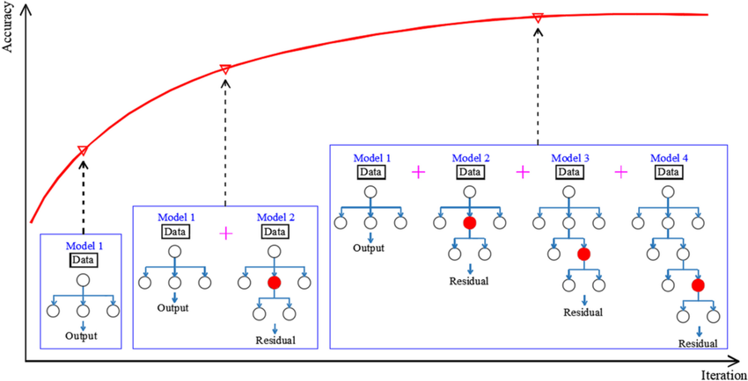
3. LG Boost (Light Gradient Boosting)
A Fast and Scalable Boosting Algorithm
Key Features
Based on Gradient Boosting Decision Trees (GBDT)
Uses leaf-wise growth instead of level-wise (used in XGBoost)

Slide 14
3. LG Boost (Light Gradient Boosting)
Steps involved →
Histogram-based splitting: Groups continuous features into bins for faster computation
Leaf-wise growth strategy: Expands the tree by splitting the leaf with the largest gain, improving accuracy
Sparse feature handling: Efficiently processes missing and categorical data
Multi-threading & GPU acceleration for high-speed training

Slide 15
Comparison with Other Boosting Algorithms

Slide 16
Comparison with Other Boosting Algorithms
Algorithm | Speed | Accuracy | Handles Large Datasets | GPU Support
AdaBoost | Slow | Moderate | No | No
XGBoost | Fast | High | Yes | Yes
LightGBM | Fastest | Highest | Yes | Yes
ADA boost → It creates multiple weak models (usually decision stumps—single-level decision trees)
XG Boost → Uses Gradient Boosting, where new trees correct errors of previous trees.
LG Boost → Similar to XGBoost but grows trees vertically (leaf-wise) instead of level-wise

