Slide 1
MizoMarket
Strengthening Agricultural Market Access and Rural Producer Realisations in Mizoram
A proposed market intelligence and value-chain development initiative under the New India Internship
Sanjesh V
IIT Madras
[Photo placeholder: Mizoram agricultural landscape behind green overlay]

Slide 2
Mizoram has significant agricultural potential, but production alone does not guarantee market access
GINGER
60.29
thousand MT
2023–24
TURMERIC
29.98
thousand MT
2023–24
ORANGE
54.37
thousand MT
2023–24
Figure to be verified
What converts production into producer value
Market access
routes beyond the farm gate
Storage
capacity to hold produce after harvest
Processing
adding value before sale
Logistics
cost and time to reach buyers
Buyer connections
wholesalers, processors, institutions
Production volume shows potential, not what farmers earn. Producer realisations are the gap this project investigates.
Source: Ministry of Food Processing Industries (MoFPI), Food Processing State Profile: Mizoram (data: DA&FW, 2023–24 Final Estimates). Orange figure not yet confirmed against source; page references to be added.

Slide 3
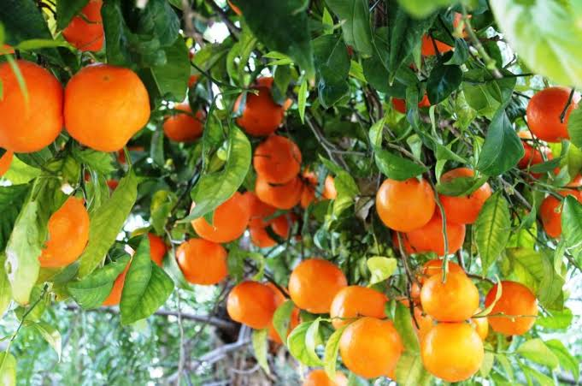
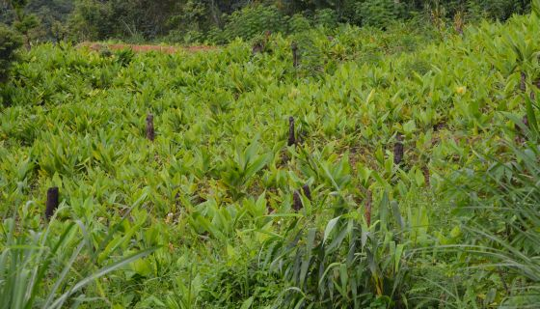
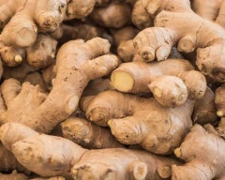
Different agricultural clusters appear to face different market-access bottlenecks
[Photo placeholder: Thenzawl orange cultivation]
[Photo placeholder: Reiek turmeric]
[Photo placeholder: East Lungdar ginger]
THENZAWL | Orange
REIEK | Turmeric
EAST LUNGDAR | Ginger
RECORDED · NII report, p. 7
Limited marketing and infrastructure; hilly terrain restricts farming
RECORDED · NII report, p. 7
Turmeric earns INR 1–1.5 lakh/acre; solar dryers in use; weak market links and processing
RECORDED · NII report
Village not covered in the NII report
HYPOTHESES TO VALIDATE
~90% farm-gate sales to passing vehicles
3–4 h transit to urban hubs
Need for price information and vendor contacts
HYPOTHESES TO VALIDATE
Cultivar- and contract-linked production
Processing concentrated at harvest
No standard quality control at intake
HYPOTHESES TO VALIDATE
Commercial ginger, diversified cropping
Ginger Society and solar cold storage
Landslide and supply-chain risks
Across all villages visited (NII, p. 8): transport time and cost due to terrain · no warehousing · weak cooperative marketing
Source: New India Internship (Pilot Programme) report, IITM–NIT Mizoram, 10 Dec 2024–10 Jan 2025, Agriculture section, pp. 7–8 (historical observations). Hypotheses are the presenter's working assumptions for field validation, not report findings.

Slide 4
The challenge is not simply finding buyers; it is coordinating the entire value chain
WORKING HYPOTHESES · REQUIRE FIELD VALIDATION
FARMER
AGGREGATION
PROCESSING & QUALITY CONTROL
TRANSPORT & DISTRIBUTION
BUYER / RETAIL MARKET
BOTTLENECK
Price transparency and bargaining power
Key question
Do farmers know prevailing prices when they sell?
BOTTLENECK
Fragmented supply and inconsistent volumes
Key question
Can volumes be pooled to meet buyer requirements?
BOTTLENECK
Seasonal capacity and quality variation
Key question
How is capacity used outside the harvest season?
BOTTLENECK
Cost, transit time and perishability
Key question
How much value is lost between farm and market?
BOTTLENECK
Uncertain demand and limited buyer connections
Key question
Which buyers would source directly from clusters?
Central insight (hypothesis): market access requires coordinated improvements across information, aggregation, processing and logistics, not a single intervention at one stage.
Note: Presenter's analytical framework. Bottlenecks are hypotheses to be tested in field research and are not proven across every village. Transport and storage constraints informed by New India Internship (Pilot) report, IITM–NIT Mizoram, 2024–25, p. 8.

Slide 5
MizoMarket should complement existing government interventions, not duplicate them
EXISTING INITIATIVES
POTENTIAL COMPLEMENTARY ROLE OF MIZOMARKET
FOCUS / FOCUS 2.0 (IFAD)
Phase 1 in 6 of 11 districts; 2.0 covers all 11, 2026–32
1 Producer and cluster visibility
2 Market information and buyer discovery
Bana Kaih Handholding Scheme
State flagship, phase 3; financial and project support
3 Aggregation and logistics coordination
Government ginger procurement
Procurement under Bana Kaih; collection centres to map
complements
4 Scheme information and support discovery
Farmer societies and producer organisations
Coverage and capacity to be mapped in the field
5 Identification of remaining implementation gaps
RECENT DEVELOPMENTS TO VALIDATE (2026 news; coverage and current status not yet verified)
Ginger procurement and price support: ~2 lakh quintals procured under Bana Kaih by Aug 2026; Rs 150 cr earmarked for five-crop procurement in 2026–27
Refrigerated parcel transport: Northeast Frontier Railway introduced refrigerated parcel vans for Mizoram's perishable produce, Mar 2026
Sources: IFAD, FOCUS Supervision Report (Feb 2023) and FOCUS 2.0 financing agreement release (2026); Commerce & Industries Dept., Govt. of Mizoram, About Bana Kaih; India Today NE, 25 Aug 2026; Times of India, Feb 2026; EastMojo, 6 Mar 2026. Complementary role is a proposal.

Slide 6
A field-informed platform connecting producers, market information and potential buyers
1 PRODUCER PROFILES
Crop, village, quantity, harvest period, contact
2 PRICE INTELLIGENCE
Indicative prices with source, market, last-updated date
ILLUSTRATIVE PROTOTYPE · NOT LIVE
MizoMarket
MizoMarket
proposed platform
Producer listing
Ginger · [Village]
Qty: [__] MT · Harvest: [month]
Contact: [via society]
Indicative price
₹[__]/kg
Source: [__] · Market: [__]
Last updated: [date]
3 BUYER DISCOVERY
Wholesalers, processors and institutional buyers
4 LOGISTICS COORDINATION
Aggregation opportunities and estimated transport costs
Find buyers
Logistics
5 MARKET ANALYTICS
Supply patterns, buyer enquiries, recurring bottlenecks
Mock-up for discussion only. No live data integration, verified transactions or farmer adoption.
Note: Proposed concept by the presenter. Each module addresses a hypothesised value-chain bottleneck; scope and features will be refined after field validation.

Slide 7
Secondary research frames the problem; primary research will determine the solution
STAKEHOLDER
WHAT WE NEED TO LEARN
PROPOSED RESEARCH PLAN
Farmers
Selling prices, quantity, buyers, transport costs and storage
Select 2–3 agricultural clusters
1
Farmer societies
Aggregation, collection and storage capacity
Interview 20–30 farmers
2
Traders and buyers
Procurement prices, quality requirements and demand
Interview 5–10 traders, processors and buyers
3
Processors
Processing capacity, seasonality and quality standards
Consult agriculture and horticulture officials
4
Government officials
Existing schemes, collection infrastructure and implementation gaps
Validate with site visits and actual price records
5
Proposed targets, not completed survey findings
“The proposed platform will be refined only after validating the needs, constraints and adoption willingness of local stakeholders.”
Note: Research design proposed by the presenter. All sample sizes are targets; no fieldwork, interviews or surveys have been conducted yet.

Slide 8
A focused 23-day research and prototype-development plan
WORKSTREAM
1
2
3
4
5
6
7
8
9
10
11
12
13
14
15
16
17
18
19
20
21
22
23
Secondary research
Day 1–3
Stakeholder interviews
Day 4–10
Value-chain analysis
Day 11–15
Prototype development
Day 16–19
Validation and final report
Day 20–23
Milestones
Day 3
Desk review complete
Day 10
Interviews complete
Day 15
Value chain mapped
Day 19
Prototype ready
Day 23
Final report
Note: Proposed work plan by the presenter for the 23-day internship window. Milestones are planned checkpoints; no activities have started.

Slide 9
From village-level observations to an implementable market-access solution
01
02
03
04
VALUE-CHAIN MAPPING
MARKET DATABASE
WORKING PROTOTYPE
IMPLEMENTATION ROADMAP
Village-level maps of producers, processors, buyers and logistics
Field-validated producer and buyer information
Demonstration of producer listings, buyer discovery and indicative pricing
Practical recommendations for government and producer organisations
“The objective is not to introduce another marketplace. It is to understand where value is lost in Mizoram's agricultural supply chains and develop a practical, locally validated way to improve producer access to markets.”
Note: Planned deliverables of the proposed internship project; none have been produced yet.

Slide 10
Sources and evidence status
HISTORICAL FIELD OBSERVATIONS
New India Internship (Pilot Programme) report, IITM–NIT Mizoram, 10 Dec 2024–10 Jan 2025, Agriculture section, pp. 6–8
OFFICIAL AND PRIMARY SOURCES
Ministry of Food Processing Industries (MoFPI), Food Processing State Profile: Mizoram (data: DA&FW 2023–24 Final Estimates), mofpi.gov.in
IFAD, FOCUS Supervision Report, February 2023; IFAD release on FOCUS 2.0 financing agreement (US$45.78m), 2026
Commerce & Industries Department, Government of Mizoram, “About Bana Kaih”, industries.mizoram.gov.in
CURRENT EXTERNAL INFORMATION (2026 NEWS)
India Today NE, “Mizoram procured over 2 lakh quintals of ginger this year: Minister”, 25 Aug 2026
Times of India, “Mizoram govt to allocate Rs 150cr for crop procurement”, Feb 2026
EastMojo, “Mizoram: Railways expand refrigerated parcel services to support horticulture”, 6 Mar 2026
OPEN ITEMS TO VERIFY
Orange production (54.37 thousand MT, 2023–24) not yet confirmed against the cited source
MoFPI page references to be added; photographs to be supplied by presenter with credits

