Slide 1
Recommendation system for venues in Pune
Amey Pandit

Slide 2
Challenge
Biggest challenge in city is to find a good venue to hangout or to happily fulfill your stomach.
Users may have different preferences
Some may check the price range
Others may check quality of the place
Our exploration may help users find out the optimum choice given price and quality.

Slide 3
Data acquisition
Data is fetched the from two different APIs.
Foursquare API
We will use this API to find all the venues we need. Foursquare API will give us following information :
Name of venue
Category of venue
Latitude and Logitude
Zomato API
Zomato API will provide us with following information :
Name of venue
Latitude and Logitude
Average cost for two
Price range
User ratings

Slide 4
Data cleaning
The data from multiple resources might not always align.
We combine data points that have their latitude and longitude values very close to one another.
Remove remaining mismatched venues and NAs

Slide 5
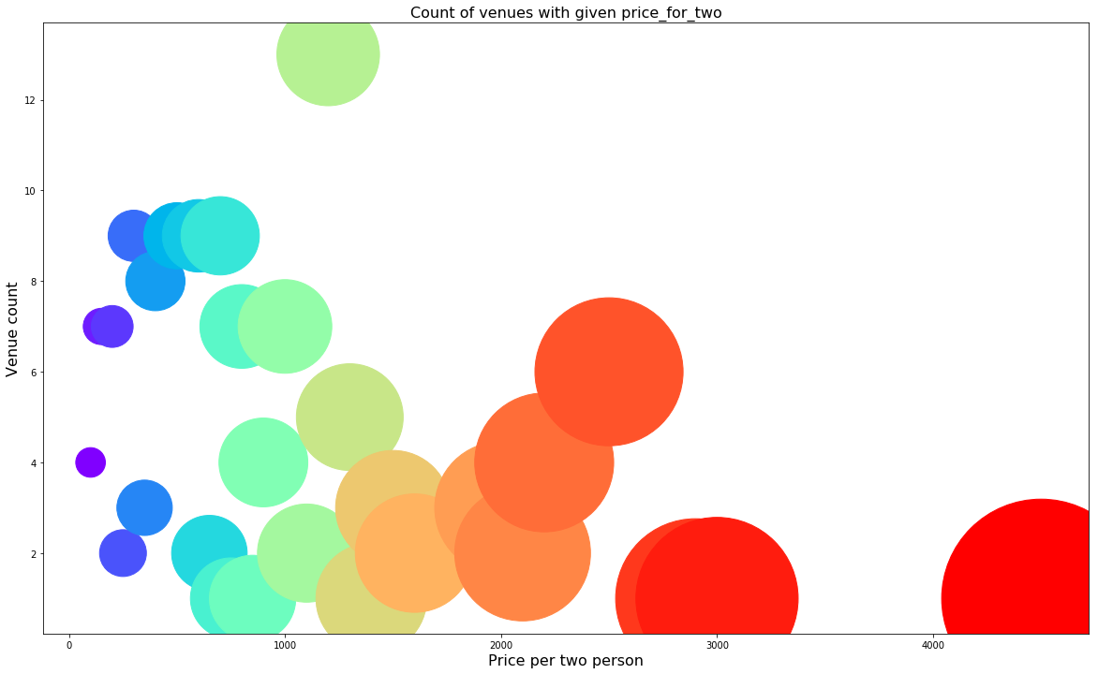

Slide 6
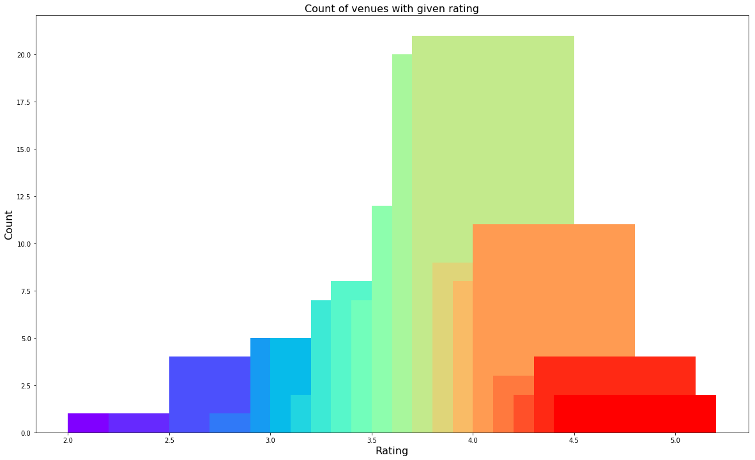

Slide 7
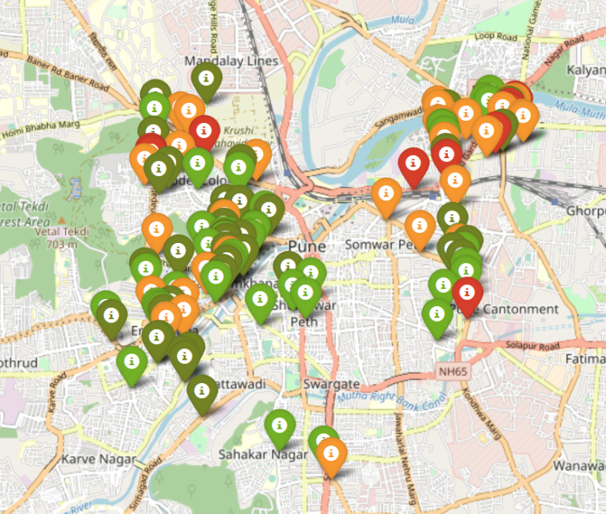
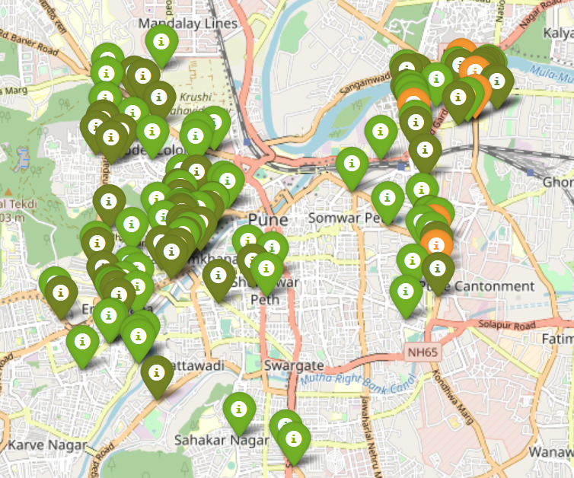
Venues by Price range
Venues by Ratings

Slide 8
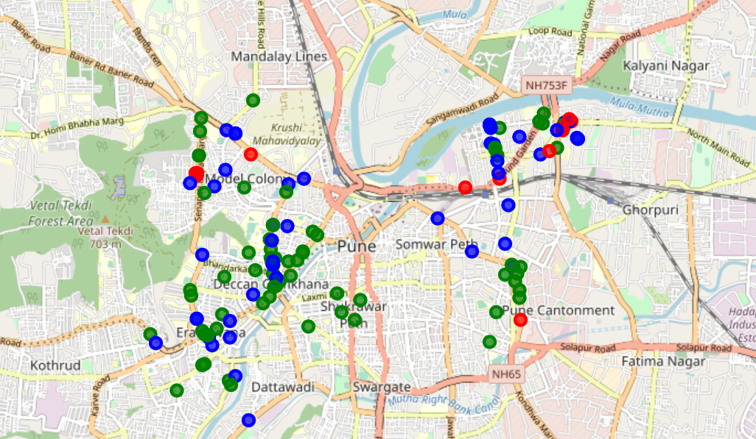
Venues by cluster

Slide 9
Conclusion
If you're looking for cheap places with relatively high rating, you should check JM road and FC road.
If you're looking for the best places, with the highest rating but might also carry a high price tag, you should visit Senapati Bapat road.
If you're looking to explore the city and have no specific criteria to decide upon the places you want to visit, you should try Koregaon park.

Slide 10
Future work
We can improve the clusters by adding other features such as traffic and peak hours.
Other features that might help are users personal choice and restaurant speciality

