Slide 1

Early Warning System for Societal Unrest
Predicting Unrest Events Across Global Regions
Sanjib Saha

Slide 2
Project Background
• Monitoring protests, strikes, and civil disturbances across 50 regions over 10 years.
• Monthly economic, environmental, and political indicators collected.
• Objective: Forecast probability of unrest one month in advance for proactive policy response.

Slide 3
Project Objectives
1. Build a predictive model to output unrest probabilities.
2. Identify the most influential indicators.
3. Evaluate model performance and calibration.
4. Propose simple, actionable alert rules for policy analysts.
5. (Bonus) Create an interactive dashboard for data exploration.

Slide 4
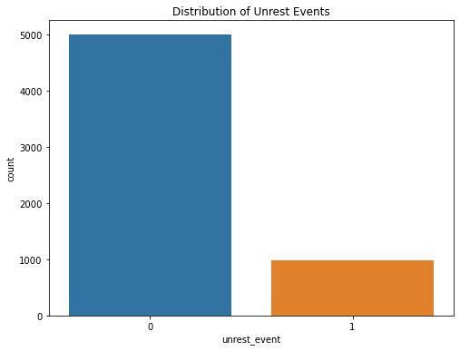
Unrest Event Distribution

Slide 5
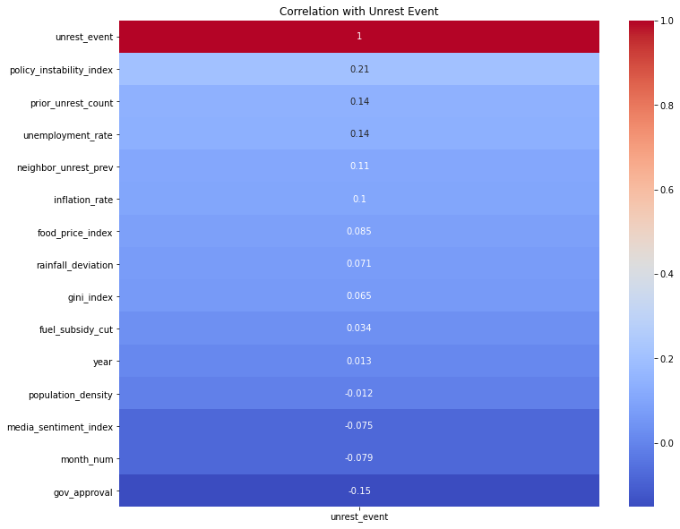
Correlation with Unrest

Slide 6
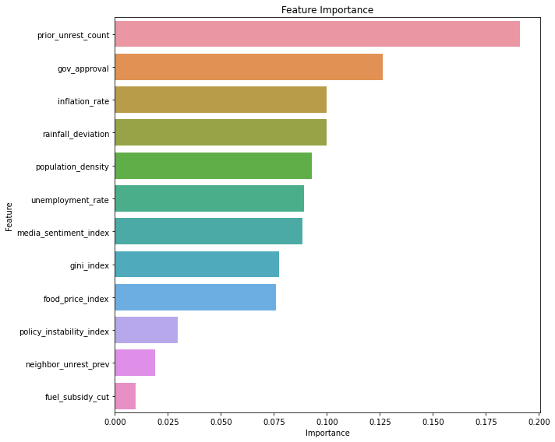
Feature Importance

Slide 7
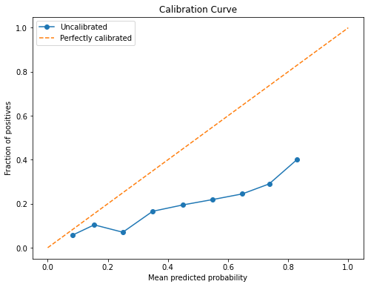
Model Calibration (Uncalibrated)

Slide 8
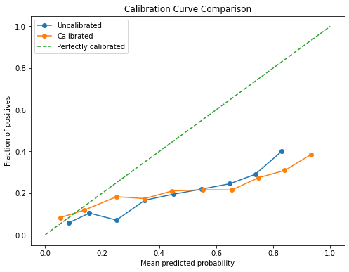
Model Calibration (Calibrated)

Slide 9
Proposed Alert Rule
• Alert if:
- Prior unrest count is high OR
- Government approval is low AND
- Inflation or rainfall deviation is high
• Analysts can:
- Monitor high-risk regions monthly
- Prioritize top 10% regions by risk score

Slide 10

Interactive Dashboard (Power BI)
• Built with Power BI
• Features:
- Select region and view predicted risk
- Explore historical trends of indicators
- Understand drivers of model output
• Scan the QR code below to access the dashboard

Slide 11
Thank You

