Slide 1
Welcome To
Student Management System
Command Line Application
With Python Object Oriented Programming Language

Slide 2
Our Team Members
Mohammad Sanjid Dad
Kaniz Mun
Md Sayem Bin Al Rafi

Slide 3
What Is Student Management System ?
A Student Management System is software to record, analyze, and manage information in a school, Collage. These systems are updated by teachers and school administrators on a rolling basis to better serve the needs of the greater student body. Without a student management system, schools would become disorganized, staff would lack clarity into scheduling and student activity, and it would become increasingly difficult for school districts to leverage data in the decision-making process.

Slide 4
What Is The Benefits of Student Management System ?
The Student Management System Has A Few Key Parts That Address The General Needs Of A School And Collage. Ex :
Overall Student Performance.
Contact Details.
Registration Forms.
Student Health Information.
Student Activity. etc..

Slide 5
What We Have In The Student Management System ?
This Student Management System We Have A Few Key Options That All Student Management System Have. Ex :
Display All Student Information.
Find A Particular Student Data.
Create A New Student Entry.
Delete A Existing Student Entry.
Edit A Existing Student Data.

Slide 6
How We Create Our Program ?
In This Software We Create It Like A Text-Based Interface or We Can Called Terminal. In This Terminal You Can Type Command and Press Enter Then The Program Print Output As Text Based On The Command. If The Command Dose Not Exists Then Print An Error Message.
In This Program We Store All Student Data In Our Local Computer. That’s Why We Use a Python library Name Pandas To Manage Our All Student Information.
Pandas Is A Data Manipulation And Analysis Library To Manage CSV, Excel, Text Files. In Panda Library It Use NumPy and SciPy As Fundamental Scientific Computing.

Slide 7
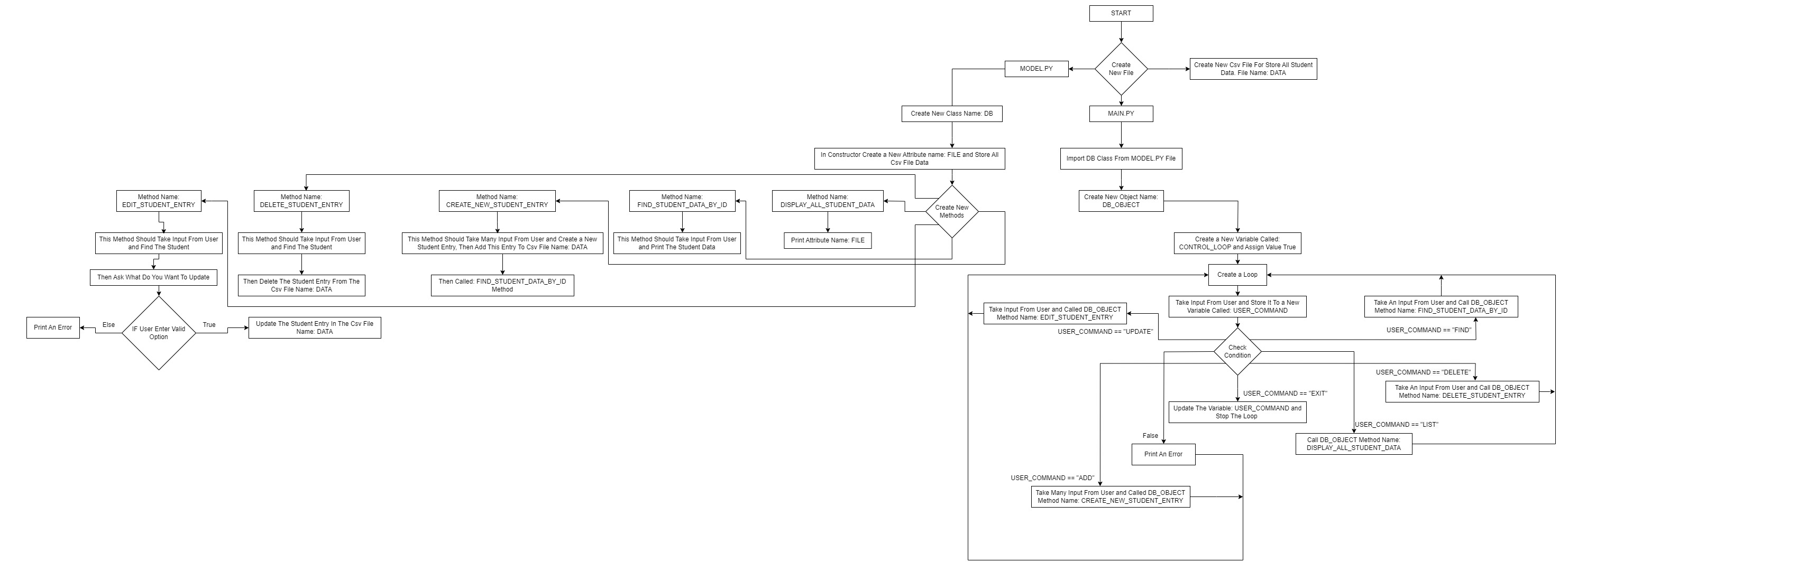
Student Management System Flow Chart :

Slide 8
Most Common Errors :
File Dose Not Exist.
Input Value Error.
Command Not Found Error.
Syntax Error.
Attribute Error.
Solve All Errors :
To Solve All Error Make Sure You Have A Local File. When You Input Data Pay Attention At The Value. Make Sure The Command You Entered Is Match The Primary Command. The Last Thing You Can Not Update Student ID And Student Semester.

Slide 9
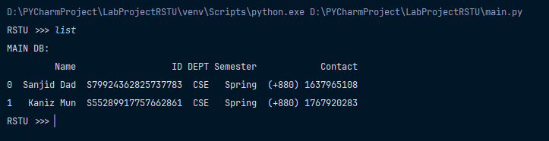
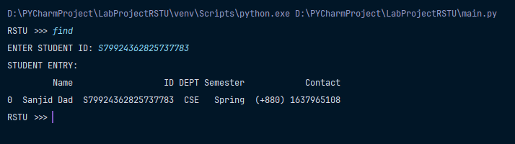
Few Project Example :
LIST Command:
FIND Command:

Slide 10
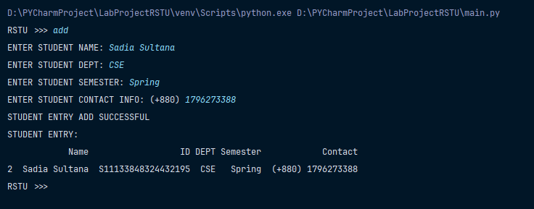
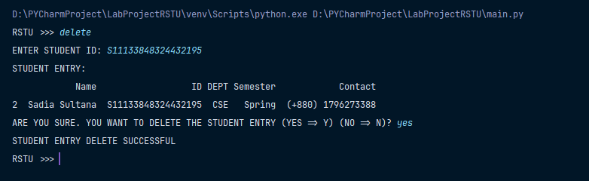
ADD Command:
DELETE Command:

Slide 11
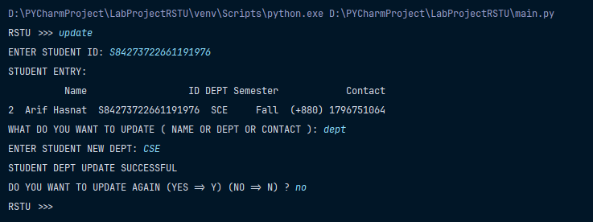
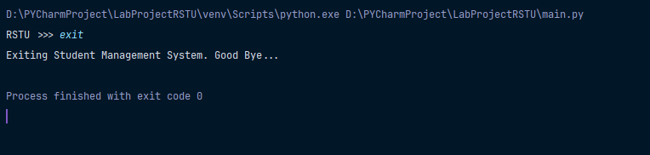
UPDATE Command:
EXIT Command:

Slide 12
Thank You

