Slide 1
Presentation on Thevenin’s Theorem
Presenter: Sk. Sanjidul Haque
ID: 162002038
Course Code: EEE 101
Course Title: Introduction to Electrical Engineering
Course Teacher: Ms. Nusrat Alim
Green University of Bangladesh

Slide 2
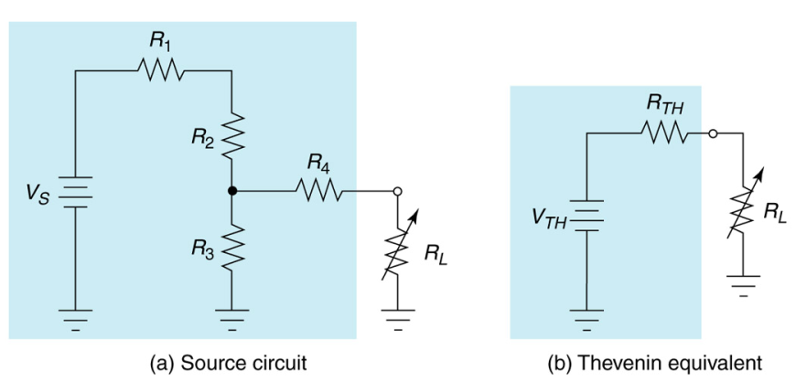
Thevenin’s Theorem
Thevenin’s Theorem – any resistive circuit or network, no matter how complex, can be represented as a voltage source in series with a source resistance

Slide 3
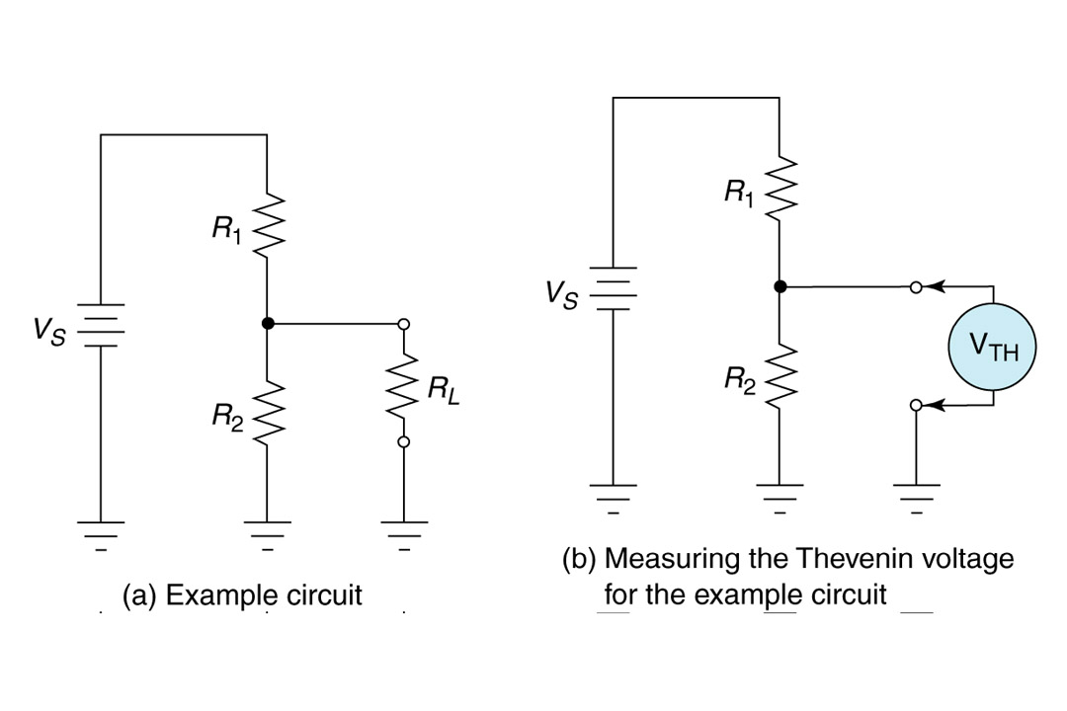
Thevenin’s Theorem
Thevenin Voltage (V_{TH}) – the voltage present at the output terminals of the circuit when the load is removed
Insert Figure 7.18

Slide 4
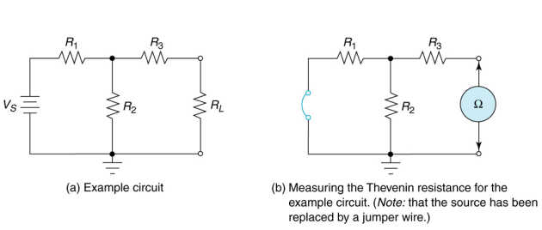
Thevenin’s Theorem
Thevenin Resistance (R_{TH}) – the resistance measured across the output terminals with the load removed

Slide 5
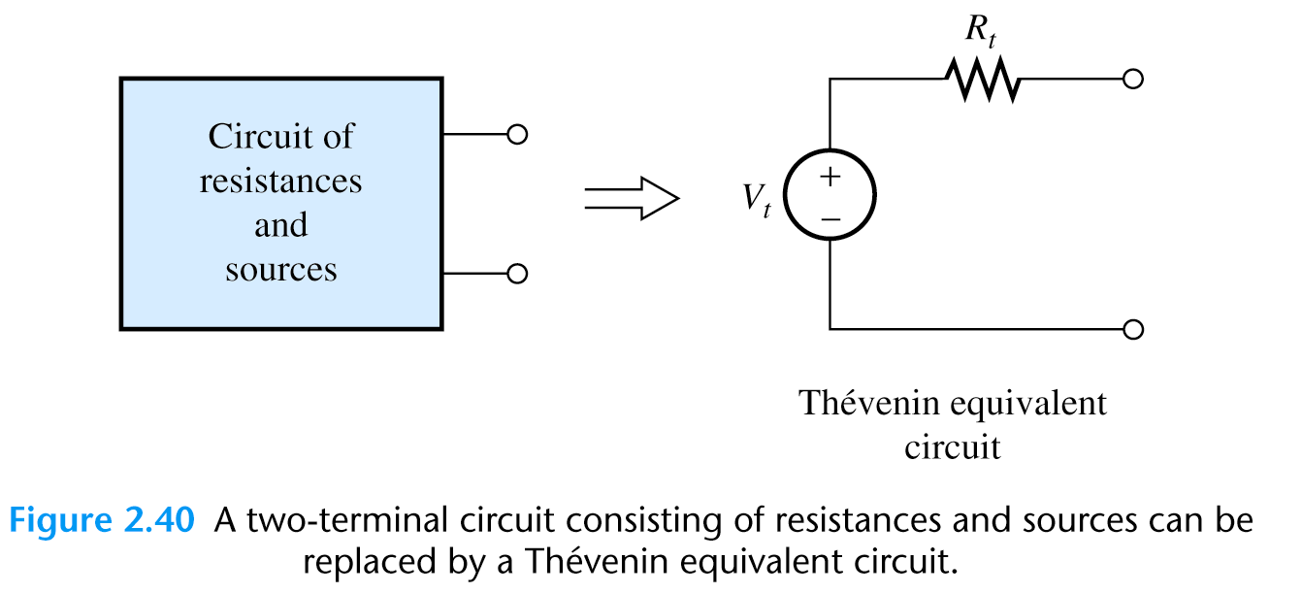
Thevenin’s Equivalent Circuits

Slide 6
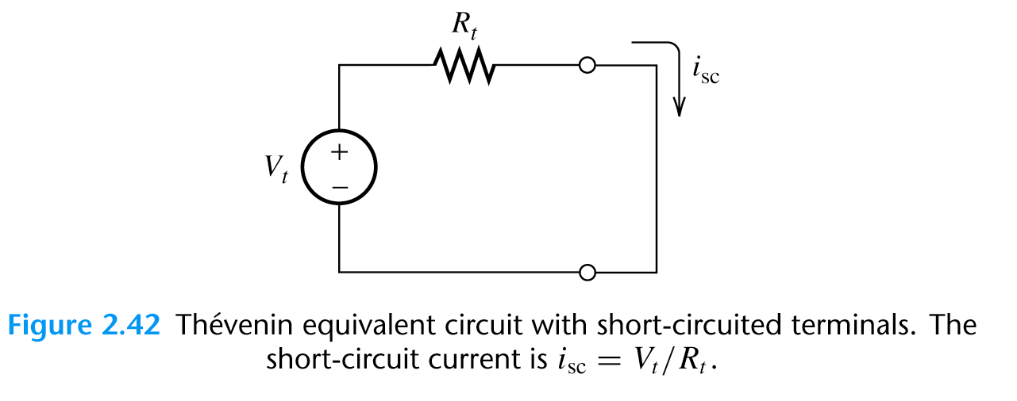
Thevenin’s Equivalent Circuits

Slide 7
Thevenin’s Equivalent Circuits

Slide 8
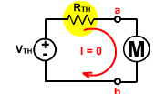
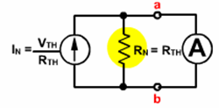
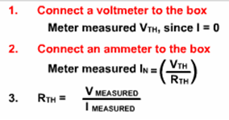
Thevenin’s Equivalent Circuits

Slide 9
Finding the Thevenin’s Resistance Directly
When zeroing a voltage source, it becomes a short circuit. When zeroing a current source, it becomes an open circuit.
We can find the Thevenin resistance by zeroing the sources in the original network and then computing the resistance between the terminals.

Slide 10
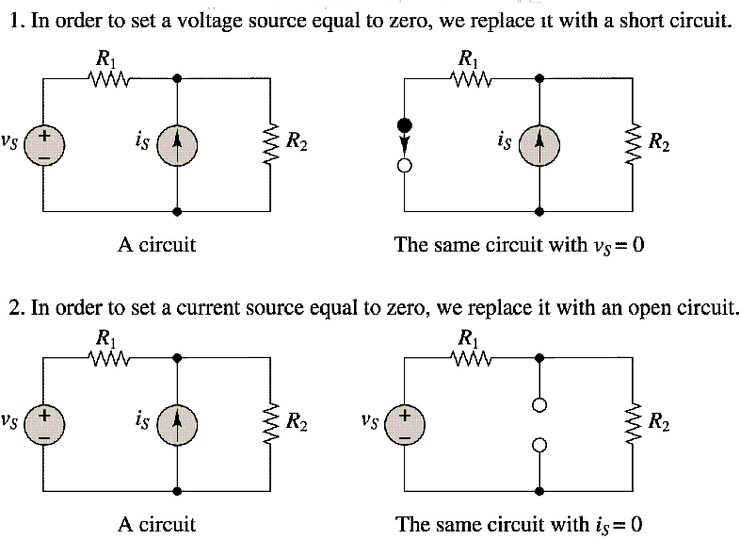
Some Circuits

Slide 11
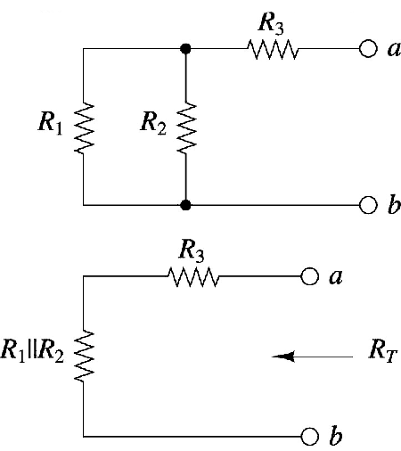
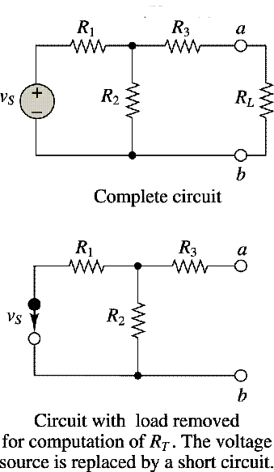
Computation of Thevenin’s resistance

Slide 12
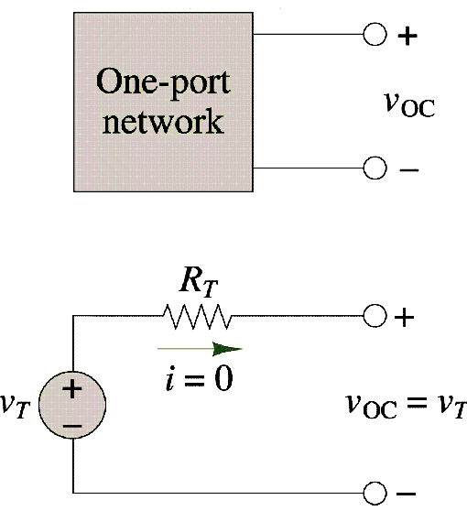
Equivalence of open-circuit and Thevenin’s voltage

Slide 13
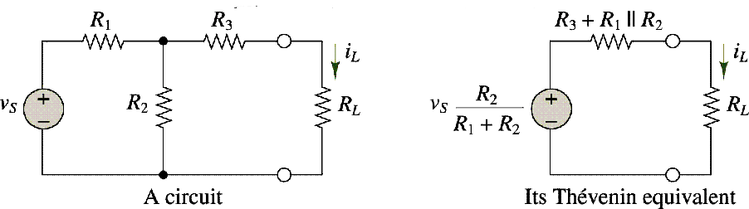
A circuit and its Thevenin’s equivalent

Slide 14
Applications of Thevenin’s Theorem
Maximum Power Transfer
Maximum power transfer from a circuit to a variable load occurs when the load resistance equals the source resistance
For a series-parallel circuit, maximum power occurs when R_{L} = R_{TH}

Slide 15
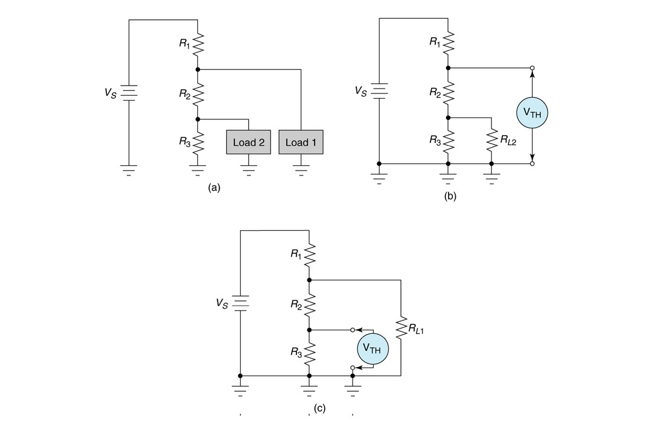
Applications of Thevenin’s Theorem
Multiload Circuits
Insert Figure 7.30

Slide 16
Thank You For Watching My Slide!!!

