Slide 1
ALGORITHMS
A Scary Nightmare

Slide 2
DEFINITION
Algorithm is a step-by-step procedure for solving or accomplishing a task.
It is well-defined set of instructions for performing a specific task.
We use pseudocode to write an algorithm.

Slide 3
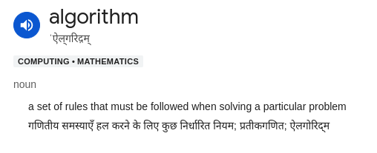

Slide 4
Linear Search

Slide 5
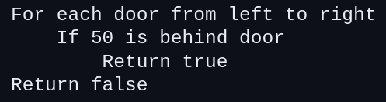

Slide 6
Binary Search
Applicable only to a sorted out ordered list of things.

Slide 7
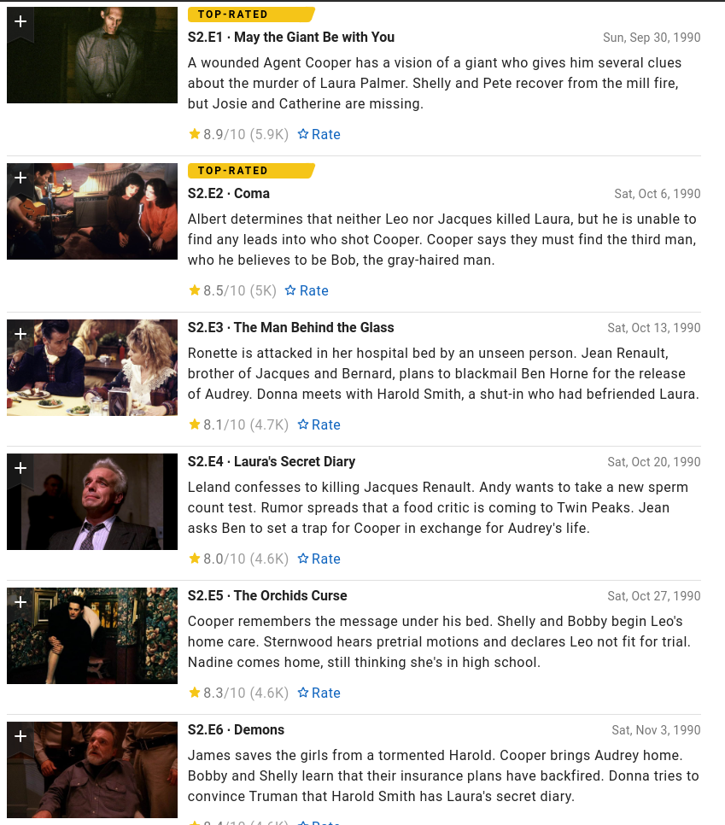

Slide 8
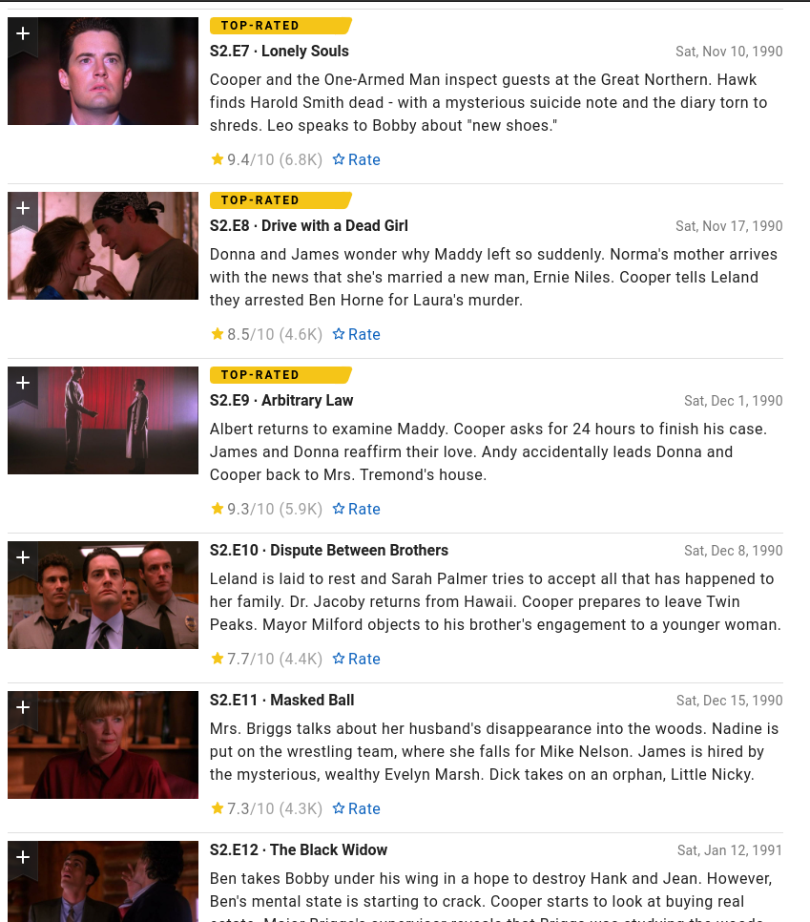

Slide 9
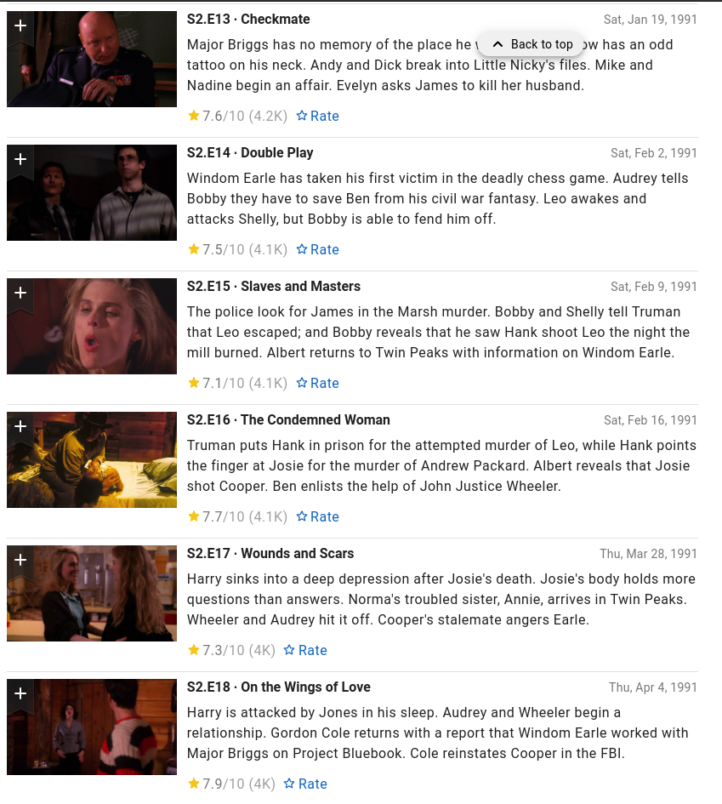

Slide 10
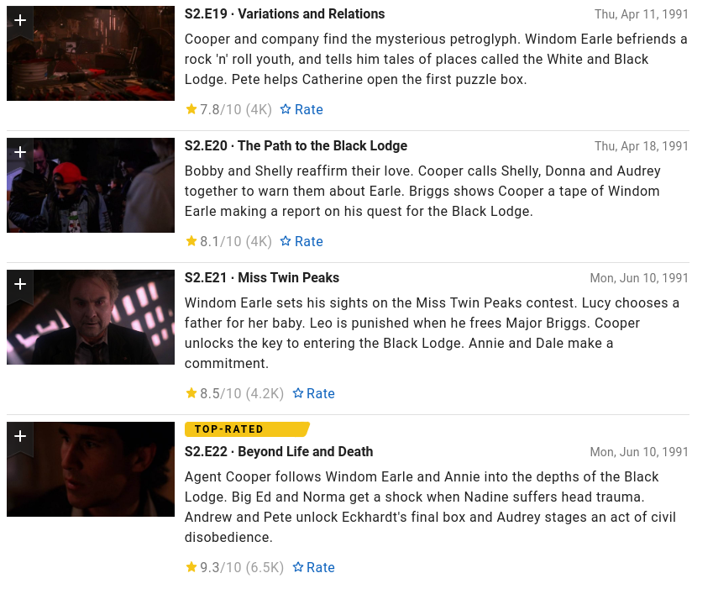

Slide 11
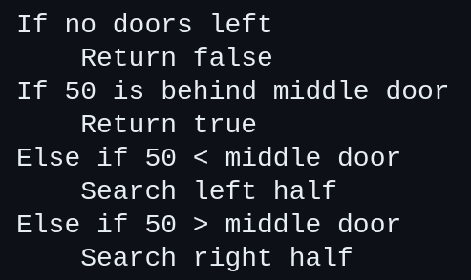

Slide 12
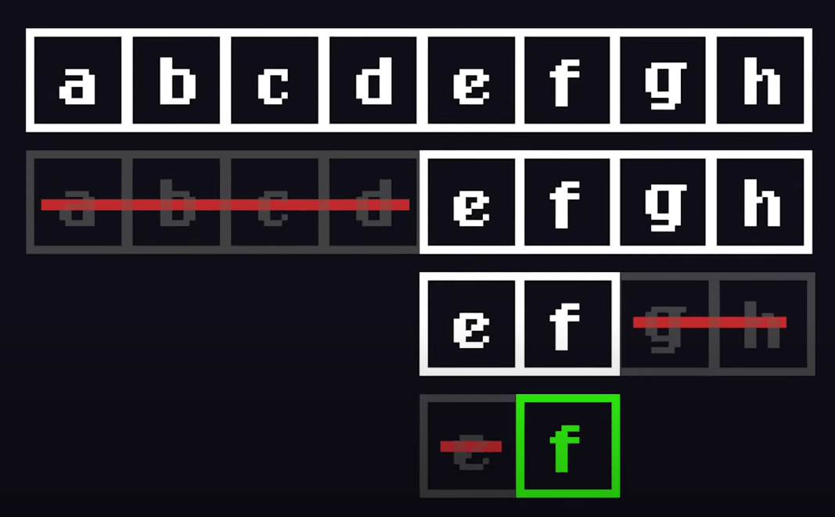

Slide 13
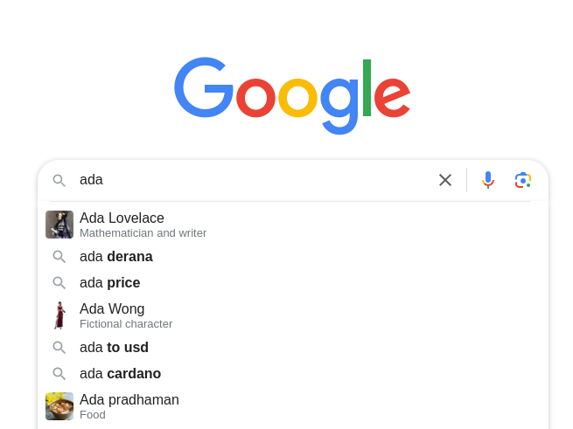

Slide 14
Selection Sort

Slide 15
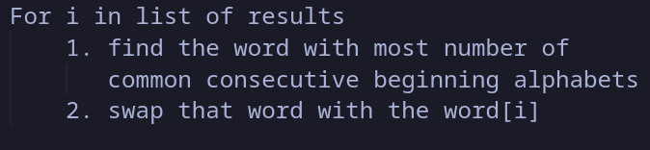

Slide 16
Why we need algorithms?
Solving problems (by breaking them down in smaller steps)
Optimizing solutions (Algorithms find the near-optimal solutions to problems)
Automating tasks (it can automate repetitive or complex tasks, saving time and effort)

Slide 17
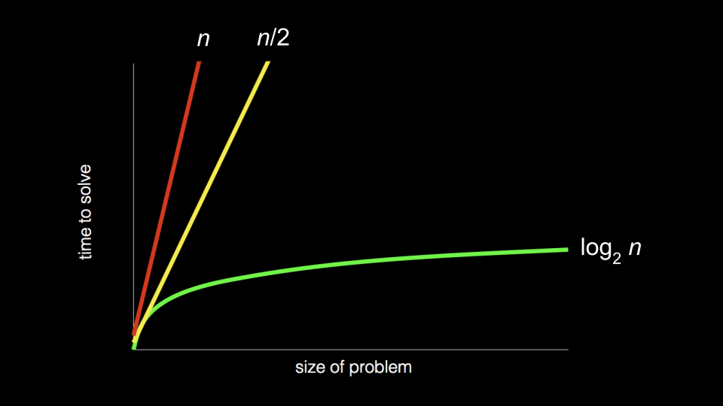

Slide 18
Characteristics of an algorithm
Clear and unambiguous
Well-defined inputs
Well-defined outputs
Finiteness
Language independent

Slide 19
Thank You
Sanjeev :- @sanji.jpg
Aditya Vikram:- @avkrxm
Follow us for presentation tutorials
We ran out of budget, emotional investment, attention span, & the need to score internal marks

