Slide 1
ALGORITHMS
A Scary Nightmare

Slide 2
DEFINITION
Algorithm is a step-by-step procedure for solving or accomplishing a task.
It is well-defined set of instructions for performing a specific task.
We use pseudocode to write an algorithm.

Slide 3
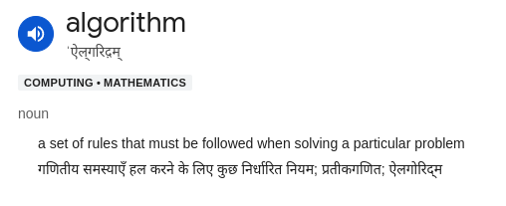

Slide 4
Linear Search

Slide 5
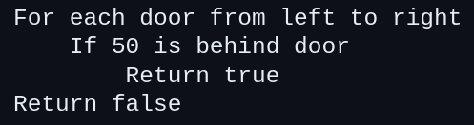

Slide 6
Binary Search
Applicable only to a sorted out ordered list of things.

Slide 7
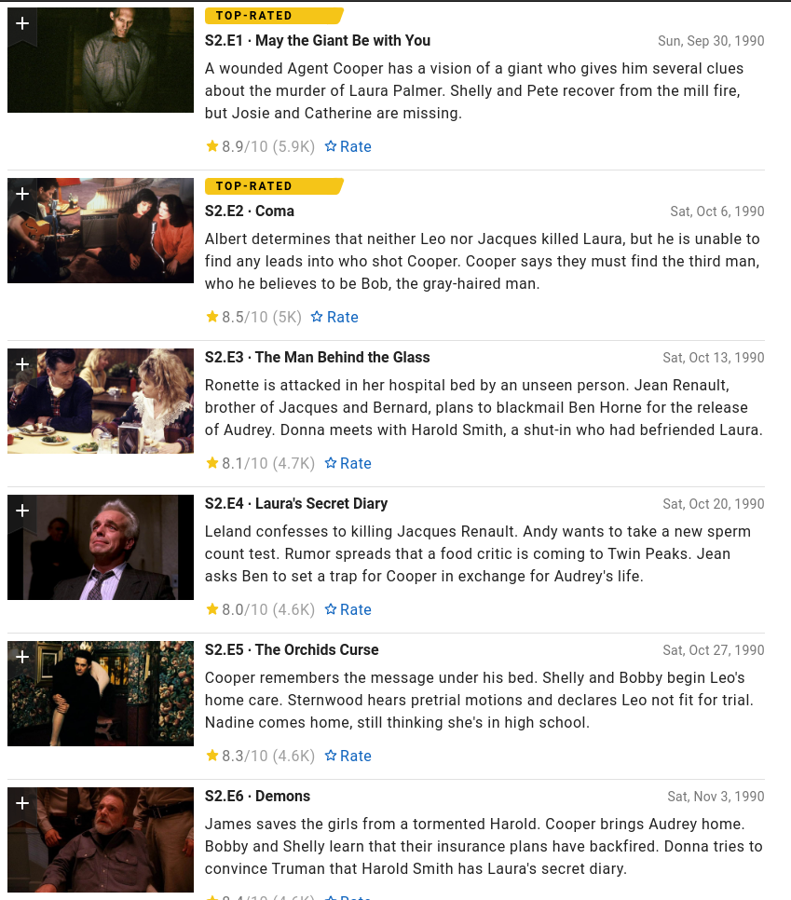

Slide 8
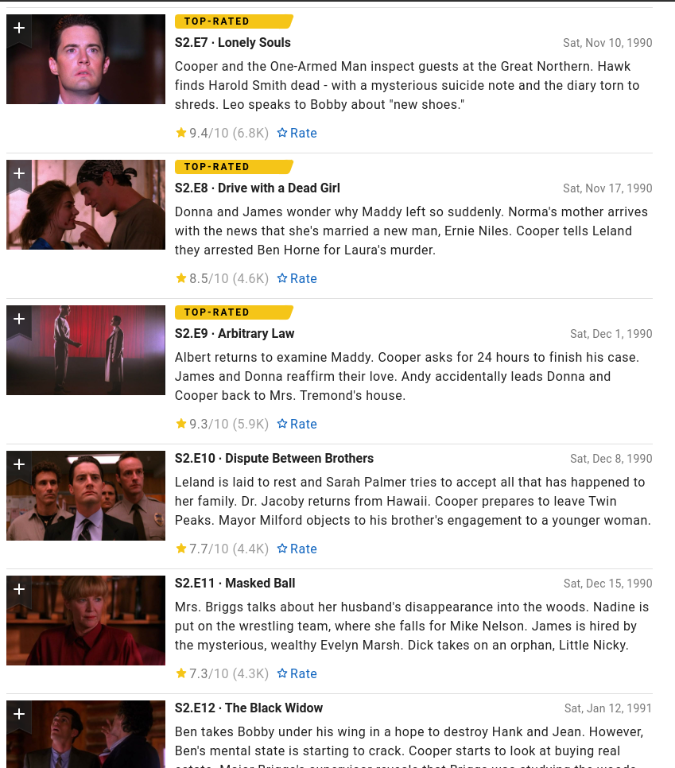

Slide 9
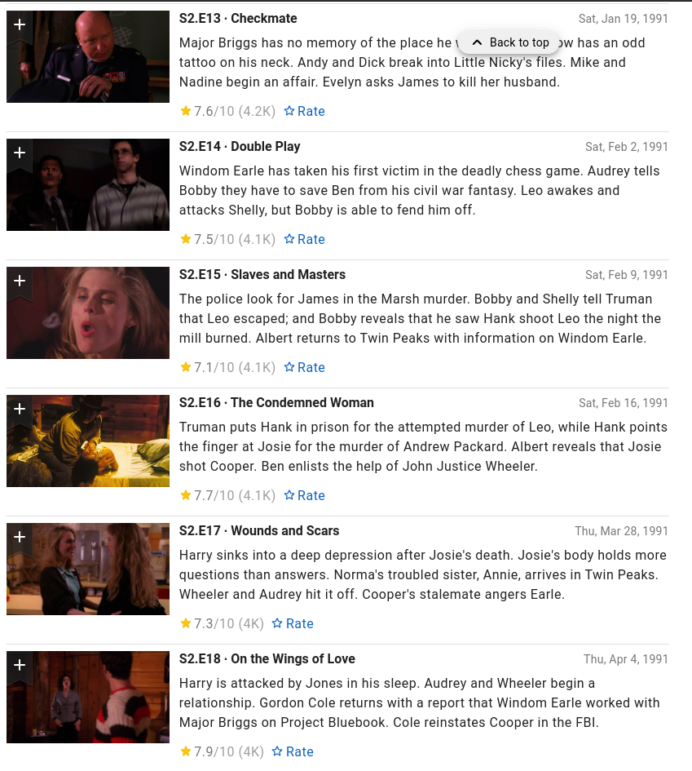

Slide 10
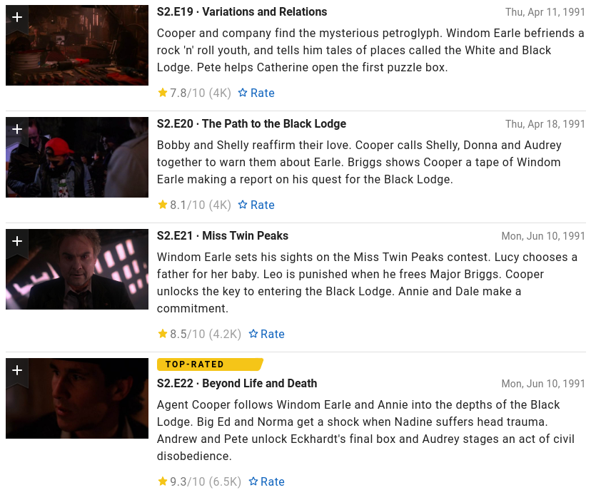

Slide 11
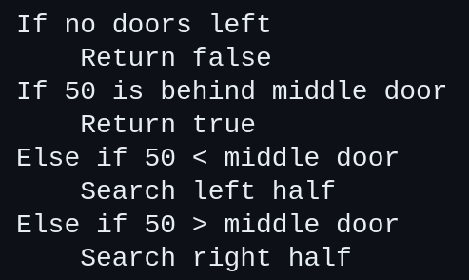

Slide 12
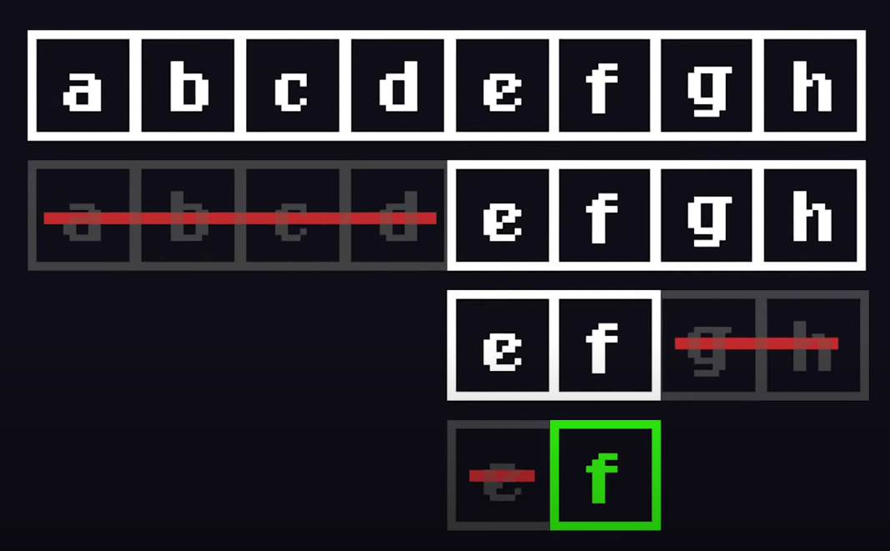

Slide 13
Why we need algorithms?
Solving problems (by breaking them down in smaller steps)
Optimizing solutions (Algorithms find the near-optimal solutions to problems)
Automating tasks (it can automate repetitive or complex tasks, saving time and effort)

Slide 14
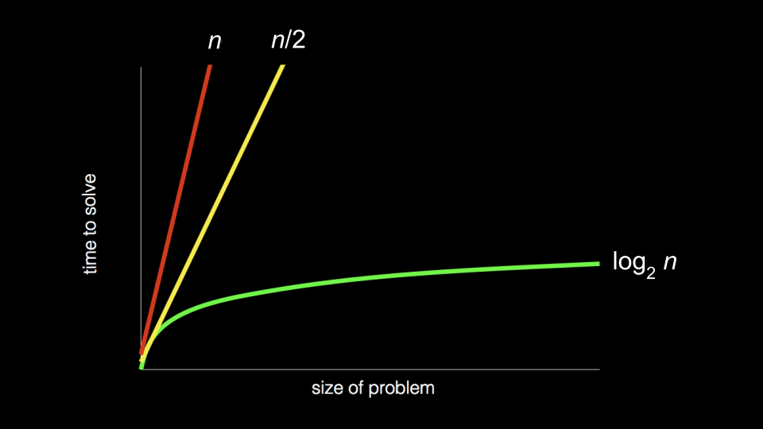

Slide 15
Characteristics of an algorithm
Clear and unambiguous
Well-defined inputs
Well-defined outputs
Finiteness
Language independent

Slide 16
Thank You
Sanjeev :- @sanji.jpg
Aditya Vikram: @avkrxm
Follow us for presentation tutorials
We ran out of budget, emotional investment, attention span, & the need to score internal marks

