Slide 1



BUILDING AN AI PIPELINE FOR IMAGE SEGMENTATION AND OBJECT ANALYSIS
SANJIT CYRUS R

Slide 2



PROCESS FLOW
IMAGE SEGMENTATION
USING MASKED RCNN
OBJECT IDENTIFICATION USING YOLO MODEL
TEXT DETECTION USING EASY OCR
IMAGE CAPTION GENERATION USING BLIP MODELS
USER INTERFACE GENERATION
PREPARATION OF SUMMARY TABLE
DATA MAPPING OF OBJECT, CAPTION AND TEXT
CAPTION SUMMARISATION USING SUMMARIZER

Slide 3

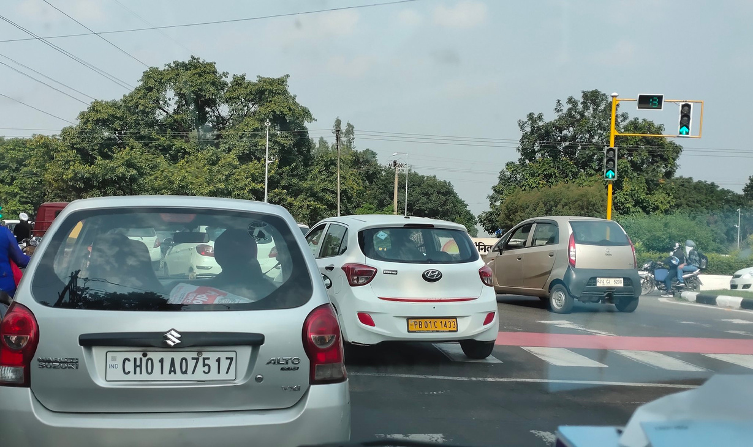
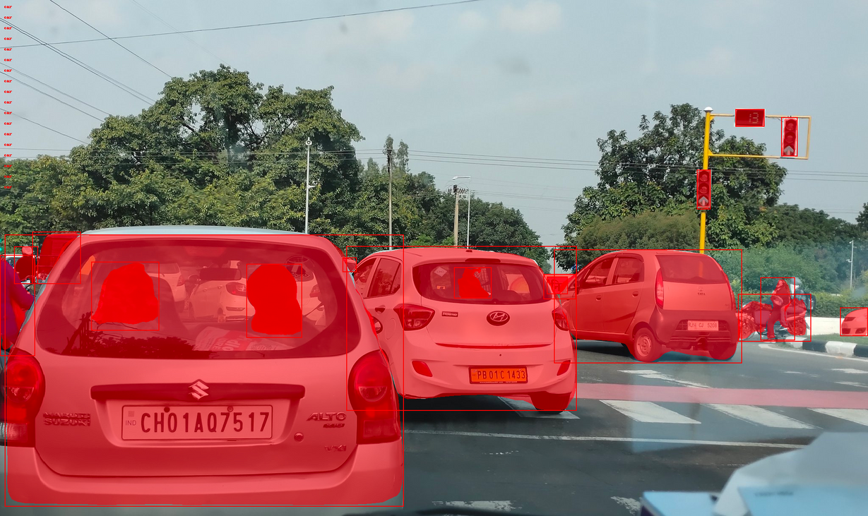
RESULTS
IMAGE SEGMENTATION USING MASKED RCNN

Slide 4
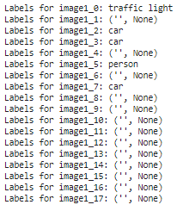
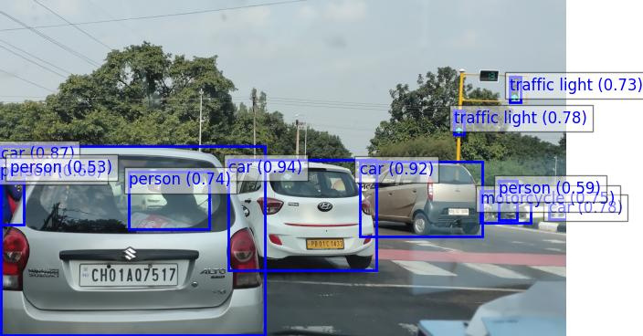
RESULTS
OBJECT IDENTIFICATION USING YOLO MODEL

Slide 5
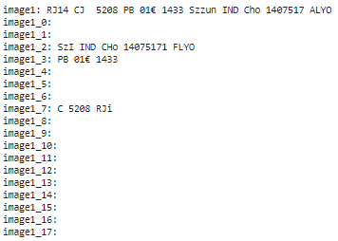
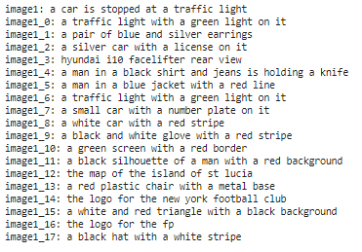
RESULTS
TEXT DETECTION USING EASY OCR
IMAGE CAPTION GENERATION USING BLIP MODELS

Slide 6
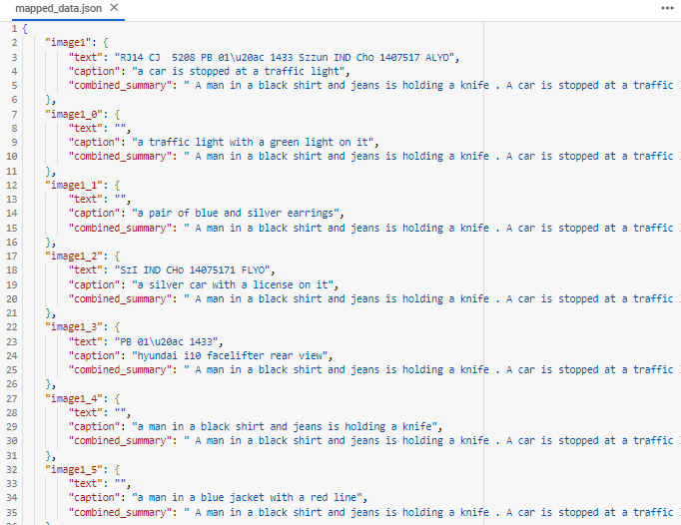
RESULTS
CAPTION SUMMARISATION USING SUMMARIZER
DATA MAPPING OF OBJECT, CAPTION AND TEXT
Combined Summary: A man in a black shirt and jeans is holding a knife . A car is stopped at a traffic light with a green light on it a pair of blue and silver earrings . A small car with a number plate on it is a white car with red stripe a black and white glove with a red stripe .

Slide 7
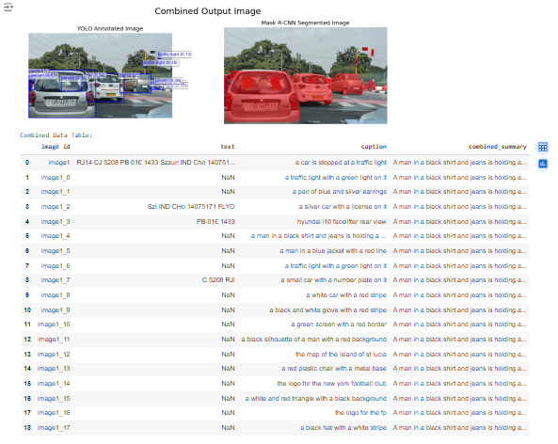
RESULTS
PREPARATION OF SUMMARY TABLE

Slide 8
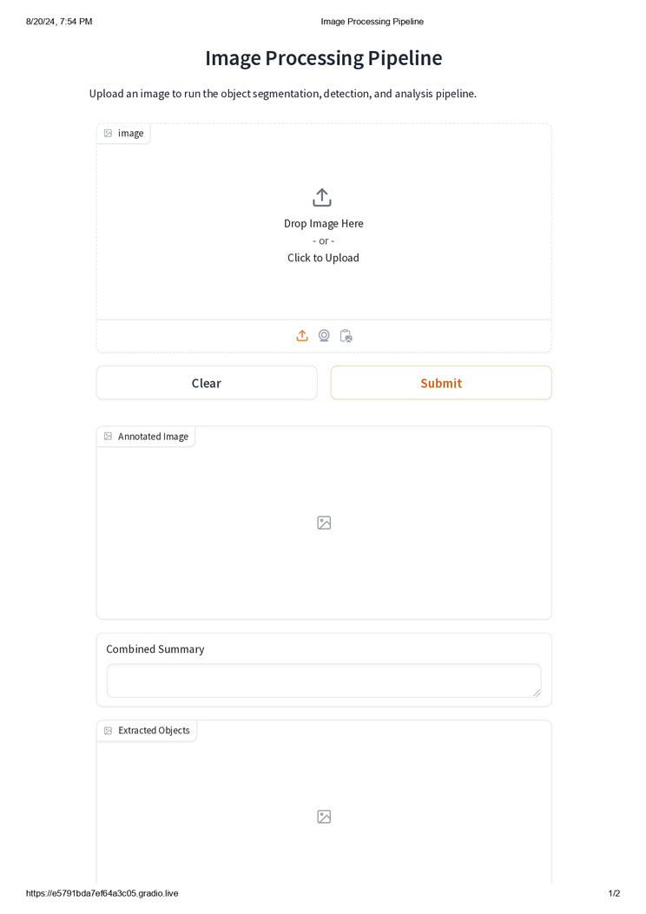
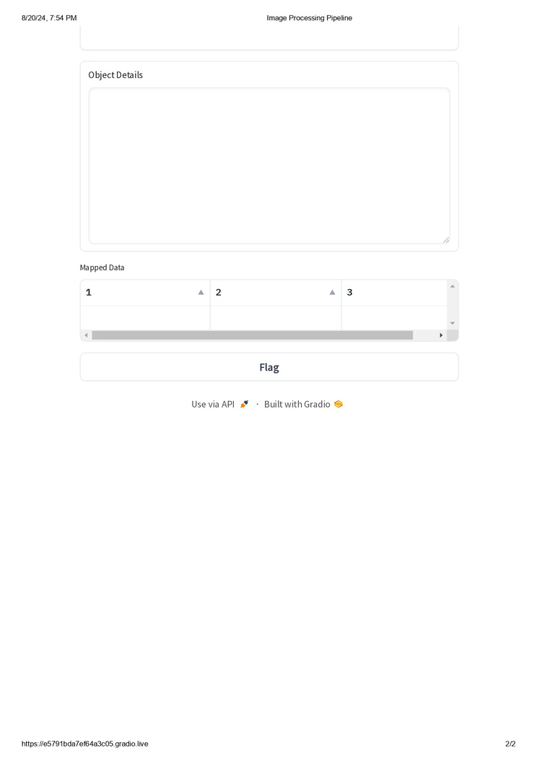
RESULTS
User interface

Slide 9

THANK YOU

